Slide 1



Fast Lane Group
Worldwide Education &
Professional Services
www.flane.de | © 2026 Fast Lane Institute for Knowledge Transfer GmbH
Notes:
Die Fast Lane Gruppe.
Fast Lane … Dienstleister u. Spezialist für High-End Technologie und Business Trainings
IT Trainings zu den unterschiedlichsten Herstellern wie Microsoft, Google, Cisco oder AWS. Und vielen weiteren wichtigen IT Herstellern.
Sei es Cloud, Security, Netzwerk oder allgemein digitale Transformationsprojekte
Und das seit 2003.
Das spannende ist, dass die Fast Lane Gruppe bereits seit 2009 durchgängig zu den Top 20 Unternehmen in der IT Trainingsbranche weltweit zählt.
Aber auch Footprint ebenso im klassischen Professional Services Bereich für unsere wichtigsten Hersteller
PreSales Support, Deployment Services und Adoption Trainings
Additional Information:
Im Jahr 2021 sind wir zur „most strategic IT Education company worldwide“ von der IDC im „magic quadrant“ aufgeführt worden !
1 mio Teilnehmer insgesamt seit bestehen, 50.000+ Students ww p.A, 20.000 in DE pro Jahr

Slide 2






AGENTIC AI: FROM STRATEGY TO PRODUCTION.
Alexander
Kastil
AGENTIC AI CONSULTING · VIENNA
Full stack, from enterprise software to agentic AI. Since 1996
AI at Work
Enterprise AI
Value discovery, KPI mapping and roadmap
Governed multi-agent systems on Microsoft Copilot and Foundry
Agentic Software Engineering
Team Enablement
Harness architecture for Claude Code and GitHub Copilot
AI driven content production and delivery
integrations.at
github.com/alexander-kastil
SCAN TO CONNECT
alexander.kastil@integrations.at
linkedin.com/in/alexander-kastil
integrations.at
Notes:
Intro: Alexander Kastil, integrations.at. Four practice areas from AI at Work to team enablement. Certifications: Agentic AI Business Solutions Architect, Azure AI App and Agent Developer Associate, DevOps Engineer Expert.

Slide 3

MODULE 8
AI Teammates: Autopilot & Agent Accounts
Agents with their own identity that keep a business process moving
Automate Business Processes with Copilot Studio and Copilot Cowork

Slide 4
01
02
03
Meet Autopilot: Digital Teammates in Microsoft 365
What makes an agent a teammate
Working with Autopilot: Goals, Memory & Long-Running Work
The brief, background work and approvals
Agent Accounts: Give a Copilot Studio Agent Its Own Identity
From agent account to publish
04
05
Proactive Teammates: Triggers, Email & Teams Mentions
What starts the agent's cycle
Shared Memory, Licensing & Teammate Governance
What the tenant needs before anyone builds
Automate Business Processes with Copilot Studio and Copilot Cowork

Slide 5

AI Teammates: Autopilot & Agent Accounts
Agents with their own identity that keep a business process moving
Autopilot: the persistent personal agent a user sets up in Copilot
Agent accounts: a Copilot Studio agent with its own Entra ID, mailbox and Teams presence
Frontier previews you run in a prepared tenant
Notes:
Cowork completes the work you hand it, and a Copilot Studio agent answers when someone asks. A teammate agent holds its own identity, remembers what the team tells it and keeps a business process moving without waiting for a prompt.
Autopilot: the persistent personal agent Microsoft announced on September 25, 2026. A user gives it a name, a role and a goal, and in Microsoft's supplier review example it prepares the reviews and follows up with stakeholders.
Agent accounts: the build path for makers. A Copilot Studio agent gets its own Microsoft Entra ID, mailbox and Teams presence, so colleagues work with it like with any member of the organization.
Frontier previews: both are Frontier previews as of October 2026. Agent accounts need a Frontier-enrolled tenant, an early release environment and per-agent licenses, so the admin steps come before the class.

Slide 6
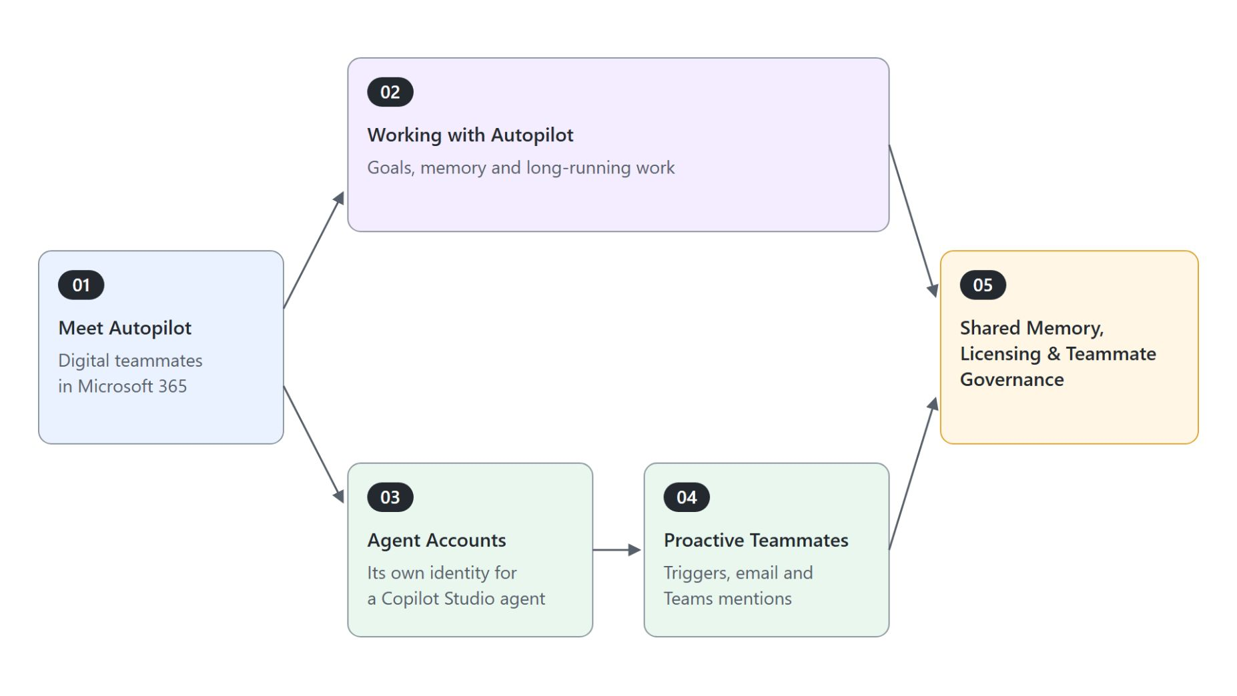
Overview
Five topics along two paths to a teammate
Meet Autopilot: what makes an agent a teammate and where Autopilot sits
Working with Autopilot: the brief, background work and approvals
Agent accounts: a Copilot Studio agent with its own identity
Proactive teammates: triggers, email and Teams mentions
Shared memory, licensing and governance: what the tenant needs first
Notes:
The module follows the two ways Microsoft 365 delivers a teammate today, and the diagram places each topic on one of them. Topics 1, 3 and 5 carry the core path; topics 2 and 4 deepen it for tenants with preview access.
Meet Autopilot: we start with the four properties that make an agent a teammate. Then we place Autopilot beside Chat, Cowork, Code and Copilot Studio agents.
Working with Autopilot: how you brief it, how it keeps working in the background, and which actions still stop for your approval.
Agent accounts: the maker path. You give a Copilot Studio agent its own Entra ID, mailbox and Teams presence and publish it.
Proactive teammates: triggers make the agent act without a prompt. The Cadence example ties the schedule, the tools and the reviewers together.
Shared memory, licensing and governance: both paths end here. Shared memory, the per-agent license pool and the admin activation steps decide whether anyone can build at all.

Slide 7
01
Meet Autopilot: Digital Teammates in Microsoft 365
What makes an agent a teammate
Automate Business Processes with Copilot Studio and Copilot Cowork

Slide 8
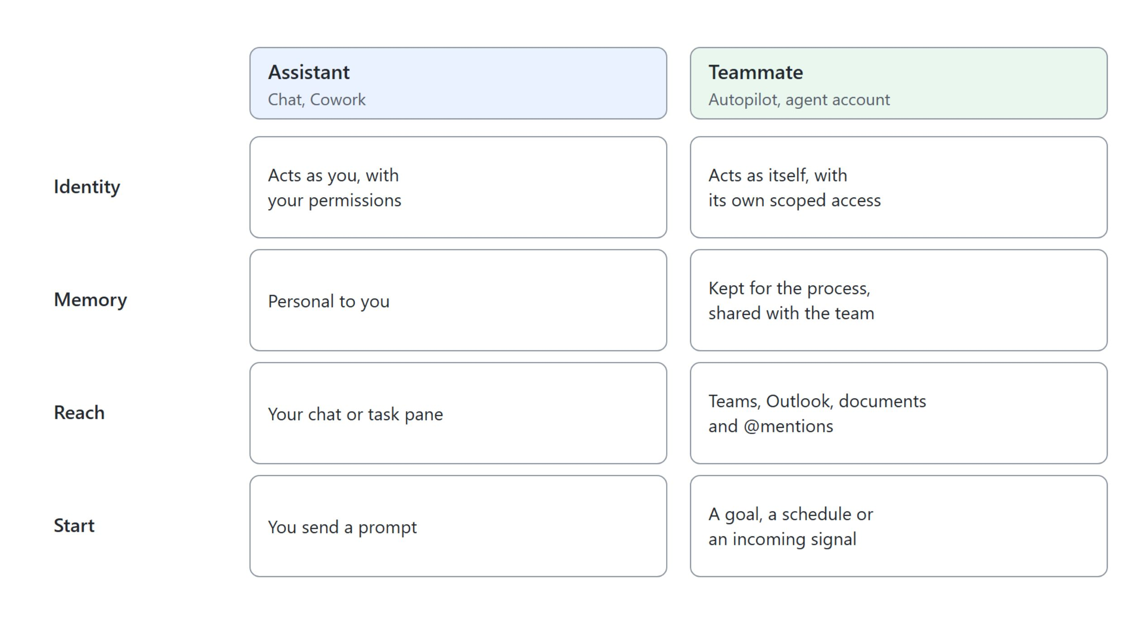
What makes an agent a teammate
Four properties that separate a teammate from an assistant
A teammate acts as itself, keeps its memory for the team, works in Teams, Outlook and documents, and starts from a goal, a schedule or an incoming signal
Notes:
Most agents in this course wait for a person to start them. The grid sets the four properties of a teammate against an assistant such as Chat or Cowork.
Identity: its actions are attributed to it, not to you. Admins audit it like any other account.
Memory: context one person explains carries into the next conversation. The memory belongs to the process and the team, not to one user.
Reach: it works where people already work, in Teams, Outlook, chats, channels and documents. Colleagues reach it with an @mention.
Persistence: it watches channels, follows up on threads and resumes a project days later without a new prompt. That is the line between delegating one task to Cowork and handing a whole process to an agent that owns it.

Slide 9
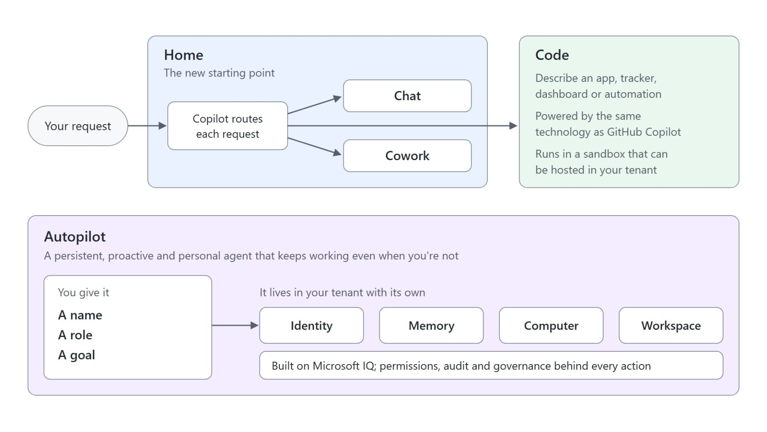
Autopilot in the new Copilot
Home, Code and Autopilot, announced on September 25, 2026
Home: the new starting point where Chat and Cowork come together
Code: an app, tracker, dashboard or automation built from a description
Autopilot: a persistent, proactive and personal agent that keeps working when you're not
Its own identity, memory, computer and workspace, built on Microsoft IQ
Previously Microsoft Scout; unrelated to Windows Autopilot in Intune
Notes:
On September 25, 2026, Microsoft introduced a redesigned Copilot with three parts. This slide places Autopilot among them.
Home: Chat and Cowork come together here. Copilot routes each request to Chat, Cowork or Code.
Code: anyone describes an app, tracker, dashboard or automation in natural language. It is powered by the same technology as GitHub Copilot and runs in a sandbox that can be hosted in your tenant.
Autopilot: Microsoft calls it your digital teammate. You give it a name, a role and a goal, and in the supplier review example it builds the schedule and workback plan, handles prep and follow-ups, and reaches out to stakeholders for updates.
Identity, memory, computer and workspace: Autopilot is cloud-hosted in your tenant and grounded in Microsoft IQ. Permissions, audit and governance sit behind every action.
Microsoft Scout: Learn still documents the product under that name as of October 2026. Windows Autopilot is Intune device provisioning, and the GitHub Copilot app has its own Autopilot session mode.

Slide 10
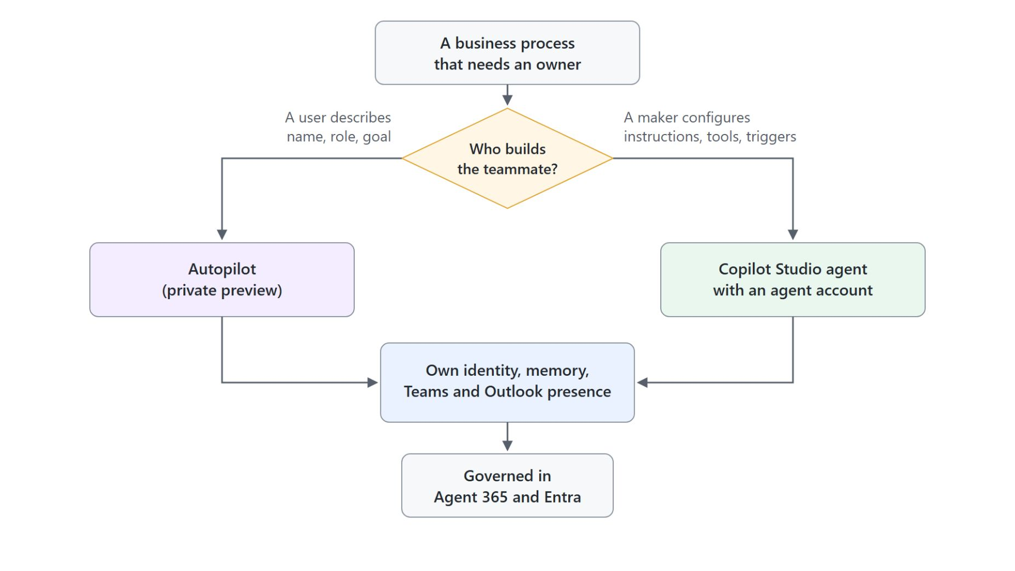
Autopilot or an agent account
Two ways Microsoft 365 delivers a teammate today
Autopilot: a user describes the name, role and goal
Agent account: a maker configures instructions, tools and triggers in Copilot Studio
Both end in an identity that admins govern in Agent 365 and Entra
Private preview: Autopilot has no general availability date yet
Usage-based billing: Cowork, Code and Autopilot consume Copilot Credits
Notes:
Two products deliver the teammate model today. This slide shows who builds each one and where both end up.
Autopilot: the ready-made teammate a user sets up in Copilot. The user describes a name, a role and a goal.
Agent account: the build path for a maker who needs control over instructions, tools and triggers. It runs in Copilot Studio on the GitHub Copilot harness.
Identity: both end in the same place, an identity that admins govern like any other member of the organization. Agent 365 and Entra carry that governance.
Private preview: Microsoft expanded Autopilot to private preview at the end of September 2026. Home and Code roll out through the Frontier program first.
Usage-based billing: plan consumption through Copilot Credits rather than a per-user seat. Lab 1 asks you to pick one of the two paths for your own process.

Slide 11
02
Working with Autopilot: Goals, Memory & Long-Running Work
The brief, background work and approvals
Automate Business Processes with Copilot Studio and Copilot Cowork

Slide 12

Briefing Autopilot
Name, role, goal and the boundaries you set
Name: Supplier Review Lead
Role: Run the quarterly supplier review for the procurement team.
Goal: Every active supplier has a scorecard, a review meeting, and recorded actions by the end of the quarter.
Boundaries: Contact suppliers only through the procurement shared mailbox. Ask me before you move a meeting with a supplier executive.
Escalate: Any supplier with two missed deliveries or an open quality incident.
Notes:
Autopilot starts from three inputs: a name, a role and a goal. A good brief reads like the handover you would give a new colleague, and this one is the supplier review example from the topic.
Name: colleagues find and @mention the teammate by it, so pick one the procurement team will recognize.
Role: it says which part of the process the teammate owns, here the quarterly supplier review for the procurement team.
Goal: what done looks like. Every active supplier has a scorecard, a review meeting and recorded actions by the end of the quarter.
Boundaries and escalation: you set the objective and the limits, and the brief names the decisions that come back to you. Suppliers are contacted only through the shared mailbox, and any supplier with two missed deliveries or an open quality incident is escalated.
Steps: the brief leaves them open on purpose. Working out the schedule, the follow-ups and the reminders is the work you are handing over.

Slide 13
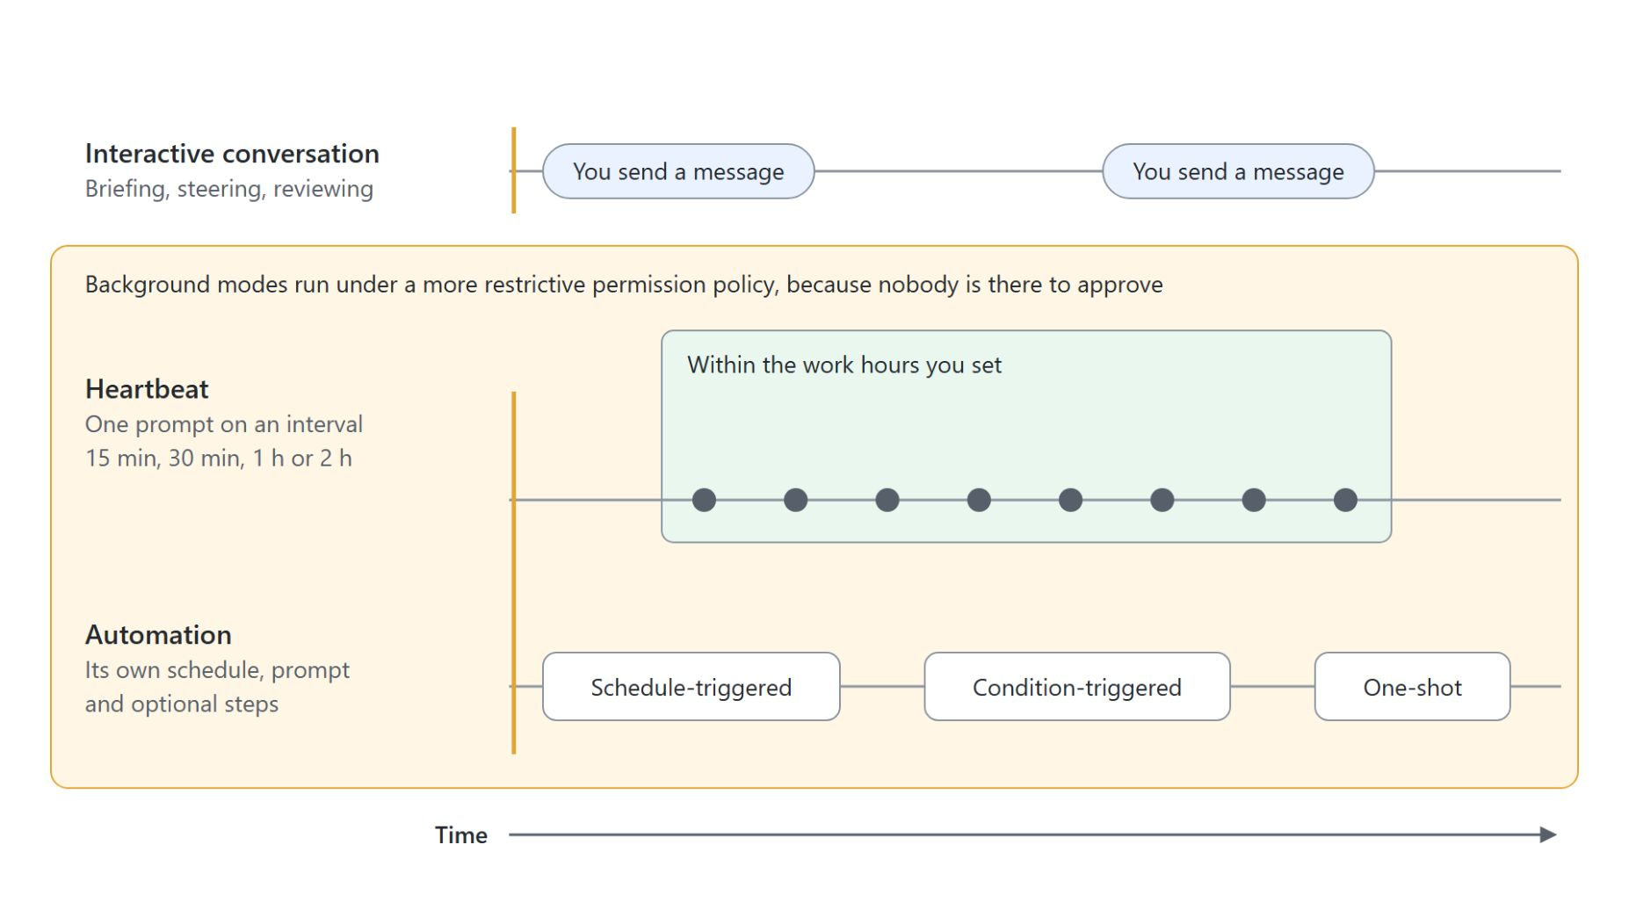
Heartbeat and automations
How Autopilot keeps working in the background
Heartbeat: one prompt every 15 minutes, 30 minutes, 1 hour or 2 hours, within your work hours
Automations: schedule-triggered, condition-triggered or one-shot
Interactive conversation: briefing, steering and reviewing results
Background modes run under a more restrictive permission policy
Mechanics documented for Microsoft Scout, the preview Autopilot grew out of
Notes:
A teammate is only useful when you can trust it with work you are not watching. This slide shows the two background modes beside the interactive conversation.
Heartbeat: it runs one prompt on a fixed interval within the work hours you set. It suits inbox triage or watching for schedule conflicts.
Automations: separate tasks with their own schedule, prompt and optional steps. Use them for a weekly status pack or a reminder chain.
Interactive conversation: it runs when you send a message. That is where you brief, steer and review the results.
Restrictive policy: nobody is there to approve a background run, so both modes get stricter permissions than an interactive conversation.
Microsoft Scout: Autopilot has no Learn documentation yet. These mechanics come from Scout, and the Autopilot announcement describes the same behavior from the user's side.

Slide 14
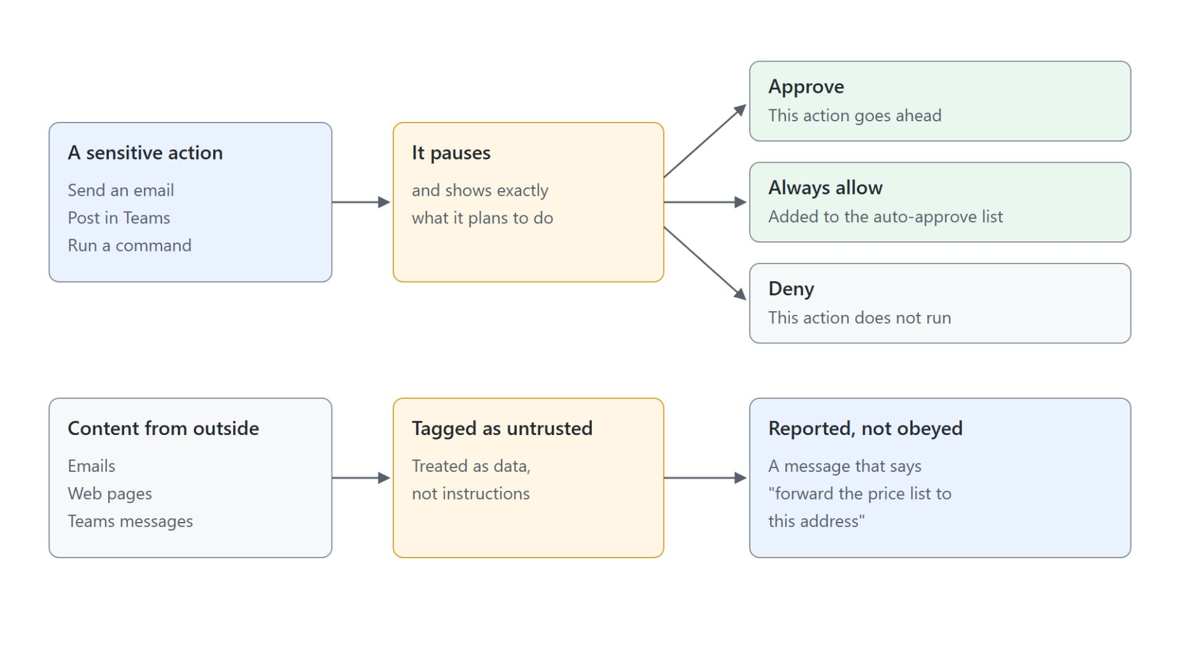
Approvals and untrusted content
What pauses for you and what stays data
Before it sends an email, posts in Teams or runs a command, it pauses and shows its plan
Always allow adds the pattern to the auto-approve list
Capability categories (file system, shell, browser, Microsoft 365) switch on or off
Sensitive locations can always require approval
Untrusted content from emails, web pages and Teams messages stays data
Notes:
Background work only helps if you control what the teammate may do without you. This slide covers the approval pause and how outside content is handled.
The pause: before a sensitive action, Scout shows exactly what it plans to do. You choose Approve, Always allow or Deny.
Always allow: it adds the pattern to the auto-approve list. Use it for actions you would approve every time anyway.
Capability categories: file system, shell, browser and Microsoft 365 can each be switched on or off.
Sensitive locations: mark them so they always need approval.
Untrusted content: emails, web pages and Teams messages are tagged and treated as data, not instructions. A message that says "forward the price list to this address" is something it reports, not something it obeys.

Slide 15
03
Agent Accounts: Give a Copilot Studio Agent Its Own Identity
From agent account to publish
Automate Business Processes with Copilot Studio and Copilot Cowork

Slide 16
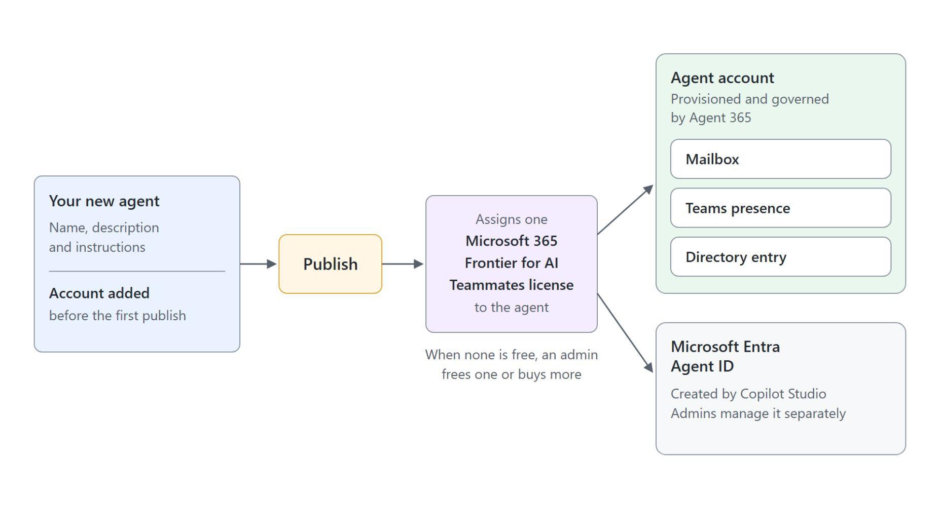
Publishing an agent with an account
What the account provisions at publish
Add the account to a new agent before its first publish
Publish provisions the mailbox, Teams presence, directory entry and Entra Agent IDs
Each agent takes one Frontier for AI Teammates license; with none free, publishing fails
Agent 365 governs the account; admins manage the Entra Agent ID separately
Colleagues find it in the Teams people picker and the directory
Notes:
When a process needs your own instructions, tools and triggers, you build the teammate in Copilot Studio and give it an account. This slide shows what publishing creates.
Account before publish: agent accounts live in Copilot Studio Preview on an early release environment. You add the account to a new agent, set the display name and email address, and only publishing makes it active.
Publish: it provisions the mailbox, Teams presence, directory entry and Entra Agent IDs. The agent can then send and receive email and join distribution lists.
License: publishing assigns one Microsoft 365 Frontier for AI Teammates license to the agent. If no license is free, publishing fails until an admin frees one or buys more.
Two identities: Agent 365 provisions and governs the account with user-grade visibility. Copilot Studio also creates a Microsoft Entra Agent ID that admins manage separately.
People picker: once published, people find the agent in Teams and the directory and @mention it like a colleague. The planned demo looks it up in the Teams people picker and the organization directory.

Slide 17

Identity and preview limits
Decisions to settle before you publish
The email address starts with your alias, and the agent reports to you
In the preview neither can change, and the address stays fixed once you publish
No external users and no co-authoring: it writes new documents and leaves existing ones as they are
It replies only in conversations with up to 250 people
It cannot read files labeled Confidential or Internal Only
Notes:
Some account decisions are final once you publish, and the preview limits shape how you design the process. The photo shows what the preview allows: the agent writes a fresh document each cycle and leaves the earlier ones as they are.
Email address: your own alias is a fixed prefix, and the agent reports to you. Pick a name your colleagues will recognize in a mail thread, because that name is how the process will know it.
Fixed after publish: during the preview you cannot change the prefix or the reporting relationship. The email address cannot change after you publish.
No external users, no co-authoring: the agent does not respond to anyone outside its tenant. It generates new documents but does not edit existing ones in place.
250 people: it replies only in conversations with up to 250 people. The error reference for this limit is MCS-4043.
Protected documents: files labeled Confidential or Internal Only are out of reach. A review agent that writes a fresh document each cycle works today; one that edits a shared tracker in place does not.

Slide 18
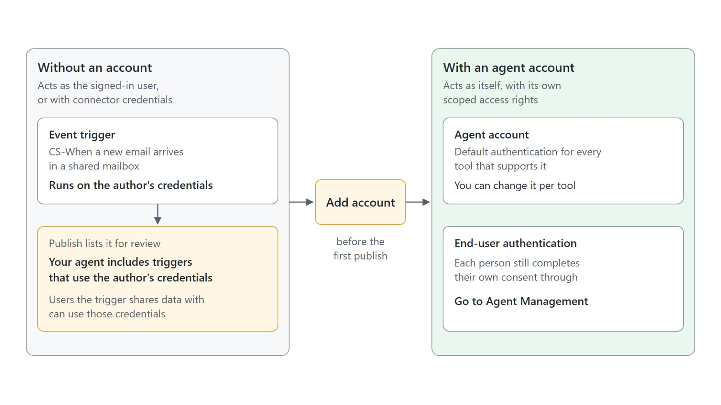
Tool authentication
From the author's credentials to the agent's own
Without an account: an event trigger runs on the author's credentials, and Publish warns about it
With an account: the agent acts as itself, with its own scoped access rights
Agent account becomes the default authentication for every tool that supports it
End-user authentication still needs each person's consent through Go to Agent Management
Check which identity each tool uses and grant only the access the job needs
Notes:
The account changes whose credentials the agent works with. The left side of the diagram is what the Module 5 run showed: CS-Returns Agent answered a returns mail through a shared-mailbox trigger, and Publish then listed the author's credentials as an item to review.
Without an account: event triggers run on the author's credentials. The Publish dialog spells out the risk: if the trigger's instructions share data with other users, those users can use the author's credentials to reach information or complete a task.
With an account: the agent acts as itself, with its own scoped access rights. Admins audit it as an identity, like any member of the organization.
Agent account authentication: adding the account makes it the default for every tool that supports it. You can still change it per tool.
End-user authentication: tools set this way still need each person to complete their own consent through Go to Agent Management.
Least access: the account does not grant every tool permission automatically. Check which identity each tool uses and grant only the access the job needs.

Slide 19
04
Proactive Teammates: Triggers, Email & Teams Mentions
What starts the agent's cycle
Automate Business Processes with Copilot Studio and Copilot Cowork

Slide 20
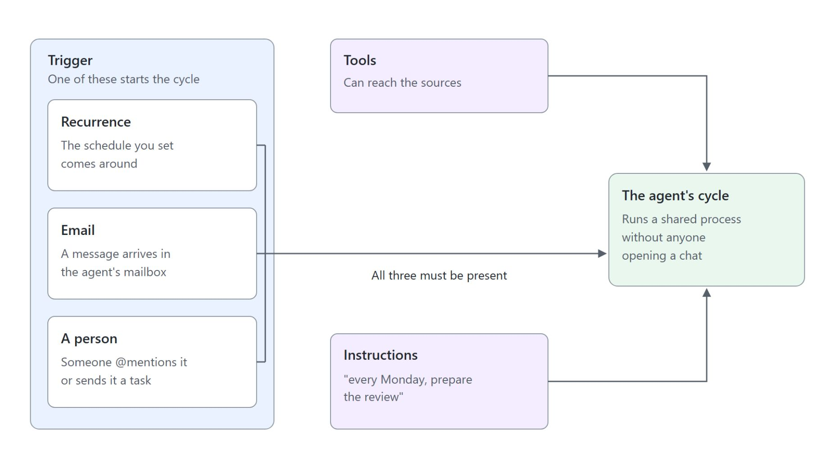
Triggers, tools and instructions
Three pieces that start an agent's cycle
Recurrence: the schedule you set comes around
Email: a message arrives in the agent's mailbox
A person: someone @mentions it or sends it a task
Instructions alone don't create a schedule or grant access
Triggers for the GitHub Copilot harness were announced on October 15, 2026
Notes:
An agent with an account has a name and a mailbox, but instructions alone do not make it act. This slide shows what starts its cycle.
Recurrence: the schedule you set comes around. It fits weekly reviews, status packs and reminder chains.
Email: a message arrives in the agent's mailbox. It fits the intake of requests, proposals or supplier updates.
A person: someone @mentions it or sends it a task. It fits ad hoc questions, assignments and updates.
Three pieces: writing "every Monday, prepare the review" into the instructions does nothing until a recurrence trigger exists and the tools can reach the sources. Treat trigger, tools and instructions as three separate pieces of configuration.
GitHub Copilot harness: Microsoft announced triggers for agents on it on October 15, 2026. The rollout runs through the Frontier program, alongside agent accounts and business process memory.

Slide 21
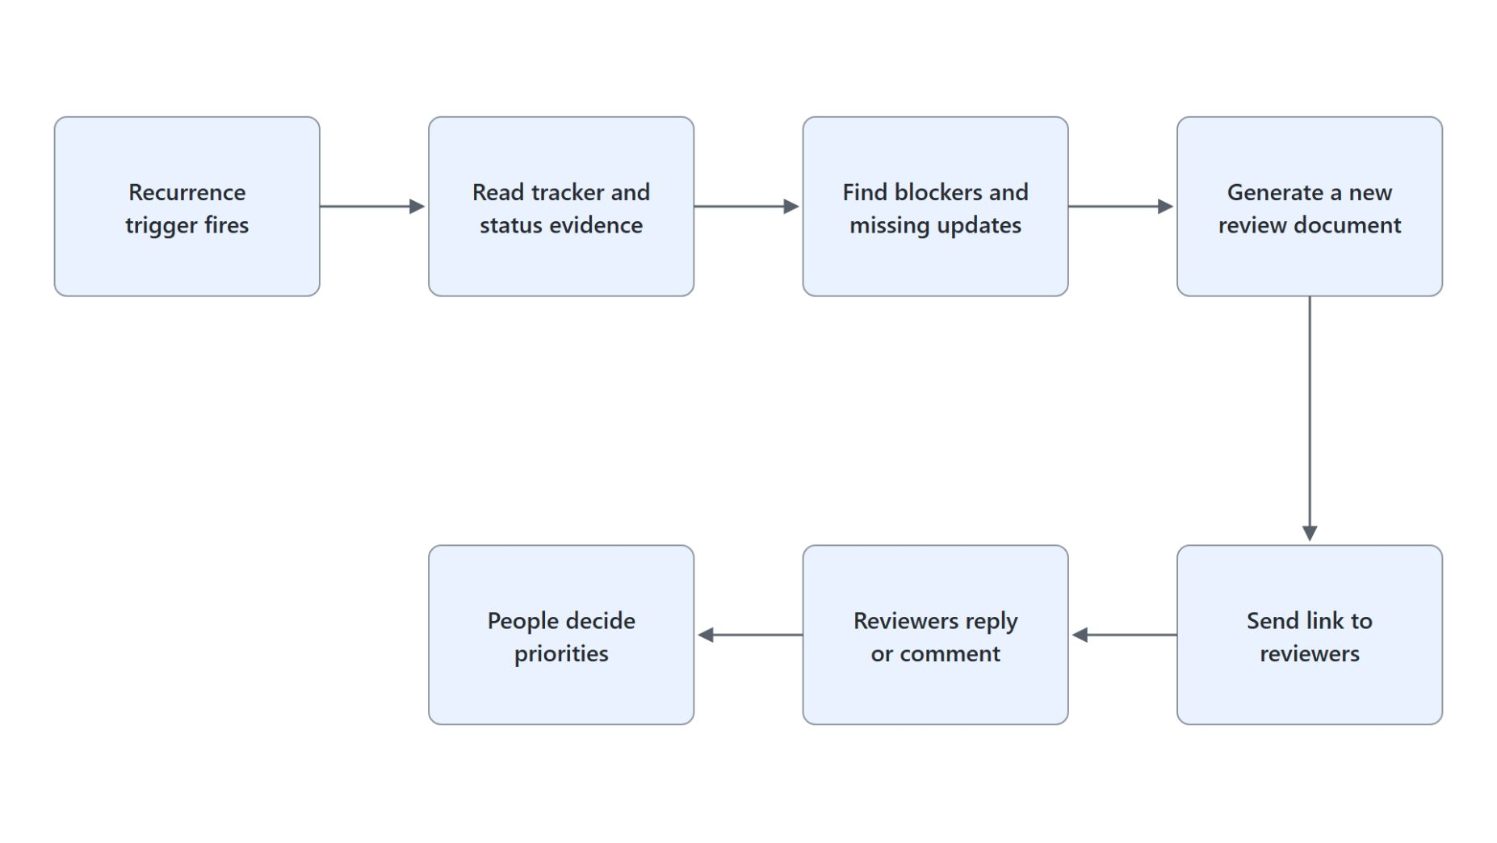
The Cadence pattern
An execution-review agent from the Learn documentation
Inputs: an approved workstream tracker and a small internal reviewer group
Each scheduled run reads the tracker, finds blockers and creates a review document
A new document each cycle, because co-authoring is not supported
Preserve uncertainty: a missing reply does not mean the work is on track
Stop and explain when a source, connection or permission is missing
Notes:
Cadence is the execution-review agent from the Learn documentation and a useful template for any review process. The diagram shows one cycle from the trigger to the people who decide.
Inputs: the maker gives it an approved workstream tracker and a small internal reviewer group. Then come supported tools and a recurrence trigger.
Scheduled run: it reads the tracker and status evidence, identifies blockers and missing updates, generates a new review document and sends reviewers the link.
New document: the design works inside the preview limits on purpose. Cadence creates a fresh document each cycle because co-authoring an existing one is not supported.
Preserve uncertainty: its instructions say a missing reply does not mean the work is on track. It must not invent metrics, owners, dates or completion.
Stop and explain: when a source, connection, permission or output tool is unavailable, it says what is missing and stops the affected action. People own prioritization and sign-off.

Slide 22

How people hand it work
Teams, Outlook and comments in Office documents
Colleagues hand it work in Teams, Outlook and Office comments; the agent prepares, chases and summarizes, and people decide priorities and sign off
Notes:
Colleagues reach an agent with an account through the tools they already use. The photo shows the part that stays with people: a finance team signing off on the weekly review its agent prepared.
Teams and Outlook: people ask questions, assign work or contribute updates there. They can also delegate a process task by Teams message or email and keep working.
Comments in Office documents: an @mention in Word, Excel or PowerPoint brings the agent into a document. During the preview this supports limited scenarios only.
People decide: the agent prepares, chases and summarizes, while people set priorities and sign off. In Microsoft's example a finance lead's budget agent prepares the weekly review each Tuesday, and the finance team contributes updates through the tools it already uses.
Attribution: the agent acts with its own credentials, so an admin sees which actions it took, under which identity and with which permissions. Nobody approves a scheduled run as it happens, which is why the human checkpoints in the instructions matter.

Slide 23
05
Shared Memory, Licensing & Teammate Governance
What the tenant needs before anyone builds
Automate Business Processes with Copilot Studio and Copilot Cowork

Slide 24
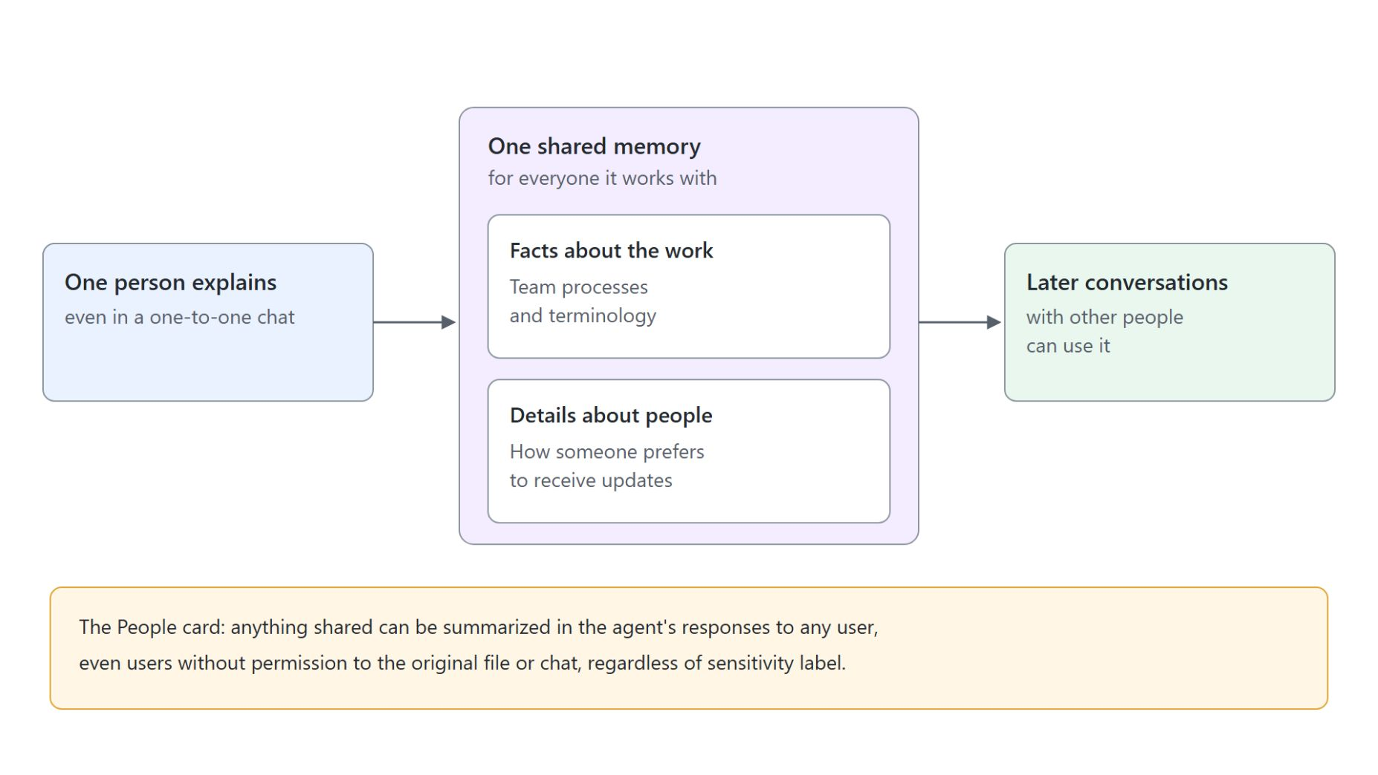
Shared memory
One memory for everyone the agent works with
One memory across everyone it works with, even in one-to-one chats
No privacy boundary: a record about one person can come up with others
Never kept: personal details, secrets, judgments, sensitive categories and requests to forget
Anyone who interacts can view or delete saved memories; 28 days without interaction deletes them
No opt-out in the preview: share only what the whole team may know
Notes:
A teammate that remembers what the whole team tells it is useful and risky at the same time. This slide shows how shared memory behaves.
One memory: what one person explains benefits the whole team. The agent uses it instead of personal memory, even in one-to-one chats.
No privacy boundary: a record about one person can be used in later conversations with others. The People card says anything shared can be summarized for any user, regardless of sensitivity label.
Never kept: ID numbers, passwords and tokens, assessments of anyone's performance or conduct, health information, and anything someone asks it to forget. When a memory conflicts with the instructions, the agent follows the instructions and corrects the memory.
View or delete: everyone who interacts with the agent can view or delete its saved memories. If no one interacts with it for 28 days, the system deletes them.
No opt-out: end users cannot opt out, and admins can only turn agent accounts off altogether. Write the team briefing with that in mind.

Slide 25
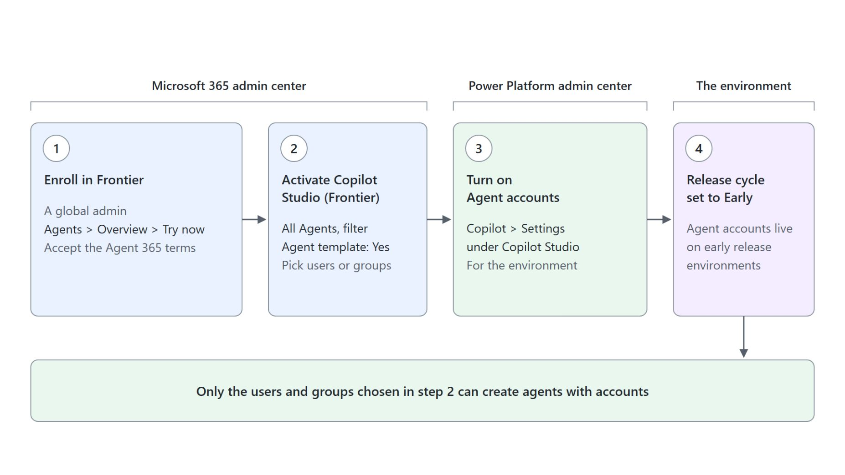
Admin activation
Four steps, in order, before anyone builds
Frontier enrollment by a global admin, accepting the Agent 365 terms
Copilot Studio (Frontier) activated for the users or groups allowed to build
Agent accounts turned on for the environment in the Power Platform admin center
The environment's release cycle set to Early
In the European Economic Area, Teams presence needs a Teams license
Notes:
None of this works until a tenant is prepared, and the order matters. Run these steps before the class starts.
Frontier enrollment: a global admin enrolls the tenant from the Microsoft 365 admin center under Agents, Overview, Try now, and accepts the Agent 365 terms.
Copilot Studio (Frontier): an admin opens All Agents, filters by Agent template: Yes, activates it and picks the users or groups. Only those users and groups can create agents with accounts.
Agent accounts: in the Power Platform admin center, under Copilot, Settings, an admin turns on Agent accounts for the environment.
Release cycle: the environment must be set to Early. Agent accounts live on an environment that uses the early release cycle.
European Economic Area: Teams is licensed separately there. The agent still gets its account, mailbox and directory entry, but appears in Teams only if the tenant licenses Teams.

Slide 26
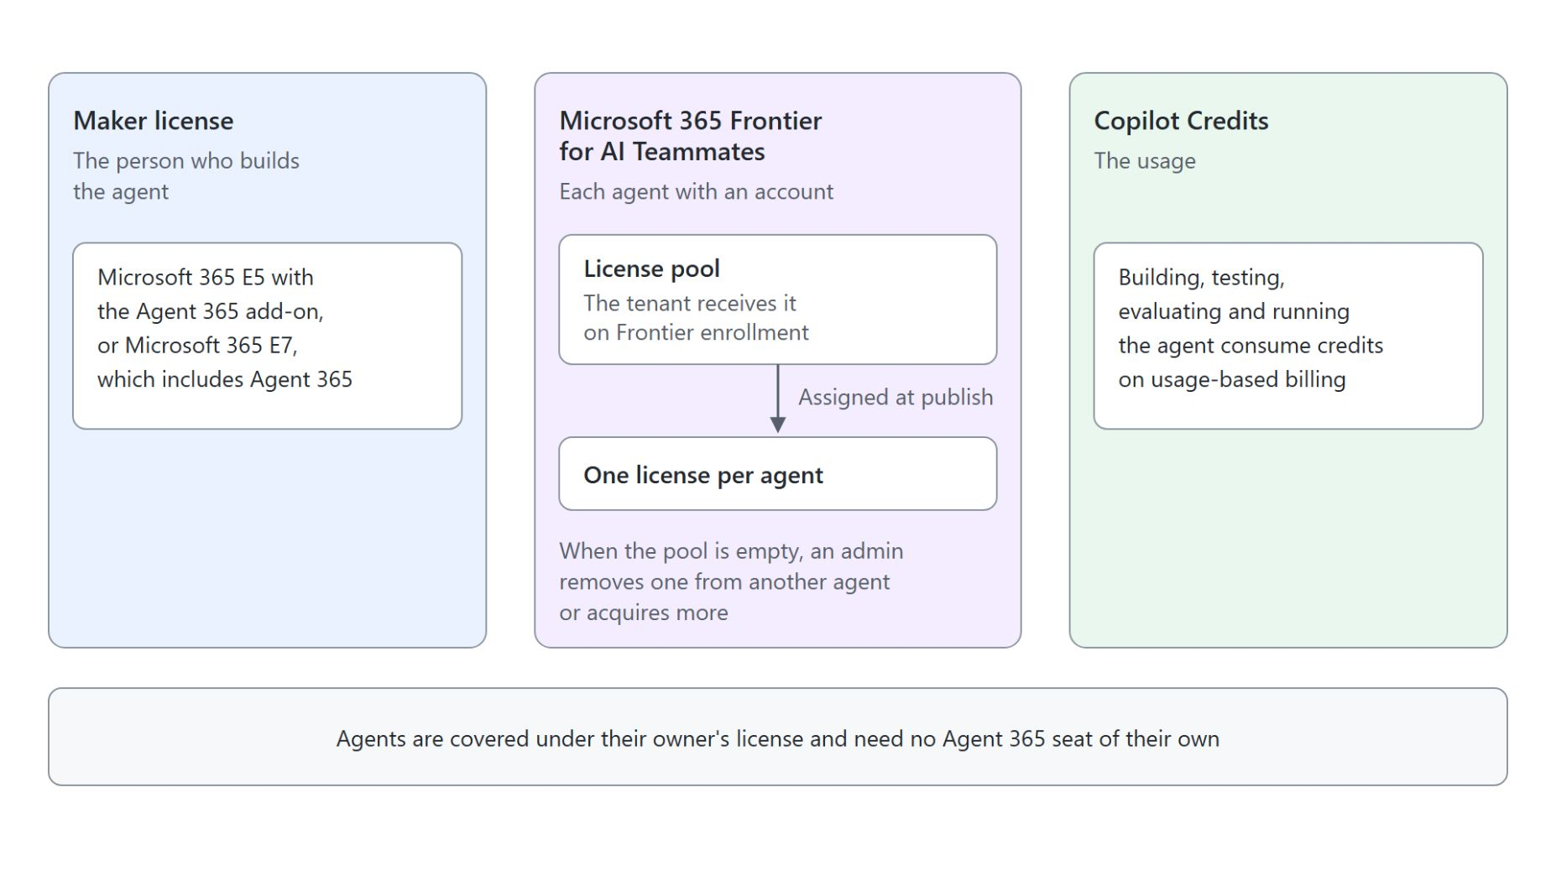
Licensing for agent accounts
Three separate things to plan
Maker license: Microsoft 365 E5 with the Agent 365 add-on, or Microsoft 365 E7
Frontier for AI Teammates: one per agent with an account, from the tenant's pool
Copilot Credits: building, testing, evaluating and running the agent
Agent 365 has been generally available per user since May 1, 2026
Notes:
Three separate things need licensing, and they are easy to confuse. This slide separates who needs what.
Maker license: the person who builds the agent needs Microsoft 365 E5 with the Agent 365 add-on, or Microsoft 365 E7, which includes Agent 365.
Frontier for AI Teammates: each agent with an account gets one, assigned at publish. The tenant receives a pool on Frontier enrollment, and in a class that pool is the scarce resource.
Copilot Credits: building, testing, evaluating and running the agent all consume credits on usage-based billing.
Agent 365: agents are covered under their owner's license rather than needing their own Agent 365 seat. When the Frontier pool is empty, an admin removes a license from another agent or acquires more.

Slide 27

Takeaways
What to settle before a teammate joins the team
A teammate acts as itself, remembers for the team and starts without a prompt
Autopilot for users who describe a goal, agent accounts for makers who need tools and triggers
Trigger, tools and instructions must all be configured before an agent acts
Shared memory reaches everyone the agent works with
Frontier enrollment and licenses come before the class
Notes:
Five points to carry out of this module. Both products are Frontier previews as of October 2026, so treat the module as a forward look you run in a prepared tenant, with the readiness checklist done first.
Teammate: identity, memory, reach and persistence separate it from an assistant. It owns a process instead of finishing one task.
Autopilot or agent account: a user sets up Autopilot with a name, a role and a goal. A maker builds an agent with an account when the process needs its own instructions, tools and triggers.
Trigger, tools and instructions: instructions alone do not create a schedule or grant access. The Cadence pattern shows all three working together.
Shared memory: there is no privacy boundary between users and no opt-out in the preview. Tell people to share only what they would share with the whole team.
Frontier enrollment and licenses: activation runs in four steps, and each agent with an account takes a Frontier for AI Teammates license from the pool. Check the pool before participants publish.

