Slide 1



Fast Lane Group
Worldwide Education &
Professional Services
www.flane.de | © 2026 Fast Lane Institute for Knowledge Transfer GmbH
Notes:
Die Fast Lane Gruppe.
Fast Lane … Dienstleister u. Spezialist für High-End Technologie und Business Trainings
IT Trainings zu den unterschiedlichsten Herstellern wie Microsoft, Google, Cisco oder AWS. Und vielen weiteren wichtigen IT Herstellern.
Sei es Cloud, Security, Netzwerk oder allgemein digitale Transformationsprojekte
Und das seit 2003.
Das spannende ist, dass die Fast Lane Gruppe bereits seit 2009 durchgängig zu den Top 20 Unternehmen in der IT Trainingsbranche weltweit zählt.
Aber auch Footprint ebenso im klassischen Professional Services Bereich für unsere wichtigsten Hersteller
PreSales Support, Deployment Services und Adoption Trainings
Additional Information:
Im Jahr 2021 sind wir zur „most strategic IT Education company worldwide“ von der IDC im „magic quadrant“ aufgeführt worden !
1 mio Teilnehmer insgesamt seit bestehen, 50.000+ Students ww p.A, 20.000 in DE pro Jahr

Slide 2






AGENTIC AI: FROM STRATEGY TO PRODUCTION.
Alexander
Kastil
AGENTIC AI CONSULTING · VIENNA
Full stack, from enterprise software to agentic AI. Since 1996
AI at Work
Enterprise AI
Value discovery, KPI mapping and roadmap
Governed multi-agent systems on Microsoft Copilot and Foundry
Agentic Software Engineering
Team Enablement
Harness architecture for Claude Code and GitHub Copilot
AI driven content production and delivery
integrations.at
github.com/alexander-kastil
SCAN TO CONNECT
alexander.kastil@integrations.at
linkedin.com/in/alexander-kastil
integrations.at
Notes:
Intro: Alexander Kastil, integrations.at. Four practice areas from AI at Work to team enablement. Certifications: Agentic AI Business Solutions Architect, Azure AI App and Agent Developer Associate, DevOps Engineer Expert.

Slide 3

MODULE 4
Extending Copilot Studio Agents with Tools
From answering questions to calling real systems
Automate Business Processes with Copilot Studio and Copilot Cowork

Slide 4
01
02
03
04
Prompt Tool & Code Interpreter
A fixed instruction for the canteen order
Dataverse: Knowledge & Business Records
Travel claims saved as table rows
Connector Tools: Prebuilt Connectors
One Teams action, filled from the chat
Agent Flows: Deterministic Automation
Fixed steps with a prompt and a reviewer
05
06
07
Custom Connectors & REST APIs
Live canteen stock from an OpenAPI file
MCP Servers as Agent Tools
Staff and shifts discovered at runtime
Computer Use: Apps Without APIs
Reading and filling web apps by screen
Automate Business Processes with Copilot Studio and Copilot Cowork

Slide 5

Tools in Copilot Studio
From answering questions to calling real systems
A grounded agent answers questions; a tooled agent acts on the systems a team already uses
Seven tool types: prompts, Dataverse, connectors, agent flows, REST APIs, MCP servers and computer use
Each demo gives a CS- agent one real job, starting with the canteen order
Notes:
This module moves a Standard agent from reading knowledge to calling real systems. Adding a tool is a configuration task on the agent's Tools page, and the maker skill is choosing the right one.
A tooled agent acts: it runs a prompt, writes a Dataverse row, posts to Teams, calls an API or an MCP server, or drives a user interface that has no API. Each tool type has a job it does best.
Seven tool types: the module takes them in delivery order, one topic each. Tools, MCP and workflows come back for GitHub Copilot agents in module 06, so the concepts carry straight across.
One real job per demo: CS-Food Stock Buddy calculates the canteen order first and later reads live stock from an API. The other demos run on CS-Travel Expense Refund, CS-Travel Agent, CS-Health Advisor, CS-Restaurant HR Manager and CS-Grey Logistics IT Help Desk.

Slide 6
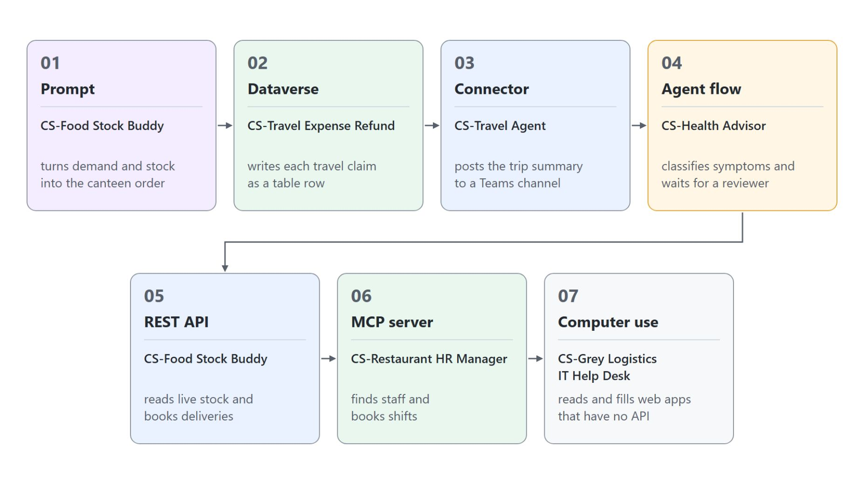
Overview
Seven tool types, one demo agent each
A prompt calculates the canteen order, and a Dataverse table keeps every travel claim
One Teams action posts a trip summary, and two agent flows run the Health Advisor's fixed steps
Live canteen stock comes from a REST API, staff and shifts from an MCP server
Computer use reads and fills web apps that have no API
Each tool type has a job it does best, and choosing the right one is the maker skill
Notes:
This slide walks the seven topics once, in delivery order, with the agent that each demo builds.
Prompt and Dataverse: CS-Food Stock Buddy hands demand and stock to a prompt that returns the order quantities. CS-Travel Expense Refund saves every claim as a row through an agent flow.
Teams action and agent flows: CS-Travel Agent posts a trip summary with one prebuilt Microsoft Teams action. CS-Health Advisor classifies symptoms in one flow and waits for a reviewer in a second one.
REST API and MCP: CS-Food Stock Buddy comes back and swaps its sample stock for the live food catalog API. CS-Restaurant HR Manager reads staff and books shifts through the repository's HR MCP server.
Computer use: CS-Grey Logistics IT Help Desk reads values from one web app and types records into another. It is the route for systems that offer no API and no connector.
Choosing the right tool: a grounded agent can answer questions, a tooled agent can act. Each topic closes with when its tool fits and when another one fits better.

Slide 7
01
Prompt Tool & Code Interpreter
A fixed instruction for the canteen order
Automate Business Processes with Copilot Studio and Copilot Cowork

Slide 8
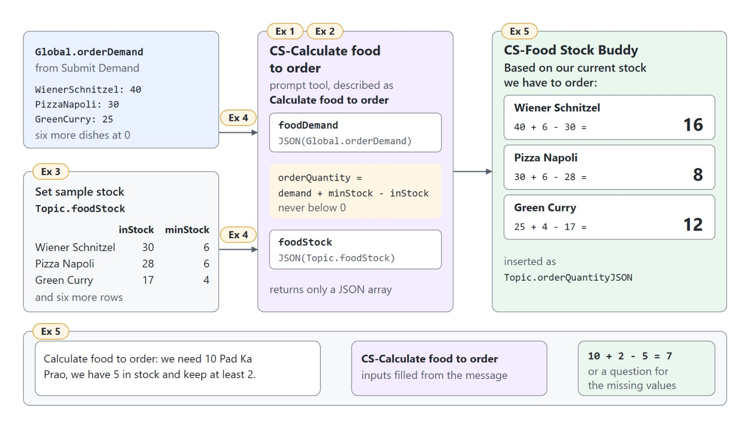
Calculating the canteen order with a prompt
CS-Food Stock Buddy passes demand and stock as JSON
The topic binds both inputs with JSON() and reads the answer from the output's text field
kind: InvokeAIBuilderModelAction
- kind: InvokeAIBuilderModelAction
input:
binding:
foodDemand: =JSON(Global.orderDemand)
foodStock: =JSON(Topic.foodStock)
output:
binding:
predictionOutput: Topic.orderQuantityRecord
Notes:
A prompt is a reusable, single-turn instruction to a model that the agent calls like any other tool. Here it takes over the arithmetic someone used to do by hand: holding the canteen's demand against the stock list.
The rule: order quantity is demand plus minimum stock minus stock in hand, never below zero. With 40 Wiener Schnitzel demanded, 30 in stock and a minimum of 6, the prompt orders 16.
The binding: the topic passes Global.orderDemand and Topic.foodStock through JSON(), so the prompt receives two JSON texts. It reads the answer from the text field directly, because wrapping that in JSON() again escapes it a second time.
The stand-in: a node named Set sample stock holds nine rows with the API's field names. The REST API topic later replaces that one node with a live call and leaves the prompt untouched.
The orchestrator path: as a tool with the description Calculate food to order, the same prompt can also run without the topic. Then the model fills the inputs itself or asks for missing values, which is why the topic carries the real data.

Slide 9
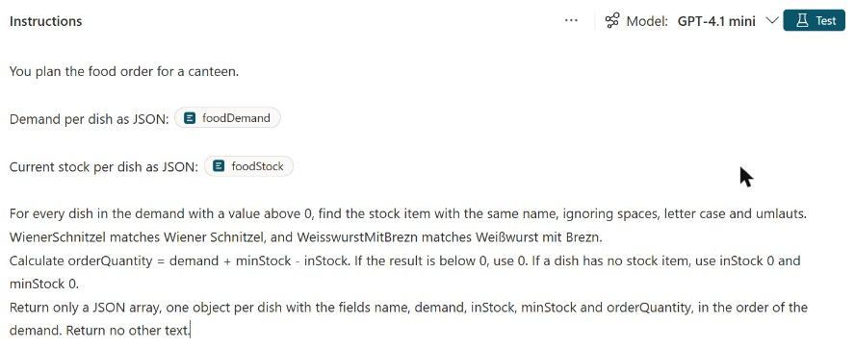
Writing and testing a prompt
Instructions, typed inputs and a test before anyone uses it
The instructions say what the model does and what the answer looks like
Typing / inserts an input; foodDemand and foodStock are Text inputs
Test with sample values first, and save only when the output has the right shape
"Return only a JSON array" and temperature 0 keep the output easy to parse
Notes:
This is prompt builder with the canteen prompt from the live run. Every prompt has three parts you design: the instructions, the inputs and the output.
Instructions: they state the task and the format of the answer. Prompt assistant can draft them from a short description of your intent, between 4 and 500 characters, and the prompt library offers templates in some regions.
Inputs: a forward slash or Add content inserts a placeholder, either Text or Image or document. The chips in the screenshot are the two Text inputs the topic fills later.
Test: you type a sample value per input and select Test, and the response appears next to the instructions. In the live run the test returned 16, 8 and 12, the numbers the rule gives.
Predictable output: temperature 0 is the default and suits extraction, classification and anything a later step parses. The model wraps JSON in a code fence unless the instructions forbid it, so keep "Return no other text", or switch the output to JSON.

Slide 10
02
Dataverse: Knowledge & Business Records
Travel claims saved as table rows
Automate Business Processes with Copilot Studio and Copilot Cowork

Slide 11

Travel claims as Dataverse rows
Business records the agent reads and writes
A claim that stays in the chat can't be approved, paid or reported on, so CS-Travel Expense Refund writes each one as a row in a Dataverse table
Notes:
Most business answers live in table rows, and Microsoft Dataverse is often where those rows already sit. This topic uses Dataverse in both directions an agent can.
Writing: today someone copies each travel claim from the conversation into a list by hand. In the demo the agent writes every submitted claim to the CS-Travel Expense Claims table through an agent flow.
Reading: a Dataverse knowledge source answers questions over up to 15 tables, searching as the signed-in user. Two people asking the same question can get different answers, because nobody sees a row they could not open in a Dataverse app.
Two decisions: reading and writing need separate design and separate permissions. Knowledge answers questions, tools change rows, and each tool runs with the credentials it is configured for.

Slide 12
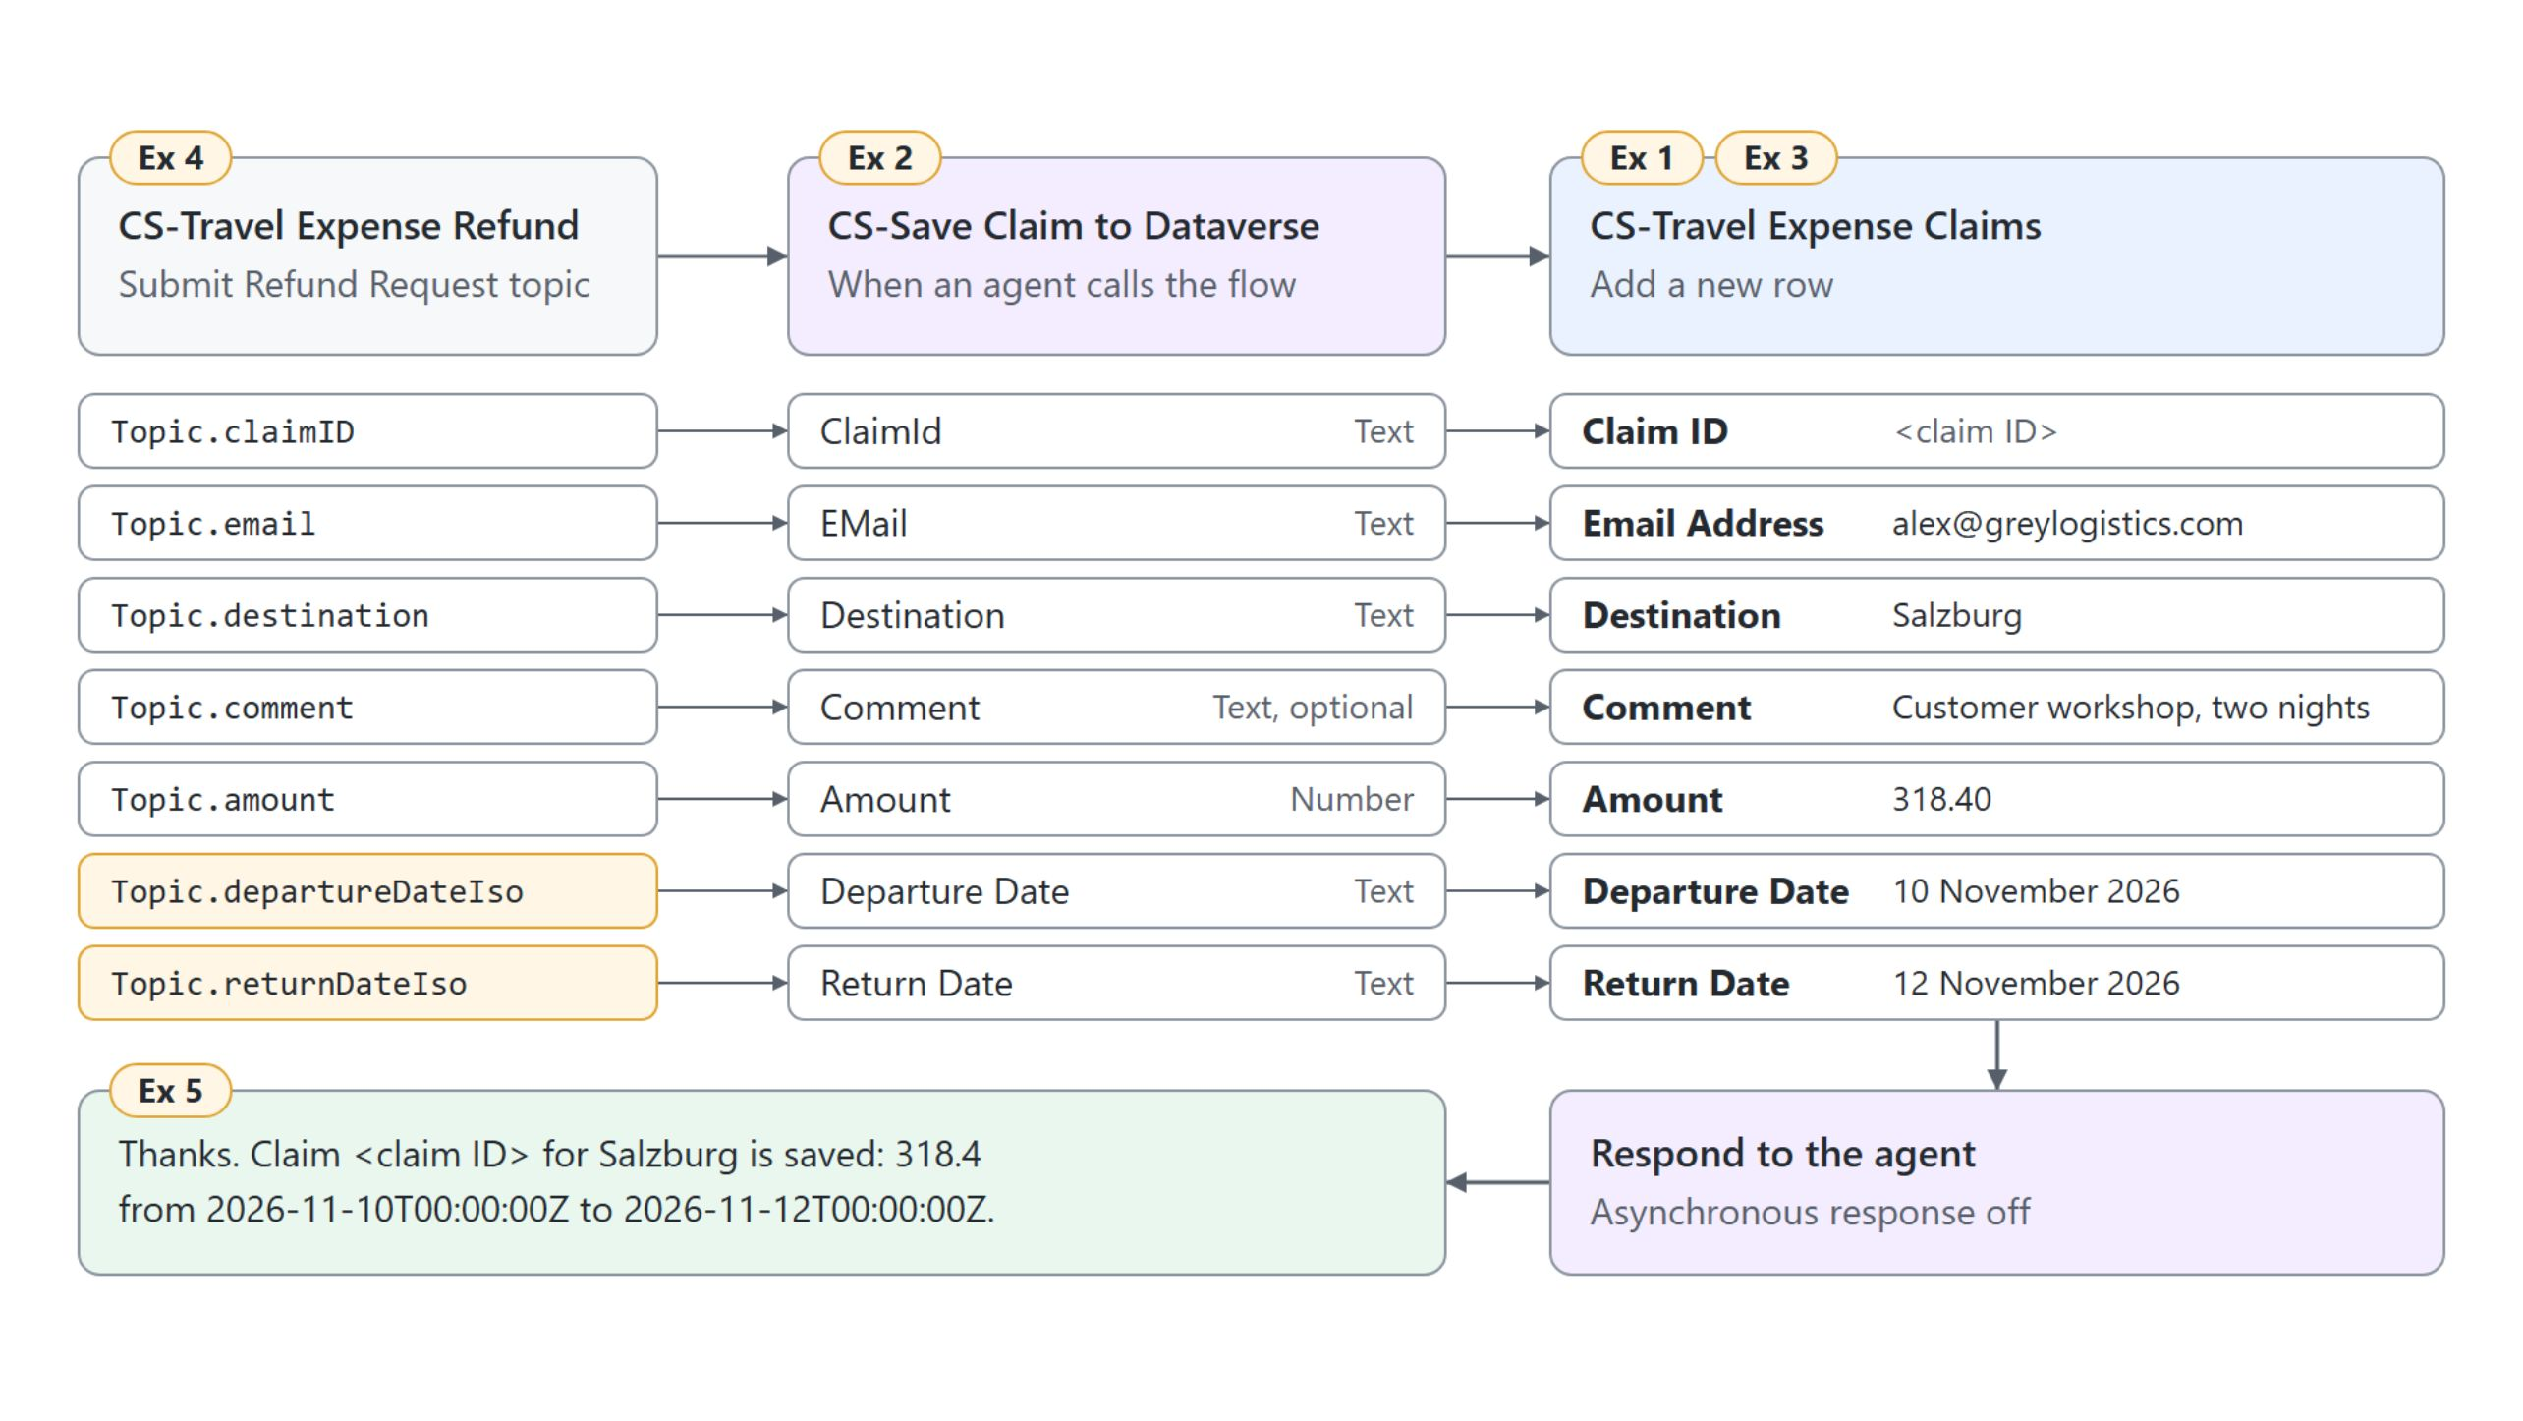
Saving a claim through an agent flow
Seven topic variables, seven flow inputs, one new row
The Action node passes the claim, ISO dates included, to CS-Save Claim to Dataverse, which adds the row and responds to the agent
Notes:
The diagram reads left to right: topic variables, flow inputs, table columns. Every column of the table mirrors one value the topic collects.
The table: CS-Travel Expense Claims has Claim ID as its primary column plus email, destination, two dates, amount and comment. The dates are Date and time columns, which is why the topic builds full ISO timestamps.
The flow: it starts with When an agent calls the flow, adds the row with the Dataverse action Add a new row, and ends with Respond to the agent. Comment is the one optional input, because the card does not require it.
The Action node: the topic, not the orchestrator, saves the claim right after its formulas run. Each input is mapped to a variable, and departureDateIso and returnDateIso carry the converted dates, because Dataverse rejects the raw card dates.
Before you debug: the flow appears under Add a tool only when it is published, keeps both its trigger and Respond to the agent, and has Asynchronous response off. The table must sit in the same environment as the agent and the flow.

Slide 13
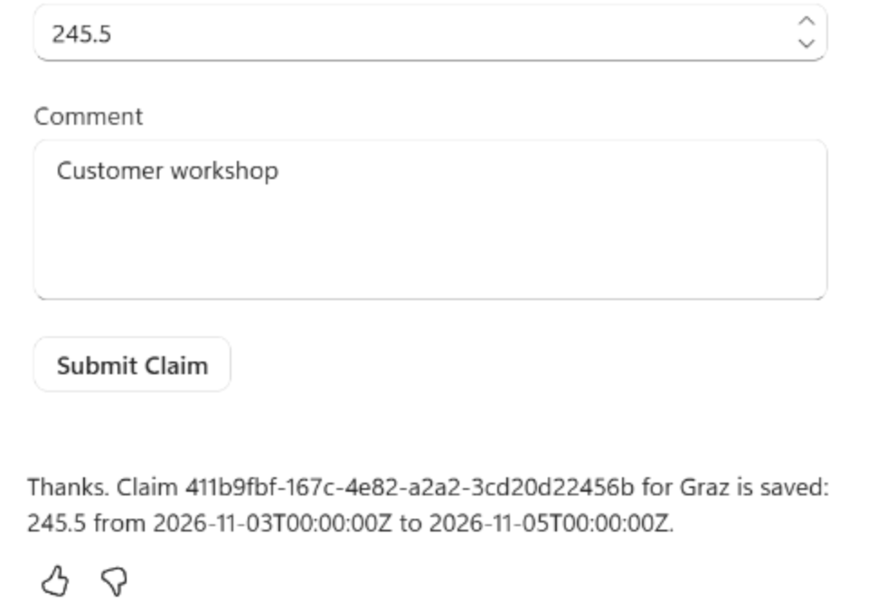
The saved claim in the test chat
The confirmation carries the claim ID and ISO dates
After Submit Claim the agent confirms the claim with its ID, amount and dates
The dates arrive as ISO timestamps, the format the Date and time columns accept
The proof is the row in Power Apps, matched against what you typed
Writes can also run through a Dataverse connector tool that asks before running
Notes:
This is the test chat from the live run, which used a Graz claim of 245.5 instead of the guide's Salzburg values. The flow ran from the topic and the confirmation came back in one turn.
Confirmation: the message comes from the topic's recap node, moved below the Action node. In the live run the orchestrator added a second line of its own, saying the claim was already saved; it did not write a second row.
ISO dates: the topic sends departureDateIso and returnDateIso, so the flow maps the date columns straight from its inputs. The cloned flow mapped its dates from inputs that did not exist, and the rebuild removes that mismatch.
The row: open CS-Travel Expense Claims in Power Apps, refresh the data view and find the claim ID. The chat message alone proves nothing about the table.
Other write paths: a Microsoft Dataverse connector tool such as Add a new row should keep Ask the end user before running on and end user credentials. The Dataverse MCP Server (preview) offers create_record and update_record under role-based access control; turn off every tool your scenario does not need.

Slide 14
03
Connector Tools: Prebuilt Connectors
One Teams action, filled from the chat
Automate Business Processes with Copilot Studio and Copilot Cowork

Slide 15
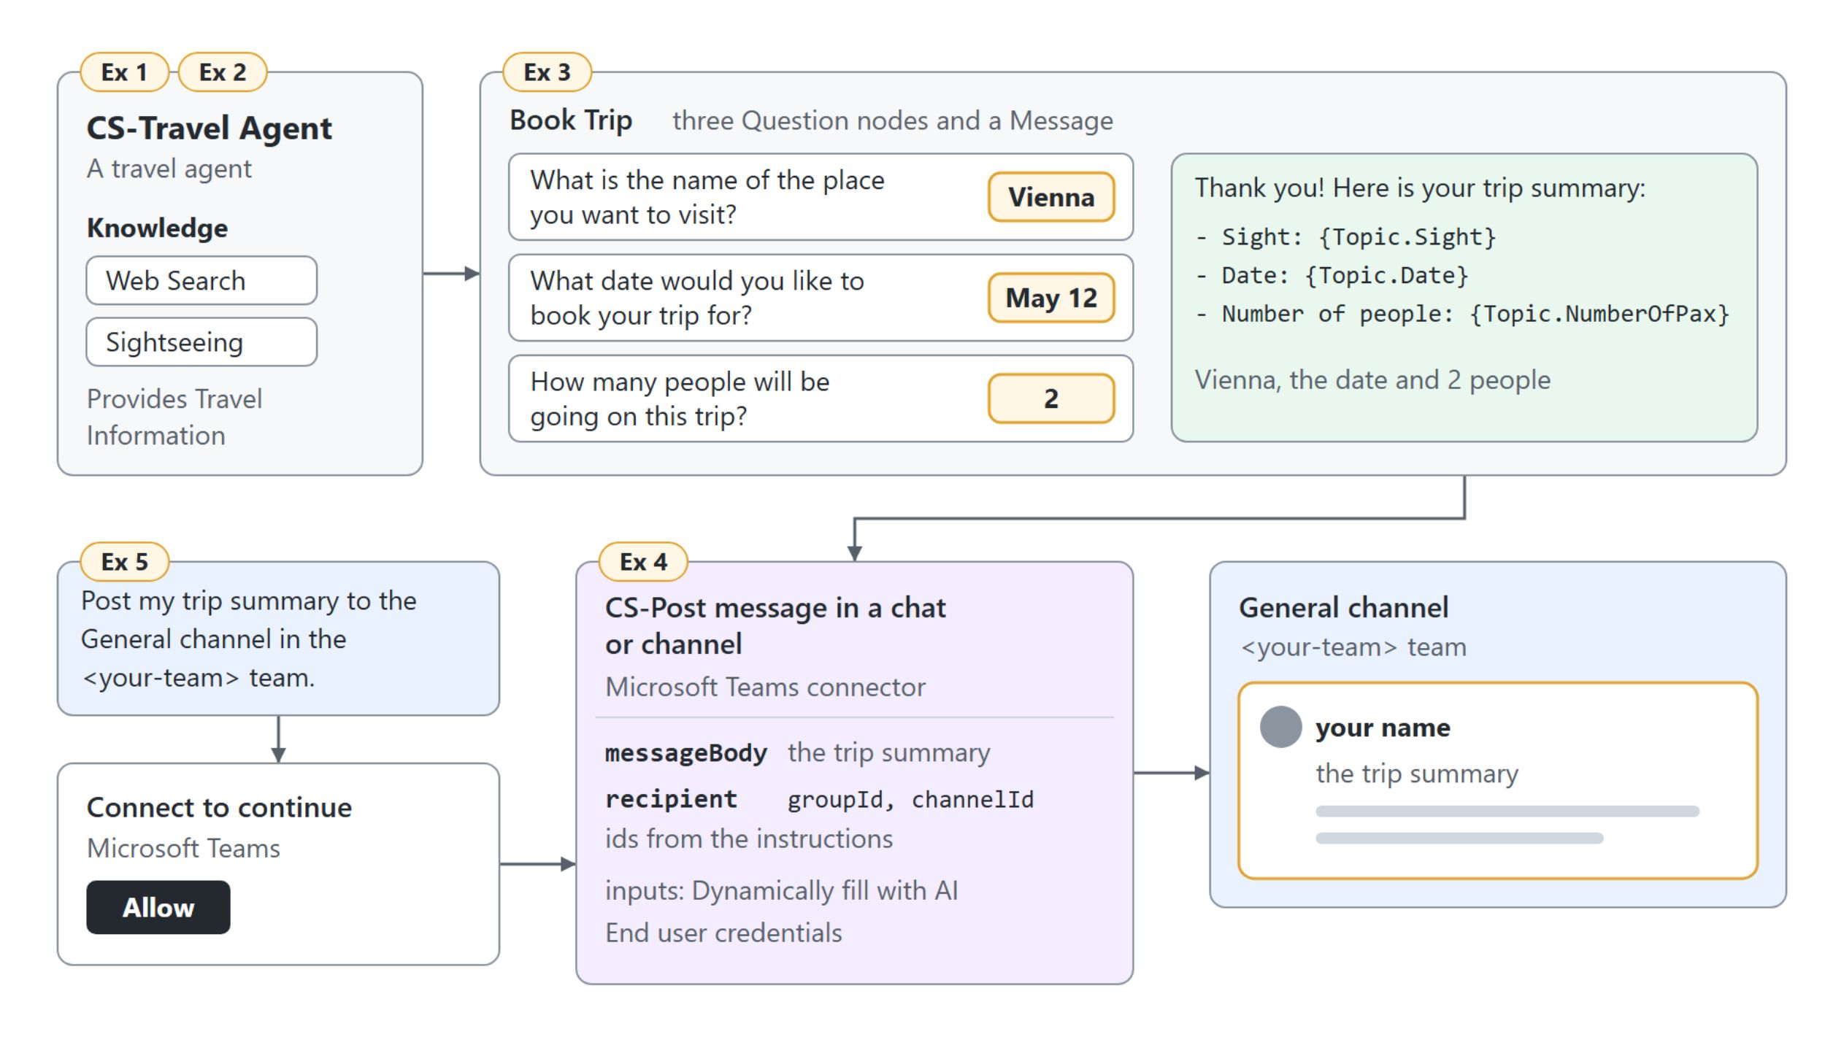
Posting a trip summary to Teams
One Microsoft Teams action as a tool of CS-Travel Agent
Book Trip collects Vienna, May 12 and 2 people, then CS-Post message in a chat or channel posts the summary to the General channel
Notes:
A trip request that stays in the chat helps nobody, because the travel desk works in a Teams channel. This demo gives CS-Travel Agent one prebuilt Teams action it can call on its own.
Connector tools: each action of a Power Platform connector you add becomes one tool, added from Tools, Add a tool, Connector. Standard connectors such as SharePoint come with every Copilot Studio plan, premium ones with select plans.
The plan: the Book Trip topic collects the booking, then the orchestrator picks the tool and writes the message from the trip summary. The activity map shows the prepared messageBody and recipient.
Channel ids: the connector addresses a channel by the team's group id and the channel id, never by names. Without the ids in the instructions, the live run failed with "Group ID does not exist"; with them, the post went through.
One action or several steps: a connector tool runs one action. When a request needs several actions in a fixed order, those steps belong in an agent flow, the next topic.

Slide 16
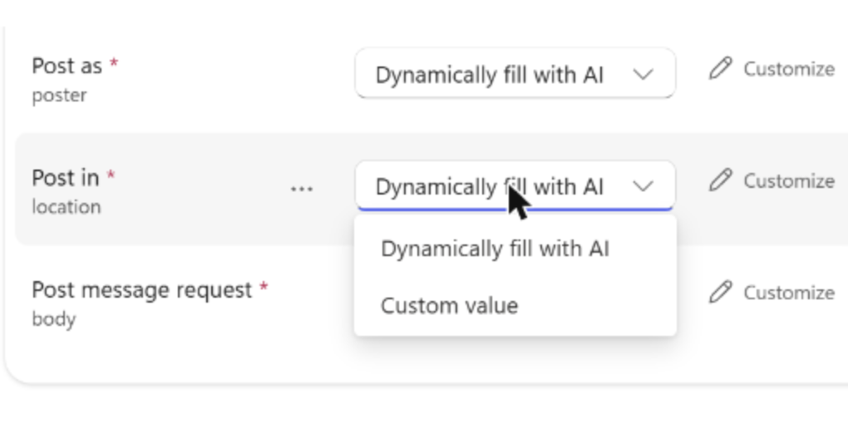
How the agent fills tool inputs
Dynamically fill with AI or a custom value, per input
Dynamically fill with AI (the default) takes the value from the conversation or asks for it
A custom value is fixed: a value, a variable or a formula such as System.User.Email
The Teams tool keeps Post as, Post in and Post message request on dynamic filling
The orchestrator chooses the tool by its name and description, so rename it after Add and configure
Notes:
With generative orchestration, the agent decides which tool answers a request and also fills that tool's inputs. This screenshot is the Teams tool's Inputs section from the live run.
Dynamic filling: the agent pulls the value from the user's message or earlier turns. When it finds none, it generates a question, so you never author a question node for these inputs.
Custom value: use it when a value must never come from the user, such as their own identity or a fixed site address. A Power Fx formula like System.User.Email fills it at runtime.
The Teams inputs: the agent fills who posts, whether it goes to a chat or a channel, and the recipient and text. It asks for anything it can't find.
Name and description: they carry most of the weight when the orchestrator chooses. Names typed in the wizard don't carry over, so rename the tool on its settings page.

Slide 17
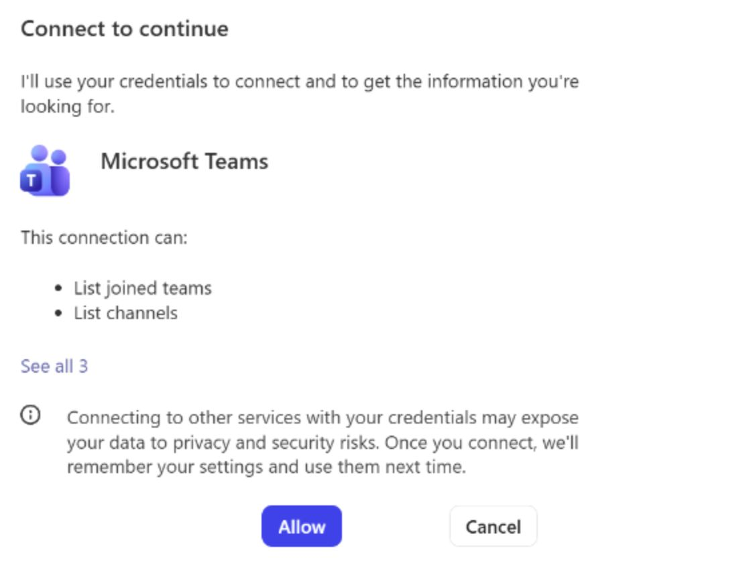
Whose credentials a tool uses
End user credentials ask each person to connect once
End user credentials (the default): each person connects on first use and acts with their own access
Maker-provided credentials run every call with the author's access
Maker-provided credentials need an authenticated channel, and admins can turn them off
The Publish dialog then warns: "Your agent runs tools that use the author's credentials."
Notes:
Every connector call runs as someone, and that choice decides what data the agent can reach. The card in the screenshot is the first Teams call of CS-Travel Agent with end user credentials.
End user credentials: each user selects Allow once, and the agent can only do what that person could do. The trip summary then appears in the channel under the user's own name.
Maker-provided credentials: every user acts with the author's access, which suits shared resources every user may read. The risk to manage is oversharing.
The conditions: maker-provided credentials need an authenticated channel, and administrators can turn the option off per environment in the Power Platform admin center. Plan for that before you build an agent around shared credentials.
The live finding: a Teams post tool on end user credentials stopped another test chat at "Let's get you connected first", and Retry kept failing. Switching that tool to maker-provided credentials fixed it, and the Publish dialog then showed the warning.

Slide 18
04
Agent Flows: Deterministic Automation
Fixed steps with a prompt and a reviewer
Automate Business Processes with Copilot Studio and Copilot Cowork

Slide 19
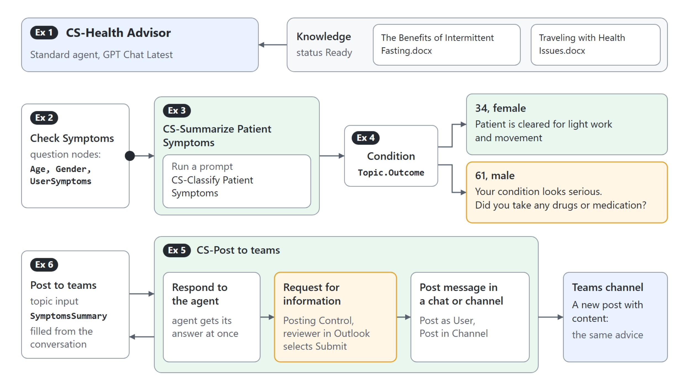
The Health Advisor's two agent flows
A prompt step classifies, a review step guards the post
Check Symptoms branches on the Outcome of CS-Summarize Patient Symptoms, and CS-Post to teams answers the agent at once, then waits for a reviewer
Notes:
Logging a ticket or posting advice has to happen the same way every time. Agent flows are the deterministic half of a Standard agent: one trigger, a fixed sequence of actions, the same output for the same input.
Flows as tools: a flow becomes a tool with When an agent calls the flow and Respond to the agent, Asynchronous response off, published, and a typical run inside the 100-second action limit. The trigger's inputs are the contract the agent fills, and the outputs are what it gets back.
The first flow: Check Symptoms collects age, gender and symptoms, and the flow returns an Outcome. A Power Fx condition looks for "cleared for light work" and asks a follow-up question when it is missing.
The second flow: it answers the agent first, then waits for a reviewer before it posts to Teams. Actions after Respond to the agent keep running for up to the 30-day flow run limit.
Flow tool or connector tool: one read or write in one service is a connector tool. Several steps in a fixed order, a condition or a person in the middle belong in a flow, billed at 13 Copilot Credits per 100 actions.

Slide 20
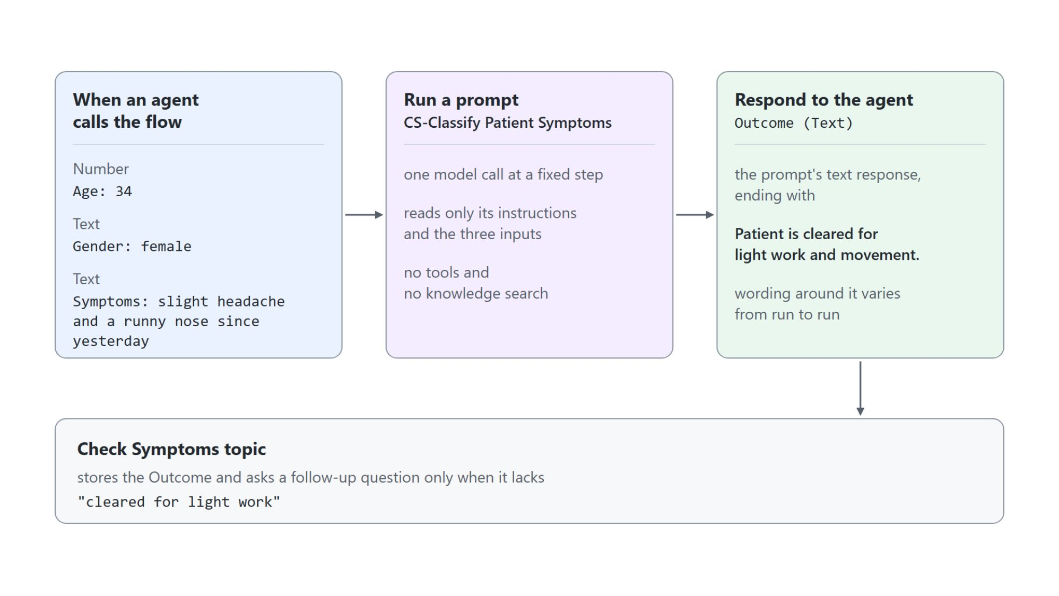
A prompt step inside an agent flow
CS-Classify Patient Symptoms classifies, the topic branches
Run a prompt makes one model call at a fixed point in the flow
The prompt reads only its instructions and the age, gender and symptoms it is given
With 34, female and mild symptoms, the answer ends "Patient is cleared for light work and movement."
Respond to the agent returns that text as Outcome, and the topic branches on it
Notes:
A flow can still use a model, as long as the model does one bounded job at a fixed point. This is the classification step of CS-Summarize Patient Symptoms with the test values from the demo.
Run a prompt: the action sits in the AI capabilities section and returns text or structured output for the next action. It makes a single model call with no tools and no knowledge search.
Only its instructions: the prompt node never searches SharePoint or reads mail on its own. An earlier step passes the data in, here the three trigger inputs.
The test: in the live run, 34, female and a slight headache with a runny nose came back with an analysis ending in the cleared-for-light-work sentence. The wording around it varies from run to run.
The Outcome: Respond to the agent returns the prompt's text response, and the Check Symptoms condition asks a follow-up question only when that sentence is missing. The cloned flow returned the trigger body instead, so every check fell into the serious branch.

Slide 21

A reviewer before the Teams post
The agent gets its answer first, the post waits for a person
Respond to the agent sits right below the trigger, so the chat gets its answer at once
Request for information emails the reviewer a Posting Control request through Outlook
The flow posts to the Teams channel only after the reviewer selects Submit
An agent waits at most 100 seconds for a flow; the review step runs on after the response
Notes:
A post to a shared channel should not leave the agent unseen, so CS-Post to teams asks a person first. A reviewer can take hours, while an agent waits at most 100 seconds for a flow.
Respond first: Respond to the agent goes directly below the trigger, so the agent answers right away. With the response after the review step, saving to Teams times out with an error.
Request for information: it sends the reviewer an email from Microsoft Power Automate titled "Posting Control" with the advice in it. Its Channel must be set, or publishing fails with missing required property 'RequestForInformationInput/channel'.
Submit: after the reviewer submits, the channel shows a post that starts "A new post with content:". The request has no inputs yet, so any submission posts; a Yes/No input and a condition give the reviewer a real choice.
Credentials: the tool runs with maker-provided credentials, so the flow uses your Teams and Human review connections. With end user credentials, the chat stopped at "Let's get you connected first".

Slide 22
05
Custom Connectors & REST APIs
Live canteen stock from an OpenAPI file
Automate Business Processes with Copilot Studio and Copilot Cowork

Slide 23
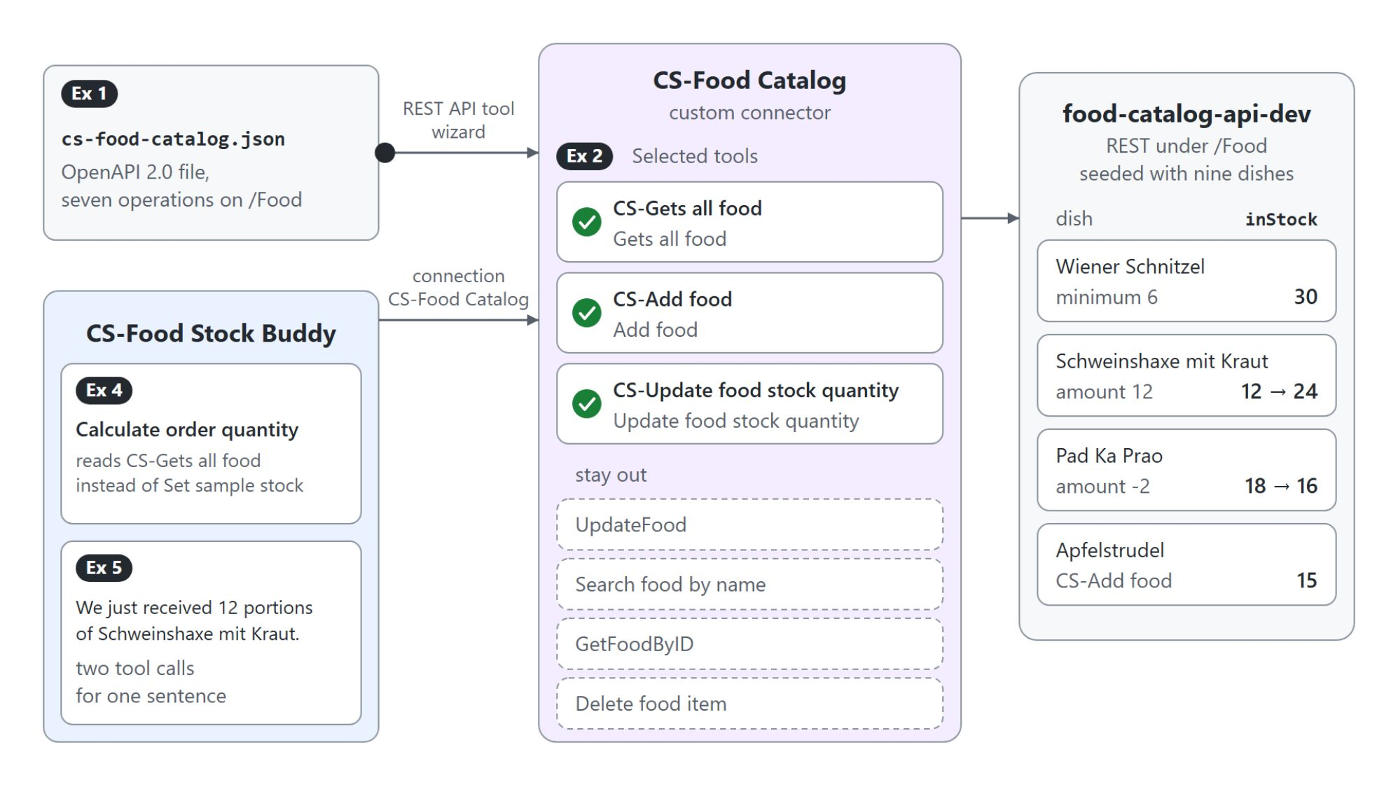
Live stock from the food catalog API
An OpenAPI file becomes CS-Food Catalog and three tools
The REST API tool wizard turns cs-food-catalog.json into the CS-Food Catalog custom connector
Three of seven operations become tools: CS-Gets all food, CS-Add food and CS-Update food stock quantity
UpdateFood, the two lookups and Delete food item stay out
Calculate order quantity now reads CS-Gets all food instead of Set sample stock
Notes:
CS-Food Stock Buddy calculated its order from a sample table that never changes, so every order went wrong as soon as a delivery arrived. The food catalog API already knows the real stock, and its OpenAPI file describes everything it can do.
The wizard: Add a tool, Add new REST API, upload the file, describe the API, pick the authentication and select the operations. Custom connectors import OpenAPI 2.0; the REST API tool (preview) also translates a v3 file.
Three tools: every operation you select becomes a tool the orchestrator can call on its own. The canteen needs to read the stock, add a dish and book a delivery.
Left out: a canteen agent that rewrites or deletes dishes is a risk nobody asked for. You expose only the operations you select.
Live stock: the node keeps the variable name foodStock, so the prompt node from topic 01 stays untouched. The free-tier web app starts cold, so open the API once before you demo it.

Slide 24
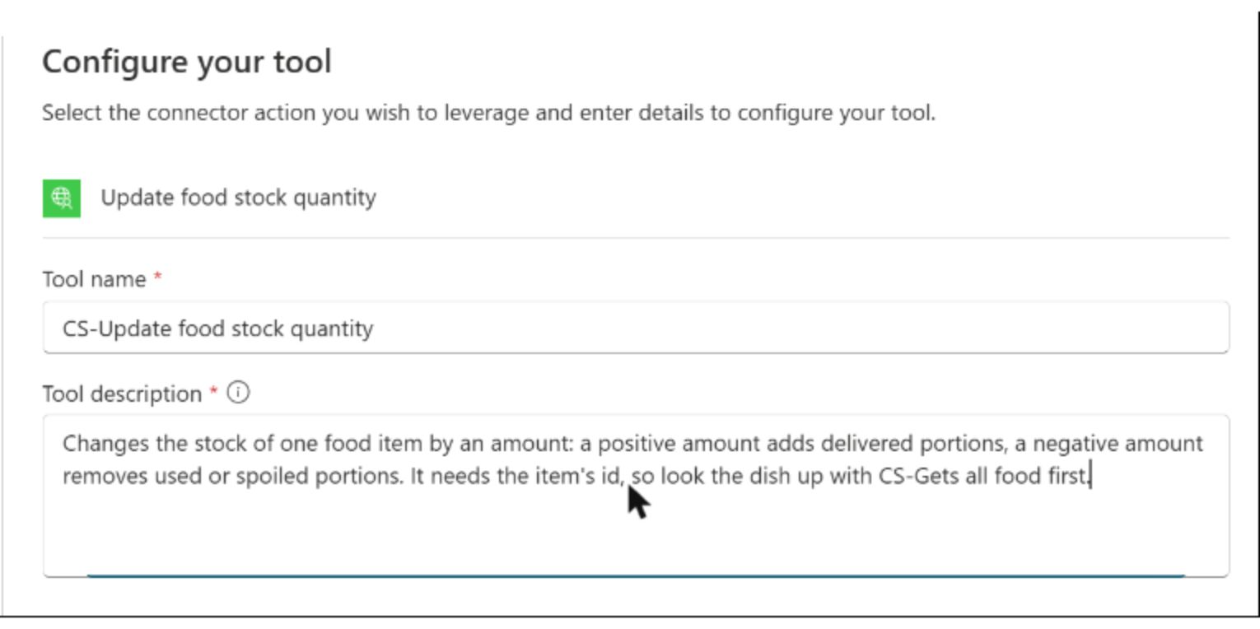
Tool descriptions the orchestrator routes on
A description can also set the call order
Each description names the job, the data and when to use the tool
"Look the dish up with CS-Gets all food first" sets the call order
Without that line the agent guessed an id and got Not Found
The wizard asks for a description of every input and output before Next turns on
Notes:
The orchestrator reads the tool description when it decides, so each one names the job, the data and when to use it. This is the third tool from the live run.
The job: a positive amount adds delivered portions, a negative amount removes used or spoiled ones. That lets one tool serve both deliveries and spoilage.
Call order: the update needs the item's id, and only the list operation knows it. The description tells the agent to look the dish up first.
Not Found: without that line the agent guessed an id and the API answered Not Found. One connector whose operations have real descriptions beats three connectors with bare ones such as "Gets all food".
Parameter descriptions: on the review page every input and output needs a description, and Next stays disabled until all are filled. The file's own descriptions are the first draft.

Slide 25

Booking a delivery in one sentence
The orchestrator chains a lookup and an update
"We just received 12 portions of Schweinshaxe mit Kraut" makes the agent look up the dish, then add 12 to its stock: 24 portions on the seeded database
Notes:
With add and update in its tool set, the agent keeps the stock true without any topic. One sentence about a delivery is enough.
Two tool calls: the activity map shows CS-Gets all food, then CS-Update food stock quantity with the dish's id and an amount of 12. In the live run the agent answered that the new stock is 24 portions.
Spoiled portions: "Two portions of Pad Ka Prao spoiled" runs the same update with an amount of -2, from 18 to 16. A new dish such as Apfelstrudel goes through CS-Add food.
The order: the next Calculate quantity to order works from 24 portions of Schweinshaxe mit Kraut and 16 of Pad Ka Prao. The quantities follow the stock as soon as it changes.

Slide 26
06
MCP Servers as Agent Tools
Staff and shifts discovered at runtime
Automate Business Processes with Copilot Studio and Copilot Cowork

Slide 27
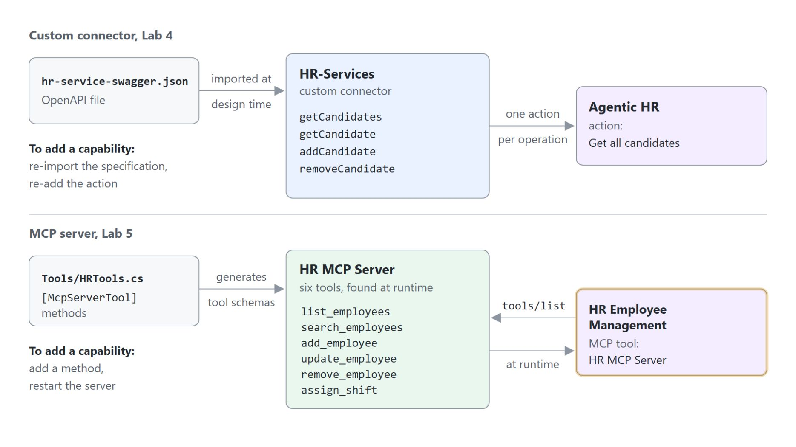
Tool discovery with MCP
A connector is fixed at import, an MCP server lists its tools at runtime
A custom connector keeps the operations of the OpenAPI file you imported
An MCP server answers `tools/list` at runtime with its current tools
Tool descriptions come from the server's `[Description]` attributes, so a vague one is fixed there
Adding a tool means adding a method and restarting the server
MCP needs generative orchestration, and topics cannot call a server directly
Notes:
A connector is a design-time contract, an MCP server a runtime one. The diagram puts the two HR labs of this module side by side: the REST API lab's connector on top, the MCP lab's server below.
Custom connector: you import an OpenAPI file and map each operation to a tool. The tool list stays fixed until you import the file again and re-add the operation.
MCP server: the agent asks the server which tools exist, and Copilot Studio reflects added, changed and removed tools on its own. On the agent the whole server is one tool, and its settings page lists the server's tools.
Descriptions: in the HR server each tool is a C# method marked [McpServerTool], and its [Description] attributes become what the orchestrator reads. A maker cannot enrich them in Copilot Studio.
Adding a tool: a new method plus a restart, and connected agents discover it the next time they list the tools. Copilot Studio supports the Streamable HTTP transport only, so a server has to sit behind an HTTPS URL.
Orchestration: only the orchestrator decides when to call one of the server's tools, so MCP does not work with classic orchestration. Learn's guidance: use MCP when several agents share a toolset or the upstream API changes often.

Slide 28
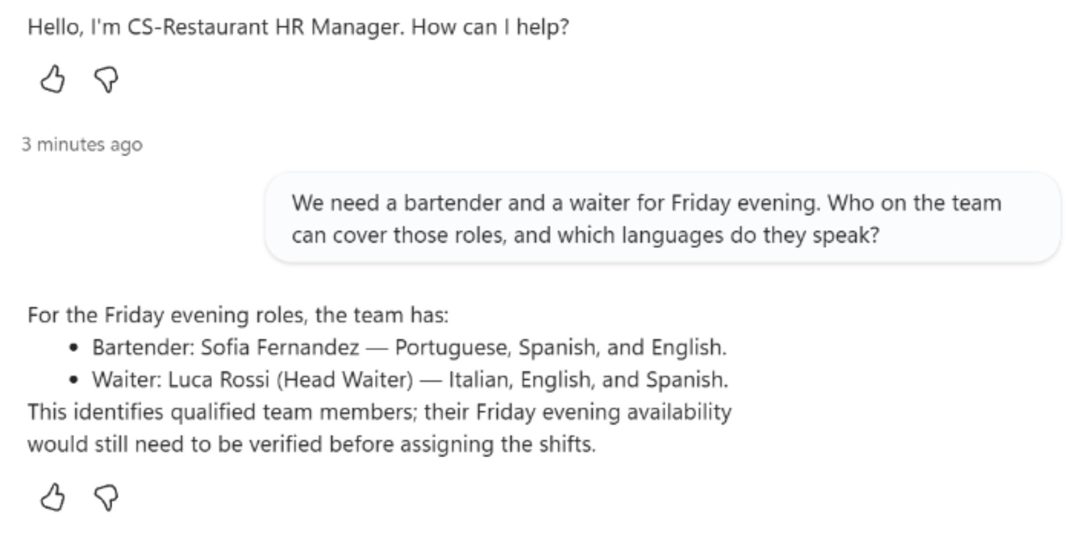
Finding staff through the HR MCP server
CS-Restaurant HR Manager reads the team before it plans
The question names no tool; the orchestrator picks CS-HR MCP Server from its description
The answer names Sofia Fernandez and Luca Rossi with their languages, from the seeded staff
The server was connected through the MCP onboarding wizard: name, description, URL, no authentication
A reply that names people missing from the server's data means no tool ran
Notes:
Step 1 of the agent's instructions says to retrieve names, roles and availability from the HR system before planning. This is the read test from the live run.
The orchestrator's choice: the wizard's server description, "Knows about employees and how they can be used in our restaurant", is what the orchestrator reads. The activity map shows list_employees or search_employees running on CS-HR MCP Server.
The answer: Sofia Fernandez is a bartender who speaks Portuguese, Spanish and English, and Luca Rossi is head waiter with Italian, English and Spanish. The agent added on its own that their Friday availability still needs checking.
The wizard: it needs no tool list, because the agent discovers the six tools from the server. The HR server answers at the root of its HTTPS address.
The check: when a reply names people the server does not know, the orchestrator answered without calling it and the activity map shows no tool call. The server's search semantics bind the agent too: a deployed search_employees that matched single names only returned nothing for a full name.

Slide 29

Booking shifts after a confirmation
The agent reads freely and writes after a yes
The agent books Sofia on the bar and Luca on waiter duty for 2026-11-06 only after you confirm, and the server sets each shift to eight hours
Notes:
A read is harmless, a write changes the schedule. The guideline "Always confirm changes before finalizing schedules" in the instructions makes the agent stop before it calls assign_shift.
Two calls after the yes: before the confirmation the activity map shows no assign_shift call. After it, two calls run with the date 2026-11-06 and shiftStartHour 14, and the server answers from 14:00 to 22:00.
Allow all: all server tools are on by default. Turn it off and switch off remove_employee, so a scheduling agent can never delete staff and tools the server adds later stay off until you turn them on.
The schedule by email: CS-Send an email, an Office 365 Outlook tool with Ask the end user before running, sends the schedule the instructions promise. It needs a Message to display, or the call fails with "This tool requires user confirmation, but no confirmation message has been set."

Slide 30
07
Computer Use: Apps Without APIs
Reading and filling web apps by screen
Automate Business Processes with Copilot Studio and Copilot Cowork

Slide 31
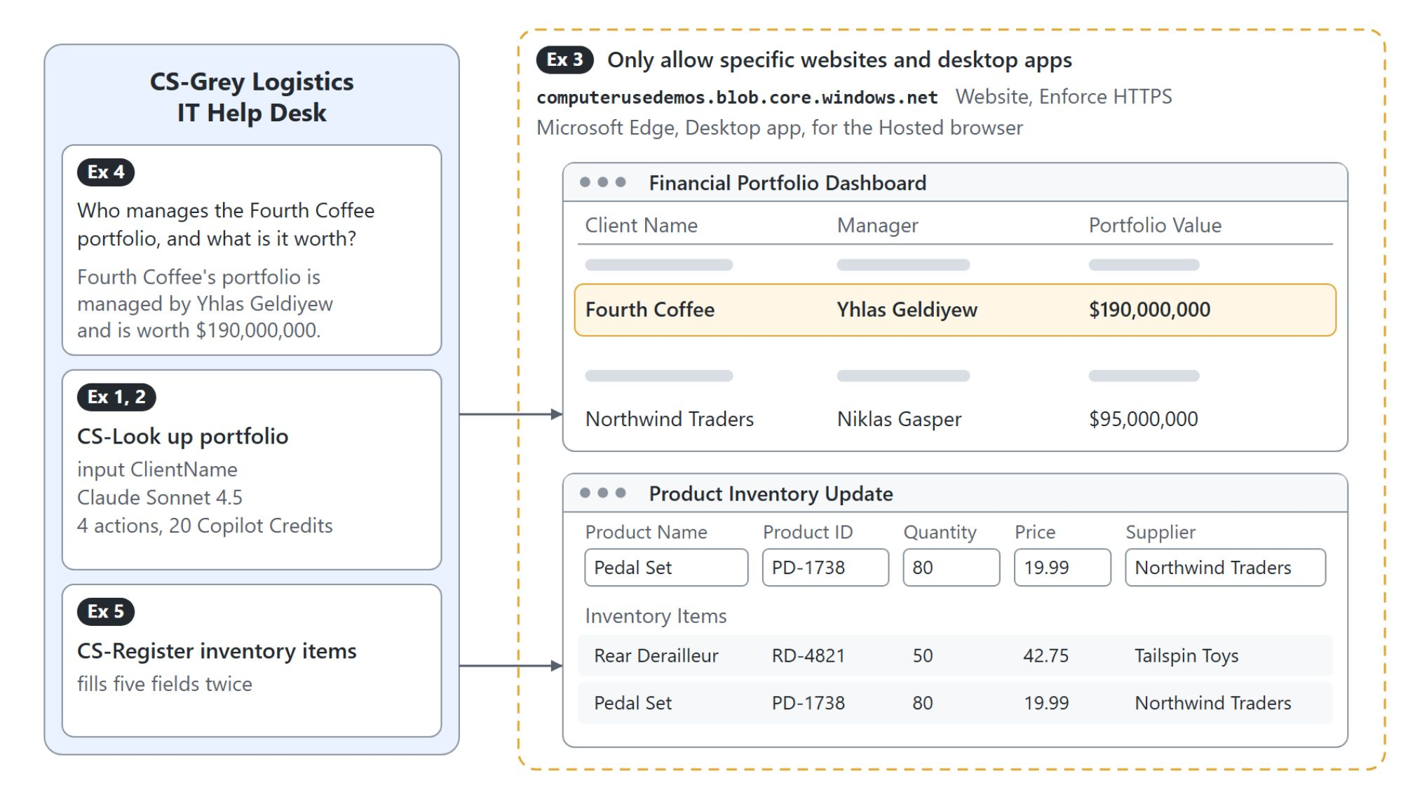
Computer use on web apps without an API
Two tools for the help desk agent, fenced to one site
CS-Look up portfolio reads a client's manager and value, CS-Register inventory items types two products into a form, both limited to one HTTPS site
Notes:
Some systems have no API and no connector, and people still use them every day by looking at the screen. Computer use gives a Standard agent the same ability through a virtual mouse and keyboard, guided by plain-language instructions.
The loop: the tool takes a screenshot, decides the next action, performs it and repeats until the task is done. Because the model reads the screen, it adapts when a button moves, where a recorded script would break.
Where it runs: every run needs a Windows machine, either the hosted browser (preview), a Cloud PC pool (preview) or your own machine registered in Power Automate. The demo runs on the hosted browser.
Two tools: CS-Look up portfolio takes the client name as an input, and CS-Register inventory items fills five fields twice. The orchestrator keeps lookups and entries apart by reading the two descriptions.
Fenced: Only allow specific websites and desktop apps limits both tools to the sample site plus Microsoft Edge, and Enforce HTTPS is on by default. Use dedicated machines with least privilege, and when the app later gains an API or a connector, replace the tool with it.

Slide 32
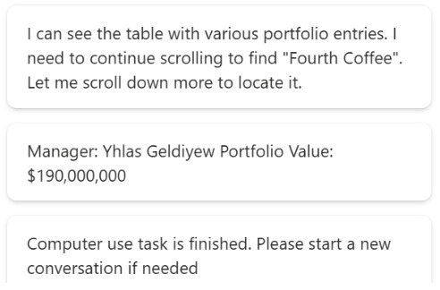
A computer use test run
The model's reasoning next to the hosted browser
The left column shows the model's reasoning after each step of the run
The hosted browser scrolls the Financial Portfolio Dashboard down to Fourth Coffee
Claude Sonnet 4.5 returned Yhlas Geldiyew, $190,000,000 exactly as the page shows it
In chat the same lookup took 4 actions: 20 Copilot Credits at 5 per step
Notes:
Test directly opens a window with the reasoning messages on the left and a live preview of the machine on the right. This is the first lookup from the live run.
Reasoning: each card says what the model sees and what it does next, such as scrolling because Fourth Coffee is not visible yet. Screenshots and reasoning steps stay in the run history on the Activity tab.
The scroll: the instructions name the site by its full URL and state exactly which two values to record. Precise instructions reach the goal in fewer steps, and fewer steps cost less.
The model: Claude Sonnet 4.5, preselected in the class environment, read the name exactly. Computer-Using Agent (CUA) zoomed until the Manager column was cut off and returned "Yhlas Galdiyew".
The cost: each step costs 5 Copilot Credits with a standard model and 15 with a premium one. The map view's Number of actions showed 4 for the chat run, which is 20 credits.

Slide 33

Takeaways
Pick the tool by the job
A prompt for the canteen order, an agent flow for fixed steps, a connector or REST API for one service
MCP for a toolset many agents share, computer use only where no API exists
The orchestrator chooses by name and description, so write them in your users' words
Rows, posts, shifts and mails go out after a confirmation, with credentials you chose on purpose
The activity map shows which tool ran and what it was given
Notes:
This closing slide collects one point per step of the path. Each one came up in a demo of this module.
Tool by job: a prompt gives a fixed instruction and format, a flow runs the same steps every time, a connector or REST API reaches one service. The canteen order ran on a prompt first and on live stock from the API later.
MCP and computer use: an MCP server suits several agents sharing a toolset or an API that changes often. Computer use is the route for systems that leave no other door; when an API exists, use it.
Name and description: they carry most of the weight when the orchestrator chooses, and a description can even set the call order. Rename every tool after Add and configure, because wizard names don't carry over.
Confirmation and credentials: Ask the end user before running guards anything that sends, writes or deletes. End user credentials are the default; maker-provided credentials act with your access for everyone.
Activity map: it shows the tool calls and the inputs the agent prepared. A reply with no tool call in the map came from the model alone.

