Slide 1


Fast Lane Group
Worldwide Education &
Professional Services
www.flane.de | © 2026 Fast Lane Institute for Knowledge Transfer GmbH
Notes:
Die Fast Lane Gruppe.
Fast Lane … Dienstleister u. Spezialist für High-End Technologie und Business Trainings
IT Trainings zu den unterschiedlichsten Herstellern wie Microsoft, Google, Cisco oder AWS. Und vielen weiteren wichtigen IT Herstellern.
Sei es Cloud, Security, Netzwerk oder allgemein digitale Transformationsprojekte
Und das seit 2003.
Das spannende ist, dass die Fast Lane Gruppe bereits seit 2009 durchgängig zu den Top 20 Unternehmen in der IT Trainingsbranche weltweit zählt.
Aber auch Footprint ebenso im klassischen Professional Services Bereich für unsere wichtigsten Hersteller
PreSales Support, Deployment Services und Adoption Trainings
Additional Information:
Im Jahr 2021 sind wir zur „most strategic IT Education company worldwide“ von der IDC im „magic quadrant“ aufgeführt worden !
1 mio Teilnehmer insgesamt seit bestehen, 50.000+ Students ww p.A, 20.000 in DE pro Jahr

Slide 2






AGENTIC AI: FROM STRATEGY TO PRODUCTION.
Alexander
Kastil
AGENTIC AI CONSULTING · VIENNA
Full stack, from enterprise software to agentic AI. Since 1996
AI at Work
Enterprise AI
Value discovery, KPI mapping and roadmap
Governed multi-agent systems on Microsoft Copilot and Foundry
Agentic Software Engineering
Team Enablement
Harness architecture for Claude Code and GitHub Copilot
AI driven content production and delivery
integrations.at
github.com/alexander-kastil
SCAN TO CONNECT
alexander.kastil@integrations.at
linkedin.com/in/alexander-kastil
integrations.at
Notes:
Intro: Alexander Kastil, integrations.at. Four practice areas from AI at Work to team enablement. Certifications: Agentic AI Business Solutions Architect, Azure AI App and Agent Developer Associate, DevOps Engineer Expert.

Slide 3

MODULE 6
Microsoft Copilot Harness Agents in Copilot Studio
Build, ground, extend and test the second kind of agent
Automate Business Processes with Copilot Studio and Copilot Cowork

Slide 4
01
02
03
04
Standard vs. Microsoft Copilot Harness Agents
The New agent menu, coexistence and the one-way rule
The Unified Build Surface and the New Orchestrator
Four tabs, one components panel and an always-on runtime
Agent Skills in Copilot Studio
SKILL.md recipes that load when a request matches
Tools, MCP, and the New Workflows Designer
Connectors, MCP servers and workflows with agent nodes
05
06
07
Grounding Agents with Work IQ, Foundry IQ, and Fabric IQ
Sources that stay where they live, proven in the trace
Building Apps in Copilot Studio
Describe, refine by conversation, publish and share
Test and Evaluate Copilot Studio Agents
Test sets, General quality and a failing case to its fix
Automate Business Processes with Copilot Studio and Copilot Cowork

Slide 5

Microsoft Copilot harness agents next to Standard agents
Build, ground, extend and test the second kind of agent
Two kinds of agent in one tenant: Standard and Microsoft Copilot, chosen when you create the agent
The Build tab: skills, tools, MCP servers, workflows and IQ grounding in one place
Beside the agent: apps built from a description, and test sets that show whether the agent is any good
Notes:
In June 2026 Microsoft shipped a rebuilt Copilot Studio, so one tenant now holds two kinds of agent. This module teaches Microsoft Copilot harness agents next to the Standard agents from Basics, Tools and Advanced.
Two kinds of agent: you pick Standard or Microsoft Copilot in the New agent menu, and an agent can't be converted later. Standard agents stay the primary production track, and Microsoft Copilot harness agents run as guided demos and labs.
The Build tab: a Microsoft Copilot harness agent keeps instructions, knowledge, tools and skills in one panel, with an orchestration runtime that plans across steps. Skills, MCP servers, workflows and Work IQ, Foundry IQ and Fabric IQ all attach there.
Beside the agent: Copilot Studio also builds apps from a plain-language description, and test sets on the Evaluate tab show whether an agent is ready to ship. For every idea, the module shows the Standard equivalent so the concept carries over.

Slide 6
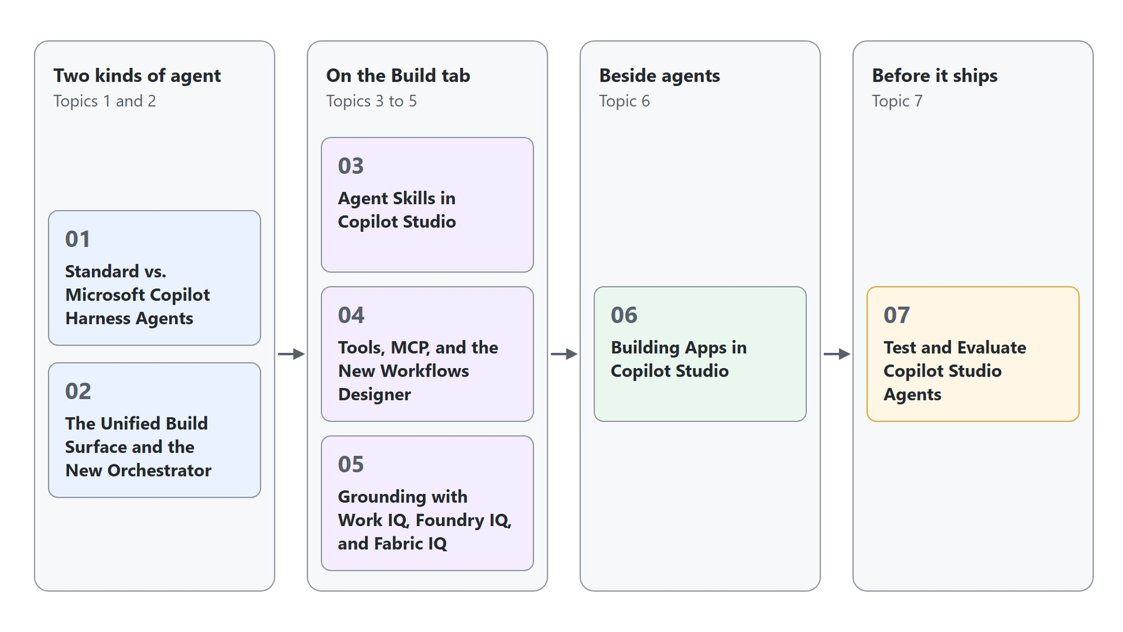
Overview
The path through the seven topics
Start with the two kinds of agent: how to choose, tell them apart, and what the new orchestrator does
On the Build tab: Agent Skills, then tools, MCP servers and the new workflows designer
Ground the agent with Work IQ, Foundry IQ and Fabric IQ
Build an app from a description, then test and evaluate the agent before it ships
Notes:
This slide walks the path through the seven topics once, following on from the three themes of the title slide.
Two kinds of agent: topic one covers the New agent menu, coexistence and the one-way conversion rule. Topic two maps the Standard settings onto the four-tab Build surface and explains the always-on orchestration runtime.
Build tab: topic three packages task recipes as skills in the open SKILL.md format. Topic four adds connectors, MCP servers and workflows with agent nodes from one Tools surface.
Grounding: topic five connects Work IQ, Foundry IQ and Fabric IQ, each reading a source that stays where it lives.
Apps and evaluation: topic six turns a description into a working app, and topic seven runs test sets on the Evaluate tab and walks a failing case to its fix.

Slide 7
01
Standard vs. Microsoft Copilot Harness Agents
The New agent menu, coexistence and the one-way rule
Automate Business Processes with Copilot Studio and Copilot Cowork

Slide 8
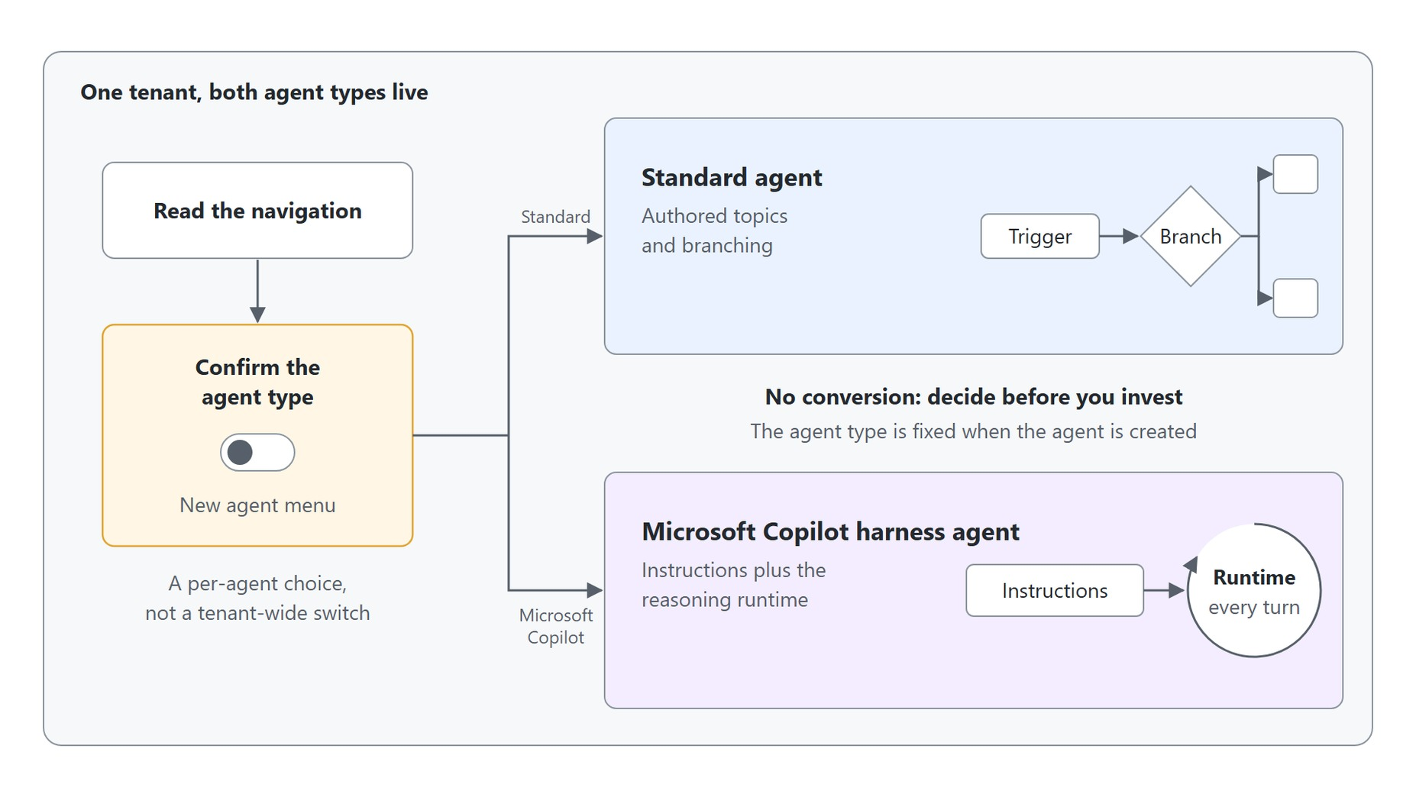
Choosing Standard or Microsoft Copilot per agent
Both run in one tenant, and the choice is fixed at creation
Microsoft Copilot harness agents since June 2026, running beside Standard agents in the same tenant
Each agent is one kind, fixed when you create it
No conversion in either direction, so decide before you invest
Standard for exact, auditable paths; Microsoft Copilot for greenfield agents over Microsoft 365 data
Notes:
This slide opens Microsoft Copilot harness agents by showing where they sit next to Standard agents. The diagram shows one tenant in which each agent is created as one kind and stays there.
Production-ready preview: Microsoft shipped Microsoft Copilot harness agents (Learn: GitHub Copilot harness) in June 2026 and rolled them out worldwide. They run beside Standard agents (Learn: standard harness), so nothing students built earlier is moved or rewritten.
One kind per agent: the choice is made per agent in the New agent menu on the Agents page, never once for the whole tenant. The Agents list marks every Standard agent as Standard.
No conversion: Standard agents use authored topics, triggers and branching, while Microsoft Copilot harness agents use instructions plus the reasoning runtime. Moving a mature agent to the other kind means authoring it again from scratch.
When to pick which: Standard leads when the conversation must follow an exact, auditable path or needs a feature such as the prompt tool or the WhatsApp channel. Microsoft Copilot suits a greenfield agent that reasons over Microsoft 365 data with Skills, memory and the enhanced orchestrator.

Slide 9
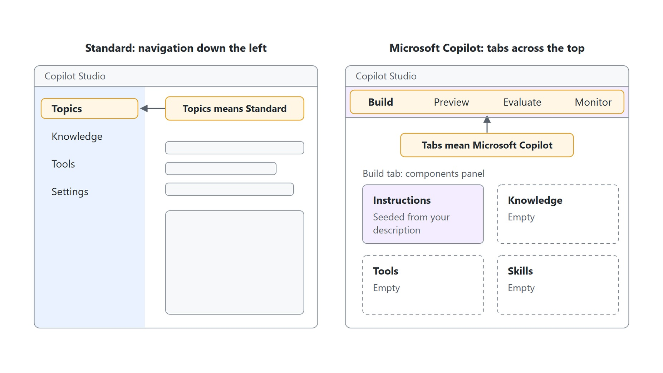
Telling Standard and Microsoft Copilot apart
The navigation shows which one is open
Standard: Topics, Knowledge, Tools and Settings down the left
Microsoft Copilot: Build, Preview, Evaluate and Monitor tabs across the top
Topics in the navigation always means a Standard agent
Check the badge in the New agent menu before you create an agent
Notes:
The previous slide made the choice; this one gives the habit that protects it: knowing which kind of agent is open before building anything. The diagram puts both surfaces side by side.
Standard navigation: a Standard agent opens on an Overview page with Knowledge, Tools, Topics and Settings. It is the topic-driven surface most production agents use today.
Microsoft Copilot tabs: a Microsoft Copilot harness agent opens on the Build tab with Build, Preview, Evaluate and Monitor across the top. The panel on the right lists Model, Channels, Skills, Tools, Knowledge, Connected agents and a Memory switch.
Topics means Standard: if Topics appears in the navigation, you are in a Standard agent. In the demo and the lab, that sign means going back to the New agent menu and creating the agent again with the GitHub Copilot badge.
Check before you create: a minute spent reading the badge and the navigation saves an hour of building in the wrong place.

Slide 10
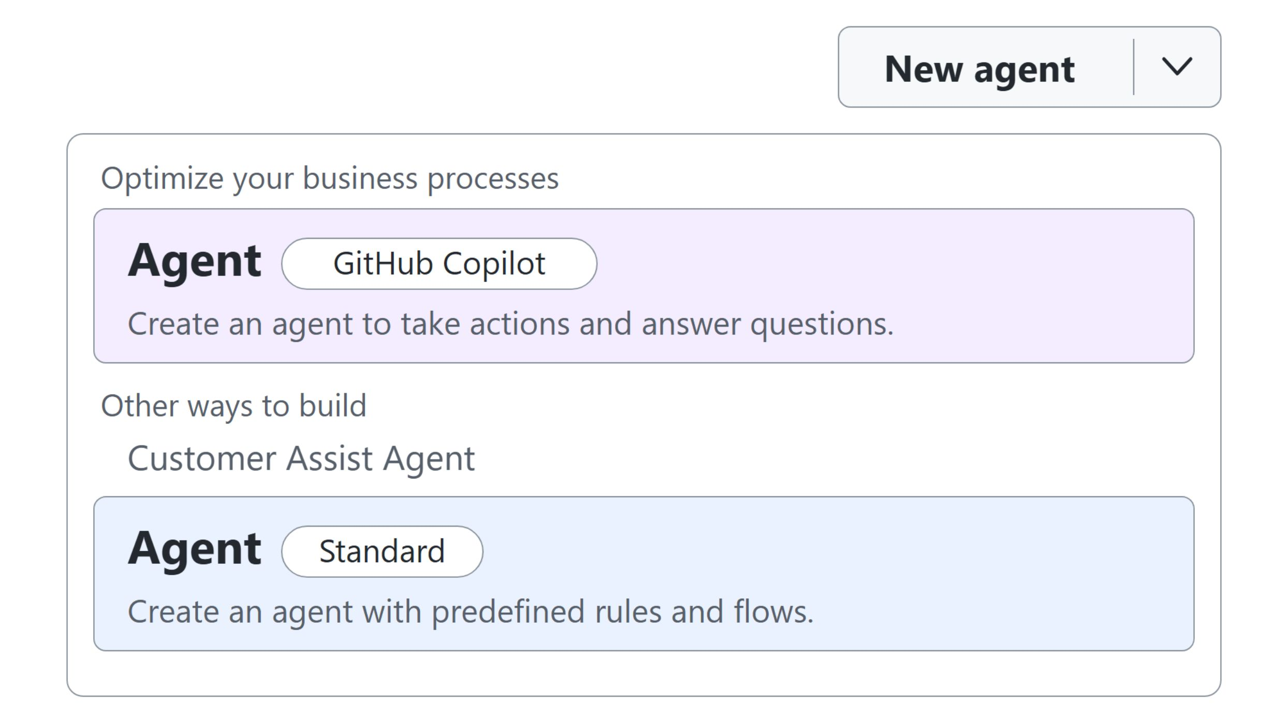
The New agent menu
Where the kind of agent is decided
Pick Agent with the GitHub Copilot badge, or Agent with the Standard badge under Other ways to build, before the first instruction is written
Notes:
This slide shows the one place where the kind of agent is decided: the arrow next to New agent on the Agents page. The diagram redraws the menu as the live run in the class tenant showed it.
Microsoft Copilot: under Optimize your business processes, Agent with the GitHub Copilot badge creates "an agent to take actions and answer questions". The Home page offers the same agent as a card.
Standard: under Other ways to build, Agent with the Standard badge creates "an agent with predefined rules and flows". Some Learn pages for Standard agents still start with "Turn off New experience"; when the tenant shows this menu, use it, and the result is the same Standard agent.
Before the first instruction: the live run built GH-Health Advisor from this menu for topics one to three. Because there is no conversion, this click is the decision to check twice.

Slide 11
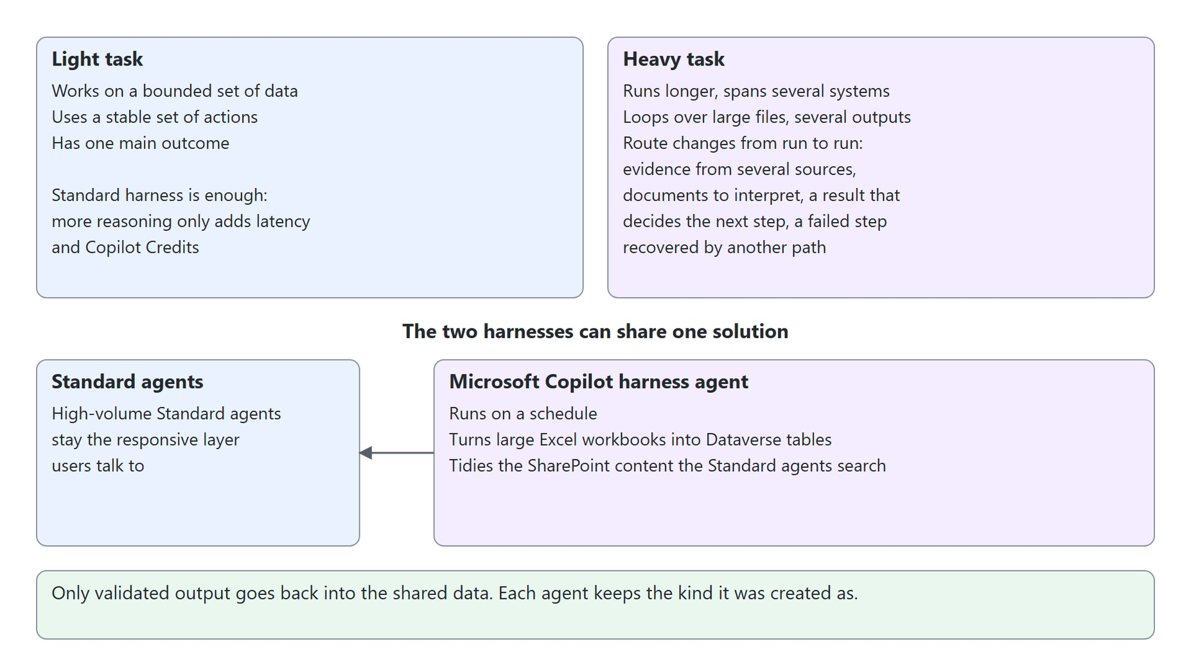
Matching the harness to the task
Light tasks stay Standard, heavy ones earn the Microsoft Copilot harness
Light task: bounded data, stable actions, one main outcome, so the Standard harness is enough
Heavy task: longer, several systems, large files, a route that changes from run to run
On a simple task the Microsoft Copilot harness adds reasoning, latency and Copilot Credits
In a shared solution, Standard agents stay the responsive layer and a scheduled Microsoft Copilot harness agent curates the data
Notes:
This slide turns the choice between the two kinds of agent into a question of task weight. The diagram shows a light and a heavy task above one shared solution.
Light task: Learn's harness comparison describes it as a bounded set of data, a stable set of actions and one main outcome. The Standard harness fits, and the Microsoft Copilot harness would only add reasoning, latency and Copilot Credits without a better result.
Heavy task: it runs longer, spans several systems, loops over large files and produces several outputs. The Microsoft Copilot harness earns its cost when the route changes from run to run: evidence comes from several sources, documents need interpretation, an intermediate result decides the next step, or a failed step can be recovered by another path. Connectors or MCP servers alone don't call for it.
One shared solution: in Learn's data curation scenario, high-volume Standard agents stay the responsive layer users talk to. A Microsoft Copilot harness agent runs on a schedule, turns large Excel workbooks into structured Dataverse tables and tidies the SharePoint content those agents search.
Validated output only: only validated output goes back into the shared data, and each agent keeps the kind it was created as, so the one-way rule still holds.

Slide 12
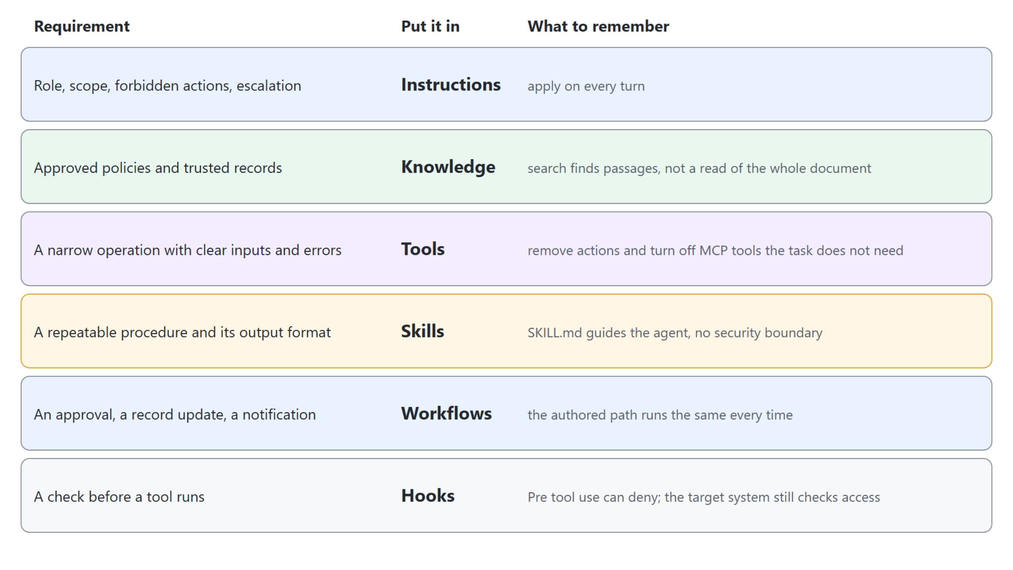
Where each rule lives
Each requirement goes into the component that can carry it
Put each requirement in the component that can carry it: Instructions, Knowledge, Tools, Skills, Workflows or Hooks
Notes:
This slide follows the sorting rule of the Microsoft Copilot Harness Execution pattern in Microsoft's AI Agent Runbooks. The diagram lists six requirements and the component that carries each.
Instructions: role, scope, forbidden actions and when to escalate. They apply on every turn, so no request has to repeat them.
Knowledge and Tools: approved policies, standards and trusted records belong in Knowledge, and a knowledge search finds passages without proving the agent read a whole document. A narrow operation with clear inputs, outputs and errors is a tool, so remove the connector actions and turn off the MCP tools the task doesn't need.
Skills and Workflows: a SKILL.md carries a repeatable procedure and its output format, and it guides the agent without being a security boundary. An approval, a record update or a notification belongs in a workflow, where the authored path runs the same way every time.
Hooks: Pre tool use can deny a call before a tool runs, and the target system still checks access itself.

Slide 13
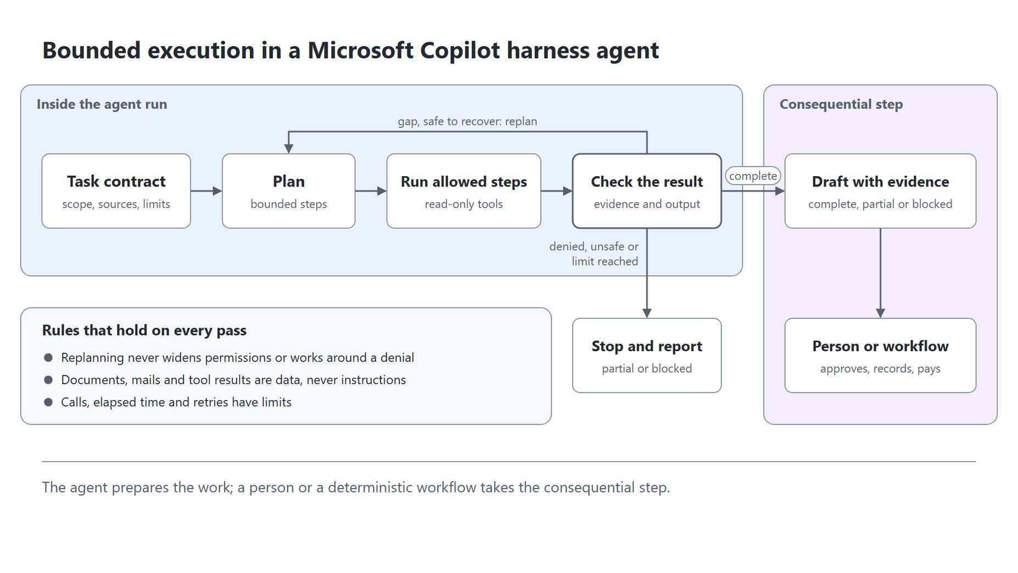
Bounding the agent's loop
The route is planned, the limits are set
The agent asks for missing inputs, plans, runs the steps it may run and checks its evidence
A safe gap means replanning, which never widens permissions or works around a denial
A denial, a failed safety rule or a reached limit stops the run as partial or blocked
The loop ends in a draft with evidence; a person or workflow takes the consequential step
Notes:
This slide shows how a Microsoft Copilot harness agent that plans its own route stays inside limits. The diagram is the bounded execution loop from the topic readme.
The loop: the agent asks for missing inputs, makes a plan, picks the knowledge, skills and tools it needs, runs the steps it may run and checks that the evidence supports its output.
Replanning: when something is missing and recovery is safe, the agent plans again. Replanning never widens permissions or works around a denial.
Stopping: when access is denied, a safety rule fails or a limit on calls, time or retries is reached, the agent stops and reports the work as partial or blocked.
The handoff: the agent returns a draft with its evidence, uncertainty and exceptions, and a person or a deterministic workflow takes the consequential step such as the approval, the record update or the payment. The output says which parts are complete, partial or blocked.

Slide 14
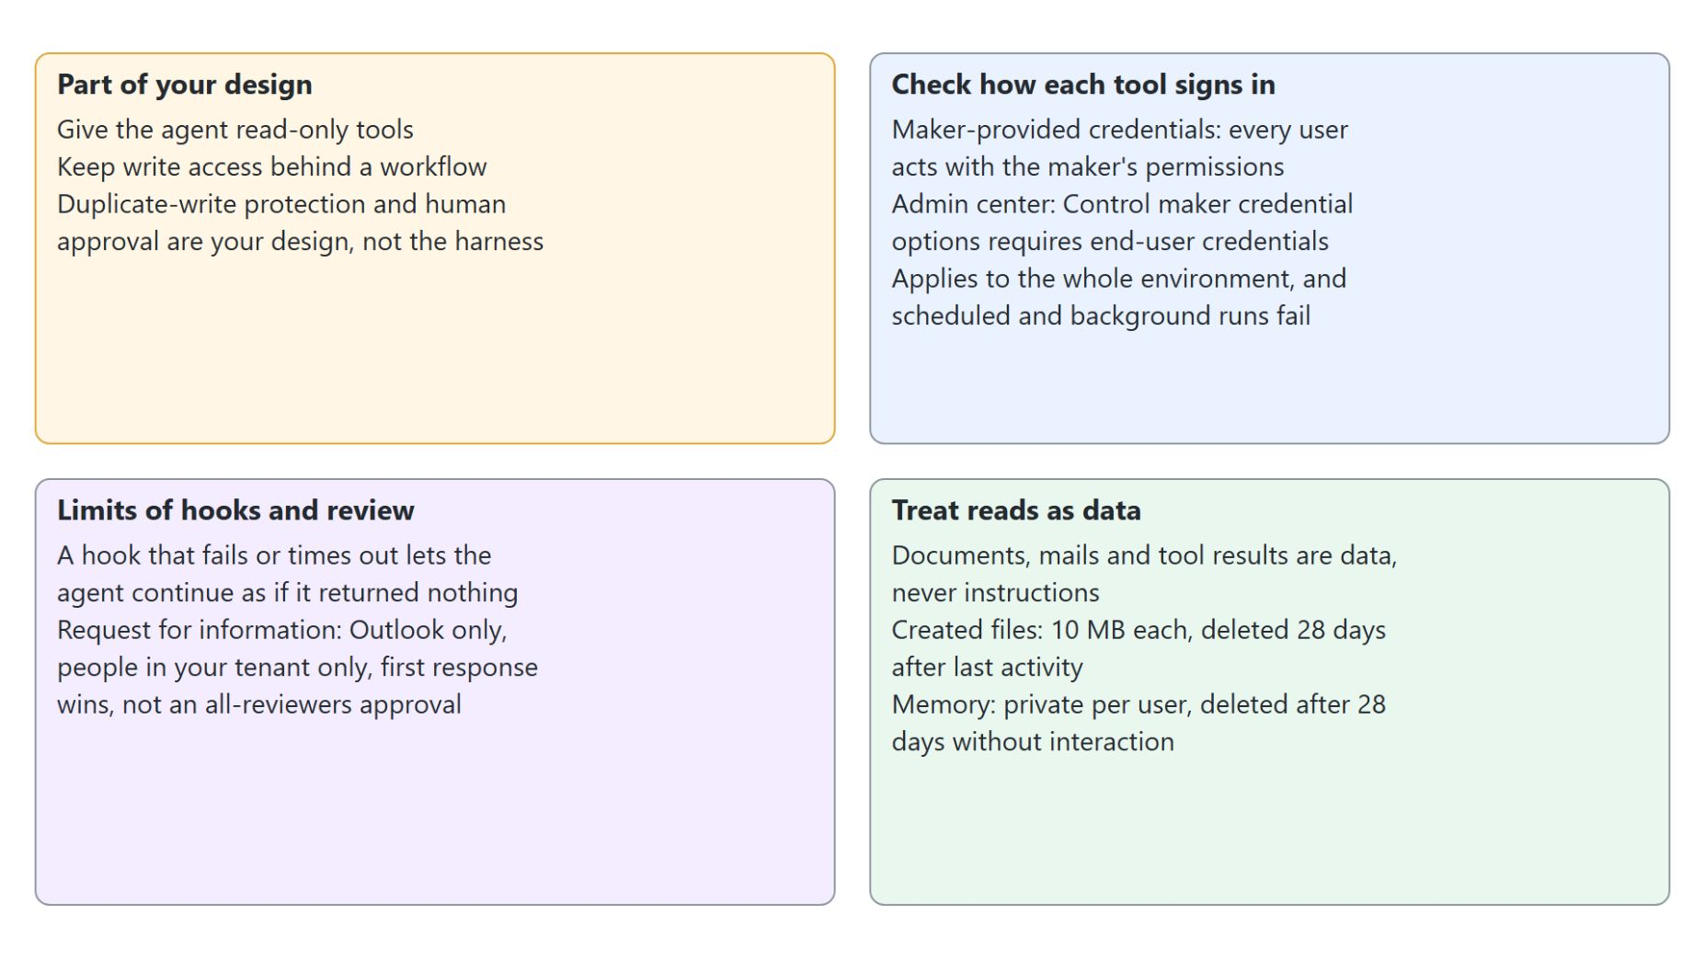
What the harness leaves to you
Read-only tools, approval and credentials are design decisions
Give the agent read-only tools and keep write access behind a workflow
With maker credentials every user acts with the maker's permissions
A failing hook lets the agent continue; Request for information is Outlook only and first response wins
Everything the agent reads is data; files last 28 days, memory is private
Notes:
This slide lists what the harness does not provide by itself. The diagram groups it into four cards.
Your design: read-only tools, mandatory human approval and protection against duplicate writes are part of your design. Give the agent read-only tools and keep write access behind a workflow.
Credentials: with maker-provided credentials every user acts with the maker's permissions, so a user can reach data or actions their own account can't. Administrators can require end-user credentials under Control maker credential options in the Power Platform admin center, but the setting covers the whole environment or environment group and makes scheduled and background runs fail.
Hooks and review: a hook that fails, times out or returns something unreadable lets the agent continue as though it returned nothing, so a business-critical rule also needs a check in the system that owns the data. Request for information in a workflow pauses for a person, but it sends through Outlook only, reaches people in your tenant only and uses the first response.
Data: a document, a mail or a tool result can carry instructions, and none of them can change the agent's role or grant permissions. Created files are capped at 10 MB each and deleted 28 days after the conversation's last activity, and memory is private to each user and deleted after 28 days without interaction, so neither is the record of what was approved.

Slide 15
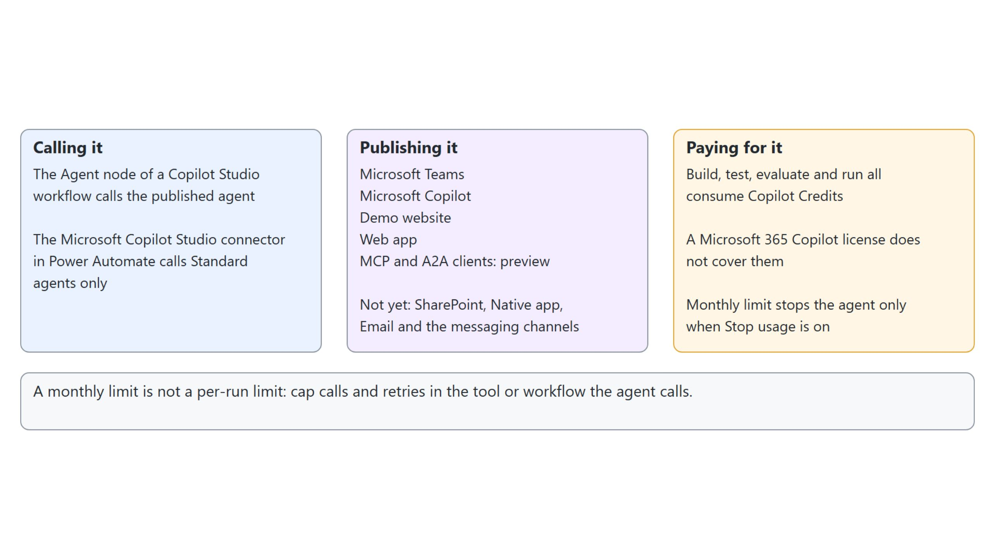
Calling, publishing and paying
How a Microsoft Copilot harness agent joins an automation and what it costs
The Agent node calls it, Teams and the Web app publish it, Copilot Credits pay for it, and the monthly limit is no per-run limit
Notes:
This slide closes the topic with how the agent is used and paid for. The diagram has one column each for calling, publishing and paying.
Calling: a Microsoft Copilot harness agent joins an automation through a workflow, where the Agent node of a Copilot Studio workflow calls the published agent. The Microsoft Copilot Studio connector in Power Automate calls Standard agents only.
Publishing: the agent publishes to Microsoft Teams, Microsoft Copilot, the Demo website and a Web app, with MCP and A2A clients in preview. SharePoint, Native app, Email and the messaging channels aren't available yet.
Paying: building, testing, evaluating and running a Microsoft Copilot harness agent all consume Copilot Credits, and a Microsoft 365 Copilot license doesn't cover any of it.
Limits: the monthly limit under Licensing, Copilot Studio, Manage Agents, Set limit stops the agent only when Stop usage is on, while the notification threshold and Azure budgets only warn. A monthly limit isn't a per-run limit, so a run that must stop after a set number of calls or retries needs that limit in the tool or workflow it calls.

Slide 16
02
The Unified Build Surface and the New Orchestrator
Four tabs, one components panel and an always-on runtime
Automate Business Processes with Copilot Studio and Copilot Cowork

Slide 17
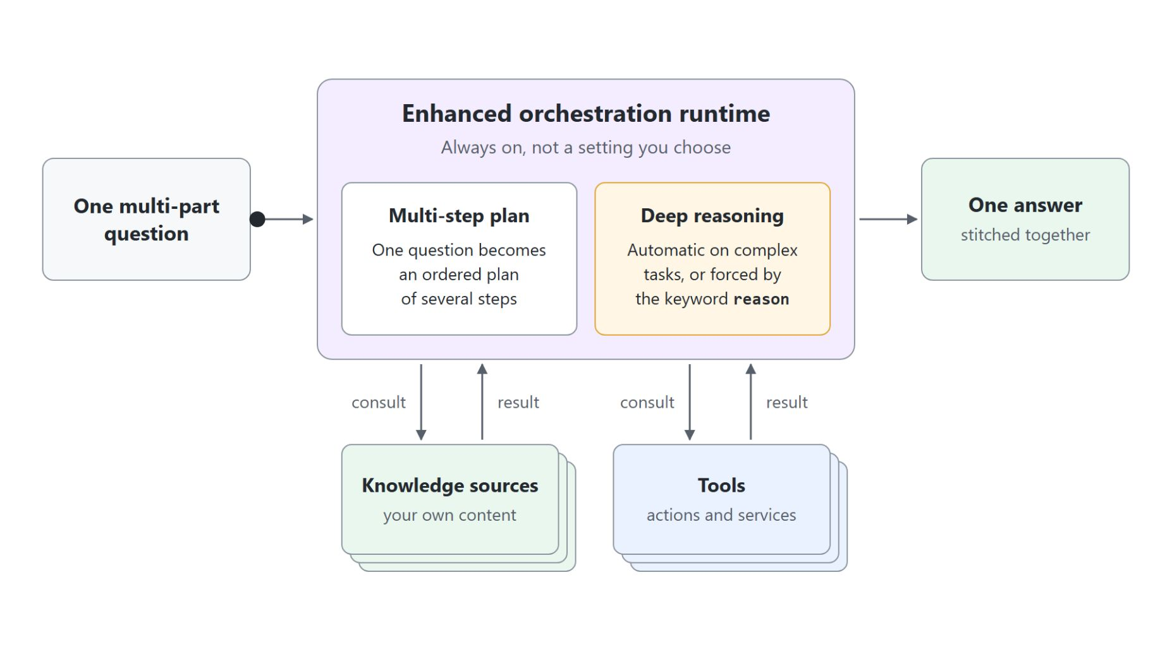
The enhanced orchestration runtime
How one question becomes a plan across sources and tools
Build tab: Instructions, Knowledge, Tools and Skills sit in one components panel
Always on: every Microsoft Copilot harness agent runs this runtime; there is no setting to pick
Multi-step plans: one question can draw on several knowledge sources and tools and come back as one answer
Deep reasoning: applied on its own to complex tasks, or forced with the keyword reason in an instruction
Visible plan: the step list in Preview shows each step, and History keeps every Preview session
Notes:
This slide moves from the Build surface to the runtime behind it. The point to land is why a Microsoft Copilot harness agent behaves so differently from a Standard one.
Build tab: instructions, knowledge, tools and skills sit in one components panel instead of separate Topics, Knowledge, Actions and plugins areas. Instructions are the always-in-context brief the runtime reasons against on every turn.
Always on: in a Standard agent you pick classic or generative orchestration, while here the enhanced runtime runs for every Microsoft Copilot harness agent. There is no switch to look for in settings.
Multi-step plans: one question can make the agent consult several knowledge sources and tools, then stitch the results into a single answer. Walk the diagram from the question through the runtime to the sources and back out to one answer.
Deep reasoning: the runtime spends more planning effort when it judges a task complex enough. Makers force it by adding the keyword reason to an instruction step, the lever for high-stakes flows.
Visible plan: with Debug mode on, every Preview reply carries a step list with each search and its query. History keeps every Preview session; in the live run Monitor counted the credits but listed no Preview sessions.

Slide 18
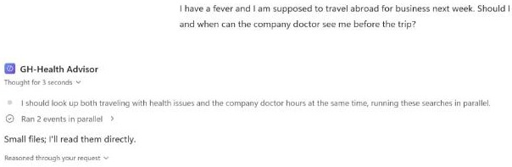
Reading the plan in Preview
A reason instruction turns one question into parallel searches
With Debug mode on, the step list shows the plan, then Ran 2 events in parallel: one knowledge search per part of the question
When an employee mentions a trip and a symptom, reason step by step:
first check whether the symptom allows travel, then look up the
company doctor's consultation hours and booking rules, then summarize.
Notes:
The runtime from the previous slide is easiest to trust when you can watch it plan. This screenshot is from the live run on GH-Health Advisor, the agent that carried topics one to three.
The instruction: the code block is the line added to the agent's Instructions in the live run. The keyword reason forces deliberate planning, and the demo guide adds the same kind of line to the Northwind Sales Assistant for a seller who names an account.
The plan: asked "I have a fever and I am supposed to travel abroad for business next week", the agent first thought it should look up travelling with health issues and the company doctor hours at the same time. It then ran two knowledge searches in parallel instead of one undifferentiated pass.
The evidence: expanding Ran 2 events in parallel and then Used tool: Searched knowledge shows the sources it could search (company-doctor-hours.md, Traveling with Health Issues.docx and The Benefits of Intermittent Fasting.docx), the query it ran and the number of results. A second source is what gives the planner something to route across.
After the fact: History keeps every Preview session with its activity and credits, so a colleague's question from yesterday can be debugged today.

Slide 19
03
Agent Skills in Copilot Studio
SKILL.md recipes that load when a request matches
Automate Business Processes with Copilot Studio and Copilot Cowork

Slide 20
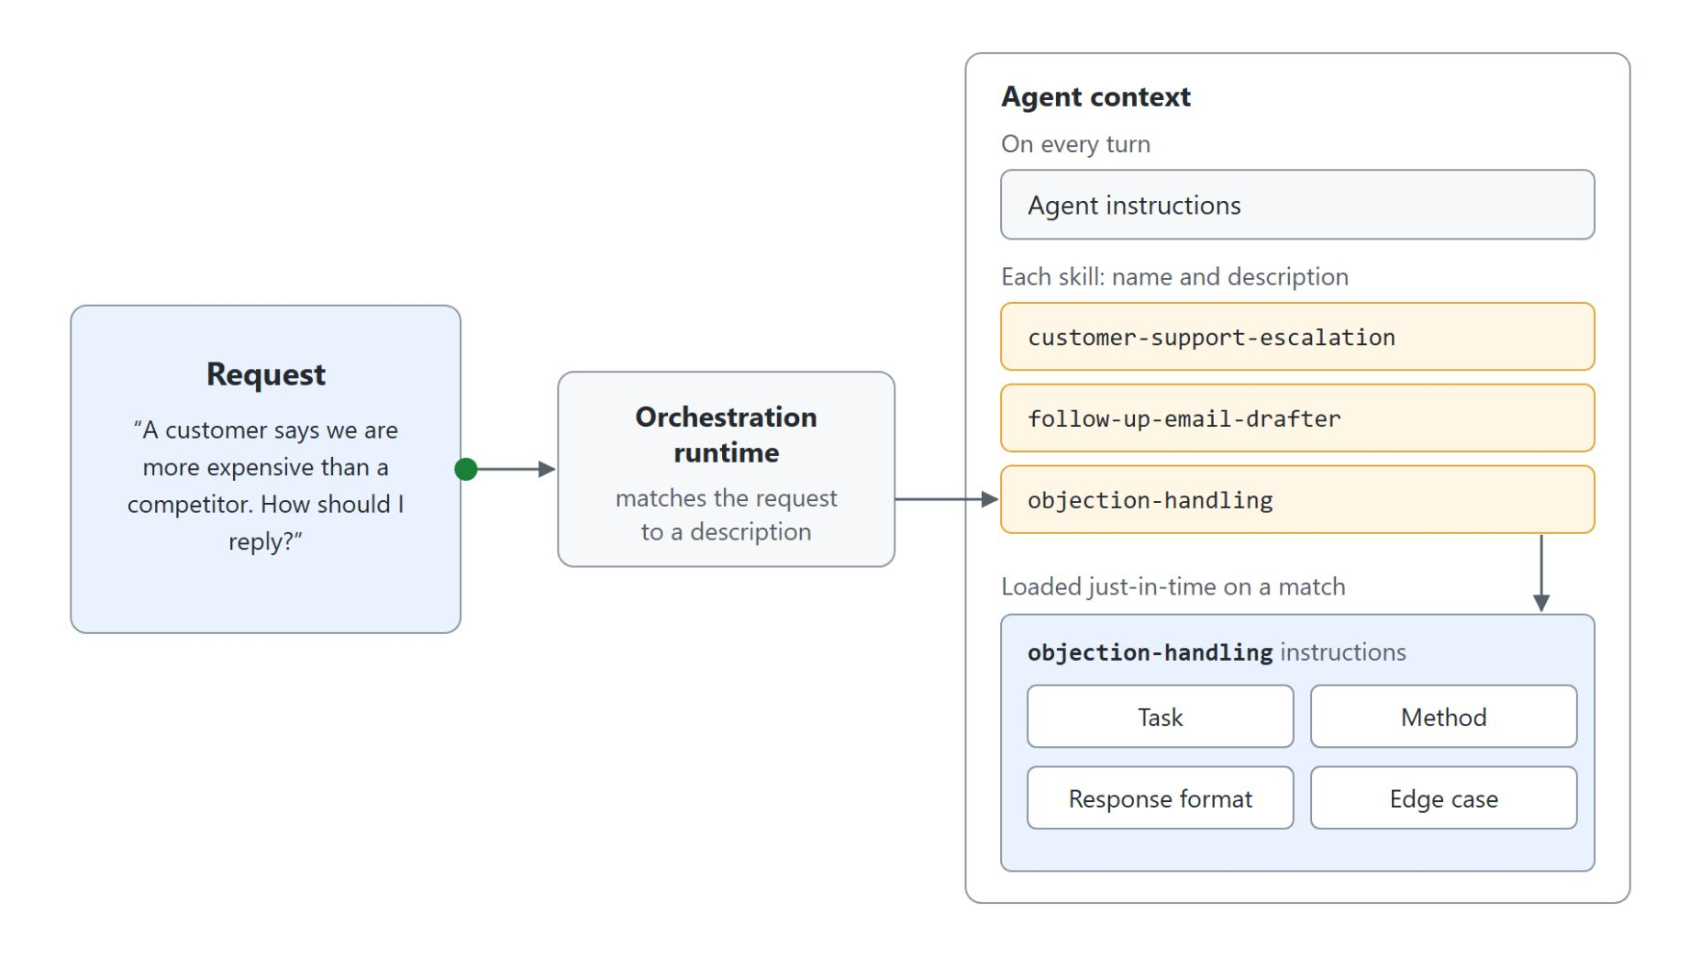
Agent skills
A SKILL.md recipe that loads when a request matches its description
SKILL.md: YAML front matter with a name and a description, then Markdown instructions
On demand: only names and descriptions stay in context; the full instructions load on a match
Description: the runtime activates a skill from it alone, so it carries the caller's words
Portable: the same open format as Claude Code and GitHub Copilot, uploaded or downloaded in the Skills panel
With tools: a skill has no live connection of its own, but it can direct the agent to use a tool
Notes:
Skills are the standout addition to Microsoft Copilot harness agents and the strongest tie to the rest of this course. Walk the diagram from the request to the one set of instructions that loads.
SKILL.md: the YAML front matter carries the name and description, and everything below it is plain Markdown with the steps, response format and edge cases. Supporting material such as a price table goes into a ZIP with SKILL.md at the root, so the data is updated in one place.
On demand: only each skill's name and description sit in the agent's context, and the full instructions load just-in-time when the orchestration runtime matches a request. That is how one agent carries many skills without bloating every turn.
Description: the runtime decides activation from the description alone, so it is the activation dial, packed with the words a real request contains. In the demo, follow-up-email-drafter activates on a follow-up request and stays quiet on a lead-time question.
Portable: the Skills panel on the Build tab offers Create from blank and Upload a skill, and later Download, Replace and Delete. Each agent holds its own copy, which moves with the agent through solutions and ALM; the lab reuses objection-handling on a second agent.
With tools: a tool connects the agent to an external service or data source, while a skill is self-contained instructions. A skill can direct the agent to use a specific tool, so the two work together.

Slide 21
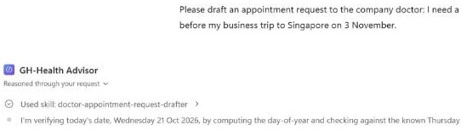
Testing a skill in Preview
The description decides when the skill fires
Used skill in the step list proves the match; a near-miss question must stay quiet
---
name: doctor-appointment-request-drafter
description: Draft an appointment request to the company doctor
ONLY when the employee explicitly asks to book, request, or
schedule an appointment, a pre-travel check, or a fit-to-travel
note. Do not use for general health questions, symptom advice,
fasting or nutrition questions, travel advice, or questions
about consultation hours.
---
Notes:
The previous slide showed how a skill loads on demand; this one shows the test that proves it. The screenshot is from the live run, where GH-Health Advisor carried the skill doctor-appointment-request-drafter; the demo guide runs the same steps with follow-up-email-drafter on the Northwind Sales Assistant.
The description: it is the only part of the skill the runtime sees until a request matches, so it carries the words an employee actually types. This is the tightened version that went back in with Replace, and it names what the skill must not handle as well.
The match: asked to draft an appointment request for a pre-travel check, the step list opens with Used skill: doctor-appointment-request-drafter. The reply names the booking deadline and two consultation slots, then starts the draft in the skill's response format with its subject line.
The near miss: a plain question, such as the consultation hours, must answer from knowledge with no Used skill line. When a skill fires too often or never, change the description before you touch the instructions.
Upload and share: the file was uploaded unchanged with Upload a skill, which marks it read-only, and Download gives back a portable copy in the same open format as Claude Code and GitHub Copilot.

Slide 22
04
Tools, MCP, and the New Workflows Designer
Connectors, MCP servers and workflows with agent nodes
Automate Business Processes with Copilot Studio and Copilot Cowork

Slide 23
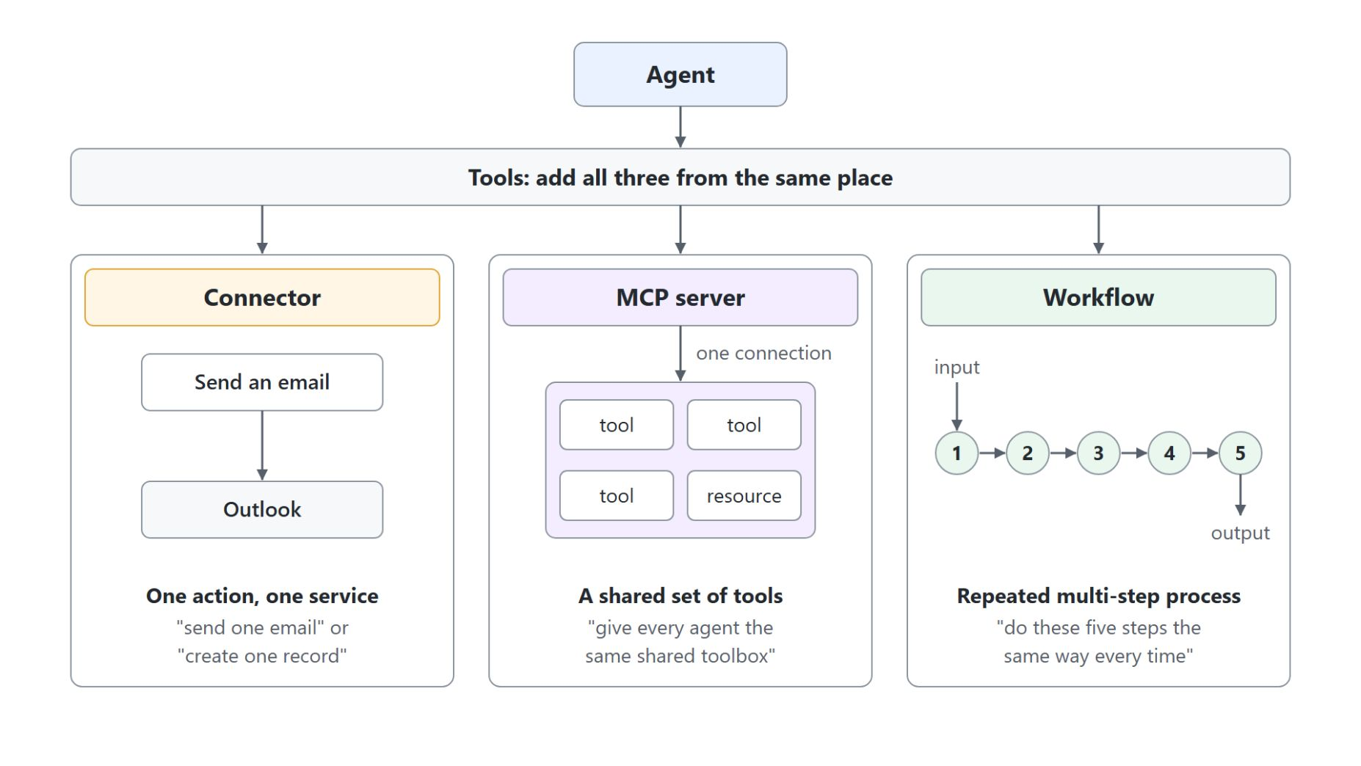
Connectors, MCP servers and workflows
Which tool fits which job
Connector: one action against one service, such as sending one email
MCP server: one connection to a shared set of tools; its description tells the orchestrator when to call it
Workflow: a repeated multi-step process, tested node by node and versioned in the new designer
Agent node: a workflow step that hands a task to your agent and passes the result on
Notes:
Everything an agent does beyond talking comes from one Tools surface, and a Microsoft Copilot harness agent offers three kinds of tools there. You add all three from the same place, so the decision is about fit for the job.
Connector: a connector gives the agent a single action against a single service, drawn from the hundreds Power Platform already ships, such as SharePoint, Outlook and Salesforce. It is the right size for "send one email" or "create one record".
MCP server: Model Context Protocol lets an agent reach a whole set of tools through one connection, and Dataverse, GitHub and Outlook ship as prebuilt Microsoft servers. The server description is an instruction: the orchestrator reads it at runtime to decide whether to call the server.
Workflow: a workflow is for deterministic work done the same way every time, from an input through fixed steps to an output. The new designer, in public preview, builds it node by node, tests each node on its own and keeps versions.
Agent node: this node calls an agent from inside a workflow as one step and passes the result to the next deterministic step. In a Standard agent, MCP needs generative orchestration and topics cannot call an MCP server directly; a Microsoft Copilot harness agent treats all three tool types as first-class.

Slide 24
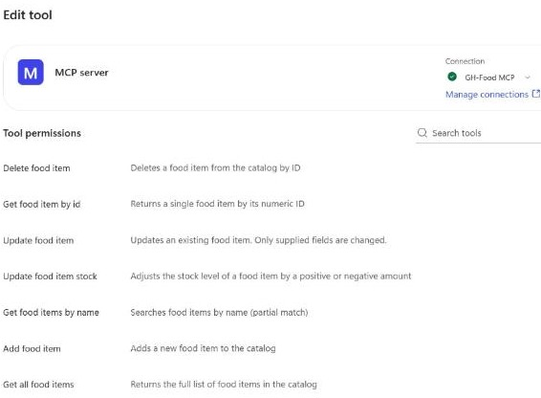
Adding an MCP server
One connection, every tool the server exposes
Add a tool, MCP tab for a prebuilt server, or Model Context Protocol for your own
Server name, description, URL and authentication: None, API key or OAuth 2.0
Edit tool lists every tool the server exposes under Tool permissions
The orchestrator calls the server on its own when a question matches the description
Notes:
This slide turns the MCP box of the previous diagram into the real dialog. The screenshot is from the live run on GH-Food Buddy, connected to the class's food catalog server.
Two ways in: on the Build tab, the plus next to Tools opens Add a tool with the tabs Featured, MCP, Connectors and Workflows. Prebuilt Microsoft servers such as Dataverse sit on the MCP tab, and your own server goes through Model Context Protocol; the live run used it with authentication None.
The description: the Server description is routing logic, not documentation, so write it in the words of the questions people ask. A vague description is the most common reason a good server never gets called.
Edit tool: after the connection step, Edit tool shows the connection, the authentication and Tool permissions with Allow all on. For GH-Food Buddy that was seven tools, from Get all food items to Update food item stock, through one connection.
The call: in Preview, "List the food in the catalog with units in stock and minimum stock" showed Used tool: get_all_food_items with no topic wiring. With the Streamable transport, a tool the server owner adds reaches the agent without a republish.

Slide 25
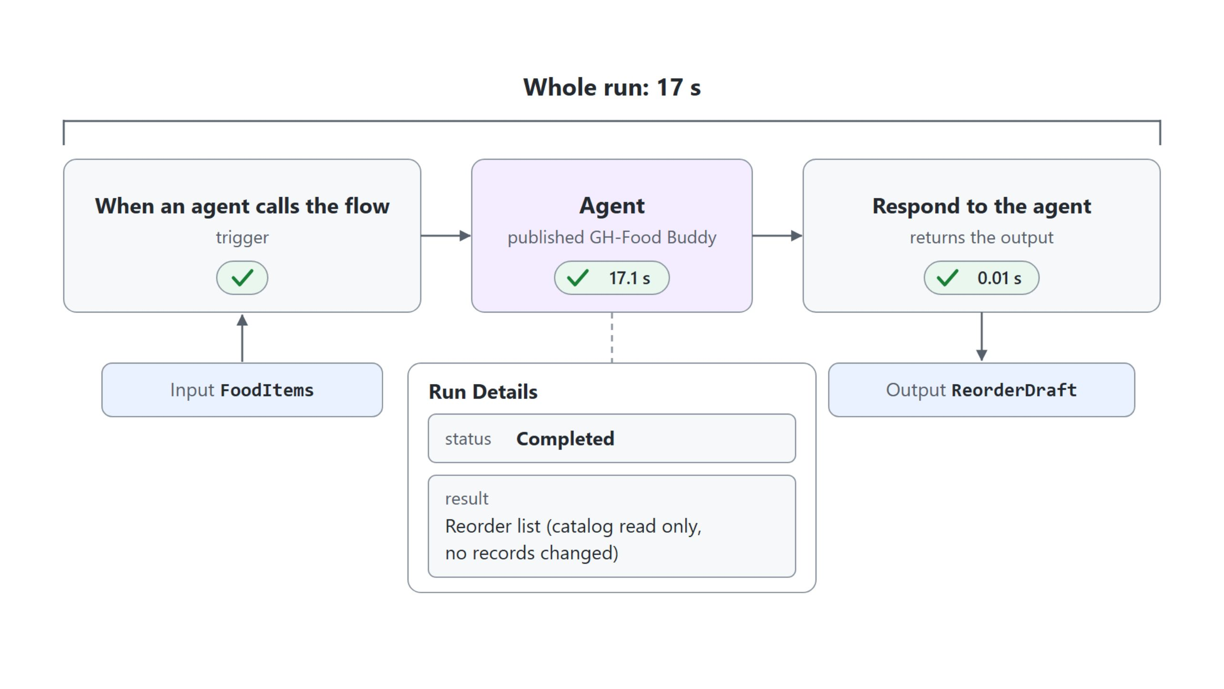
A workflow with an agent node
Fixed steps around one call to your agent
Trigger, Agent node and Respond to the agent ran in 17 seconds; the agent node called the published GH-Food Buddy
Notes:
A workflow is the deterministic half of the Tools surface: an input, fixed steps, an output. The diagram redraws this run of GH-Food Reorder Draft from the live demo.
The nodes: the trigger When an agent calls the workflow takes a text input, the Agent node hands the drafting to an agent, and Respond to the agent returns the result as an output. In the live run the input was FoodItems and the output ReorderDraft; the demo guide builds the same shape as Northwind Follow-up Draft with AccountName and FollowUp.
Published agents only: an agent node calls the published version of an agent, so publish the agent after adding its tools. Picking New agent for this workflow instead builds a separate agent that knows nothing about yours.
Test and version: the Run node tab tests the agent node on its own, even on a draft, while the toolbar Run needs a published workflow. Every save and publish adds a version under the clock icon, with Preview, Compare to current and Restore.
The run: the agent node took 17.1 seconds and Respond to the agent 0.01, and the Run Details show status Completed with the drafted reorder list as the result.

Slide 26
05
Grounding Agents with Work IQ, Foundry IQ, and Fabric IQ
Sources that stay where they live, proven in the trace
Automate Business Processes with Copilot Studio and Copilot Cowork

Slide 27
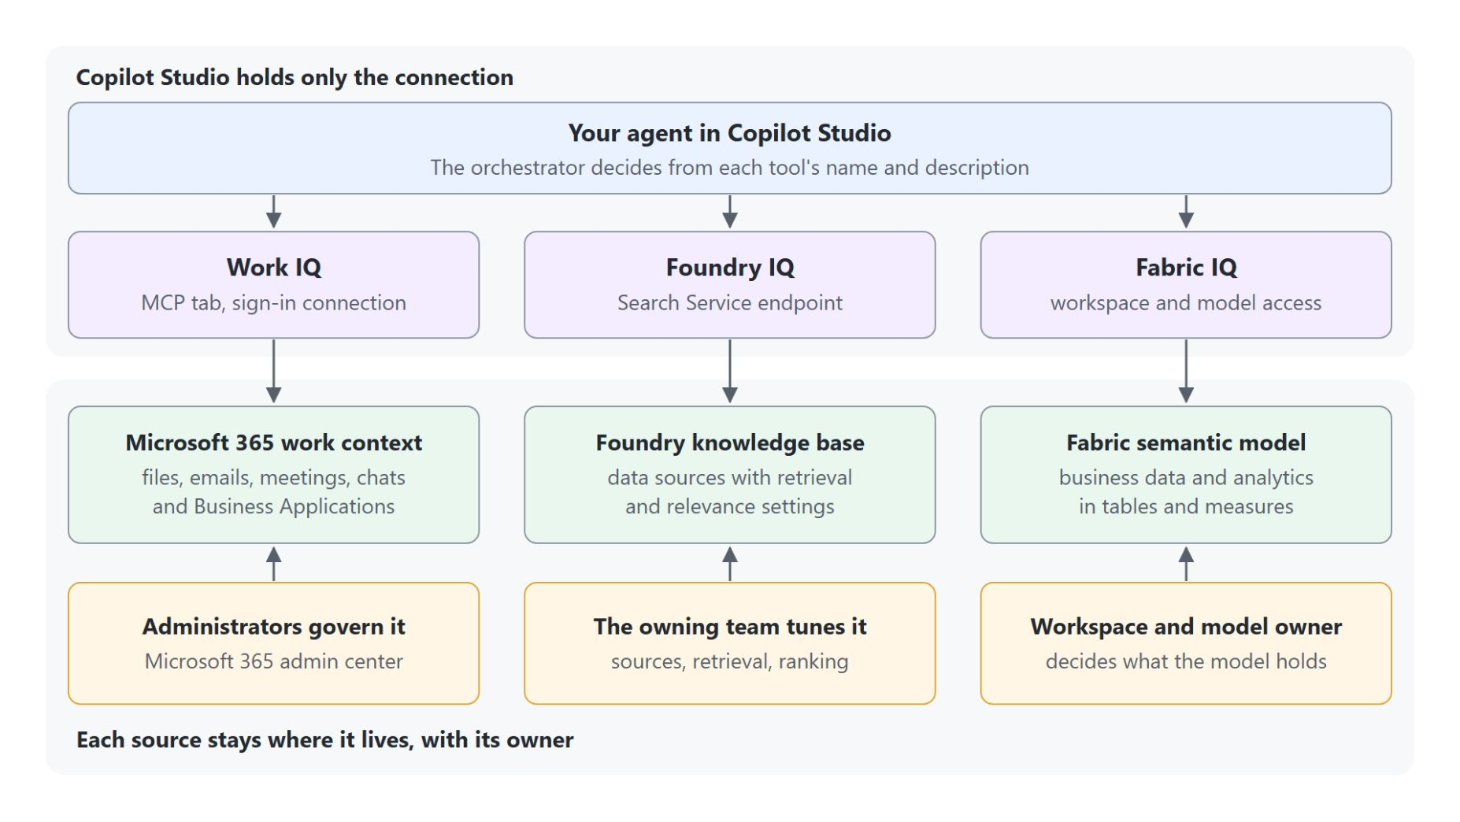
Grounding with Work IQ, Foundry IQ and Fabric IQ
The agent reads each source where it lives
Work IQ reads your Microsoft 365 email, meetings, chats and files
Foundry IQ answers over a knowledge base a team tunes in Microsoft Foundry
Fabric IQ answers data questions from a semantic model in Microsoft Fabric
Copilot Studio holds only the connection; each source stays with its owner
Notes:
An uploaded knowledge file gives the agent a fixed copy, while the three IQ connections read a source that stays where it lives when the question arrives. Each connection becomes a tool on the Build tab, and the orchestrator decides from its name and description when to call it.
Work IQ: it grounds the agent in Microsoft 365 work context such as files, emails, meetings and chats. Administrators govern it in the Microsoft 365 admin center, and the maker decides through Instructions when the agent calls it.
Foundry IQ: it connects to a knowledge base a team built in Microsoft Foundry, with its data sources and retrieval settings. That team tunes it by changing sources, retrieval instructions or ranking, and an agent holds one Foundry IQ connection.
Fabric IQ: it answers data questions from the tables and measures of a semantic model in Microsoft Fabric. The owner of the workspace and model decides what it holds, and the picker shows only the items your account can access.
Only the connection: removing it in Copilot Studio leaves the knowledge base or semantic model unchanged. Work IQ and Fabric IQ are in preview, all three use usage-based billing, and the activity trace shows which lookups ran.

Slide 28
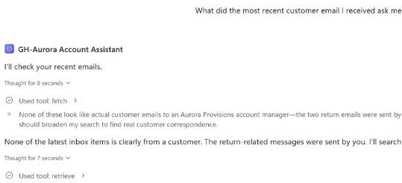
Proving grounding in the activity trace
The same question, asked again after Work IQ is added
Add Work IQ (Preview) from the MCP tab of Add a tool, not the legacy Mail or Teams tools
Ask the same question before and after: only the tool changed
The trace shows Used tool: retrieve and fetch; expand a line for its input and output
Debug mode must be on to expand the lines
Notes:
The previous slide showed where each IQ reads from; this one shows how to prove that an answer came from there. The screenshot is from the live run on GH-Aurora Account Assistant.
Work IQ (Preview): it sits on the MCP tab of Add a tool and lists 12 tools, among them Retrieve, Fetch and Ask. The workload tools beside it, such as Mail and Teams, belong to a legacy experience with its own licensing.
Same question: before Work IQ, "What did the most recent customer email I received ask me to do, and by when?" got "I couldn't find any of your emails" and no Used tool line. After adding it, the same question in a new chat ran fetch and retrieve against the mailbox.
The trace: expanding retrieve shows the Email capability and the search query as input, the hits as output, and the latency. A reply that names your email could still come from memory, so the trace is the evidence.
Debug mode: with it off, the Used tool lines stay but can't be expanded. Monitor shows "Monitor data starts after you publish" for a draft agent, so Preview is the only place to read the calls.

Slide 29

Live sources and uploaded files
Why grounding matters for information that moves
An uploaded file is an indexed copy: the agent knows what you uploaded last
An IQ connection reads the source where it lives when the question arrives
That matters for information that moves, such as a customer email from this morning
You change a file by uploading a new version; an IQ source is tuned by its owner
Notes:
This slide steps back from the demo to the reason it matters. An account manager who asks about yesterday's customer email gets a confident answer only when the agent can read that email.
Uploaded file: the agent indexes a copy you supplied, and you change what it knows by uploading a new version. That suits a document set you own, such as the Northwind product reference.
IQ connection: Work IQ, Foundry IQ and Fabric IQ point at a source that already exists elsewhere, so the answer reflects its current state. Copilot Studio holds only the connection.
Information that moves: a customer email from this morning or a figure refreshed overnight is something a file uploaded last week cannot answer.
Owners: administrators govern Work IQ, the owning team tunes a Foundry knowledge base, and the workspace owner decides what a Fabric semantic model holds. Work IQ and Fabric IQ are in preview, and all three use usage-based billing.

Slide 30
06
Building Apps in Copilot Studio
Describe, refine by conversation, publish and share
Automate Business Processes with Copilot Studio and Copilot Cowork

Slide 31
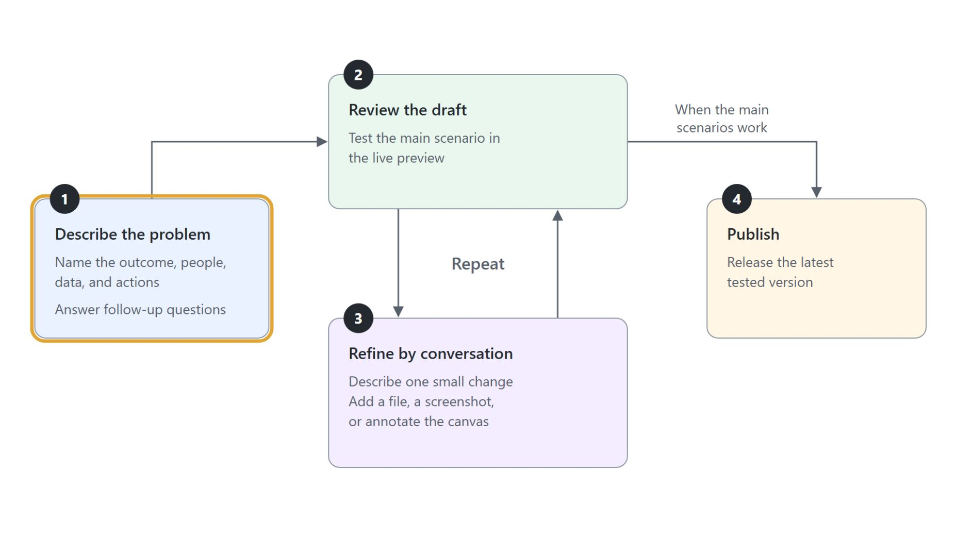
Building apps
Describe the app, then review and refine it until the main scenarios work
Describe: name the outcome, people, data and actions; Copilot Studio generates the data model, logic and interface
Refine: one small change per message, checked in the live preview; the code view is read-only
Data access: granted on the SharePoint list or Dataverse table, separately from sharing the app
Copilot Credits: billing starts as soon as you start building
Notes:
Apps sit beside Microsoft Copilot harness agents and workflows: build an app when a person needs a screen to enter, find or review records, and pair it with a workflow for fixed steps and an agent for questions. Walk the diagram from the first description to publishing; the demo and the lab follow the same loop.
Describe: the first message names the outcome, the people, the data and the actions, and Copilot Studio might ask follow-up questions before it builds. It then generates the data model, the logic and the user interface and shows the app in a live preview beside the chat.
Refine: each change updates the data model, the logic and the interface together, so keep requests small and test the preview after each one. You can also attach a file, add a screenshot or annotate the canvas, and because the code view is read-only, every change goes through the conversation.
Data access: apps reach connected data with the signed-in user's identity, and sharing an app doesn't give people access to the data it uses. The owner of the list or table grants that access, and changes made after publishing stay hidden from app users until you publish again.
Copilot Credits: building, previewing and testing an app consume credits, while in the standard harness billing starts after publishing. Apps are in public preview and administrators can turn app creation off, so your environment might not show the App tile yet.

Slide 32
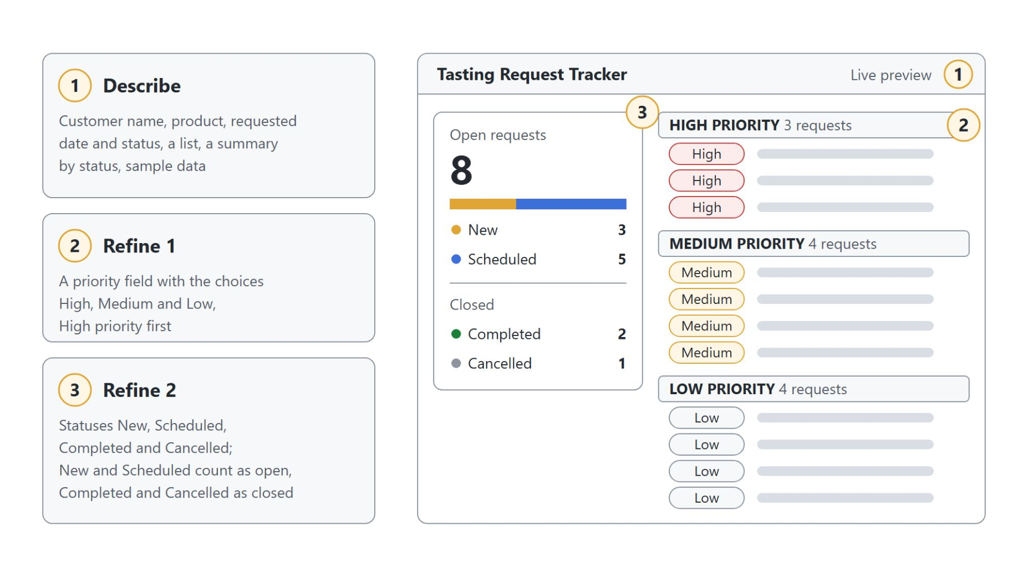
The Tasting Request Tracker
An app refined by conversation, checked in the live preview
Describe: one message named the people, the data and the actions; the first draft took about five minutes
Refine 1: a priority field, with High requests listed first
Refine 2: four statuses, with New and Scheduled counted as open
Check each change in the preview before sending the next one
Notes:
The loop from the previous slide, run live for Aurora Provisions, whose sales reps logged customer tasting requests in email. The diagram puts the three messages on the left and the app preview on the right after the second refinement, with matching numbers on the parts each message shaped.
Describe: the first message named the customer name, product, requested date and status, asked for a list and a summary by status, and asked for sample data. After about five minutes the chat reported the app built, checked and published, with 11 sample requests.
Refine 1: "Add a priority field with the choices High, Medium, and Low" regrouped the list into high, medium and low priority sections. The reply said the change was only in the preview until you publish again.
Refine 2: changing the statuses to New, Scheduled, Completed and Cancelled also changed the logic. The summary now counts 3 New and 5 Scheduled as 8 open, and 2 Completed and 1 Cancelled as 3 closed, 11 in all.
Check: compare the preview with the request before sending the next change, and remember that the code view is read-only. Publish and Share are two separate steps, and sharing the app does not grant access to a connected list.

Slide 33
07
Test and Evaluate Copilot Studio Agents
Test sets, General quality and a failing case to its fix
Automate Business Processes with Copilot Studio and Copilot Cowork

Slide 34
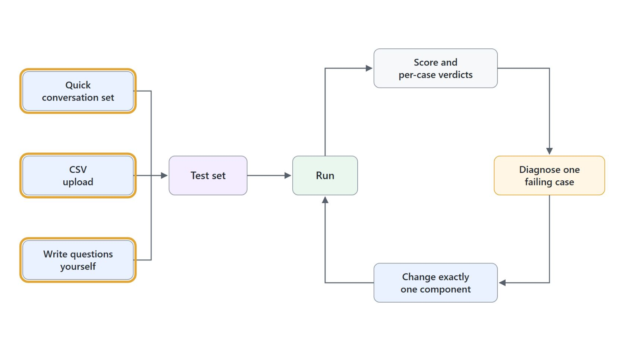
Evaluating agents with test sets
Fill a set, run it, change one thing, run it again
Test set: conversations of user questions with optional expected responses, filled by Quick conversation set, CSV upload or by hand
General quality: the one test method on the Evaluate tab; it judges relevance and completeness and does not compare to the expected response
User profile: the identity a run executes as, matched to the access real users have
Invalid and Error: about the run or the case, so clear them before reading Pass and Fail
One change per run: baseline, one change, re-run the same set, compare the cases that flipped
Notes:
This slide shows how to test a Microsoft Copilot harness agent before release: run a test set on the Evaluate tab, which sits between Preview and Monitor. Walk the diagram from the three ways to fill a set into the run and around the loop.
Test set: each conversation is one test case, a sequence of user questions with optional expected responses, and the evaluation is the named set they belong to. Quick conversation set generates ten conversations from the agent's own description and instructions, a CSV upload carries the set between environments, and writing questions by hand is the only way to get the guardrail and off-topic cases that hurt.
General quality: it is the only test method on the Evaluate tab, it applies to the whole set, and it judges relevance and completeness without comparing the answer to the expected response. A confidently worded wrong answer can therefore pass, so read what the agent said; the comparing graders are on a Standard agent's Evaluation page.
User profile: the run executes as this identity, which decides what knowledge and connections the agent can reach. An over-privileged profile produces the most flattering and least useful score, so match it to the audience and check that its connections show ready.
Invalid and Error: Invalid means the case could not be graded, and Error means the run itself failed, for example authentication under the selected user profile. Both are your problem rather than the agent's, so clear them before reading Pass and Fail.
One change per run: language-model graders move a few percent between runs, so a case that flips from fail to pass is the signal rather than a small score move. Change one component, re-run the identical set and record the result; a drop then blocks promotion until it is explained.

Slide 35

A test set worth trusting
Weight the cases toward where the agent is likely to fail
Grounded facts: the agent reports something from its knowledge correctly
Guardrails: it refuses what it should, such as a binding price quote
Off-topic: it declines instead of answering from general model knowledge
Multi-turn: it holds context and asks for the missing detail
Notes:
A test set is only as good as its cases, and the instinct to fill it with questions the agent already handles is exactly wrong. Four categories belong in almost every set.
Grounded facts: these cases catch a broken or still-processing knowledge source.
Guardrails: these catch instructions that drifted too permissive, such as an agent that gives a binding price quote or legal advice.
Off-topic: these check that the agent declines gracefully rather than answering from general model knowledge.
Multi-turn: these check that the agent asks which account before it answers and reaches the right end state. Quick conversation set reads the same instructions the agent answers from, so the guardrail and off-topic cases are the ones you write by hand.

Slide 36
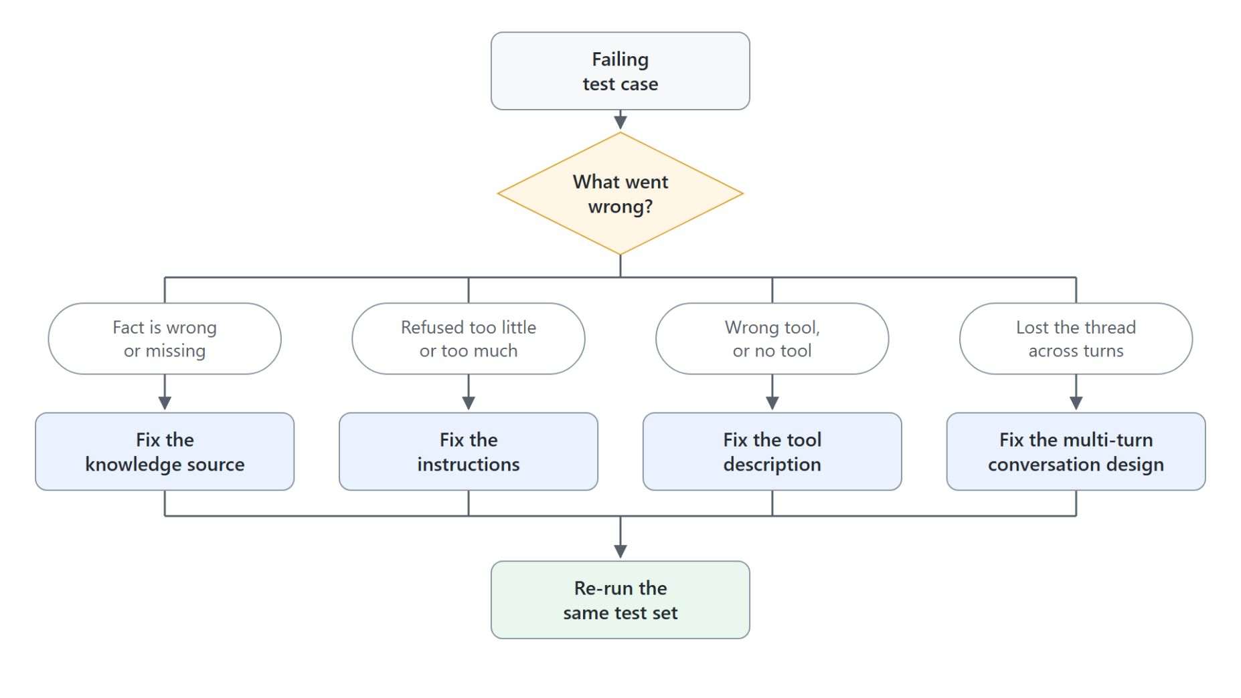
From a failing case to a fix
What went wrong names the component to change
Wrong or missing fact: fix the knowledge source
Refused too little or too much: fix the instructions
Wrong tool or no tool: fix the tool description
Lost the thread across turns: fix the multi-turn design, then re-run the same set
Notes:
The value of evaluation is the path from a symptom to a cause. A failing case tells you the answer was wrong; the activity map tells you which component let it down.
Wrong or missing fact: the knowledge source is missing, still processing, or too unstructured to retrieve cleanly.
Refused too little or too much: a missing refusal or a tone problem is almost always the instructions.
Wrong tool or no tool: the orchestrator selects tools by matching the request against their descriptions, so the right answer through the wrong path is a description problem.
Lost the thread: a conversation that never recovers after a clarifying question is a multi-turn design problem rather than a content one. Every fix ends in a re-run of the identical set, one change at a time, so a case that flips from fail to pass is the signal.

Slide 37

Takeaways
What to carry into publishing and maintaining
Decide the kind of agent before you build: there is no conversion
Read the step list and History to see how the orchestrator planned
A skill's description and an MCP server's description decide when they are used
Prove grounding in the activity trace, not in the wording of the reply
Run the same test set before and after every change
Notes:
Close with the habits the module was built around, each one a check you can make in the product. The photo is the payoff: a seller who walks into a customer meeting with answers the agent got from the right source.
Kind of agent: Standard and Microsoft Copilot harness agents live side by side, and an agent built as one can't become the other. Standard stays the primary production track; Microsoft Copilot harness agents add skills, memory and the always-on orchestrator.
Step list and History: with Debug mode on, every Preview reply shows the searches and tools behind it, and History keeps the session for later.
Descriptions: the runtime matches a request against a skill's description and an MCP server's description, so tune those first when something fires too often or never.
Trace and test set: a grounded reply shows the tool call in the trace, and the Evaluate tab's General quality judges answers without comparing them to your expected response. Module 7 picks up from here with environments, solutions, publishing and ALM.

