Slide 1

MASTER CLASS
Automate Business Processes with Copilot Studio and Copilot Cowork
4 Days
Automate Business Processes with Copilot Studio and Copilot Cowork

Slide 2


Fast Lane Group
Worldwide Education &
Professional Services
www.flane.de | © 2026 Fast Lane Institute for Knowledge Transfer GmbH
Notes:
Die Fast Lane Gruppe.
Fast Lane … Dienstleister u. Spezialist für High-End Technologie und Business Trainings
IT Trainings zu den unterschiedlichsten Herstellern wie Microsoft, Google, Cisco oder AWS. Und vielen weiteren wichtigen IT Herstellern.
Sei es Cloud, Security, Netzwerk oder allgemein digitale Transformationsprojekte
Und das seit 2003.
Das spannende ist, dass die Fast Lane Gruppe bereits seit 2009 durchgängig zu den Top 20 Unternehmen in der IT Trainingsbranche weltweit zählt.
Aber auch Footprint ebenso im klassischen Professional Services Bereich für unsere wichtigsten Hersteller
PreSales Support, Deployment Services und Adoption Trainings
Additional Information:
Im Jahr 2021 sind wir zur „most strategic IT Education company worldwide“ von der IDC im „magic quadrant“ aufgeführt worden !
1 mio Teilnehmer insgesamt seit bestehen, 50.000+ Students ww p.A, 20.000 in DE pro Jahr

Slide 3

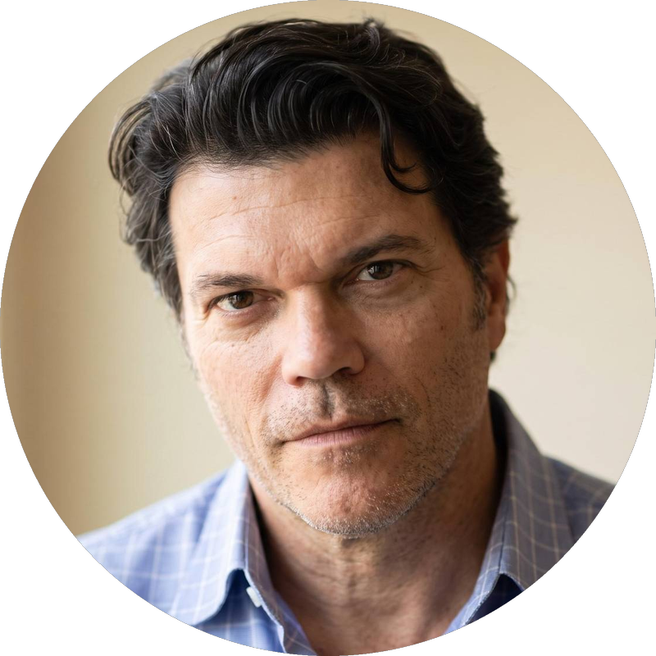

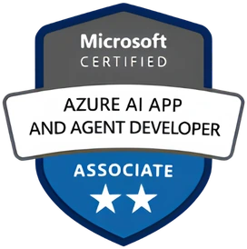

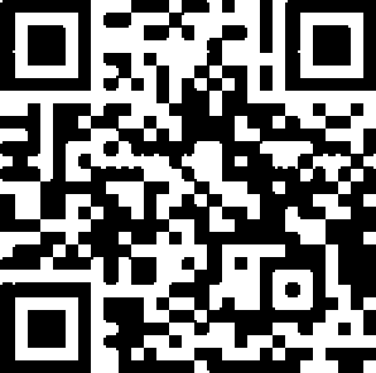
AGENTIC AI: FROM STRATEGY TO PRODUCTION.
Alexander
Kastil
AGENTIC AI CONSULTING · VIENNA
Full stack, from enterprise software to agentic AI. Since 1996
AI at Work
Enterprise AI
Value discovery, KPI mapping and roadmap
Governed multi-agent systems on Microsoft Copilot and Foundry
Agentic Software Engineering
Team Enablement
Harness architecture for Claude Code and GitHub Copilot
AI driven content production and delivery
integrations.at
github.com/alexander-kastil
SCAN TO CONNECT
alexander.kastil@integrations.at
linkedin.com/in/alexander-kastil
integrations.at
Notes:
Intro: Alexander Kastil, integrations.at. Four practice areas from AI at Work to team enablement. Certifications: Agentic AI Business Solutions Architect, Azure AI App and Agent Developer Associate, DevOps Engineer Expert.

Slide 4
DAY 1 OF 4
DAY 1
DAY 2
DAY 3
DAY 4
Meet agents and Cowork
What agents are and cost, Cowork for everyday work, and a first Copilot Studio agent.
Introduction to Copilot Cowork and Copilot Studio
Agents, how they work, harnesses, build paths, credits and productivity agents
Copilot Studio Basics
Standard agents, knowledge, topics, Power Fx, Adaptive Cards and publishing
01
ON TO DAY 2
03
02
Microsoft 365 Copilot Cowork
Built-in and custom skills, scheduled prompts, plugins and approvals
Automate Business Processes with Copilot Studio and Copilot Cowork
Modules 01 to 03

Slide 5
DAY 2 OF 4
DAY 1
DAY 2
DAY 3
DAY 4
Give agents tools
Ground and publish the HR agent, then connect it to prompts, connectors, flows, APIs and MCP.
Tools in Copilot Studio
Prompts, connectors, Agent Flows, Dataverse, REST APIs, MCP and Computer Use
04
ON TO DAY 3
FROM DAY 1
Automate Business Processes with Copilot Studio and Copilot Cowork
Module 04

Slide 6
DAY 3 OF 4
DAY 1
DAY 2
DAY 3
DAY 4
Autonomy and the Copilot harness
Autonomous, reasoning and multi-agent designs, then the Microsoft Copilot harness.
Advanced Copilot Studio Agents
Autonomous agents, deep reasoning, multi-agent routing and Foundry agents
05
06
FROM DAY 2
ON TO DAY 4
Microsoft Copilot harness agents next to Standard agents
Build surface, Agent Skills, Workflows, IQ grounding, apps and evaluations
Automate Business Processes with Copilot Studio and Copilot Cowork
Modules 05 to 06

Slide 7
DAY 4 OF 4
DAY 1
DAY 2
DAY 3
DAY 4
Ship and hand over
Ground, extend and evaluate harness agents, then publish, maintain and meet AI teammates.
Publishing & Maintaining Copilot Studio Agents
Environments, solutions, channels, ALM, source control and coding agents
07
08
FROM DAY 3
FINISH
OPTIONAL
AI Teammates: Autopilot & Agent Accounts
Autopilot, agent accounts, proactive triggers, shared memory and governance
Automate Business Processes with Copilot Studio and Copilot Cowork
Modules 07 to 08

