Slide 1
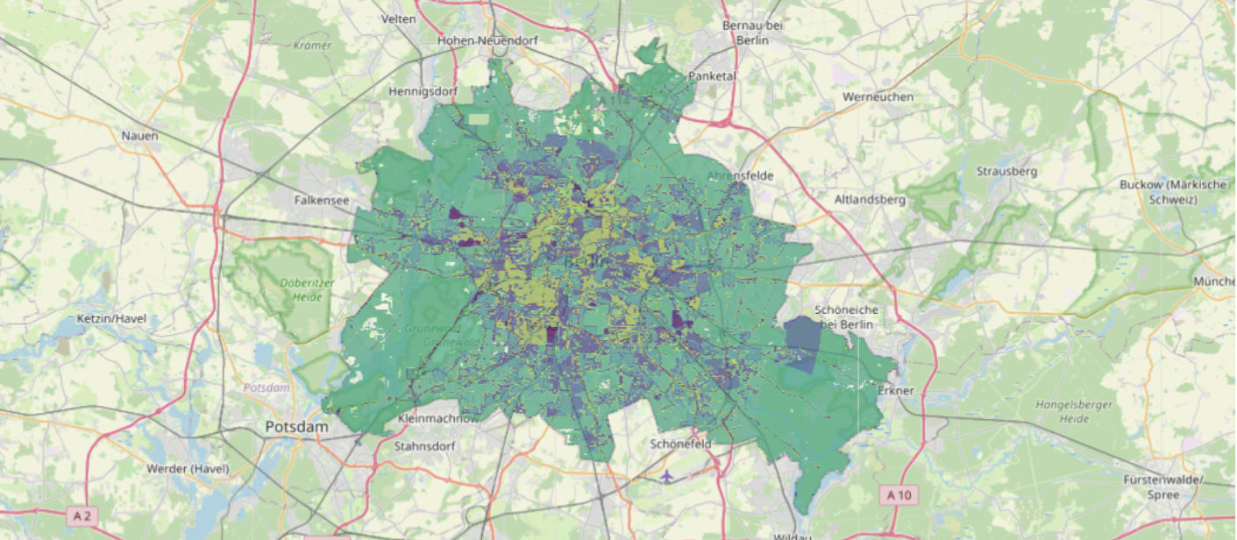
Environmental and Social Indicators of Berlin
26.01.2026
Leah Melchert, Alexander Mayer und Rosina Engert

Slide 2
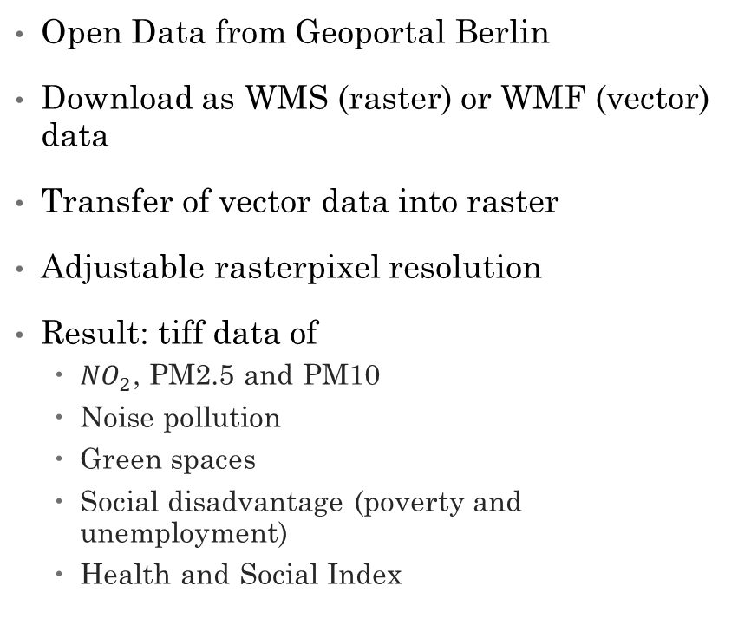
Data and Data handling
Open Data from Geoportal Berlin
Download as WMS (raster) or WMF (vector) data
Transfer of vector data into raster
Adjustable rasterpixel resolution
Result: tiff data of
  ${NO}_{2}$, PM2.5 and PM10
  Noise pollution
  Green spaces
  Social disadvantage (poverty and unemployment)
  Health and Social Index
PM10
Notes:
Weiße flächen da in schwarzweiß nicht alle kategorien 1,2,3 darstellbar? Oder ist schwarz hier no data?
Wie genau haben wir wmf nochmal umgewandelt (das waren einfach Polygone, die wir easy in raster umwandeln konnten, oder?)

Slide 3
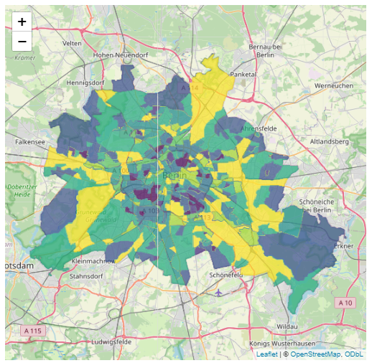
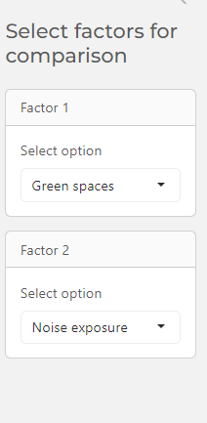
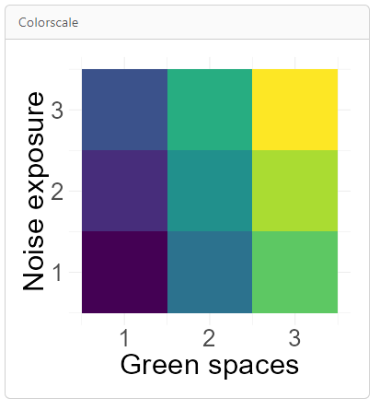
Methods
Comparison of two indicators based on a 2D-Colorscale
Use of the colorscale to create a new raster image

Slide 4
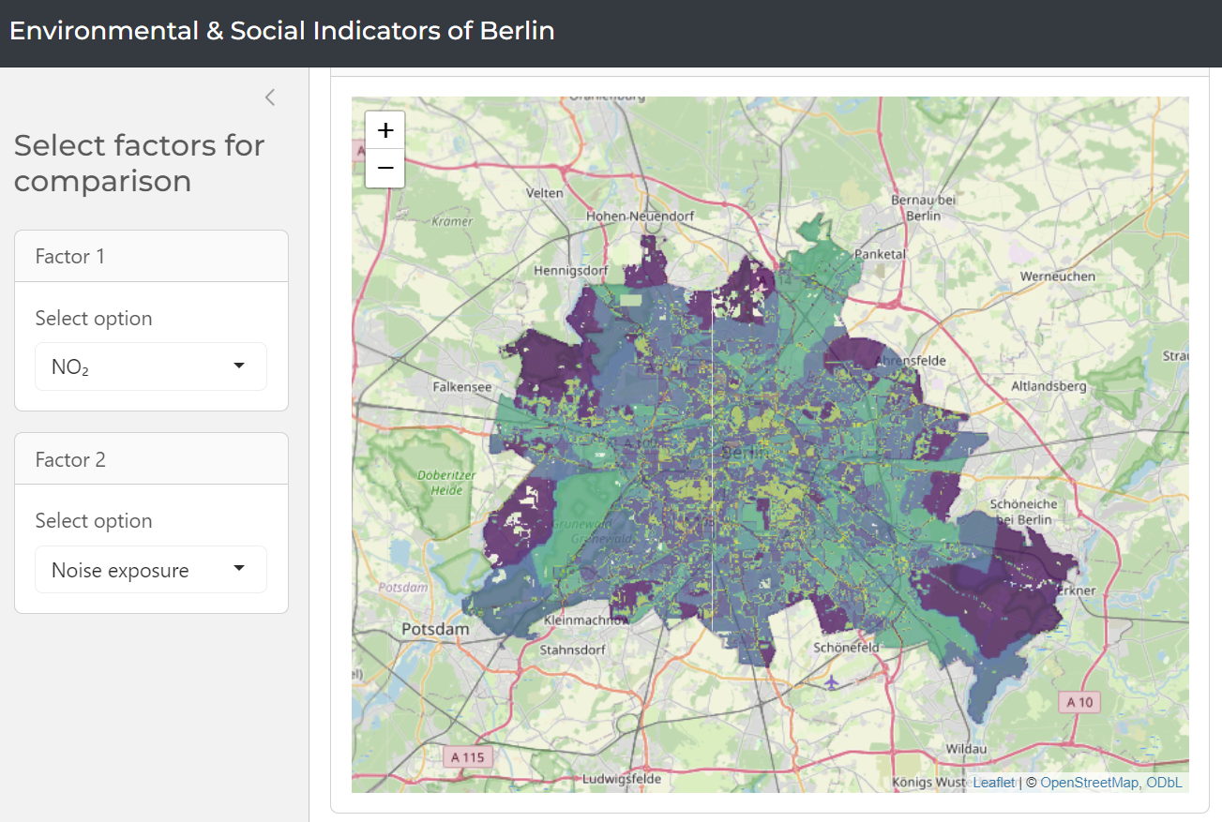
Applicability in the future or in other scales for users
Use case of application:
city planning in Berlin
individual living/ activity space search
Adaptation of method:
  For other regions (vector and raster data is possible to implement)
  With other parameters (easy application on any parameters to identify relationships in space)

