Slide 1

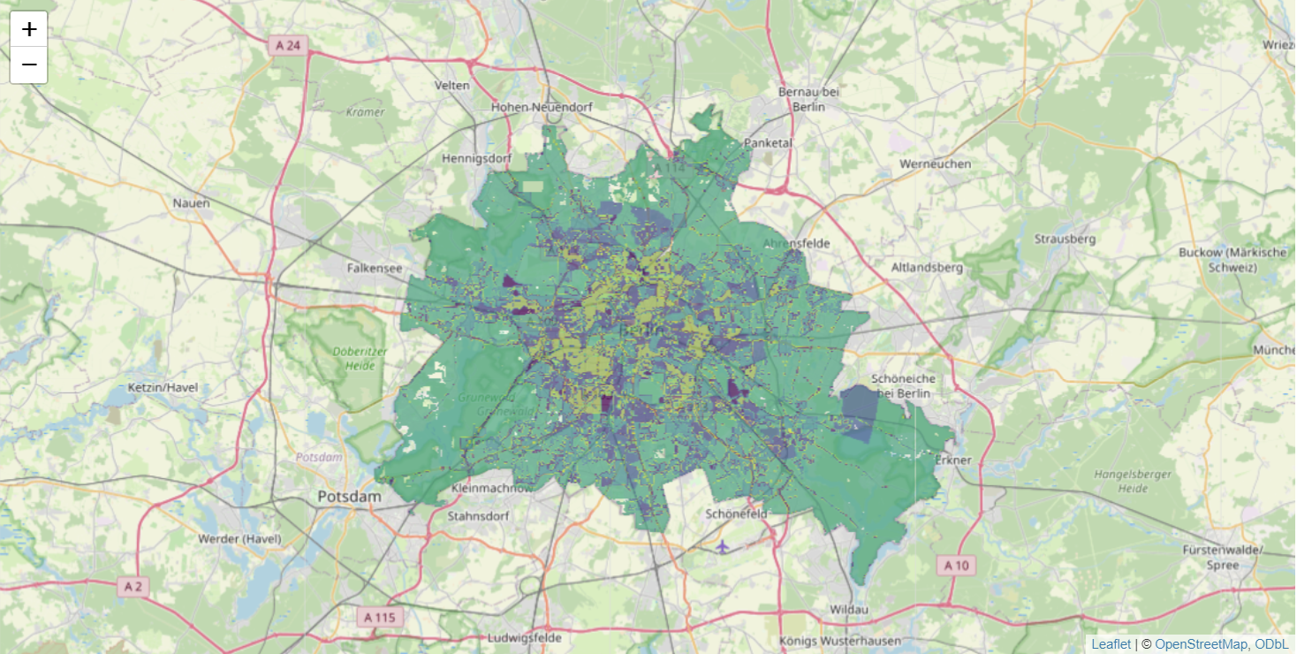

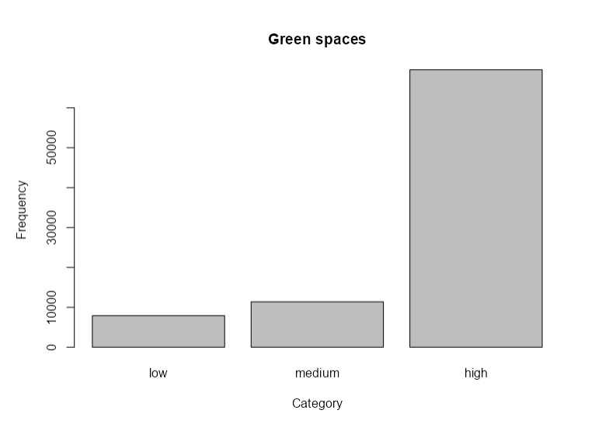
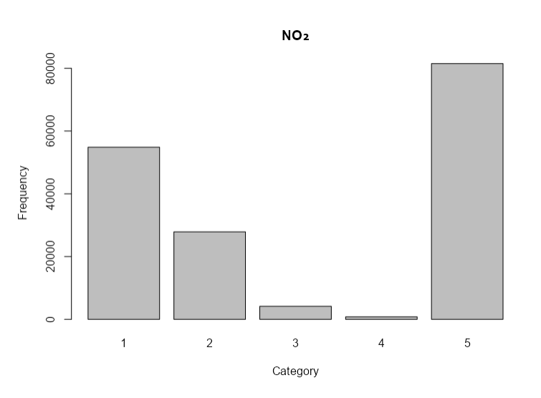
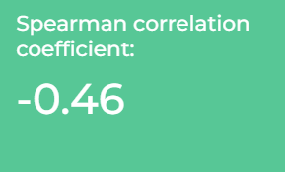
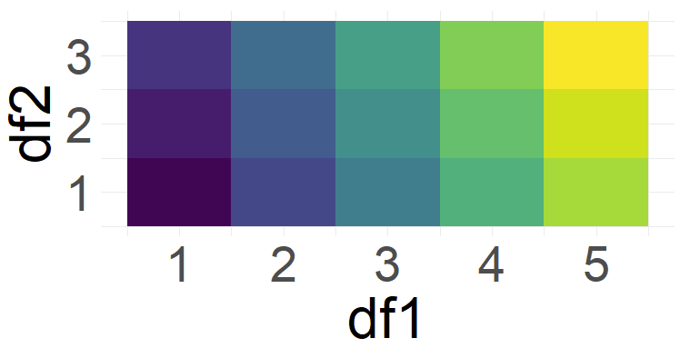
Environmental and Social Indicators of Berlin:
2D-Data Visualisation and Statistics
Environmental & social factors
WFS / WMS Data
Filter, reclassify, rasterize, reproject
Select two data frames (df1, df2) & create 2D-Colormap

