Slide 1
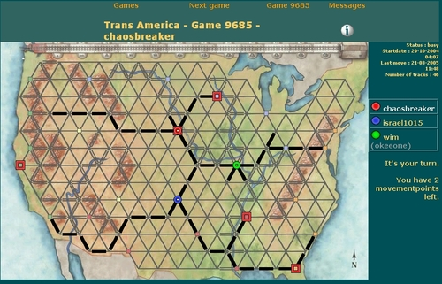
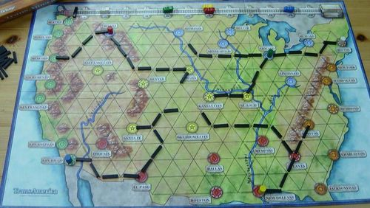
0 1 2 3 4 5 6 7 8 9 10 11 12 13 14 15 16 17 18 19
SEATTLE
HELENA
BISMARK
DULUTH
0 1 2 3 4 5 6 7 8 9 10 11 12 13 14 15 16 17 18 19
PORTLAND
???
CHICAGO
SALT LAKE CITY
???
???
???
CINCINNATI
NEW YORK
SACRAMENTO
OMAHA
???
DENVER
SAN FRANCISCO
KANSAS CITY
ST LOUIS
WASHINGTON
LOS ANGELES
SANTA FE
OKLAHOMA CITY
???
PHOENIX
MEMPHIS
CHARLESTON
SAN DIEGO
DALLAS
ATLANTA
EL PASO
JACKSONVILLE
HOUSTON
NEW ORLEANS
0 1 2 3 4 5 6 7 8 9 10 11 12 13 14 15 16 17 18 19

