Slide 1

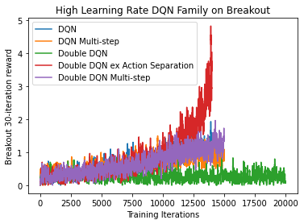
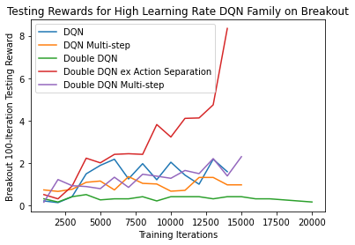
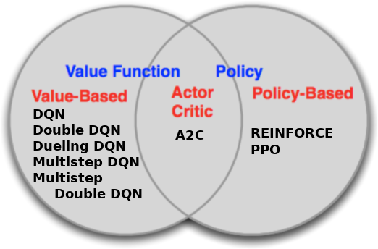
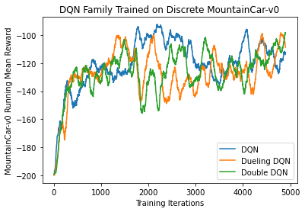
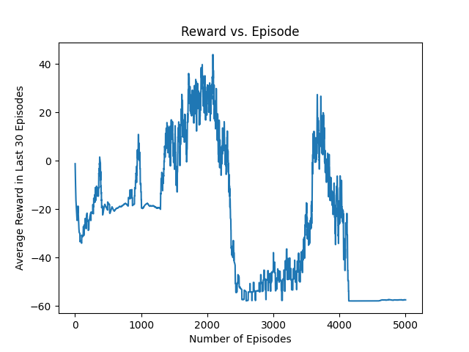
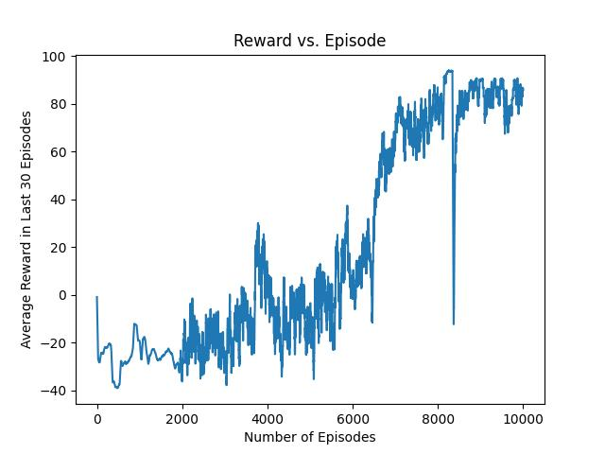
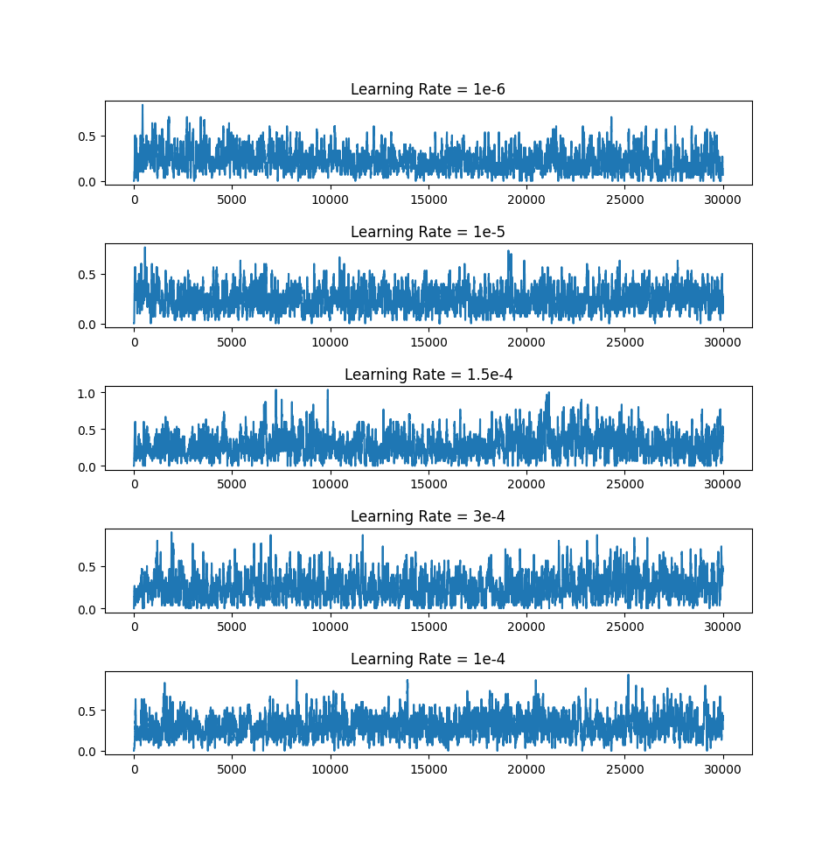
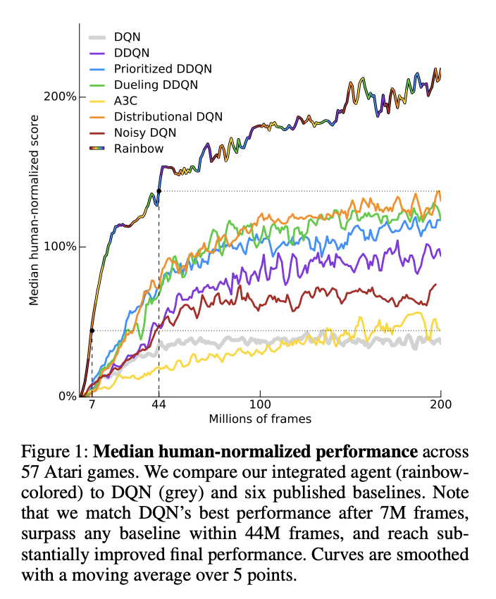
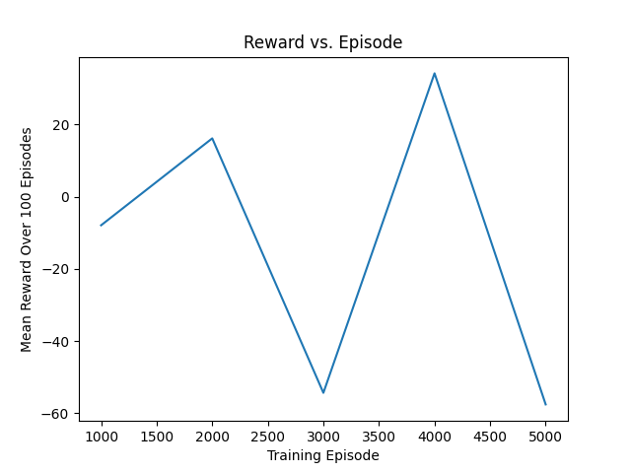
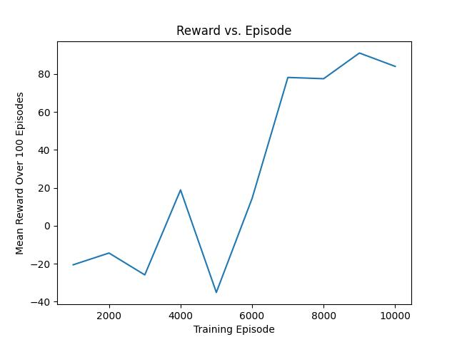

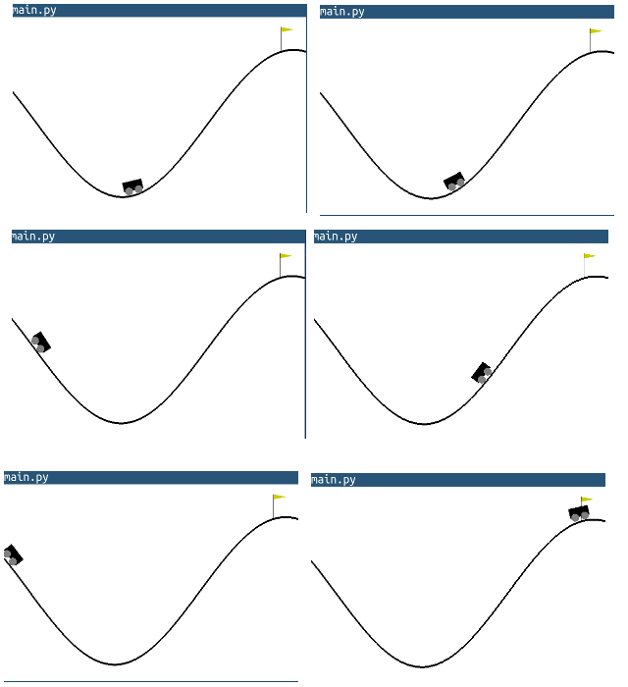
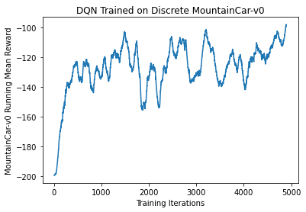
Benchmarking Reinforcement Learning Agents
on Diverse Tasks
Jannik Haas, Quincy Hershey, Brian Lewandowski,
Alex Moore, Scott Tang
Gihhub.com/moorea1/cs525
Motivation
Understanding which agents succeed on which tasks is a fundamental understanding of reinforcement learning. To practice the development, implementation, and optimization of many agents, our team chose Breakout and MountainCar in order to understand the process and results behind a diverse set of standard reinforcement learning agents.
Breakout-v0 Task Results
Here we show results during training and testing for our set of 5 DQN-variety models. We additionally vary these results over a high- and low-learning-rate setup to compare the training between each.
Discussion
Here is the discussion on the experimental results. This can include some bullet points and a general discussion of our thoughts, shortcomings, or just our feelings.
Rainbow, part of our inspiration:
https://paperswithcode.com/method/rainbow-dqn
Agents
MountainCar-v0 Task Results
Here is a topic sentence for these results. Here is another sentence introducing the plots. This discussion can continue until the end of the bubble
Tasks
Breakout-v0 MountainCar-v0
DQN Family on Discrete MountainCar-v0
Citations
Gym.openai.com
Bellemare 2013: Arcade Learning Environment
Mnih et al. 2013: Atari with Deep Reinforcement Learning

