Slide 1

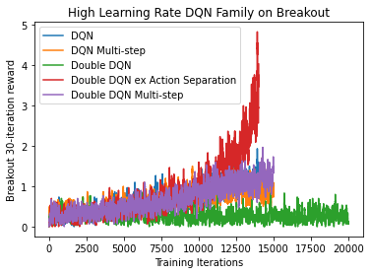
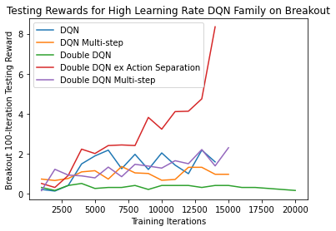
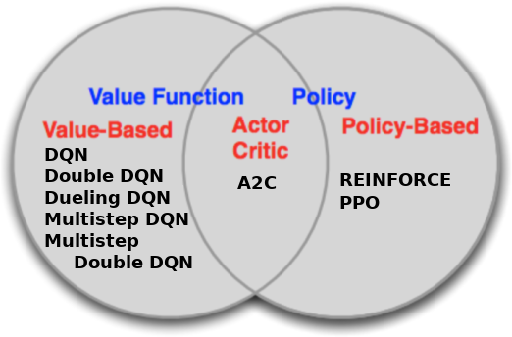
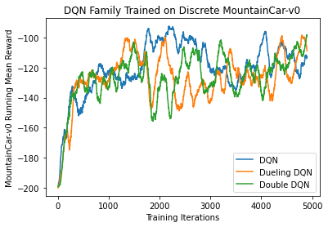
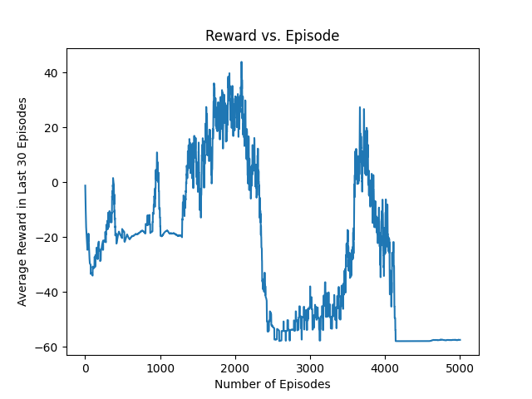
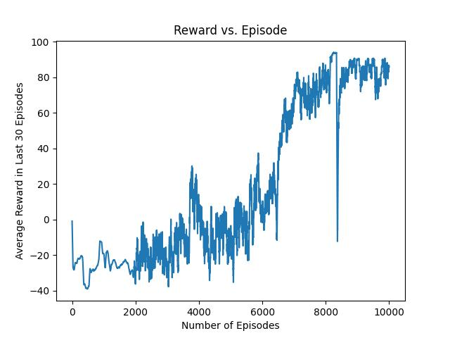
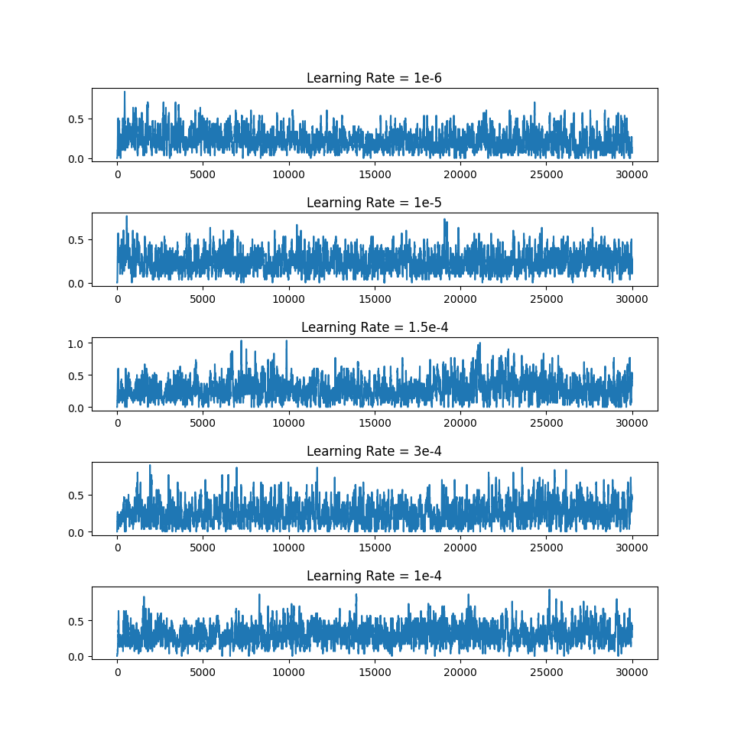
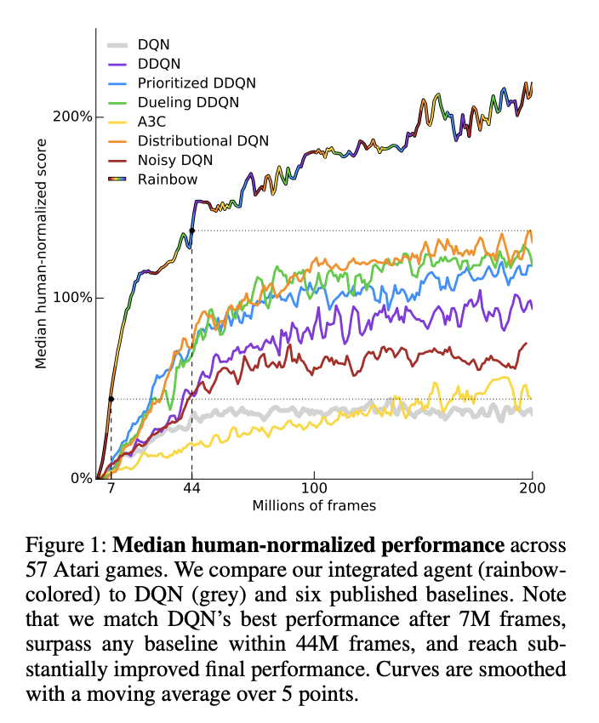
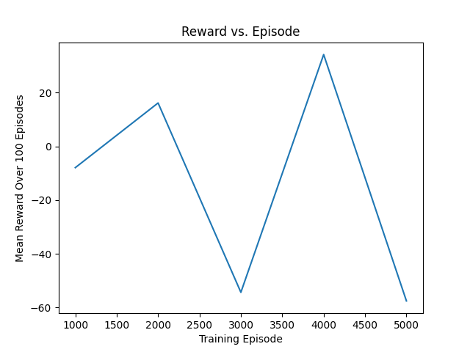
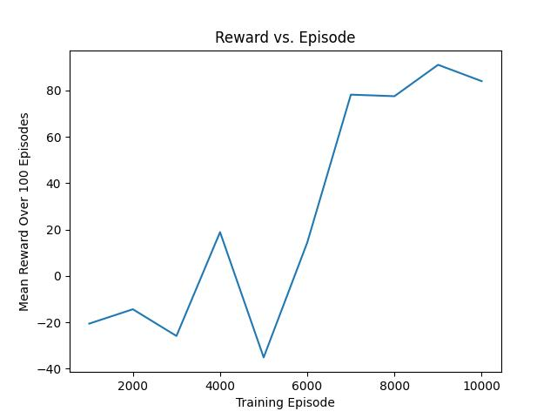

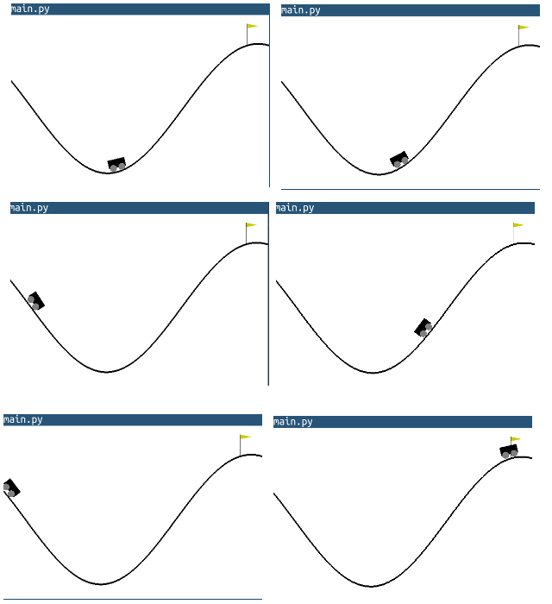
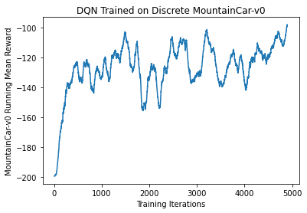
Benchmarking Reinforcement Learning Agents
on Diverse Tasks
Jannik Haas, Quincy Hershey, Brian Lewandowski,
Alex Moore, Scott Tang
Gihhub.com/moorea1/cs525
Motivation
Understanding which agents succeed on which tasks is a fundamental understanding of reinforcement learning. To practice the development, implementation, and optimization of many agents, our team chose Breakout and MountainCar in order to understand the process and results behind a diverse set of standard reinforcement learning agents.
Breakout-v0 Task Results
Here we show results during training and testing for our set of 5 DQN-variety models. We additionally vary these results over a high- and low-learning-rate setup to compare the training between each.
Discussion
Here we have explored the effects of discrete and continuous action spaces, as well as investigated the effect of learning rate on a large swathe of models.
We make conclusions about the nature of some reinforcement learning models, the overwhelming importance of hyperparameter selection, and the complications in asking what the “best” reinforcement learning models are.
Last, we propose standards for how benchmarking research should be done based on our experience with the process of model comparison.
Rainbow, part of our inspiration:
Agents
MountainCar-v0 Task Results
Here is a topic sentence for these results. Here is another sentence introducing the plots. This discussion can continue until the end of the bubble
Tasks
Breakout-v0 MountainCar-v0
DQN Family on Discrete MountainCar-v0
Citations
Gym.openai.com
Bellemare 2013: Arcade Learning Environment
Mnih et al. 2013: Atari with Deep Reinforcement Learning
Rainbow: https://paperswithcode.com/method/rainbow-dqn

