Slide 1

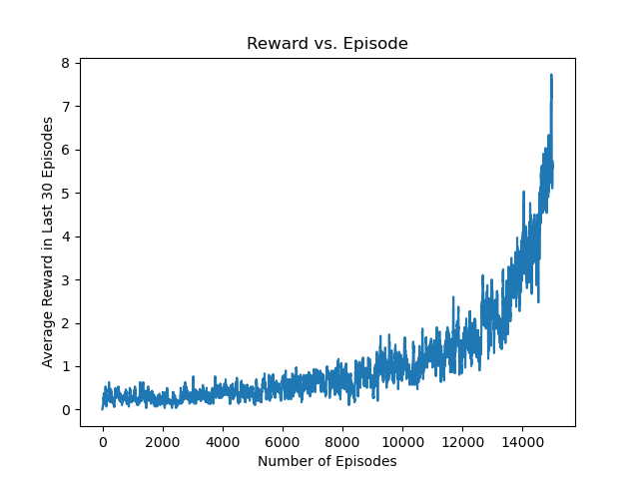
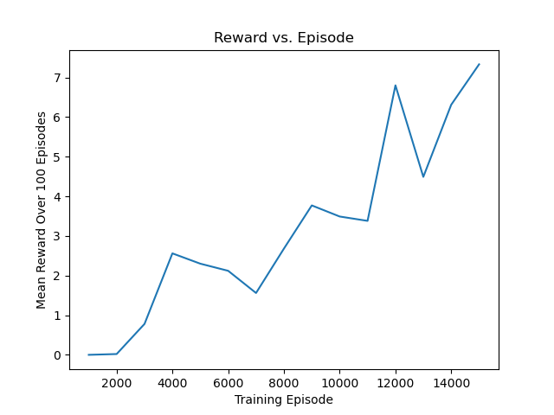
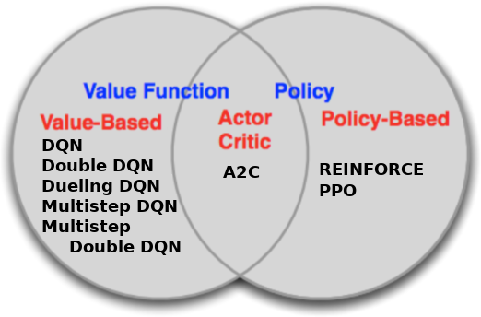
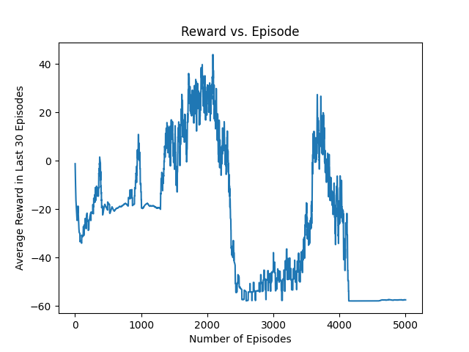
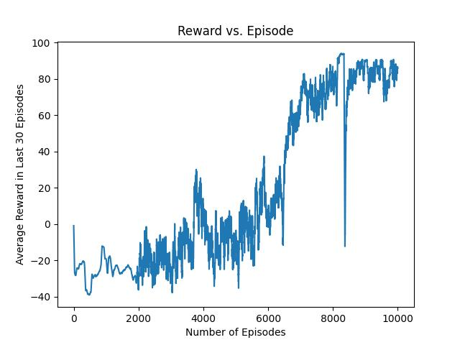
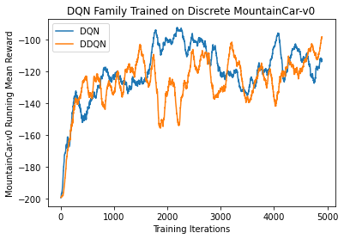
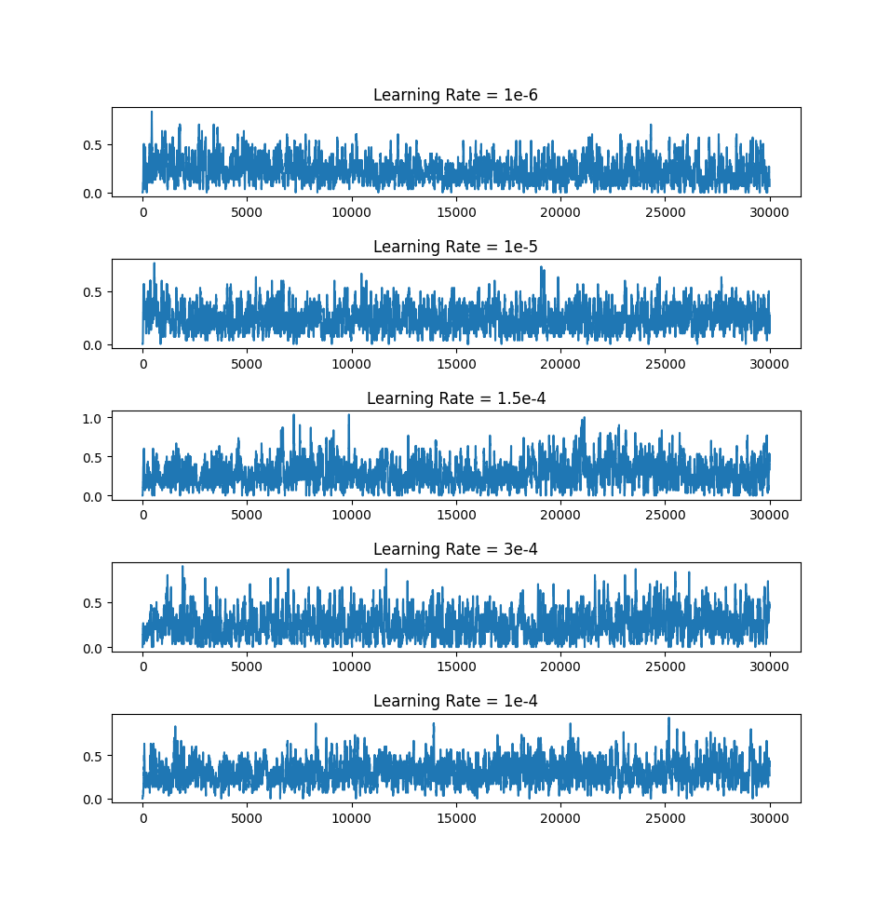
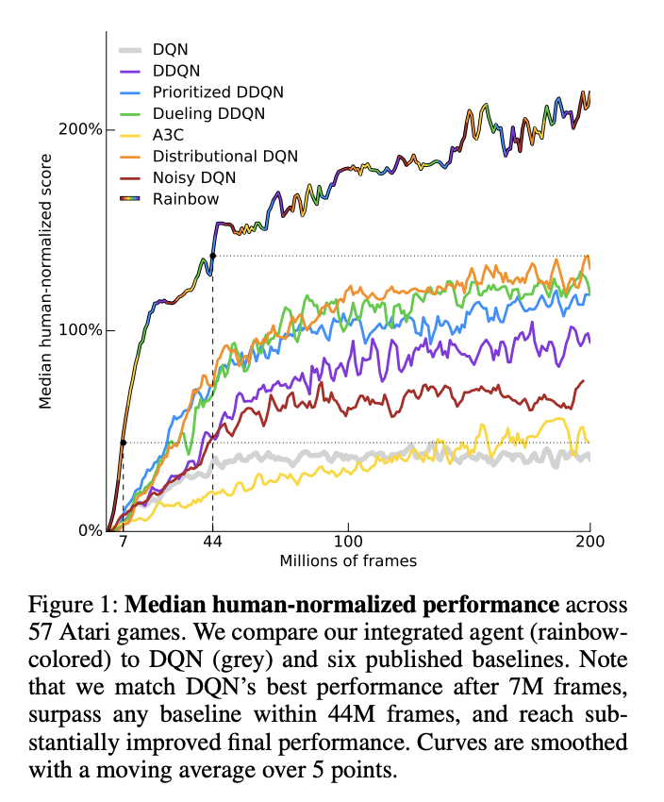
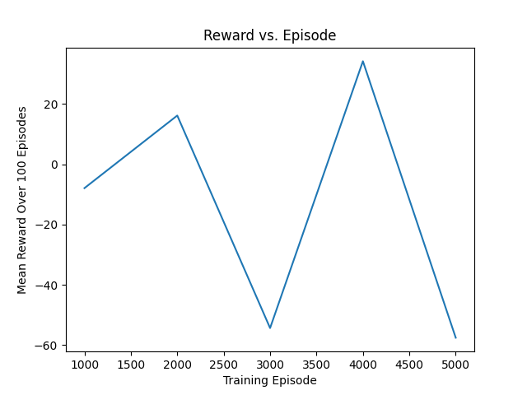
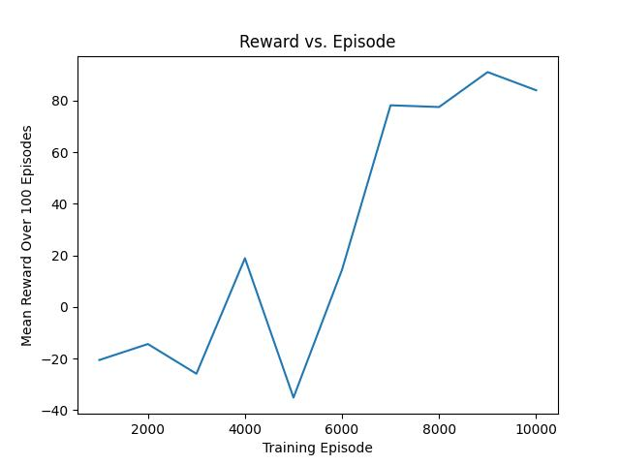

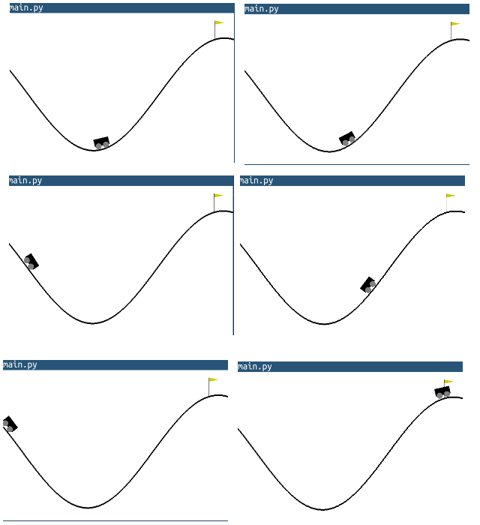
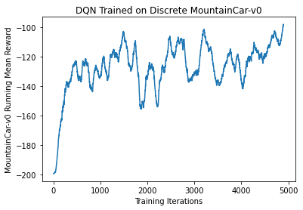
Benchmarking Reinforcement Learning Agents
on Diverse Tasks
Jannik Haas, Quincy Hershey, Brian Lewandowski,
Alex Moore, Scott Tang
Gihhub.com/moorea1/cs525
Motivation
Understanding which agents succeed on which tasks is a fundamental understanding of reinforcement learning. To practice the development, implementation, and optimization of many agents, our team chose Breakout and MountainCar in order to understand the process and results behind a diverse set of standard reinforcement learning agents.
Breakout-v0 Task Results
Here is a topic sentence for these results. Here is another sentence introducing the plots. This discussion can continue until the end of the bubble
Discussion
Here is the discussion on the experimental results. This can include some bullet points and a general discussion of our thoughts, shortcomings, or just our feelings.
Rainbow, part of our inspiration:
https://paperswithcode.com/method/rainbow-dqn
DQN
Double DQN
Dueling DQN
Agents
MountainCar-v0 Task Results
Here is a topic sentence for these results. Here is another sentence introducing the plots. This discussion can continue until the end of the bubble
Tasks
Breakout-v0 MountainCar-v0
DQN^ vDDQN
Citations
Gym.openai.com
Bellemare 2013: Arcade Learning Environment
Mnih et al. 2013: Atari with Deep Reinforcement Learning

