Slide 1



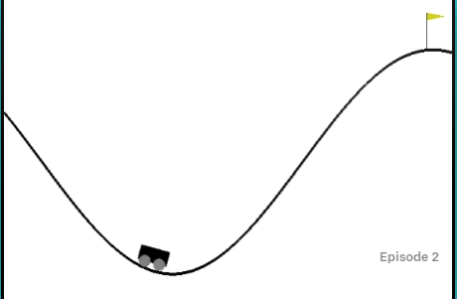
Benchmarking Reinforcement Learning Agents
on Diverse Tasks
Jannik Haas, Quincy Hershey, Brian Lewandowski, Alex Moore, Scott Tang
Motivation
Understanding which agents succeed on which tasks is a fundamental understanding of reinforcement learning. To practice the development, implementation, and optimization of many agents, our team chose Breakout and MountainCar in order to understand the process and results behind a diverse set of standard reinforcement learning agents.
Discrete Action Space Task Results
Discussion
Agents
We use two primary model domains, continuous- and discrete-action space designed models:
DQN, Dueling DQN, Double DQN
REINFORCE, PPO, MC
Continuous Action Space Task Results
Tasks
Breakout-v0 MountainCar-v0
Citations
Gym.openai.com
Bellemare 2013: Arcade Learning Environment
Mnih et al. 2013: Atari with Deep Reinforcement Learning

