Slide 1

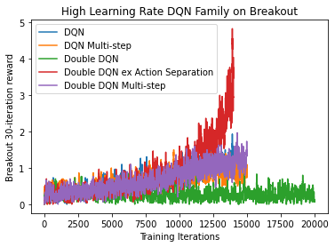
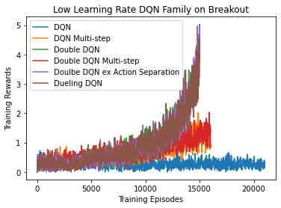
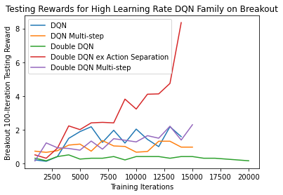
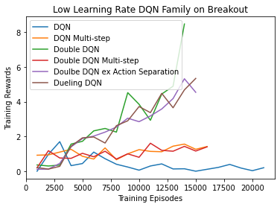
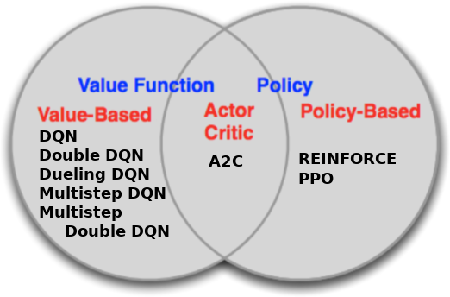
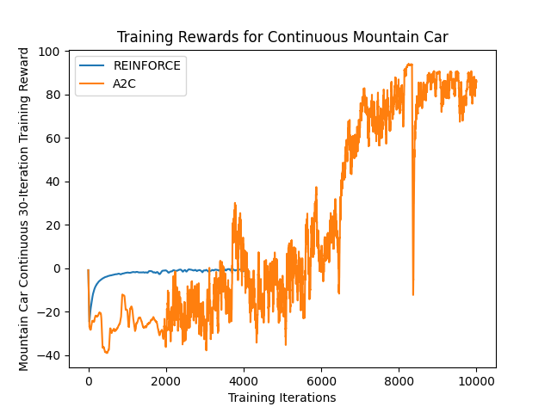
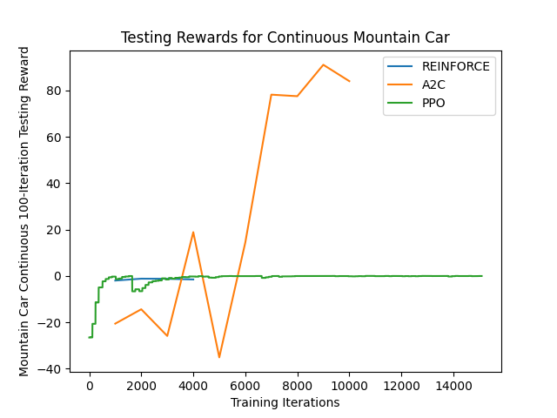
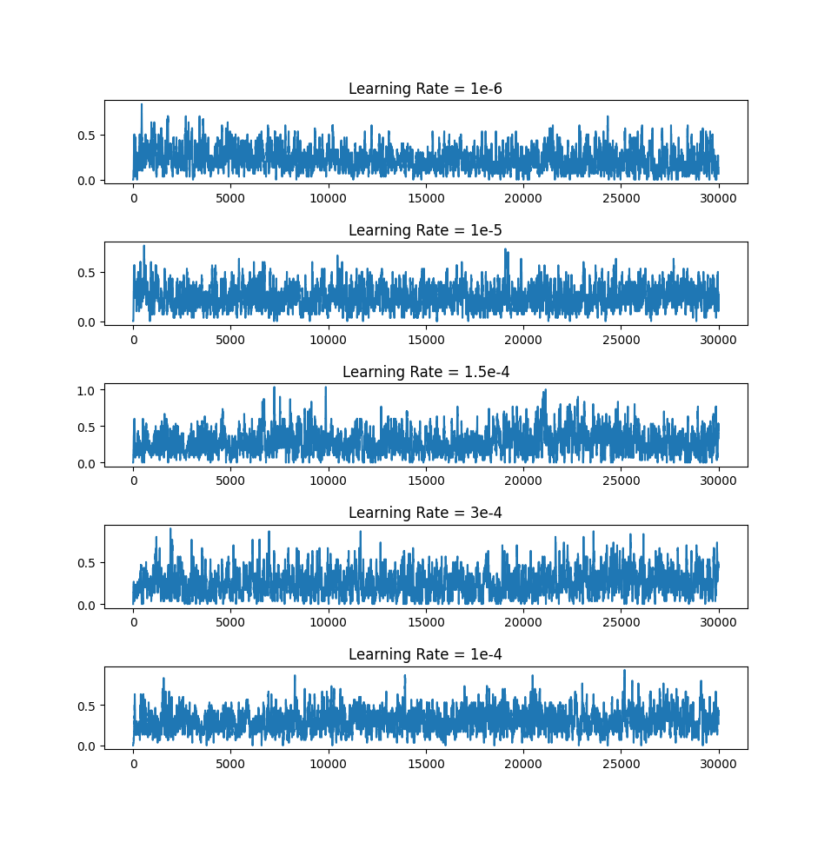
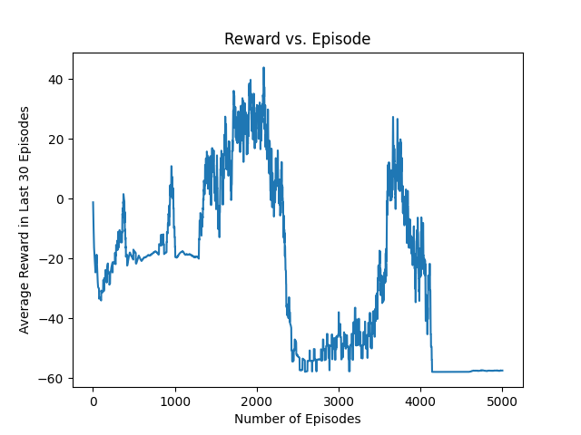

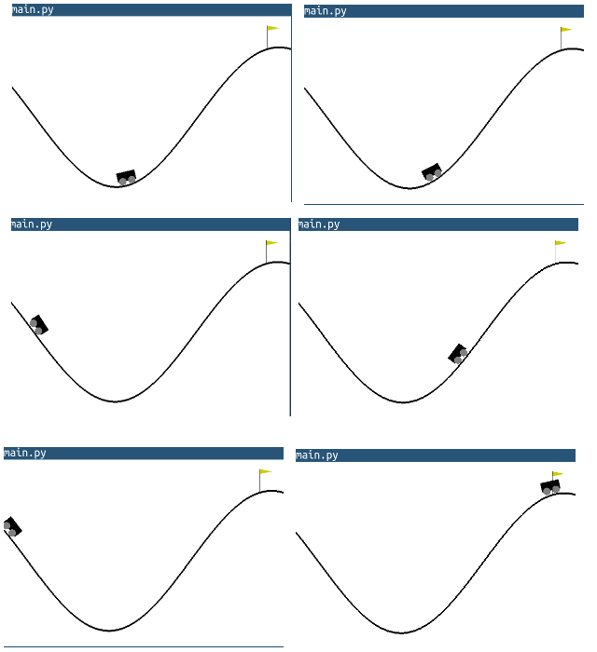
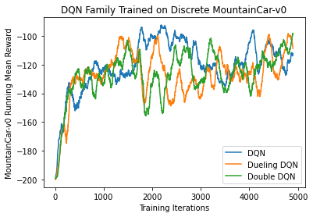
Benchmarking Reinforcement Learning Agents
on Diverse Tasks
Jannik Haas, Quincy Hershey, Brian Lewandowski,
Alex Moore, Scott Tang
Gihhub.com/moorea1/cs525
Motivation
Understanding which agents succeed on which tasks is a fundamental understanding of reinforcement learning. To practice the development, implementation, and optimization of many agents, our team chose Breakout and MountainCar in order to understand the process and results behind a diverse set of standard reinforcement learning agents.
Discussion
Here we have explored the effects of discrete and continuous action spaces, as well as investigated the effect of learning rate on a large swathe of models.
We make conclusions about the nature of some reinforcement learning models, the overwhelming importance of hyperparameter selection, and the complications in asking what the “best” reinforcement learning models are.
Last, we propose standards for how benchmarking research should be done based on our experience with the process of model comparison.
Agents
MountainCar-v0 Task Results
Here we have results on the mountain car task. The models that we trained and tested found different solutions to the problem and converged at different rates during training.
Tasks
Breakout-v0 MountainCar-v0
Citations
Gym.openai.com
Bellemare 2013: Arcade Learning Environment
Mnih et al. 2013: Atari with Deep Reinforcement Learning
Rainbow: https://paperswithcode.com/method/rainbow-dqn

