Slide 1
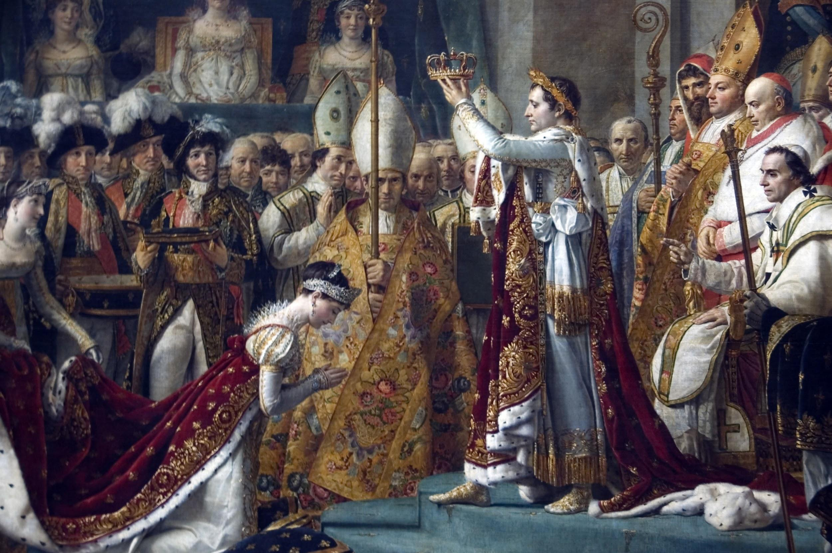
CS 548 Project 4
Alex and Noel

Slide 2
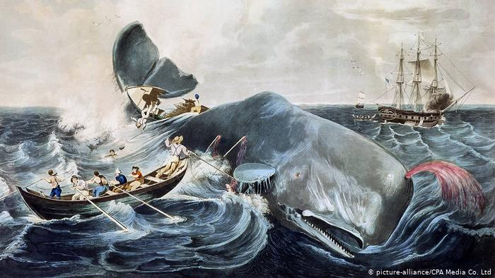
CS 548 Project 4
Alex and Noel

Slide 3
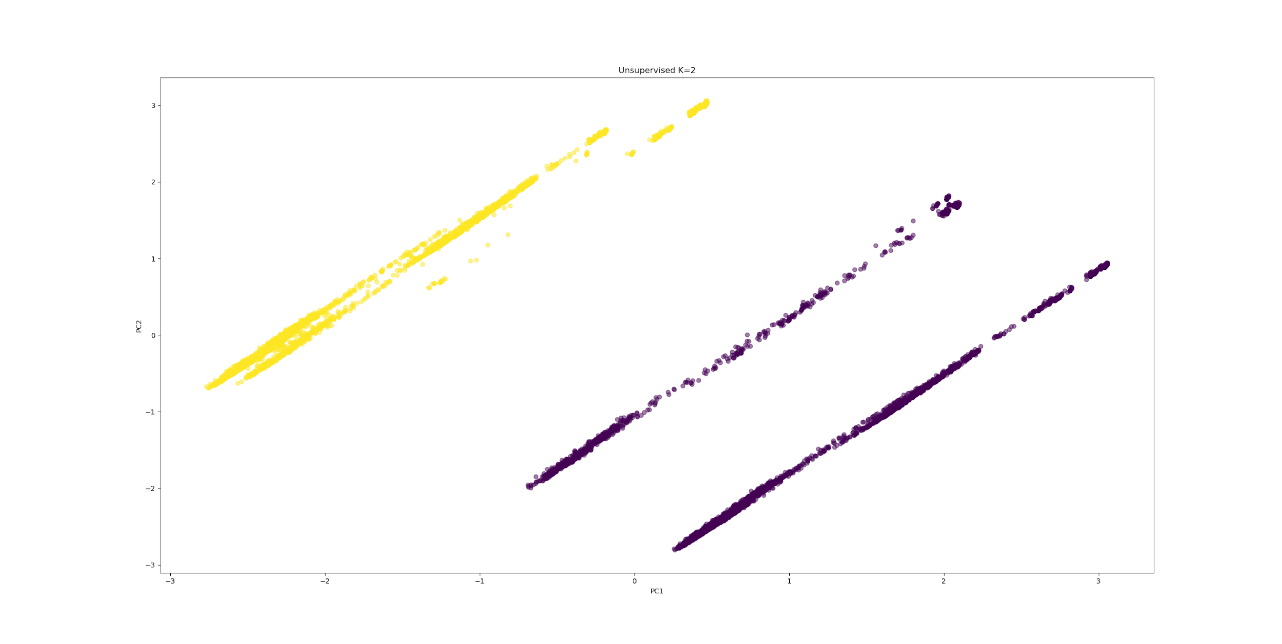
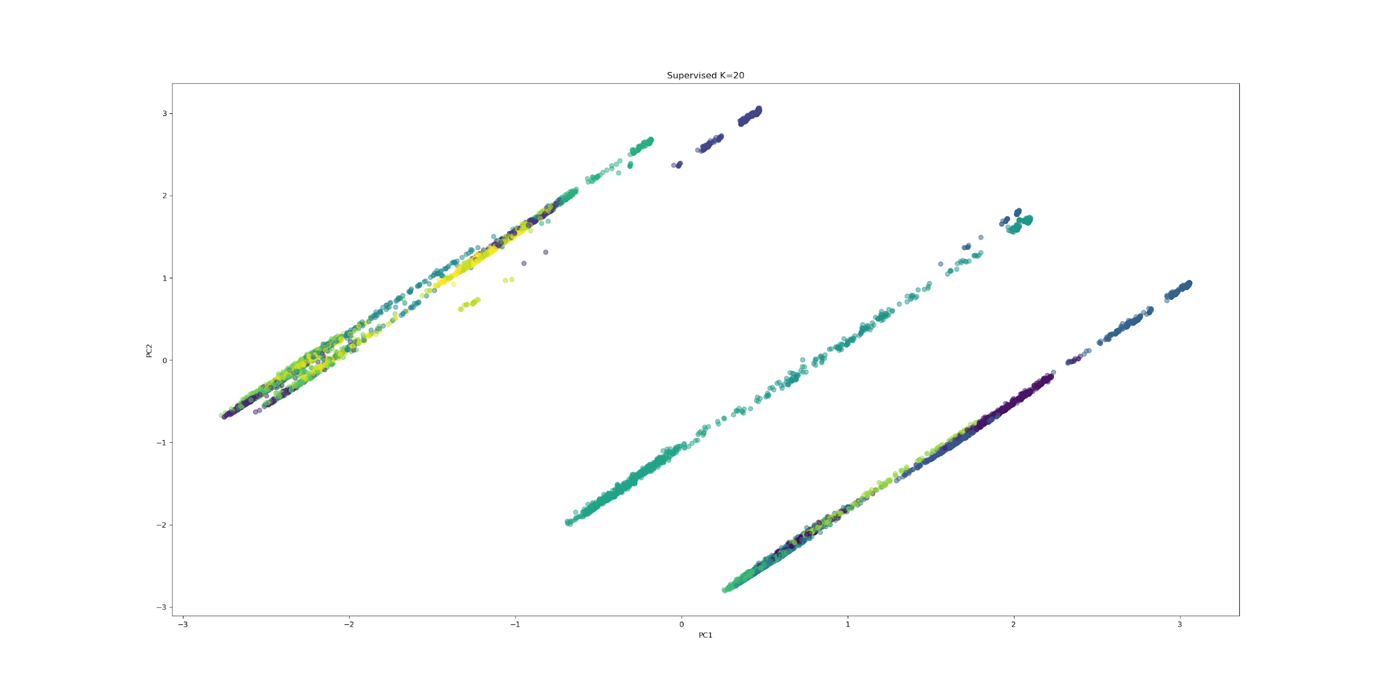
Questions
Findings
How many groups are typical to form in the data? What do the numbers mean?
How close are the points to one another? Are there noticable dense and sparse regions?
How does removing `sex` affect the cluster scores?

Slide 4
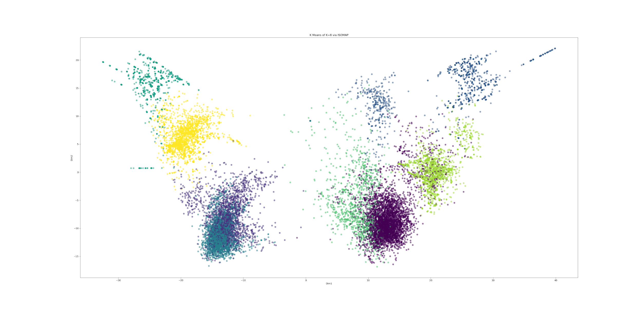
Alternate Manifolds

Slide 5
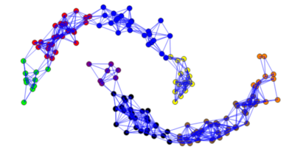
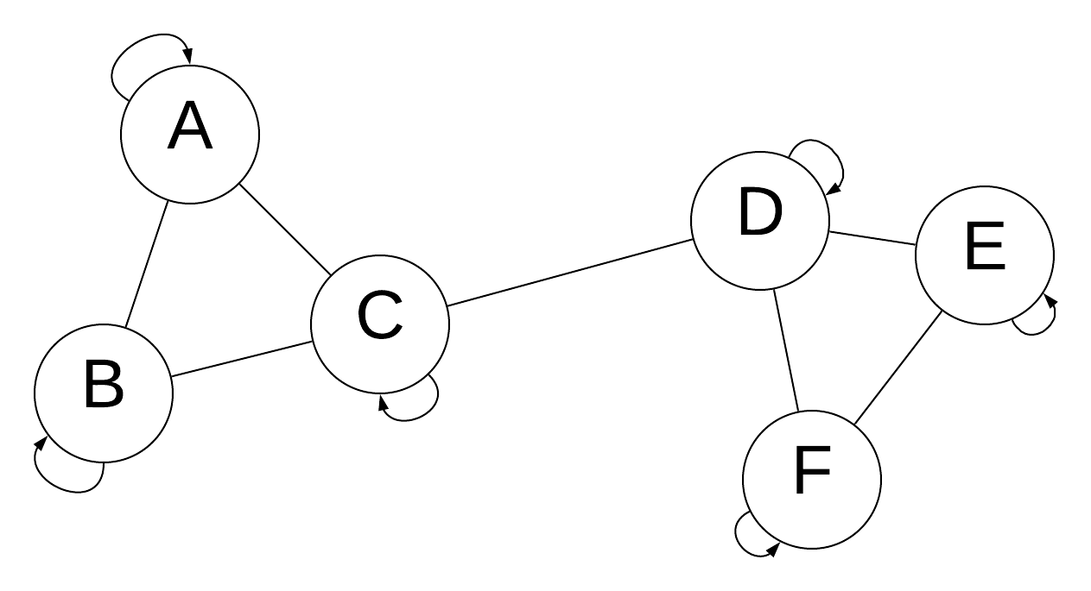
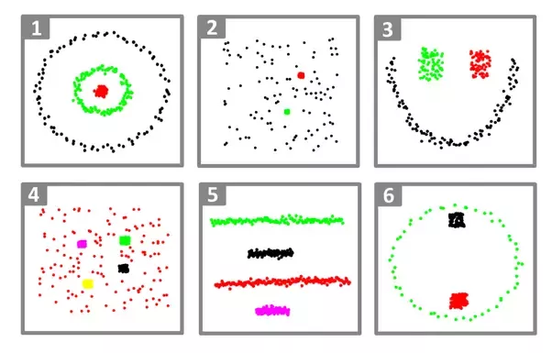
Spectral Clustering
Uses Laplacian Matrix related to the similarity matrix
Eigenvalues give minimal-edge cuts
Graph-clustering vs. data-clustering
http://math.ucdenver.edu/~sborgwardt/wiki/index.php/Spectral_clustering

