Slide 1
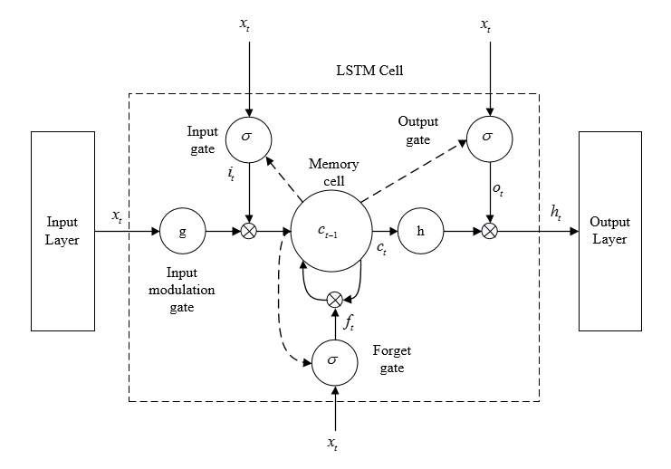
Neural Network Approach
Initial Approach was to use an RNN with LSTM nodes
Performance wasn’t better than random guessing.

Slide 2
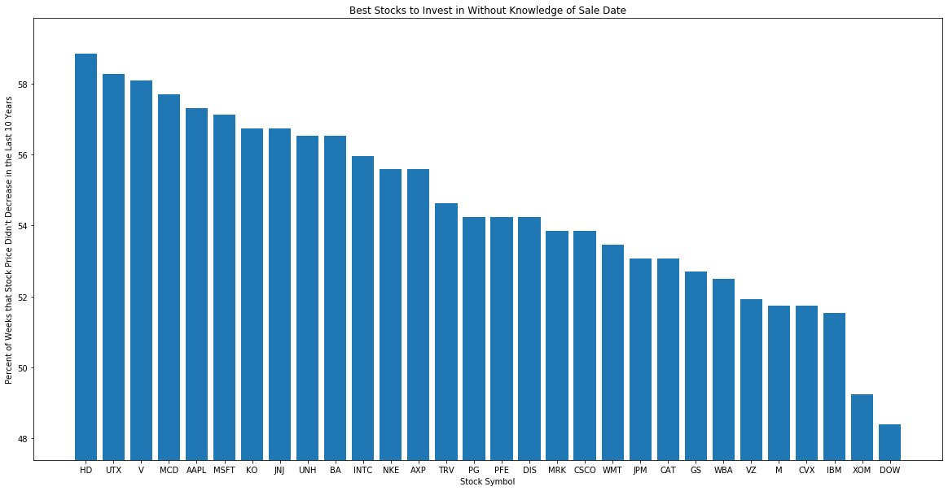
Consistent Gain Approach
If one doesn’t know when they’ll need to withdraw their money, it’s best to pick stocks that decrease the least amount of the time.

