Slide 1
MPI-3 Hybrid Working Group Status

Slide 2
MPI interoperability with Shared Memory
Motivation: sharing data between processes on a node without using threads
Sandia applications motivation:
Dump data into a “common” memory region
Synchronize
All processes just use this memory region in read-only mode
And they want this in a portable manner

Slide 3
MPI interoperability with Shared Memory: Plan A
The original plan was to provide
Routines to allocate/deallocate shared memory
Routines to synchronize operations, but not to operate on memory (similar to MPI_Win_sync)
Operations on shared memory are done using load/store operations (unlike RMA)
Synchronization would be done with something similar to MPI_Win_sync
There was a suggestion to provide operations to operate on the data as well, but there was no consensus on that in the working group
A routine to create a communicator on which shared memory can be created
The Forum’s feedback that this was not possible to do in MPI unless it knows the compilers capabilities
Process 0 Process 1
store(X)
MPI_Shm_sync()
MPI_Barrier() ----------------- MPI_Barrier()
MPI_Shm_sync()
load(X)

Slide 4
MPI interoperability with Shared Memory: Plan B
The second plan was to remove shared memory synchronization routines; we still have:
Routines to allocate/deallocate shared memory
A routine to create a communicator on which shared memory can be created
The Forum’s feedback was that allocation/deallocation might not be useful without operations to synchronize data
The use-case for only creating shared memory and expect the user to handle memory barriers was fairly minimal
Also, another feedback was to do this as an external library

Slide 5
MPI interoperability with Shared Memory: Plan C
The third plan is to remove shared memory allocation routines; we still have:
A routine to create a communicator on which shared memory can be created
MPI_Shm_comm_create(old_comm, info, &new_comm)
The info argument can provide implementation-specific information such as, within the socket, shared by a subset of processes, whatever else
No predefined info keys
There has been a suggestion to generalize this to provide a communicator creator function that provides “locality” information
Will create an array of communicators, where the lower index communicators “might contain” closer processes (best effort from the MPI implementation)
An attribute on the communicator would tell if shared memory can be created on it

Slide 6
MPI Interoperability with Thread Teams
Motivation: Allow coordination with the application to get access to threads, instead of the application maintaining a separate pool of threads than the MPI implementation
Proposal in a nutshell
Thread teams are created
The user can provide the threads in the team to the MPI implementation to help out the MPI implementation
A user-defined team allows the user to have control on locality and blocking semantics for threads (i.e., which threads block waiting to help)

Slide 7
Point-to-point Communication on InfiniBand
5 fold performance difference

Slide 8
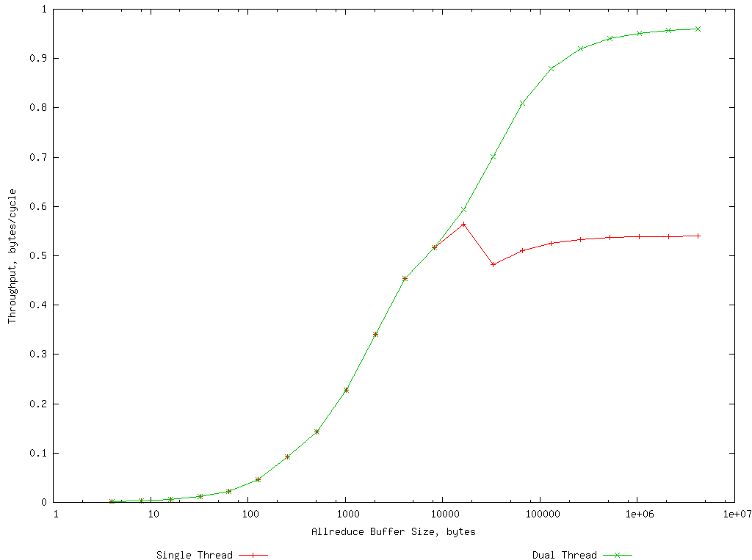
Allreduce on BG/P

Slide 9
Thread Teams Models
Two models proposed
Synchronous model: all threads in the team synchronously join and leave the team – more restrictive for the application but has more optimization opportunity for MPI
Asynchronous model: threads join the team asynchronously; processes can leave synchronously or asynchronously break out
Both models are essentially performance hints
Optimized MPI implementations can use this information

Slide 10
Thread Teams: Synchronous Model
In the synchronous model, the Join and Leave calls can be synchronizing between the threads
The MPI implementation can assume that all threads will be available to help
The programmer should keep the threads synchronized for good performance
The MPI implementation knows how many threads are going to help, so it can statically partition the available work, for example
This model does not allow for threads to “escape” without doing a synchronous leave
Join
Join
Join
Join
Allgather
Leave
Leave
Leave
Work
MPI can hold threads to help
Leave
Leave call Returns
Possible Implementation

Slide 11
Thread Teams: Asynchronous Model
In the asynchronous model, the Join call is not synchronizing between the threads
The leave call is still synchronizing, but threads are allowed to either help using “leave” or “break out” without helping
The MPI implementation does not know how many threads are going to help
This model allows for threads to “break out” without doing a synchronous leave
Join
Join
Join
Allgather
Leave
Join
Break
Work Pool
Leave
MPI can hold threads to help
Leave
Leave Returns (still synchronous)
Possible Implementation

Slide 12
Thread Teams Proposed API
Team creation/freeing
MPI_Team_create(team_size, info, &team)
One predefined info key for “synchronous”; default is “asynchronous”
Similar to the MPI RMA chapter in that the info arguments are true assertions; if the user says “synchronous” and tries to break out, that’s an erroneous program
MPI_Team_free(team)
Team join/leave functionality
MPI_Team_join(team)
A thread can only join one team at a time
MPI_Team_leave(team)
MPI_Team_break(team)

Slide 13
Hartree-Fock Example
do {
One_Electron_Contrib(Density, Fock)
while (task = next_task()) {
{i, j, k} = task.dims
X = Get(Density, {i,j,k} .. {i+C,j+C,k+C})
#pragma omp parallel {
Y = Work({i,j,k}, X) ; <------ compute intensive
omp_barrier()
MPI_Team_join(team)
if (omp_master) {
Accumulate(SUM, Y, Fock, {i,j,k}, {i+C,j+C,k+C}) ; <----- communication intensive
} ; OMP master
MPI_Team_leave(team)
} ; OMP – end parallel block
}
#pragma omp parallel {
Update_Density(Density, Fock) ; <----- communication intensive
my_energy = omp_gather()
MPI_Team_join(team)
if (omp_master) {
energy = MPI_Allgather(my_energy) ; <----- moderately communication intensive
} ; OMP master
MPI_Team_leave(team)
} ; OMP – end parallel block
} while (abs(new_energy - energy) > tolerance)

