Slide 1
Non-Collective Communicator Creation
Ticket #286
int MPI_Comm_create_group(MPI_Comm comm, MPI_Group group, int tag, MPI_Comm *newcomm)
Non-Collective Communicator Creation in MPI. Dinan, et al., Euro MPI ‘11.

Slide 2
Non-Collective Communicator Creation
Currently: Collective operation
Non-Collective: Create communicator collectively only on new members
Avoid bulk synchronization
Load balancing: Reassign processes from idle groups to active groups
Overhead reduction
Multi-level parallelism, small communicators
Recovery from failures
Not all ranks in parent can participate
Compatibility with Global Arrays
Past: collectives using MPI Send/Recv
☹

Slide 3
Non-Collective Communicator Creation Algorithm
0
1
2
3
4
5
6
7
MPI_COMM_SELF
(intracommunicator)
MPI_Intercomm_create
(intercommunicator)
MPI_Intercomm_merge
0
1
2
3
4
5
6
7
0
1
2
3
4
5
6
7
0
1
2
3
4
5
6
7
✓

Slide 4
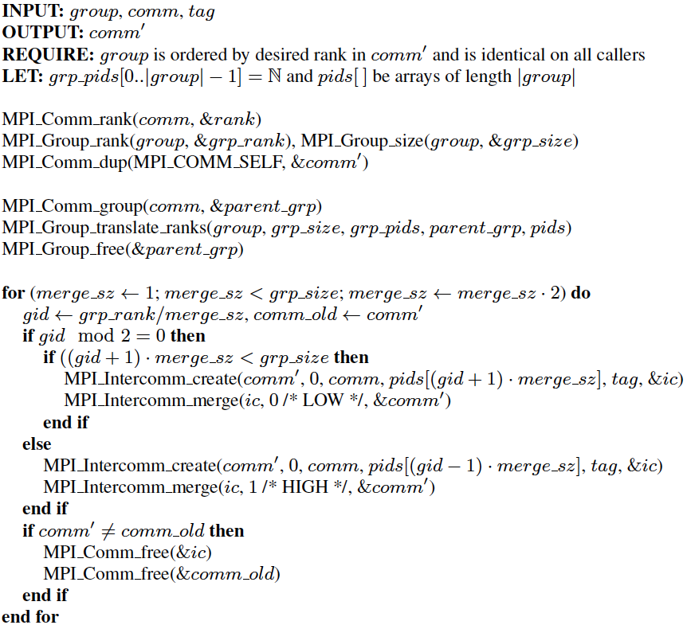
Non-Collective Algorithm in Detail
R
Translate group ranks to ordered list of ranks on parent communicator
Calculate my group ID
Left group
Right group

Slide 5
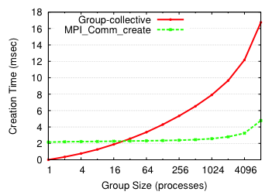
Evaluation: Microbenchmark
O(log² g)
O(log p)

Slide 6
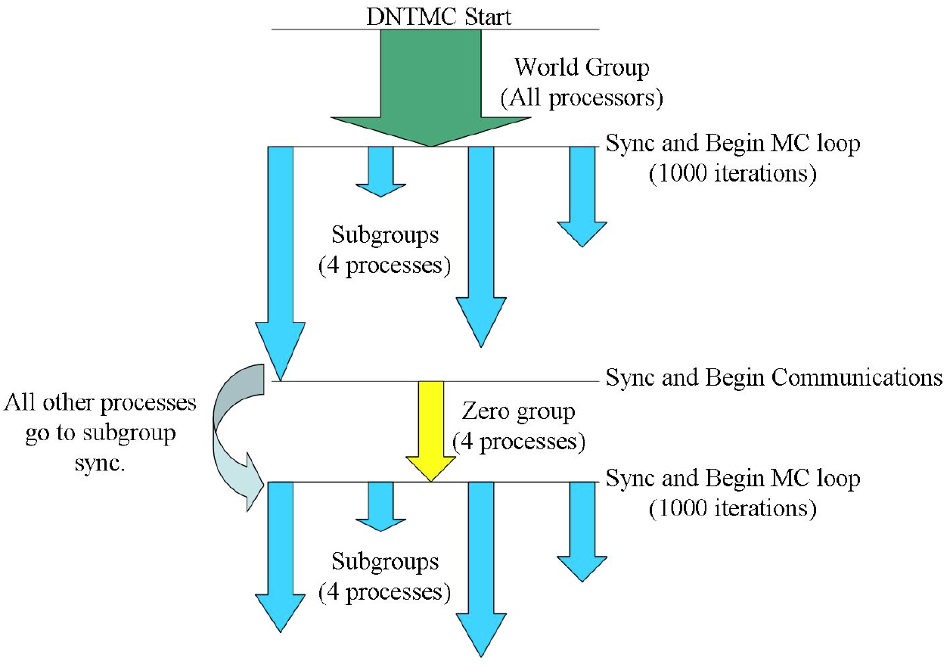
Case Study: Markov Chain Monte Carlo
Dynamical nucleation theory Monte Carlo (DNTMC)
Part of NWChem
Markov chain Monte Carlo
Multiple levels of parallelism
Multi-node “Walker” groups
Walker: N random samples
Load imbalance
Sample computation (energy calculation) is irregular, can be rejected
Regroup idle processes into active group
Preliminary results: 30% decrease in total application execution time
T L Windus et al 2008 J. Phys.: Conf. Ser. 125 012017

Slide 7
Santorini straw vote to proceed with a formal reading: Yes ( 16 ), No ( 0 ), Abstain ( 1 )

