Slide 1
Group-Collective Communicator Creation
Ticket #286
Non-Collective Communicator Creation in MPI. Dinan, et al., Euro MPI ‘11.

Slide 2
Non-Collective Communicator Creation
Create a communicator collectively only on new members
Global Arrays process groups
Past: collectives using MPI Send/Recv
Overhead reduction
Multi-level parallelism
Small communicators when parent is large
Recovery from failures
Not all ranks in parent can participate
Load balancing
Reassign processes from idle groups to active groups
☹

Slide 3
Non-Collective Communicator Creation Algorithm
0
1
2
3
4
5
6
7
MPI_COMM_SELF
(intracommunicator)
MPI_Intercomm_create
(intercommunicator)
MPI_Intercomm_merge
0
1
2
3
4
5
6
7
0
1
2
3
4
5
6
7
0
1
2
3
4
5
6
7
✓

Slide 4
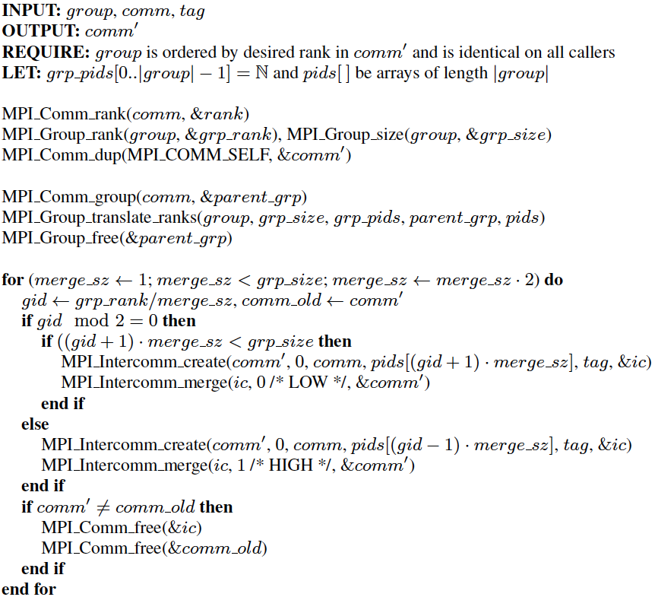
Non-Collective Algorithm in Detail
R
Translate group ranks to ordered list of ranks on parent communicator
Calculate my group ID
Left group
Right group

Slide 5
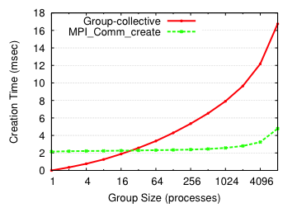
Evaluation: Microbenchmark
O(log² g)
O(log p)

Slide 6
MCMC Benchmark Kernel
Simple MPI-only benchmark
“Walker” groups
Initial group size: G = 4
Simple work distribution
Samples: S = (leader % 32) * 10,000
Sample time: t_{s} = 100 ms / |G|
Weak scaling benchmark
Load balancing
Join right when idle
Asynchronous: Check for merge request after each work unit
Synchronous: Collectively regroup every i samples
0 | 4 | 8 | 12 | … | 32 | 36 | 40 | 44 | …

Slide 7
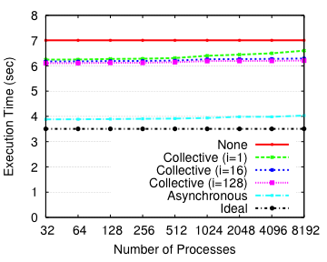
Evaluation: Load Balancing Benchmark Results

Slide 8
Ticket #286: Group-collective communicator creation
MPI_Comm_create_group(comm, group, tag, newcomm)
IN comm communicator (handle)
IN group Group, which is a subset of the group of comm (handle)
IN tag "safe" tag (integer)
OUT newcomm new communicator (handle)
int MPI_Comm_create_group(MPI_Comm comm, MPI_Group group, int tag, MPI_Comm *newcomm)
MPI_COMM_CREATE(COMM, GROUP, TAG, NEWCOMM, IERROR)
INTEGER COMM, GROUP, KEY, NEWCOMM, IERROR

Slide 9
MPI_COMM_CREATE_GROUP provides the same semantics as MPI_COMM_CREATE, however comm must be an intracommunicator and this routine need only be invoked by processes in the input group, group. Like MPI_COMM_CREATE, if a process calling MPI_COMM_CREATE_GROUP is not a member of given group it returns MPI_COMM_NULL. If different groups are provided by different callees, the calls will be interpreted as separate group-collective communicator construction operations; each call requires all members of the group to invoke this routine. This results in the same behavior as MPI_COMM_CREATE with different group arguments.
Advice to users: Group-collective creation of an intercommunicator can be achieved by creating the local communicator using MPI_COMM_CREATE_GROUP and using this as the input to MPI_INTERCOMM_CREATE.
This call may use point-to-point communication with communicator comm, and tag tag between processes in group. Thus, care must be taken that there be no pending communication on comm that could interfere with this communication. Likewise, if a given process performs multiple subset-collective communicator creation calls, the user must be careful to order calls and use different tag arguments to ensure that calls match correctly.
Advice to users: MPI_COMM_CREATE may provide lower overhead because it can take advantage of collective communication on comm when constructing newcomm.
Proceed with proposal? Yes ( 16 ), No ( 0 ), Abstain ( 1 )

