Slide 1
Tickets #324 and #477
Fault Tolerance Working Group
September 2015 MPI Forum

Slide 2
Background
Section 8.3 is imprecise about where MPI_ERRORS_ARE_FATAL is applied.
The first and second sentences are contradictory (MPI_ABORT accepts a communicator argument)
The second sentence is more permissive for FT implementations and good software engineering.

Slide 3
Motivation
Allows the application to clean itself up after an error.
Flush state to disk, close files, etc.
Step 0 for any FT solution
Could be part of ULFM, but this is more generic.
Allows very basic FT implementations and applications
Without these changes, if any communicator uses MPI_ERRORS_ARE_FATAL, all use it.
Even if users don’t want FT, they still might want to clean up reliably
Have some users at BSC who would already like to see this available

Slide 4
Changes Summary - Ticket 324
MPI_ERRORS_ARE_FATAL causes all connected processes to abort (as if called by MPI_ABORT).
Better define how communicators inherit error handlers for each communicator creation function.
Windows all inherit their error handler from MPI_WIN_NULL
Mirrors files
General text cleanup to have definitions in a single place.
ADVICE: HQI should detect aborts correctly

Slide 5
Changes Summary - Ticket 477
Add new error handler MPI_ERRORS_ABORT which aborts only a communicator
Define MPI_COMM_SELF as default communicator for error handlers (instead of MPI_COMM_WORLD)

Slide 6
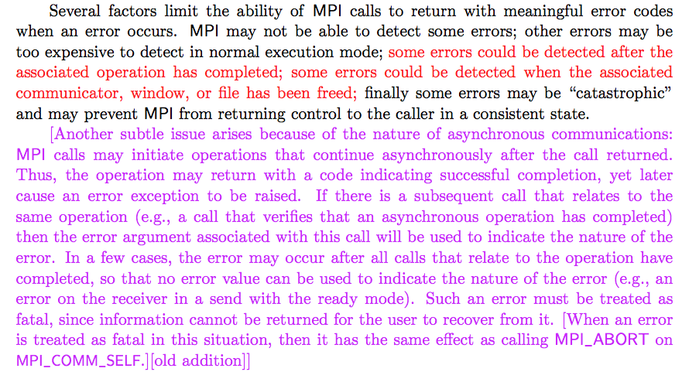
324 - Section 2.8 (p. 21)
Replace unclear purple text with shorter red text

Slide 7
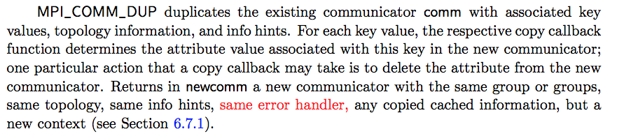
324 - Section 6.4 (p. 240)
MPI_COMM_DUP propagates error handler
Also covers MPI_COMM_DUP_WITH_INFO and MPI_COMM_IDUP

Slide 8
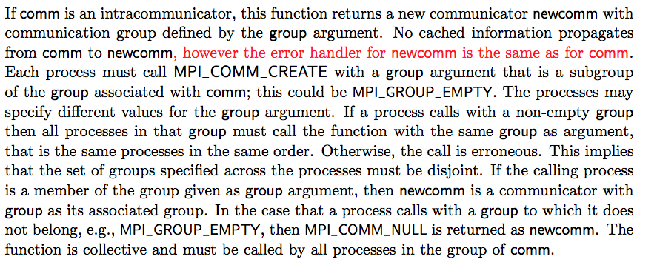
324 - Section 6.4 (p. 242)
MPI_COMM_CREATE propagates error handler

Slide 9
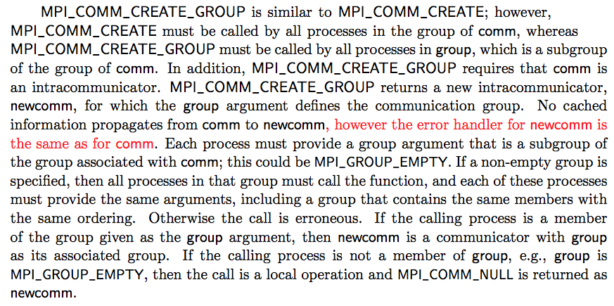
324 - Section 6.4 (p. 245)
MPI_COMM_CREATE_GROUP propagates error handler

Slide 10
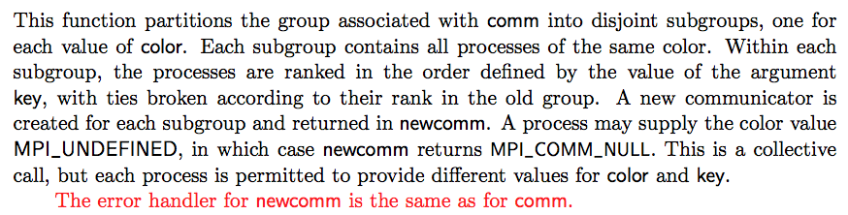
324 - Section 6.4 (p. 246)
MPI_COMM_SPLIT propagates error handler

Slide 11
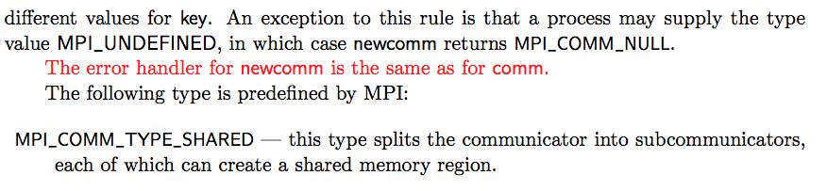
324 - Section 6.4 (p. 250)
MPI_COMM_SPLIT_TYPE propagates error handler

Slide 12

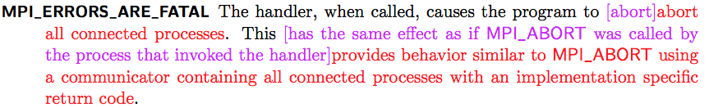
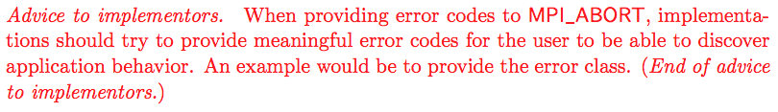
324 - Section 8.3 (p. 342)
return code for what?
More clearly say that we want to return error classes here (except when you can’t)
Add callback to section about general error handling
Clarify definition of MPI_ERRORS_ARE_FATAL
Add advice about MPI_ABORT error codes

Slide 13
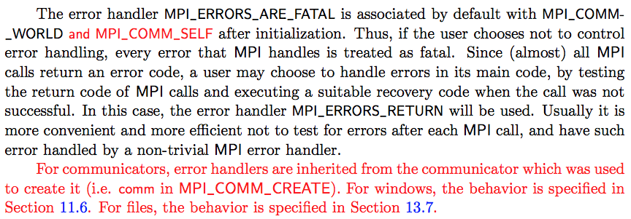
324 - Section 8.3 (p. 343)
add text for “MPI_COMM_PARENT”
A communicator’s error handler is inherited from the communicator which was used to create it (e.g., …
Don’t define communicators here, point to the definitions of the functions
Set MPI_ERRORS_ARE_FATAL as default for MPI_COMM_SELF (no prev default)
Generally specify default behavior for inheritance

Slide 14
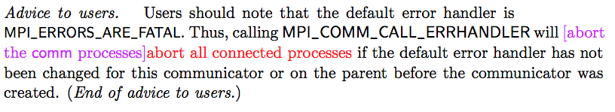
324 - Section 8.5 (p. 355)
Update advice for MPI_COMM_CALL_ERRHANDLER

Slide 15
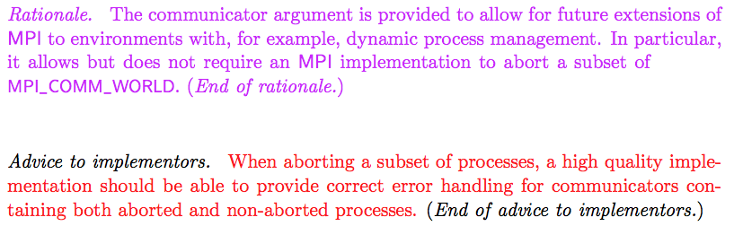
324 - Section 8.7 (p. 363)
Update PDF on ticket
correct error handling is not well defined
Remove old rationale
Add advice to impl about detecting aborts

Slide 16
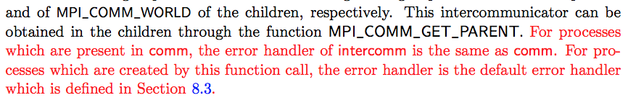
324 - Section 10.3 (p. 377)
FIXME!
same as comm on each process
Double check MPI_COMM_JOIN, CONNECT/ACCEPT, INTERCOMM_CREATE/MERGE, etc.
p. 379 SPAWN -> MPI_COMM_SPAWN
Specify default error handler for MPI_COMM_SPAWN
Notes:
Remember that error handlers are local

Slide 17
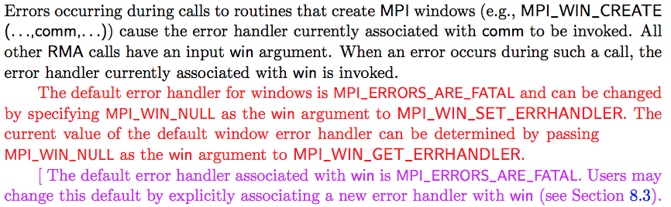
324 - Section 11.6.1 (p. 454)
Specify default error handler for RMA
Mirrors existing spec for files

Slide 18
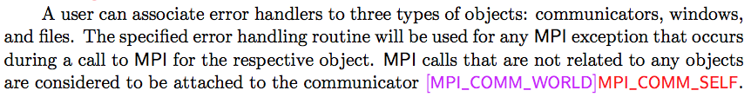
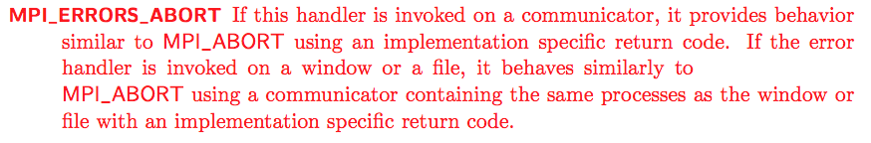
477 - Section 8.3 (p. 342)
ADD JUSTIFICATION SLIDE
Change default error handler from MPI_COMM_WORLD to MPI_COMM_SELF
Notes:
Discussed using MPI_COMM_NULL as the default communicator for operations that don’t have a communicator. The default error handler for MPI_COMM_NULL is whatever MPI_COMM_WORLD is. This would also need to allow MPI_ABORT to accept MPI_COMM_NULL.
We took a straw vote and it was about 15 - 3 in favor of the current proposal rather than MPI_COMM_NULL.

Slide 19
Burden on Implementations
Must provide MPI_ERRORS_ABORT
In practice, could be the same as MPI_ERRORS_ARE_FATAL
Change error handler propagation for windows
Minor change to inherit from MPI_WIN_NULL
Can still abort all processes if that’s what the implementation wants to do
Implementations that choose to do better now have clear instructions
Optional:
Improve MPI_ABORT to only abort a subcommunicator

Slide 20
Implementation
MPICH
Need to add new error handler
Open MPI
Runtime doesn’t support continuing with a subset of processes
Should be easy to implement in UTK branch for ULFM
Notes:
Internally, it may be necessary for an implementation to notify all communicators about an abort in order to cleanup correctly.

Slide 21
Backup Slides

Slide 22
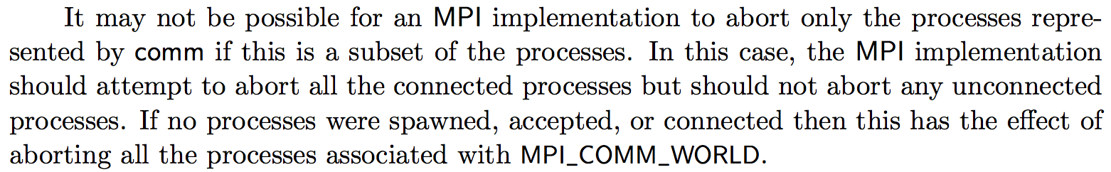
Previous Objections
This prevents the application from handling an exception safely! (MPI_SEND kills apps)
If you want to be safe, set your error handler to MPI_ERRORS_RETURN on communicators that you want to keep alive.
Completing MPI_SEND does not imply that the message has been received (or that the receiver is alive).
This has a large burden on implementations!
This is just as optional as FT has always been. Feel free to abort.

Slide 23
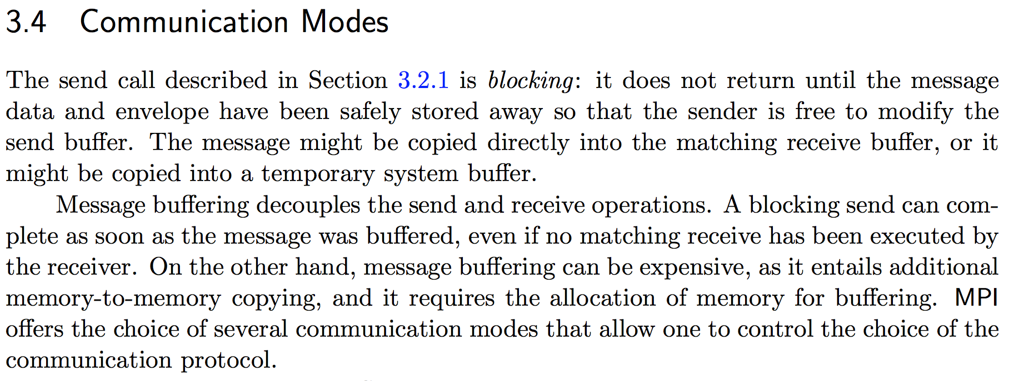
Why MPI_Send can succeed when the receiver is dead
Returning from MPI_Send does not imply that the message is received, only buffered somewhere.

