Slide 1
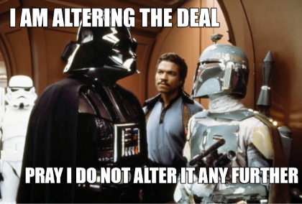
MPI Forum RCM/FRM Meeting Procedure

Slide 2

At the “RCM” (Feb 22 – Feb 25) MPI Forum Chair
Present the compiled list of changes since the Release Candidate Document was published that have been made and will be made before completing MPI 4.0.
Already Done
(chap. cmte. changes at RCM)
Fix whitespace on p. 483
...
To Do
(errata at FRM)
Fixes for Big Counts
...
February 2021
March 2021
April 2021
May 2021
June 2021
RCM
FRM

Slide 3
Immediately (By This Friday, Feb 26) Chapter Committee Chairs
Create issues in mpi-forum/mpi-issues repository for all remaining issues
Add them to the MPI 4.0 project
If you already have an issue, you’re done!
Issues that are being tracked across multiple pull requests either need to combine the pull requests or separate the issues.
There should be a 1:1 mapping from issue to pull request.
February 2021
March 2021
April 2021
May 2021
June 2021
RCM
FRM

Slide 4
Immediately MPI Standard Document Editor
Merge all pull requests that have been approved (at the December meeting and the February meeting) back into the mpi-4.x branch.
Create a new branch called mpi-4-rc-june starting at the point where the above work is completed.
February 2021
March 2021
April 2021
May 2021
June 2021
RCM
FRM

Slide 5
Between Now and April 26 Chapter Committee Chairs
Create new pull requests for all issues that were delayed and new issues raised during February meeting.
New pull requests should be made against the new mpi-4-rc-june branch
Focus on “emergency fixes” for newly introduced features. Long-term cleanup should aim for MPI 4.1.
If you have existing text in the mpi-4-rc branch, you can use `git cherry-pick` to replay your commits on a new branch based on mpi-4-rc-june (example on next slide).
Discuss changes in virtual meetings.
February 2021
March 2021
April 2021
May 2021
June 2021
RCM
FRM

Slide 6
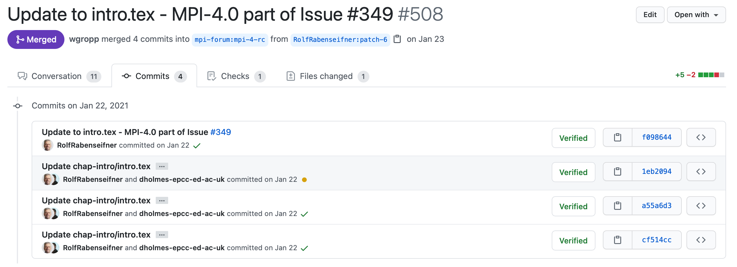
Example of Replaying Existing Text
$ git remote –v mpi-forum https://github.com/mpi-forum/mpi-standard.git (fetch) mpi-forum https://github.com/mpi-forum/mpi-standard.git (push) wesbland https://github.com/wesbland/mpi-standard.git (fetch) wesbland https://github.com/wesbland/mpi-standard.git (push) $ git fetch –all $ git checkout –b intro_fixes mpi-forum/mpi-4-rc-june $ git cherry-pick cf514cc $ git cherry-pick a55a6d3 $ git cherry-pick 1eb2094 $ git cherry-pick f098644
$ # Continue making edits from here...
Find old Pull Request on GitHub and look at “Commits” tab

Slide 7
Problems Finishing 4.0
It’s not clear when an issue is ready to be merged
Some issues are either being merged too early (e.g., see February RC)
Some are merged later than necessary (makes RC unstable at the end of the cycle)
There are too many issues that should be delayed for MPI 4.1 clogging up the 4.0 bandwidth
Large, non-critical issues can delay MPI 4.0 further

Slide 8
When Should an Issue be Merged?
We need a definitive way to say that an issue is ready to be merged into the RC.
In the normal process, votes determine this. Things are clear. 👍
When merging before the votes (RC model), things aren’t clear and merged too early. 👎
Suggestion: We have a “release manager” who ensures that PR have adequate reviews and that all items are addressed before marking them as ready to go for Bill.
Further suggestion: Wes is the release manager.

Slide 9
We’re Seeing Too Many New Changes
Original goal:
Fix problems with MPI 4.0 that were introduced by MPI 4.0
Partitioned Communication, Sessions, MPI_T Events, etc.
Fix other emergency issues that would cause backward incompatibilities
Reality:
Many issues that are unrelated to these goals are being raised for 4.0 and are likely to delay things again.
Example: progress definitions, “MPI process”, etc.
31 issues currently tagged with “mpi-4.0”

Slide 10
Suggestion: Release Manager as Gatekeeper
Most items currently being considered for MPI 4.0 are being considered “because we have time”.
We don’t have time and many of these little things are piling up and could delay MPI 4.0 again.
Wes will be going through the project board and relabeling things that do not cause breaking changes for MPI 4.0 and moving them to MPI 4.1.
Anything already merged since the Feb meeting (and not reverted) will be kept in.
These issues can (and should) still be addressed, but we’ll work on them immediately after the June meeting through the normal process.
February 2021
March 2021
April 2021
May 2021
June 2021
RCM
FRM

Slide 11
Proposed Resolutions
Issues to continue for MPI 4.0 (12):
#424, #433, #437, #438, #440, #444, #454, #456, #459, #460, #489, #491
Issues to move to MPI 4.1 (8):
#350, #443, #449, #457, #466, #468,#492, #493
Issues already merged (pending vote) for MPI 4.0 (9):
#435, #453, #458, #461, #462, #463, #464, #465, #488
Issues to close (2):
#405, #450

Slide 12
6 weeks before the FRM (April 26) Chapter Committee Chairs
Resolve all remaining open issues from the previous lists
Work with Bill to merge any changes (prior to errata vote at the FRM)
Complete all informal readings for any opened PRs
All PRs need to be posted by April 26 to give time for Bill to review and merge them.
February 2021
March 2021
April 2021
May 2021
June 2021
RCM
FRM

Slide 13
4 weeks before the FRM (May 10) MPI Standard Document Editor
Publish a new Release Candidate Document
Anything that was officially voted in at the previous meeting goes into the mpi-4.x branch.
Anything that still needs a vote goes into the mpi-4-rc-june branch.
The mpi-4-rc-june branch should be based on (or merged with) the mpi-4.x branch.
February 2021
March 2021
April 2021
May 2021
June 2021
RCM
FRM

Slide 14
2 weeks before the FRM (May 24) MPI Forum Chair
MPI Forum officer nominations close
February 2021
March 2021
April 2021
May 2021
June 2021
RCM
FRM

Slide 15
At the FRM (June 7 – June 9) Chapter Committee Chairs
Present changes since the December 2020 RCM

Slide 16
At the FRM (June 7 – June 9) MPI Forum Secretary
Conduct a ballot for each change that happened between the RCM and FRM that was on the previously published list.
This follows “errata” rules and anything that fails will need to be reverted.
Conduct a ballot for each change that happened between the RCM and FRM that was not on the previously published list.
This follows the “no-no” rules and anything that fails will need to be reverted.
February 2021
March 2021
April 2021
May 2021
June 2021
RCM
FRM

Slide 17
At the FRM (June 7 – June 9) MPI Forum Chair
Compile a list of all still-unresolved issues that could be fixed before releasing MPI 4.0.
February 2021
March 2021
April 2021
May 2021
June 2021
RCM
FRM

Slide 18
At the FRM (June 7 – June 9) MPI Forum Secretary
If there is anything left on the chair’s list, on a different date than the previous ballots, hold another ballot about whether to delay ratification.
If this passes, repeat the FRM at the next meeting.
Conduct a ballot on whether to ratify the entire document
If this passes, Bill publishes the final version of MPI 4.0 to the MPI Forum website.
If this fails, start back at the beginning of this slide deck.
February 2021
March 2021
April 2021
May 2021
June 2021
RCM
FRM

Slide 19
At the FRM (June 7 – June 9) MPI Forum Secretary
Conduct ballots for the MPI Forum Officers
Following the procedures in the procedures document (i.e., continue ballots until some candidate for each office has a majority of non-abstain votes).
New officers begin their term and work with the old officers to transfer knowledge, state secrets, executive washroom keys, etc.
February 2021
March 2021
April 2021
May 2021
June 2021
RCM
FRM

