Slide 1
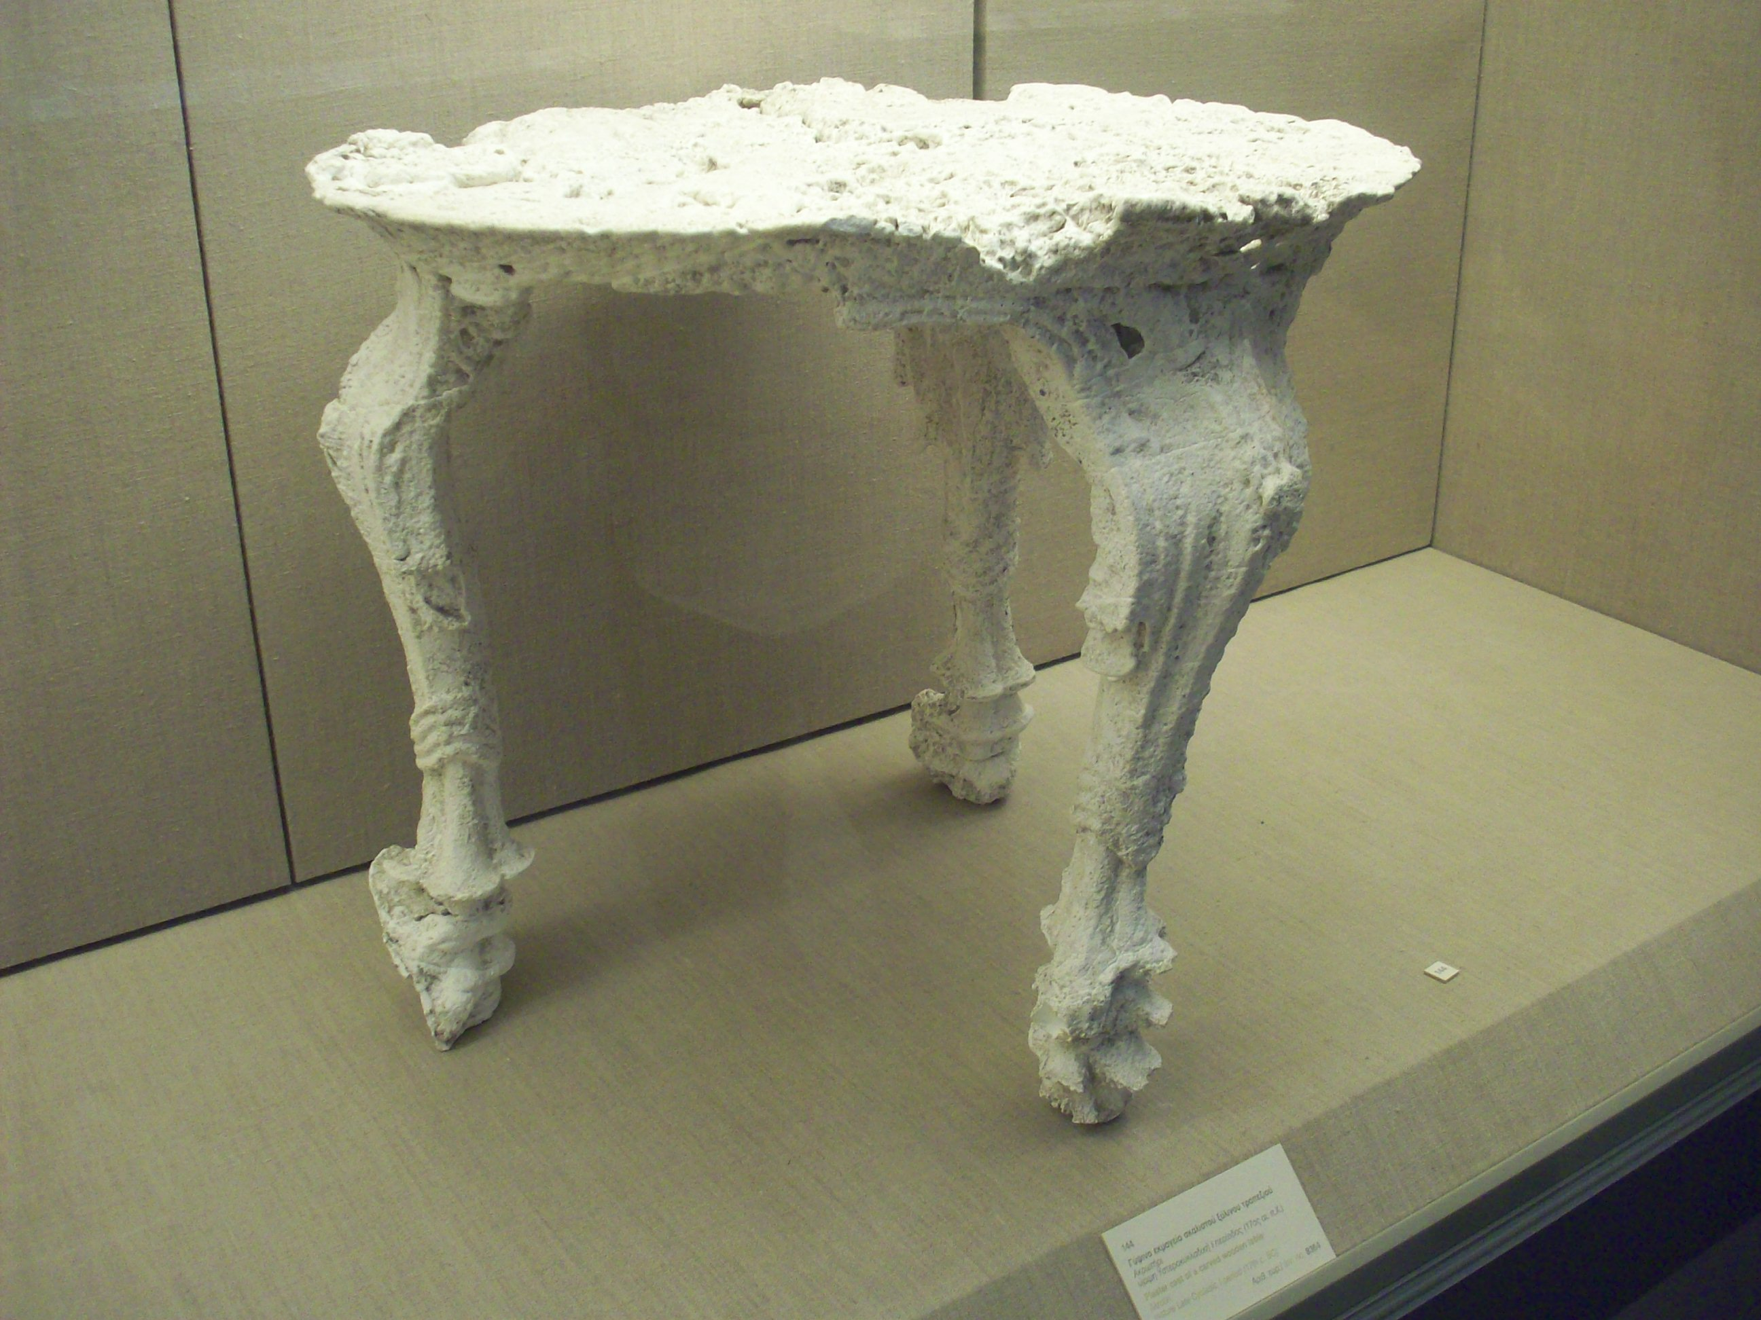

Slide 2
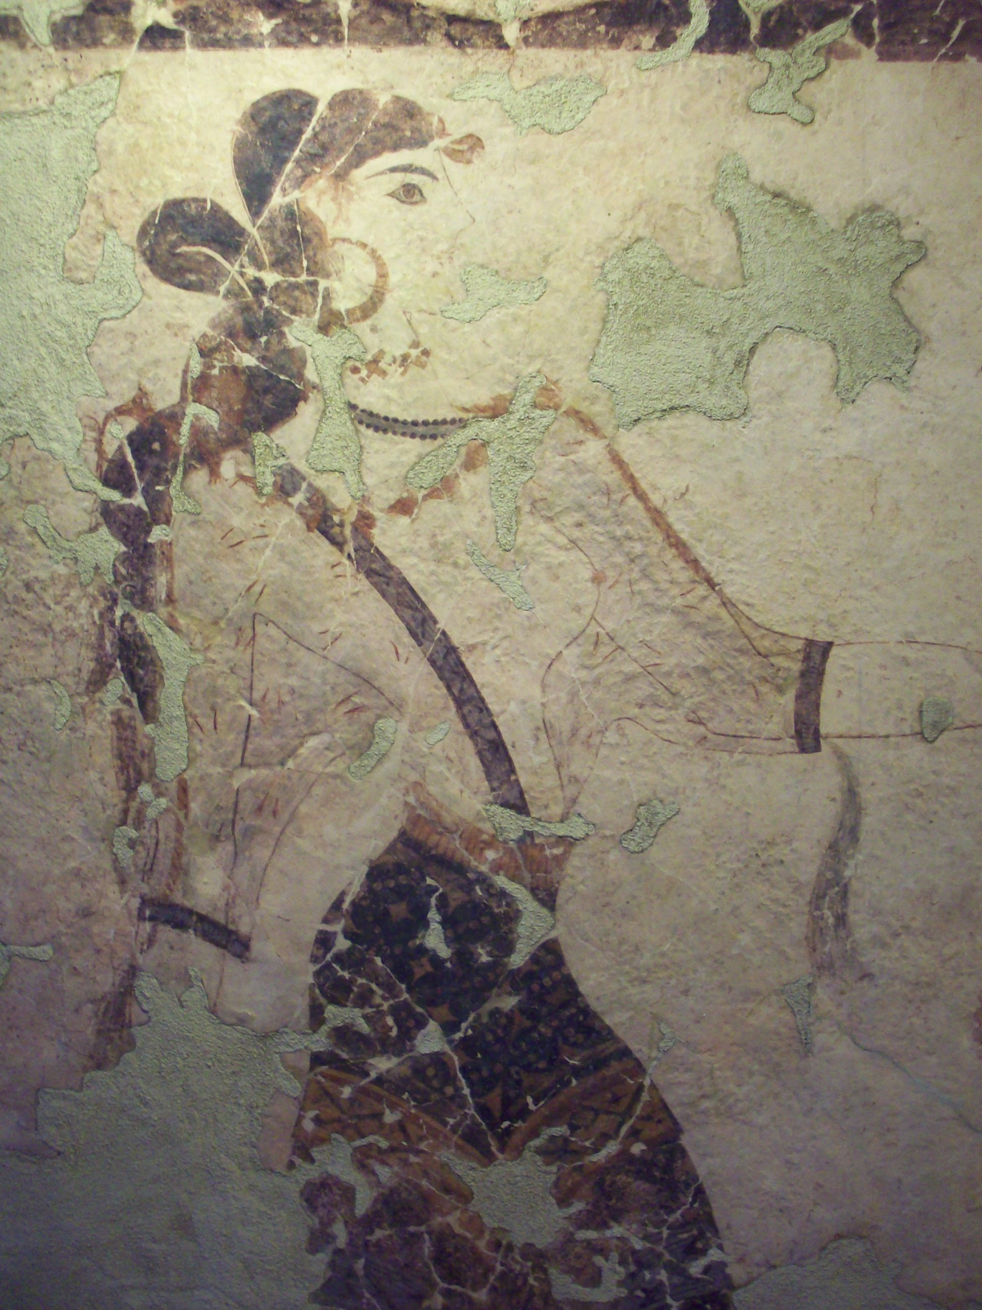
http://findarticles.com/p/articles/mi_hb3284/is_n272_v71/ai_n28697339/
FindArticles / Reference / Antiquity / June, 1997
A lepidopterous cocoon from Thera and evidence for silk in the Aegean Bronze Age by E. Panagiotakopulu, P.C. Buckland, P.M. Day, C. Doumas, A. Sarpaki, P. Skidmore

