Slide 1
Non-Collective Communicator Creation
Tickets #286 and #305
int MPI_Comm_create_group(MPI_Comm comm, MPI_Group group, int tag, MPI_Comm *newcomm)
Non-Collective Communicator Creation in MPI. Dinan, et al., Euro MPI ‘11.

Slide 2
Non-Collective Communicator Creation
Current: Collective on parent
Proposed: Create communicator collectively only on new members
Avoid coarse-grain synchronization
Load balancing: Reassign processes from idle groups to active groups
Reduce overhead
Multi-level parallelism, create small communicators
Recovery from failures
Not all ranks in parent can participate
Compatibility with Global Arrays
Past: collectives using MPI Send/Recv
☹

Slide 3
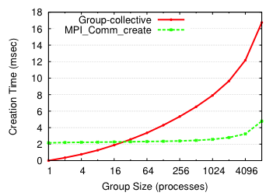
Evaluation: Microbenchmark
O(log² g)
O(log p)

Slide 4
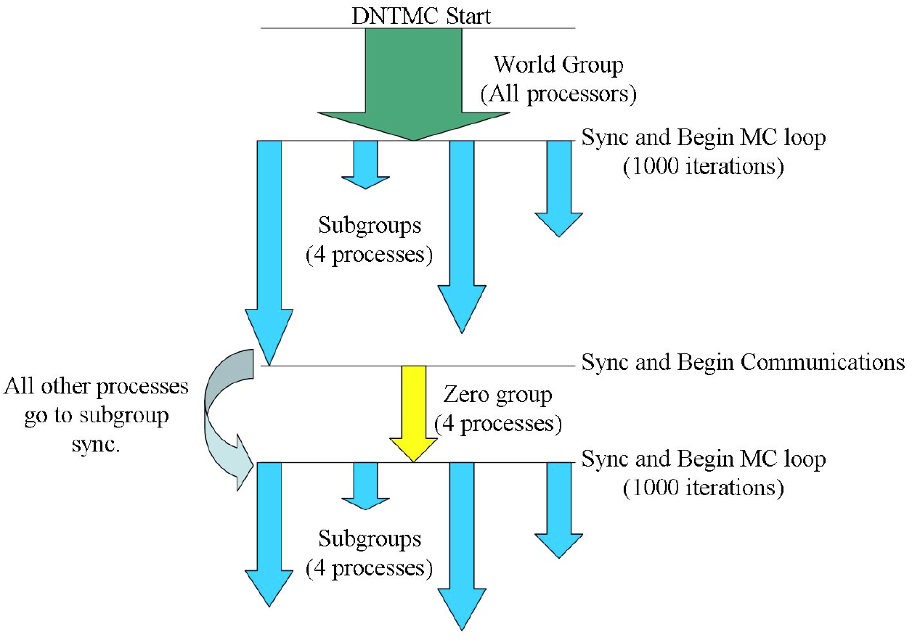
Case Study: Markov Chain Monte Carlo
Dynamical nucleation theory Monte Carlo (DNTMC)
Markov chain Monte Carlo
Part of NWChem
Multiple levels of parallelism
Multi-node “Walker” groups
Walker: N random samples
Load imbalance across groups
Regroup idle processes into active group
37% decrease in total application execution time
Load Balancing of Dynamical Nucleation Theory Monte Carlo Simulations Through Resource Sharing Barriers [IPDPS ‘12]
T L Windus et al 2008 J. Phys.: Conf. Ser. 125 012017

Slide 5
Update: Tagged Collectives Tag Space
Define two tag spaces:
Point-to-point tag space
Tagged collectives tag space
Spaces share the same semantics
MPI_TAG_UB
MPI_TAG_ANY
…
Tags match only within the same space
Ticket #305: Extend MPI_Intercomm_create(…) to use TCTS
Backward compatible, much easier to use
Notes:
In Favor: 16, No: 0, Abstain: 4

