Slide 1
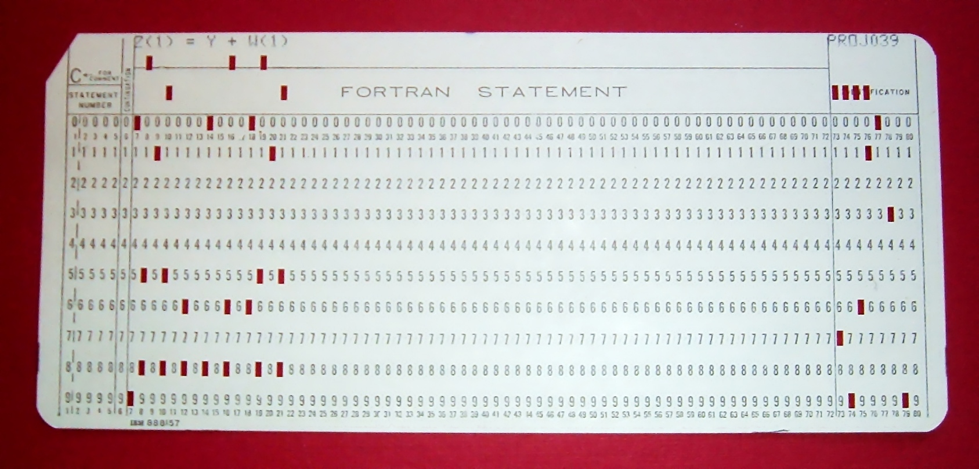
Everyone loves Fortran

Slide 2
1. Deprecate mpif.h

Slide 3
Fortran refresher
Two Fortran interfaces for each MPI function
Available in three different bindings
Integer
MPI handles
Derived type
MPI handles
mpif.h
mpi
module
mpi_f08
module

Slide 4
The goal
Deprecate mpif.h
Leave mpi module alone (not deprecated)
Integer
MPI handles
Derived type
MPI handles
mpif.h
mpi
module
mpi_f08
module

Slide 5
Why bother?
Still going to have the integer MPI handle interface, so why bother deprecating mpif.h?
Integer
MPI handles
mpif.h
mpi
module

Slide 6
Why bother?
Signal to the user community that the integer MPI handle interface is old
Integer
MPI handles
mpif.h
mpi
module

Slide 7
Why bother?
Most (all?) MPI implementations’ mpif.h do not contain interfaces (prototypes). The mpi module must contain interfaces.
Integer
MPI handles
mpif.h
mpi
module

Slide 8

Consequences
mpif.h is frozen
No MPI-3.1/beyond functions will be added to mpif.h

Slide 9

Consequences
HOWEVER
Most (all?) MPI implementations’ mpif.h do not contain interfaces (prototypes)
So most users will (continue to) be able to use MPI-3.1/beyond subroutines in mpif.h subroutines, anyway

Slide 10

Consequences
Technically, mpif.h will be frozen
Practically:
Deprecated, not removed
No legacy codes will break
Extending legacy/mpif.h codes to use MPI-3.1/beyond functions will likely still work
→ Unless they use new MPI-3.1+ constants! These will not be in mpif.h

Slide 11
Consequences
We expect most users will ignore the fact that mpif.h is deprecated
Codes that do convert to the mpi module:
2 line code change
Get compile-time type checking
Paves the way for removing the integer handle interfaces in ?MPI-10?
…and MPI implementations will continue to have it for even longer than that

Slide 12
Public service announcement
From OMPI SC’14 BOF slides
STOP USING mpif.h!
All modern Fortran compilers have strong “use mpi” Open MPI support
Modern = Gfortran >= v4.9
Modern = any other Fortran compiler

Slide 13
Public service announcement
From OMPI SC’14 BOF slides
Change two lines of code
subroutine foo
implicit none
include ‘mpif.h’
integer :: a
…
subroutine foo
use mpi
implicit none
integer :: a
…

Slide 14
Public service announcement
From OMPI SC’14 BOF slides
mpif.h
Stop the madness

Slide 15
2. Deprecate MPI_SIZEOF

Slide 16
Fortran refresher
MPI_SIZEOF added in MPI-2
Circa 1996
No other way in Fortran (90) to get the size, in bytes, of an element
MPI_SIZEOF returns size of a single element (even if you pass in an array)

Slide 17
Fortran refresher
MPI_SIZEOF
Number of bytes of a single element
F08 storage_size() intrinsic
Number of bits of a single element
F08 c_sizeof() intrinsic
Same result of sizeof() in C

Slide 18
The goal
Deprecate MPI_SIZEOF in MPI-4
Circa 2016

Slide 19
Why bother?
MPI_SIZEOF no longer necessary
F08 has c_sizeof() and storage_size() intrinsics
MPI should not subvert native language constructs
Particularly for MPI functions explicitly added to make up for a (previous) language deficiency
MPI_SIZEOF is somewhat annoying to implement

Slide 20

Consequences
Plenty of time for any Fortran compiler who has not already implemented these to actually implement them

Slide 21
Consequences
There are codes using MPI_SIZEOF today

Slide 22

Consequences
These codes will require a minor code change

Slide 23
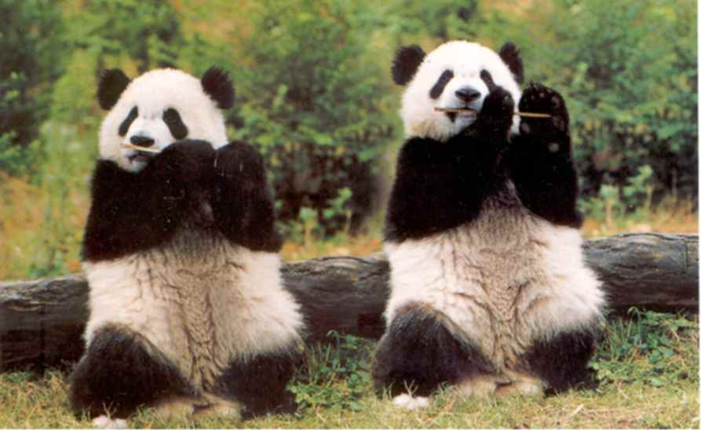
Consequences
MPI implementations will carry MPI_SIZEOF forever

