Slide 1
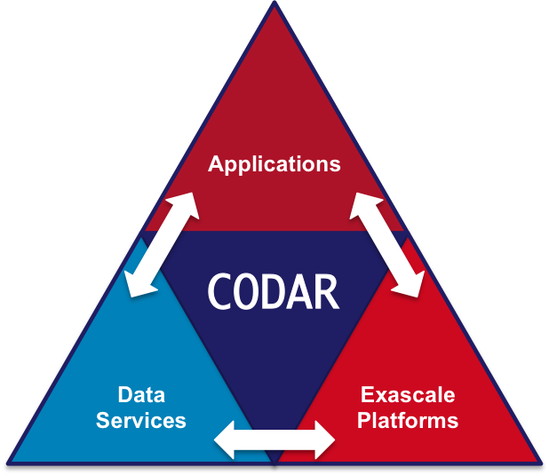

MPI_COMM_LAUNCH(): Advanced Support for multi-application workloads in mpi
erhtjhtyhy
Justin M Wozniak
Computer Scientist
Data Science & Learning Division
Argonne National Laboratory
MPI Forum @ Cisco
December 5, 2018

Slide 2
context
Want to run scientific ensembles:
Parameter sweeps, searches, optimizations
Tests under varying parameters and process counts
Workflows and code coupling cases where jobs can exit or fail
State of the art:
MPI_Comm_spawn() has limited availability
in part due to complexity of implementing?
MPI_Comm_spawn() does not support job exit detection and failures
Users write complex shell scripts against vendor-specific job launchers
Proposing an alternate function: MPI_Comm_launch()
Implemented on clusters (via MPICH/mpiexec hack) and by a vendor (internal)

Slide 3
MPI_COMM_LAUNCH(): details
int MPIX_Comm_launch(const char *cmd, char **argv,
MPI_Info info, MPI_Comm comm,
int* exit_code);
Runs “in-place” on given communicator- no interaction with scheduler, etc.
Parent is blocked
No communication between parent and child
Parent gets exit code- easy recovery from child failures

Slide 4
MPI_COMM_LAUNCH(): Benefits
Allows user to use familiar communicator management to setup subjob
We have done things with MPI_Comm_split() and MPI_Comm_create_group()
Easy to work with unmodified child codes
Allows for the development of MPI-based workload management systems
Write simple test harnesses or parameter sweeps in C or Fortran + MPI
Or use an MPI-based system like ADLB, Swift/T, or MPI-Bash (all implemented!)
Possibly work with other parallel programming systems?

Slide 5
Questions / comments ?
Thanks for listening!
For more info see: Launching MPI applications inside MPI applications Proc. WORKS @ SC 2017.

Slide 6
Acknowledgments
This research was supported by the Exascale Computing Project (17-SC-20-SC), a joint project of the U.S. Department of Energy’s Office of Science and National Nuclear Security Administration, responsible for delivering a capable exascale ecosystem, including software, applications, and hardware technology, to support the nation’s exascale computing imperative.

Slide 7
Extra slides: examples

Slide 8

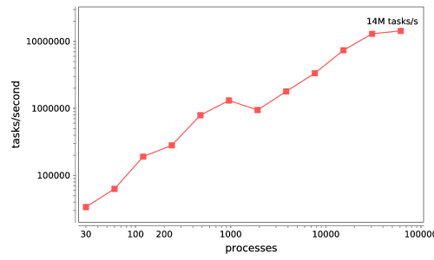







Swift/T: Enabling high-performance Scripted workflows
Supports tasks written in many languages
Write site-independent scripts, translates to MPI
Automatic task parallelization and data movement
Invoke native code, script fragments
Rapidly subdivide large partitions for MPI jobs in multiple ways
Swift/T control process
Swift/T worker
Swift worker process
C
C++
Fortran
C
C++
Fortran
MPI
C
C++
Fortran
64K cores of Blue Waters
2 billion Python tasks 14 million Pythons/s
Compiler techniques for massively scalable implicit task parallelism. Proc. SC 2014.
$ conda install -c lightsource2-tag swift-t

Slide 9
Swift/T example
When file A is created, launch N sub jobs of varying size
file B[]; // Define an array of file variables
A => {
foreach i in [0:N-1] {
file B_i<"B-%i.txt"%i>;
string args_B[] = [ int2string(i),
filename(A), filename(B_i) ];
@par=i launch("./child.x", args_B) => B_i = touch();
B[i] = B_i;
}}
Child tasks are load-balanced, MPI_Comm_create_group() is done automatically!

Slide 10
MPI-BAsh
Author: Scott Pakin (LANL)
Forked and extended for MPI_Comm_launch() by Wozniak
#! /usr/bin/env mpibash
enable -f mpibash.so
mpi_init mpi_init
mpi_comm_rank rank
mpi_barrier
if [ $rank -eq 0 ] ; then
iter=0
while [ $iter -lt $niters ] ; do
mpi_send 1 X
mpi_recv 1 msginfo
let iter++
done
. . .
# Run with:
$ mpirun -np 16 ./my-script.sh
#! /usr/bin/env mpibash
enable -f mpibash.so
mpi_init mpi_init
mpi_comm_rank rank
mpi_comm_split $rank $rank newcomm
echo newcomm: $newcomm
mpi_comm_set $newcomm
mpi_comm_rank rank
mpi_comm_launch hostname
echo exit_code $?
. . .

