Slide 1
MPI = Function Pointers
The Future Is Now
Jeff Squyres, Tony Skjellum, Martin Ruefenacht
MPI Forum
2019 Mar 7

Slide 3
What do we want?
A solution for Big Count
(Pseudo) Polymorphism for C
Sessions part deux
Different sessions = different resources (hardware/software)
Hyper-customization
Adaptability at each MPI handle (object)
The possibility of QMPI
QMPI = PMPI + 1
Preserve MPI-3 backwards compatibility
MPI_Init(…), MPI_Send(…), etc.

Slide 4
How do we do that?
Handles → Objects

Slide 5
General Scheme
Use MPI_Get_base(…) to get the first set of function pointers
Request a specific MPI version (e.g., 3, 4)
Get a “base” set of functions that are not tied to MPI handles
E.g.: Init, Initialized, Finalize, Finalized, Get_version, …etc.
All MPI handles now contain function pointers (i.e., methods)
C: structs with function pointers
Fortran: real classes / objects

Slide 6
All your base are belong to us
MPI_Get_base(enum version, void *interface)

Slide 7
All your base are belong to us
MPI_Get_base(enum version, void *interface)
version == MPI_VERSION_3
Init(…)
Init_thread(…)
Initialized(…)
Finalize()
Finalized(…)
…
MPI_3_Base

Slide 8
version == MPI_VERSION_3
MPI_Get_base(…)
MPI_Init(…)
MPI_3_Base

Slide 9
version == MPI_VERSION_3
MPI_Get_base(…)
MPI_Init(…)
MPI_3_Base
COMM_WORLD
MPI_3_Interface

Slide 10
version == MPI_VERSION_3
MPI_Get_base(…)
MPI_Init(…)
MPI_3_Base
COMM_WORLD
MPI_3_Interface
Send(…)
Recv(…)
Isend(…)
Irecv(…)
…
Test(…)
Wait(…)
…
MPI_3_Comm
MPI_3_Request

Slide 11
version == MPI_VERSION_3
MPI_Get_base(…)
MPI_Init(…)
MPI_3_Base
COMM_WORLD
MPI_3_Interface
Send(…)
Recv(…)
Isend(…)
Irecv(…)
…
Test(…)
Wait(…)
…
MPI_3_Comm
MPI_3_Request
Look familiar?

Slide 12
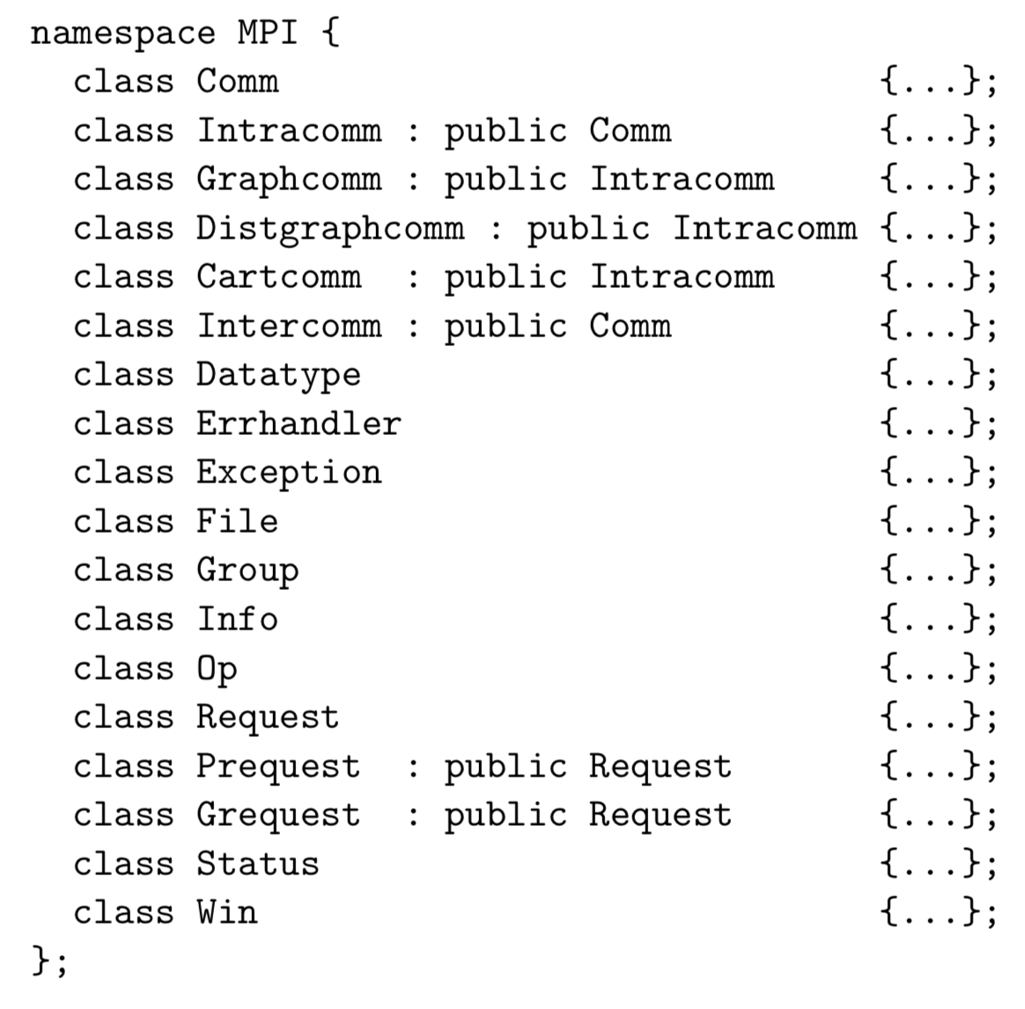

Slide 13
The MPI-2 C++ bindings
The C++ bindings nicely map out classes,
the methods they should contain, etc.

Slide 14
All your base are belong to us
MPI_Get_base(enum version, void *interface)
version == MPI_VERSION_4
Init(…)
Init_thread(…)
Initialized(…)
Finalize()
Finalized(…)
Session_init(…)
Session_finalize(…)
…
MPI_4_Base

Slide 15
version == MPI_VERSION_3
MPI_Get_base(…)
version == MPI_VERSION_4
MPI_3_Base
MPI_4_Base
Session_init(…)
Get_pset(…)
Get_info(…)
Group_from_pset(…)
…
MPI_4_Session

Slide 16
version == MPI_VERSION_3
MPI_Get_base(…)
version == MPI_VERSION_4
MPI_3_Base
MPI_4_Base
Session_init(…)
Incl(…)
Union(…)
Rank(…)
Size(…)
Create_comm(…)
…
Get_pset(…)
Get_info(…)
Group_from_pset(…)
…
MPI_4_Group
MPI_4_Session
Send(…)
Recv(…)
Isend(…)
Irecv(…)
…
MPI_4_Comm
MPI_Count counts

Slide 17
version == MPI_VERSION_3
MPI_Get_base(…)
version == MPI_VERSION_4
MPI_3_Base
MPI_4_Base
Session_init(…)
Incl(…)
Union(…)
Rank(…)
Size(…)
Create_comm(…)
…
Get_pset(…)
Get_info(…)
Group_from_pset(…)
…
MPI_4_Group
Function pointers all based on thread level and assertions from Session_init()
MPI_4_Session
Send(…)
Recv(…)
Isend(…)
Irecv(…)
…
MPI_4_Comm

Slide 18
version == MPI_VERSION_3
MPI_Get_base(…)
version == MPI_VERSION_4
MPI_3_Base
MPI_4_Base
Session_init(…)
Incl(…)
Union(…)
Rank(…)
Size(…)
Create_comm(…)
…
Get_pset(…)
Get_info(…)
Group_from_pset(…)
…
QP, scratch buffers, etc.
MPI_4_Group
Dedicated resources can be cached on the session
Send(…)
Recv(…)
Isend(…)
Irecv(…)
…
MPI_4_Session
MPI_4_Comm

Slide 19
How does this preserve backwards compatibility?

Slide 20
MPI_Foo() function wrappers
MPI_Init(…) / MPI_Init_thread(…) can:
Call MPI_Get_base() with version==MPI_VERSION_3
Stash the base in a global
All MPI_Foo() functions become wrappers around function pointer calls

Slide 21
How does this work with PMPI?

Slide 22
For MPI-4, it would be better with something like QMPI
Returned function pointers can point to tool functions instead of “real” MPI functions.
Ideas presented in QMPI slides are compatible with the function pointer philosophy.

Slide 23
…Leave slides to look at sample code…

