Slide 1


Architecture Design
Alexander Standaert
Wouter Diels

Slide 2
OUTLINE
ARCHITECTURE AND TIMING
DECODERS
SENSE AMPLIFIERS
LOAD
PLANNING AND CONTENT TABLE
CONCLUSION : Conclusion and Future work

Slide 3
TIMING (1)
LBen_0
SelLB_0
LBenbar_0
SelREF_0
RefEnable
LBen_1
SelLB_1
LBenbar_1
SelREF_1
BLencoded
BL decoder
WLencoded
WL decoder
Number of Bitlines
GBen
Start address
Start decoding
Constraints / Optimization
T1 ≈ T2 : cell should be selected when the load is turned on, if not → dead time. (BL and WL decoder same size)
T1 ≈ T3 : if T1 > T3 ref is selected before mem → energy waste ( Design non optimal ref buffer)
GBen
LBen_0
SelLB_0
Lbenbar_1
SelREF_1
BL_0
T₁
WL_0
T₂
RefEnable
T₃

Slide 4
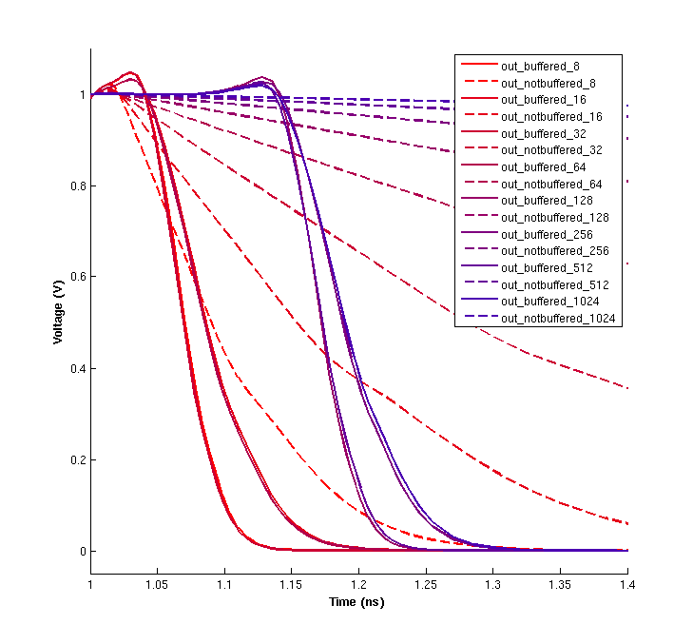









REFERENCE ARRAY: Buffers
RefEnable
Number of Bitlines
Buffer designed with logical effort
(stage effort = 4)

Slide 5
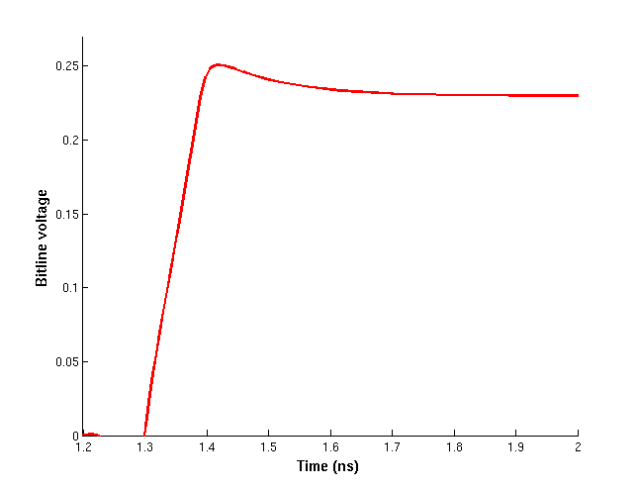
TIMING (2)
SelL
BL decoder
T5 is enabled
WL decoder
SelLbar
Memory cell connected to BL
Constraints / Optimization
cell should be selected when load is turned on → T₃≈ T₄≈ T₅ .
T₃< T₄ because of inverter. T₅ is dependent of size of BL and WL decoders. When T₃ < T₄,T₅ the bitline is rising without cell selected
Start decoding
Bitline start rising
BL decoder
SelL
T₃
SelLbar
T₄
WL decoder
WL
T₅

Slide 6
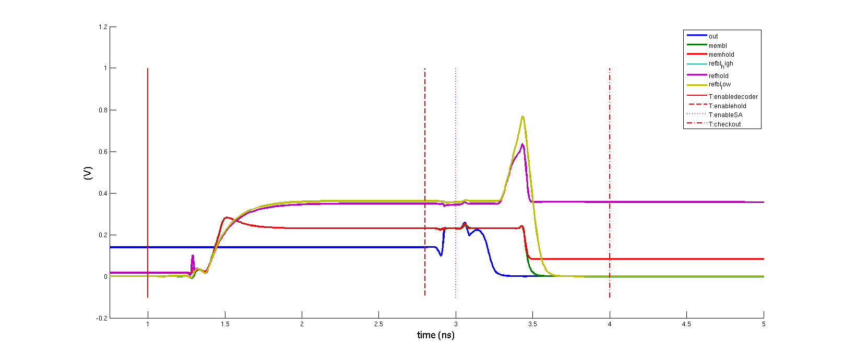
TIMING (3)
SelL
BL decoder
WL decoder
SelLbar
Memory cell disconnected to BL
Constraints / Optimization
cell should be deselected when load is turned off → T₃≈ T₄≈ T₅ .
T₃< T₄ because of inverter. T₅ is dependent of size of BL and WL decoders. When T₃ > T₅ the bitline is rising without cell selected
Start decoding
Bitline start falling
BL decoder
SelL
T₃
SelLbar
T₄
WL decoder
WL
T₅

Slide 7
TIMING (temp1)
Memory cell connected to BL
Bitline start rising
Memory cell disconnected to BL
Start decoding
Start decoding
Bitline start falling
BL decoder
BL decoder
SelL
SelL
T₄
T₇
SelLbar
SelLbar
T₅
T₈
WL decoder
WL decoder
WL
WL
T₆
T₉

Slide 8
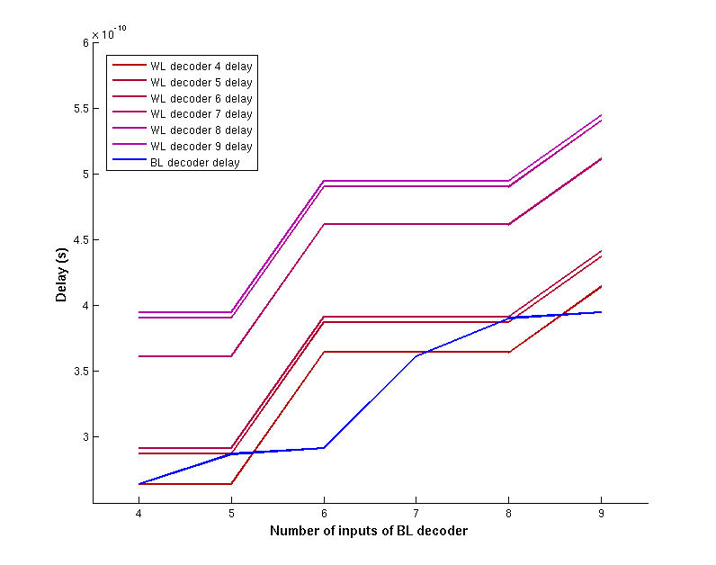
TIMING (4)
SelL
BL decoder
WL decoder
SelLbar
Memory cell disconnected to BL
Constraints / Optimization
cell should be deselected when load is turned off → T₃≈ T₄≈ T₅ .
T₃< T₄ because of inverter. T₅ is dependent of size of BL and WL decoders. When T₃ > T₅ the bitline is rising without cell selected
Start decoding
Bitline start falling
BL decoder
SelL
T₆
SelLbar
T₇
WL decoder
WL
T₈

Slide 9
TIMING (5)
SelL
SelLbar
Memory cell disconnected to BL
Constraints / Optimization
ref should be selected when load is turned on → T₆≈ T₇≈ T₈ .
T₆< T₇ because of inverter. T₈ is dependent of delay element (2 inverters)
Start decoding
Bitline start falling
RefEnable
SelL
T₆
SelLbar
T₇
WL
T₈

Slide 10
TIMING (6)
SelL
SelLbar
Memory cell disconnected to BL
Constraints / Optimization
ref should be selected when load is turned off → T₉≈ T₁₀≈ T₁₁ .
T₉< T₁₀ because of inverter. T₁₁ is dependent of 2 inverters
Start decoding
Bitline start falling
RefEnable
SelL
T₉
SelLbar
T₁₀
WL
T₁₁

Slide 11
TIMING (temp2)
Memory cell disconnected to BL
Bitline start falling
Memory cell disconnected to BL
Start decoding
Start decoding
Bitline start falling
RefEnable
RefEnable
SelL
SelL
T₁₂
T₁₅
SelLbar
T₁₃
T₁₆
SelLbar
WL
WL
T₁₄
T₁₇

Slide 12
TIMING (temp3)
SA MUX
SA
BL
BitLine MUX
T₁₈
T₂₁
SA MUX
T₁₉
T₂₂
SA EN
T₂₀
T₂₃

Slide 13
TIMING (7)
 | Affects | Implies
(1) | Speed | #WL ≈ #BL
(2) | Energy | /
(3) | Speed | #WL < #BL
(4) | Clean signals | #WL > #BL
(5) | Speed | T_{delay} < T_{nor +inv}
(6) | Clean signals | T_{delay} > T_{nor +inv}
Could try to extend ref delay to compensate energy wast in bitlines but time is to short
→ Don’t connect all the ref cells to bitline
ADDRESSING
Use not fully coded address (number of bits = 24??)
address_GB select_LB0 select_LB1 address_BL address_WL
Consider address bit voltage to come from ideal voltage source

Slide 14
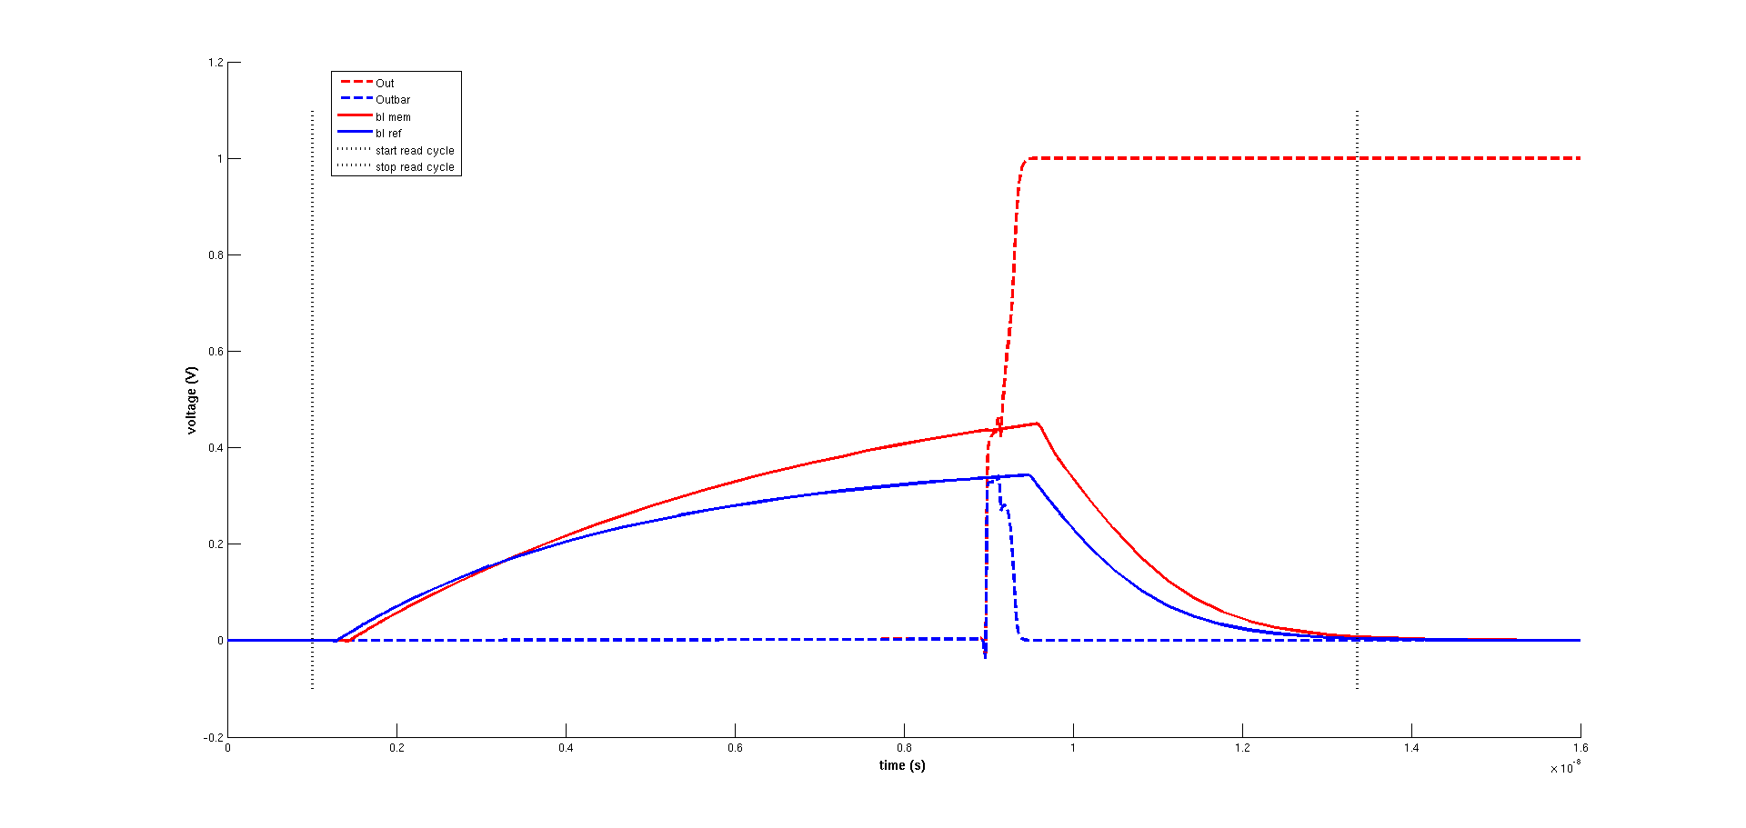
ARCHITECTURE (1)
Find all possible solutions for #WL, #BL, #GB in the range 2³⁻⁹
That comply to the following constraints:
# cells = 4194304 (4MB)
# BL ≤ #WL
Simulate as follows:
Add initial conditions to nodes to get a quicker convergence in dc op point
20 solutions
Sa_en at bl diff = 100mV
New read cycle starts when bl is low again

Slide 15
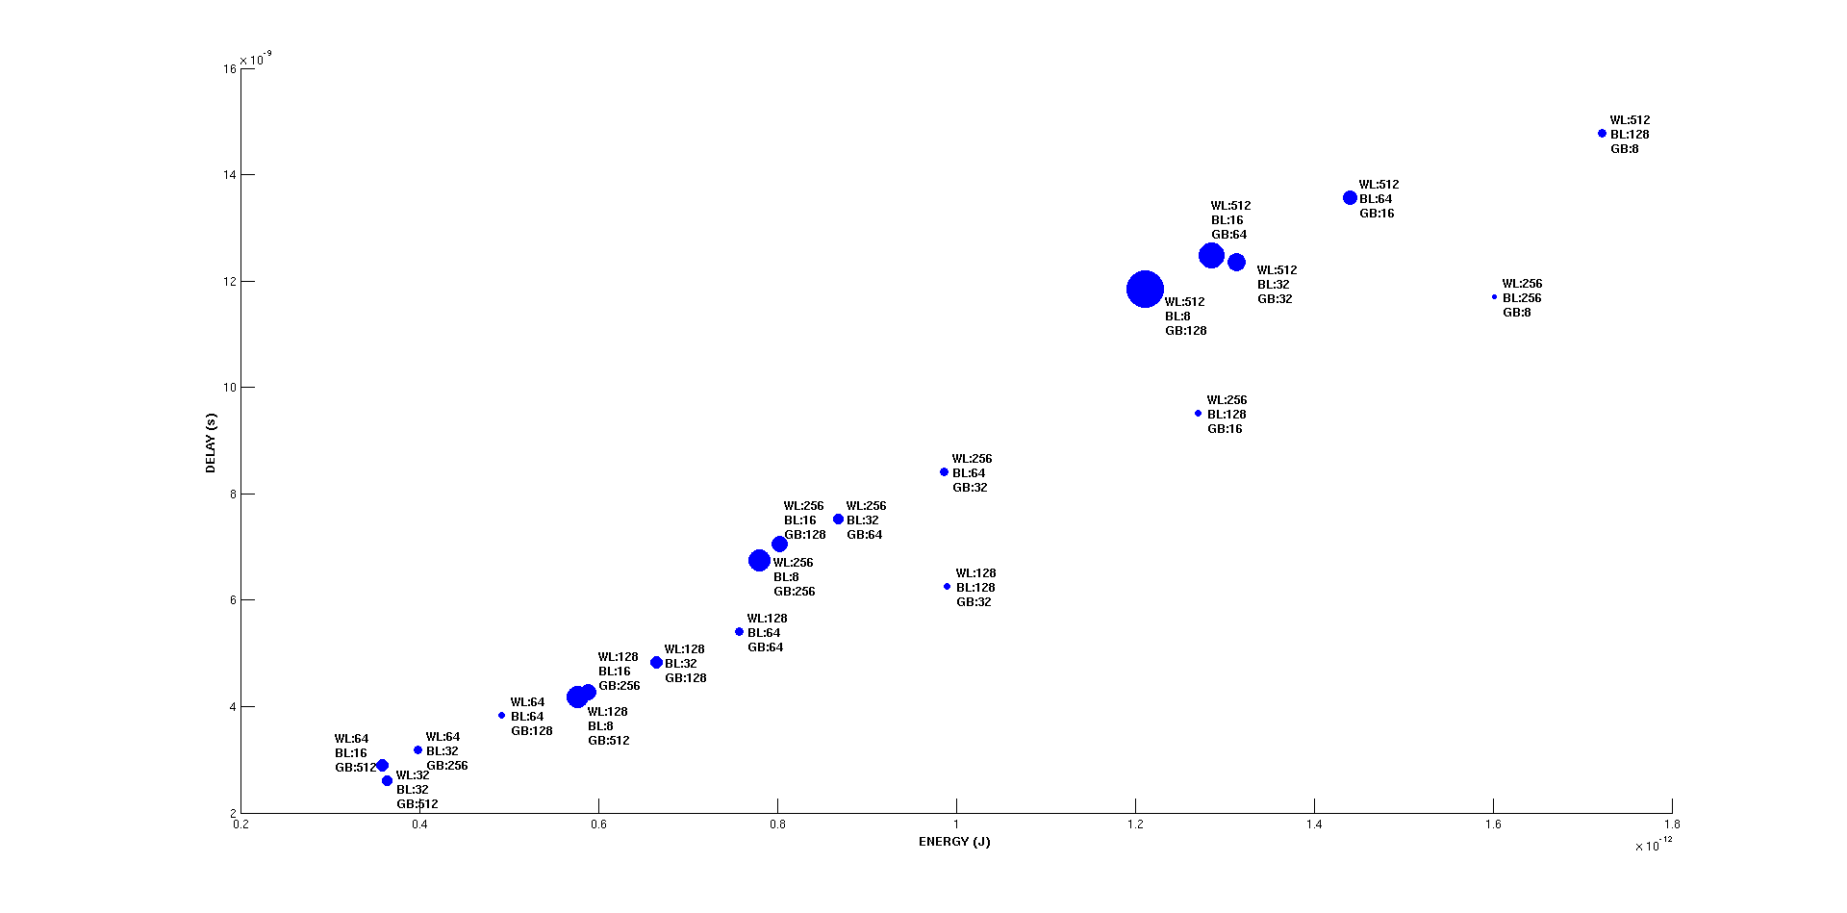
ARCHITECTURE (2)

Slide 16
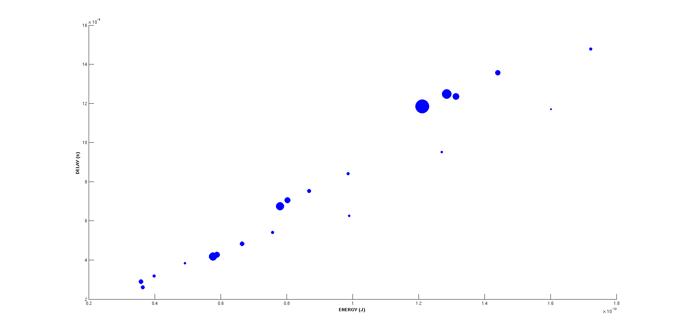
ARCHITECTURE (2)
Delay and energy mainly determent by #WL and #BL
Area determent by decoder area and #GB
# BL ↗
WL:512
WL: 256
WL: 128
WL: 64
WL: 32

Slide 17
ARCHITECTURE (temp)
# BL ↗
WL:512
WL: 256
WL: 128
WL: 64
WL: 32

Slide 18
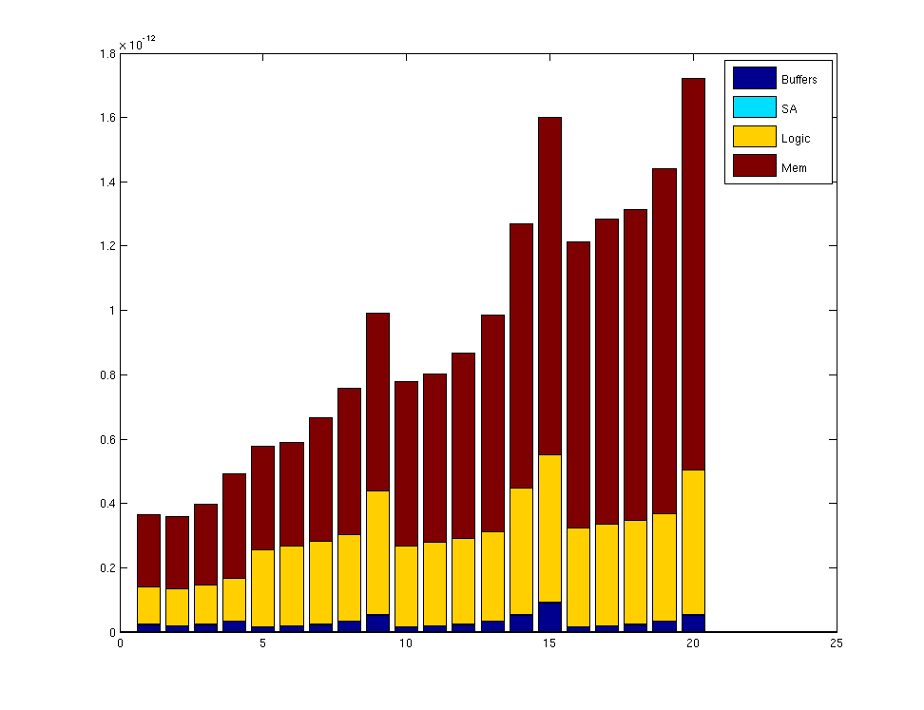
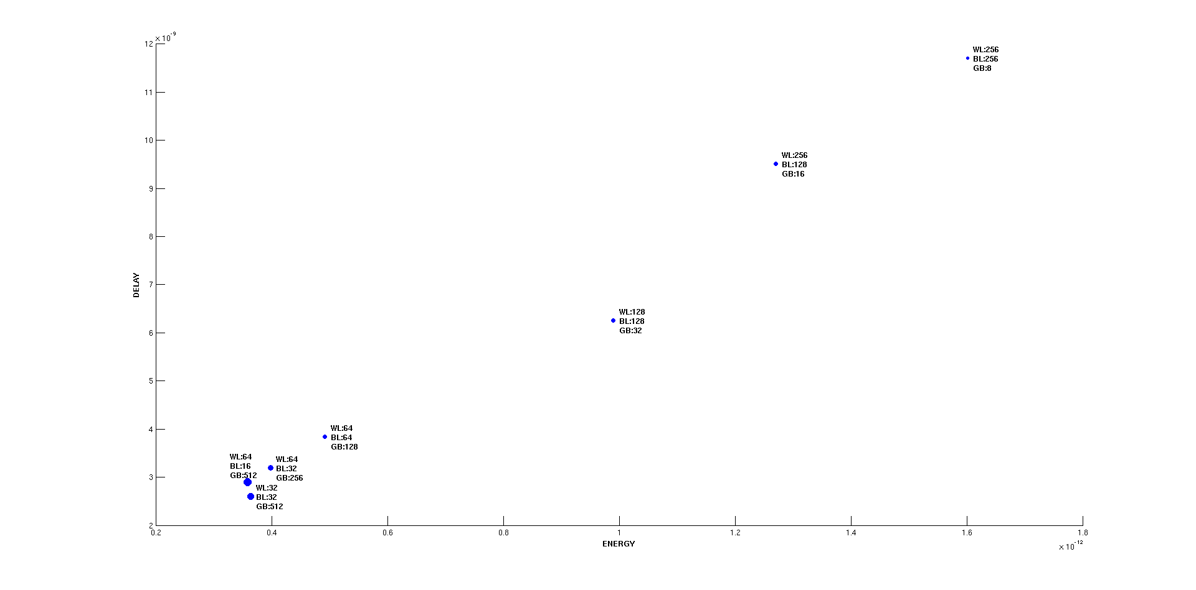
ARCHITECTURE (3)
Pareto curve
Energy ratio
Leakage energy is 2 orders of magnitude smaller

Slide 19
OUTLINE
ARCHITECTURE AND TIMING
DECODERS
SENSE AMPLIFIERS
LOAD
PLANNING AND CONTENT TABLE
CONCLUSION : Conclusion and Future work

Slide 20
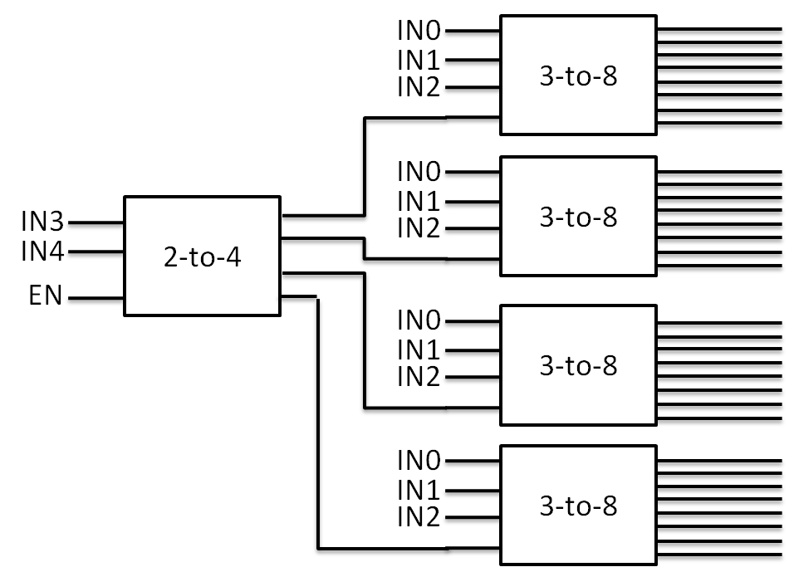
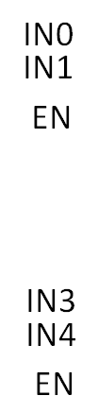
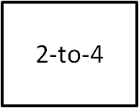
DECODERS (1)
Type 1
Type 2
Delay dependent of previous and current address
Prone to glitches
Delay more or less constant for each address
Delay and Energy are more robust against mismatch

Slide 21
DECODERS (2)
Replace by
Use as buffer and in bigger decoders add stages

Slide 22
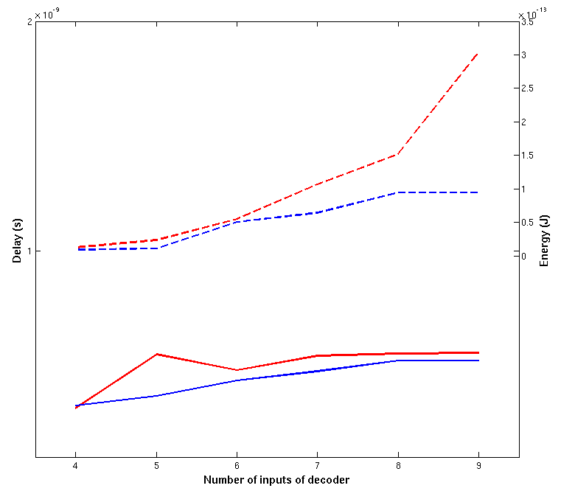

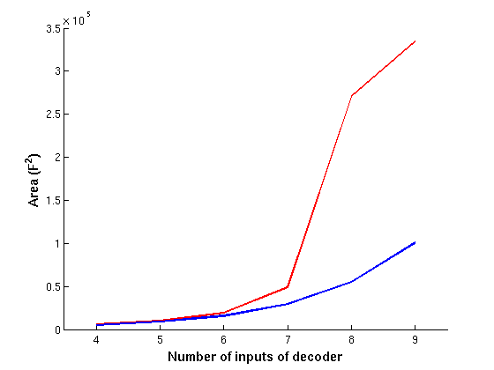
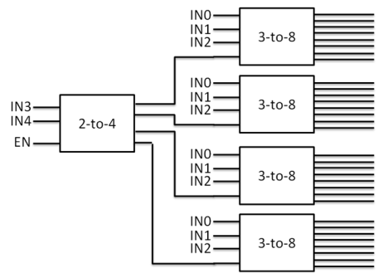
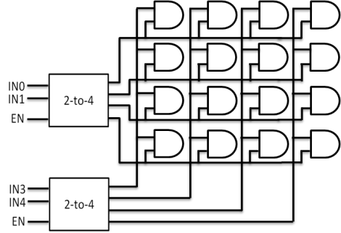
DECODERS (3)
←Worst case delay and energy at worst case delay
(≠ worst case energy !!!)
↓Total area (F² = min technology area)

Slide 23
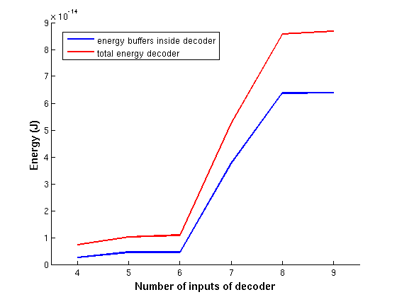
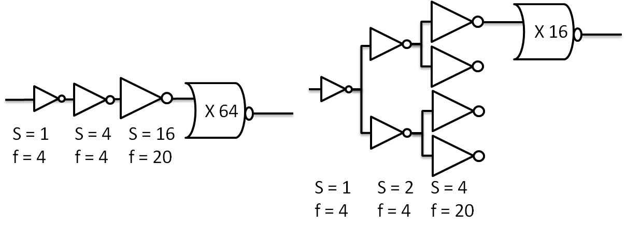
DECODERS (4)
Most energy goes to buffers
Failed attempt to make buffers less energy consuming → E = C*V²
Total C stays the same in both configurations

Slide 24
OUTLINE
ARCHITECTURE AND TIMING
DECODERS
SENSE AMPLIFIERS
LOAD
PLANNING AND CONTENT TABLE
CONCLUSION : Conclusion and Future work

Slide 25
Sense Amplifier
Sensitivity analysis
Sweep Vt- & β-mismatch of different transistors independently and manually
Offset as function of variation instances
Done for minimal SA, since no idea yet of sizes to be used in our architecture

Slide 26
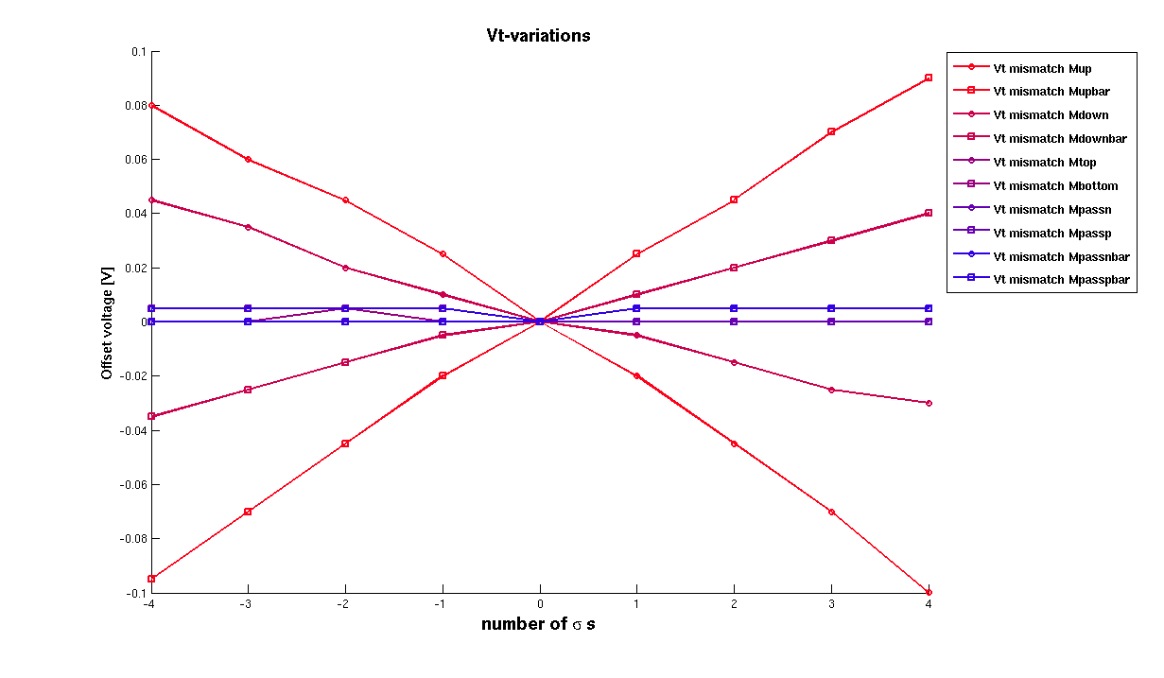
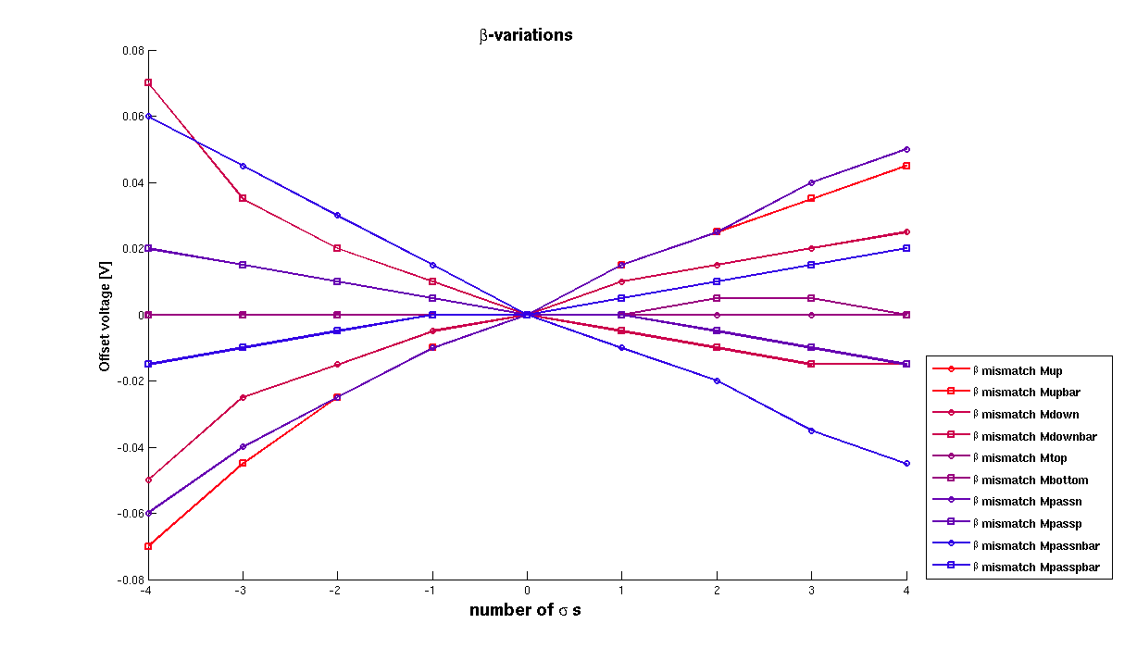
Sensitivity results
Mtop
Mpassn
Mpassnbar
Mup
Mupbar
Mdown
Mdownbar
Mpassp
Mpasspbar
Mbottom

Slide 27
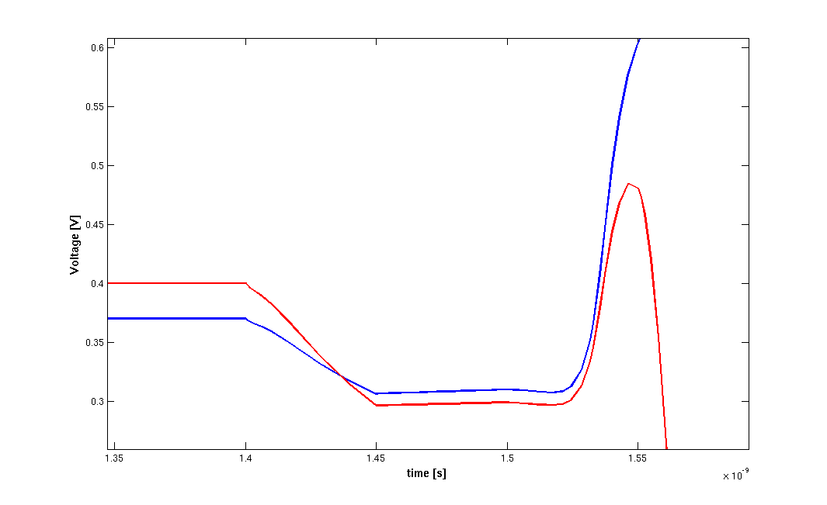
Sensitivity Analysis
Mainly contributions by differential pair
Also β-variations pass-gates: charge injection not matched anymore
Pass gates turned off
No β variation
latching
nMOS β variation ( )

Slide 28
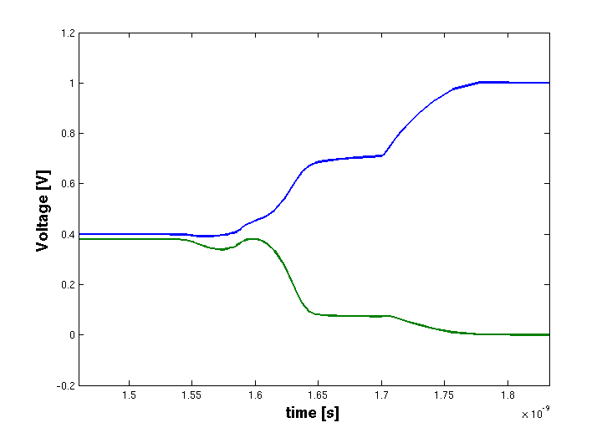
Pass Gate mismatch
Avoid by allowing (short) overlap PassEnable & LatchEnable
Interesting phenomenon
Latch enabled
Passgates off

Slide 29
Diels effect ©®
(minimal SA)

Slide 30
temp
I_{vdd}
I_{in}
I_{vss}

Slide 31
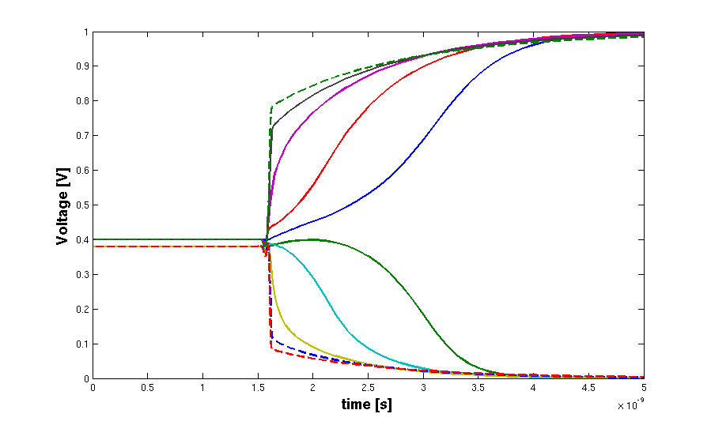
Diels effect ©®
Depending on resistance value, strange dynamic behaviour.
Cbig=46fF
Cint=161aF
R=0 Ω
R=5 kΩ
R=10 kΩ
R=15 kΩ
R=20 kΩ

Slide 32
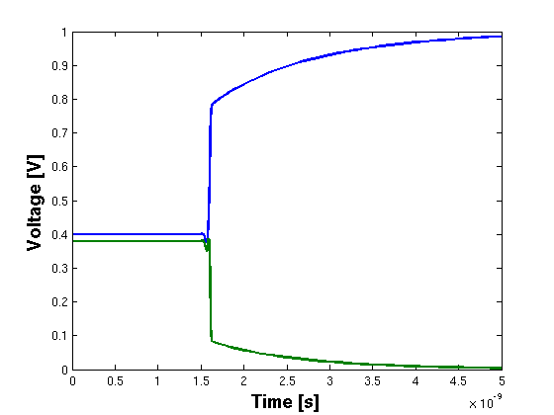
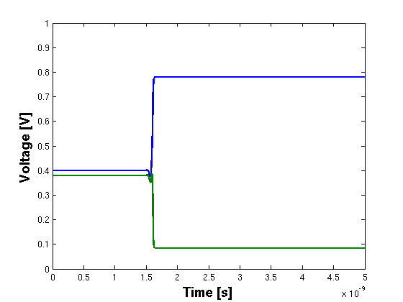
Diels effect ©®
Capacitor acts as short in beginning
Ordinary voltage drop over resistor, output charges normally (high frequencies)
Afterwards also charging C
With Capacitor
Without Capacitor

Slide 33
Diels effect ©®
Out(bar) charges almost linearly
AC voltage over capacitor almost zero
Latching and RC-charging are separated
Vc response for linearly charging source
RC-product must be large enough in order for C-short approximation to hold

Slide 34
Diels effect ©®
When RC-product is too small:
Latching and RC-charging no longer separated
Difficult to mathematically describe

Slide 35
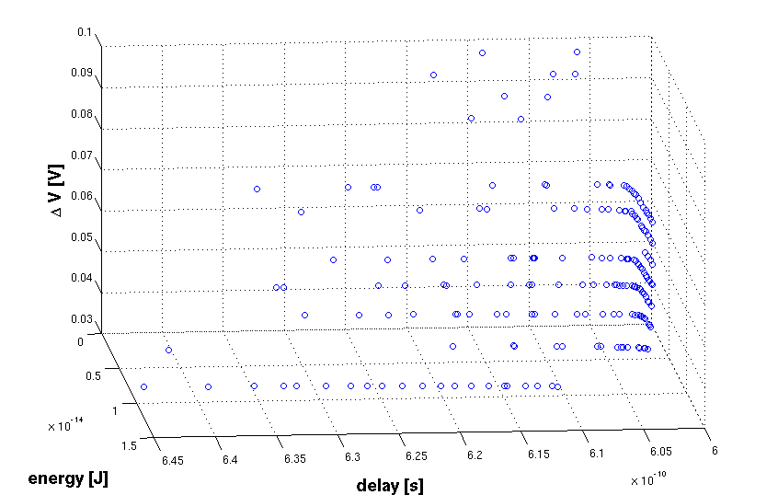
Sense amplifier pareto
Very large simulation
Pareto surface delay-energy-ΔV

Slide 36
OUTLINE
ARCHITECTURE AND TIMING
TIMING
SENSE AMPLIFIERS
LOAD
PLANNING AND CONTENT TABLE
CONCLUSION : Conclusion and Future work

Slide 37
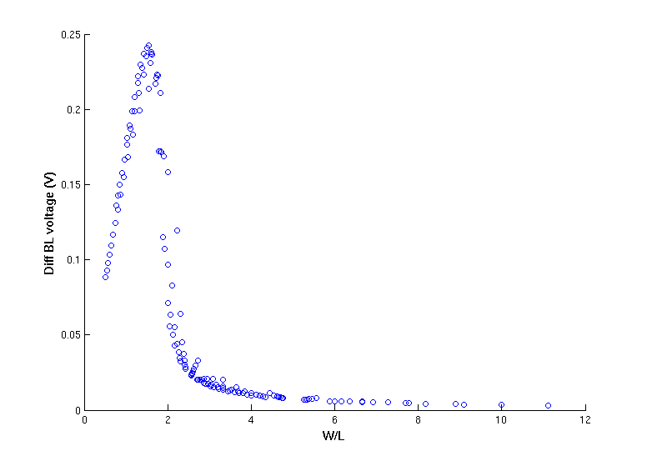
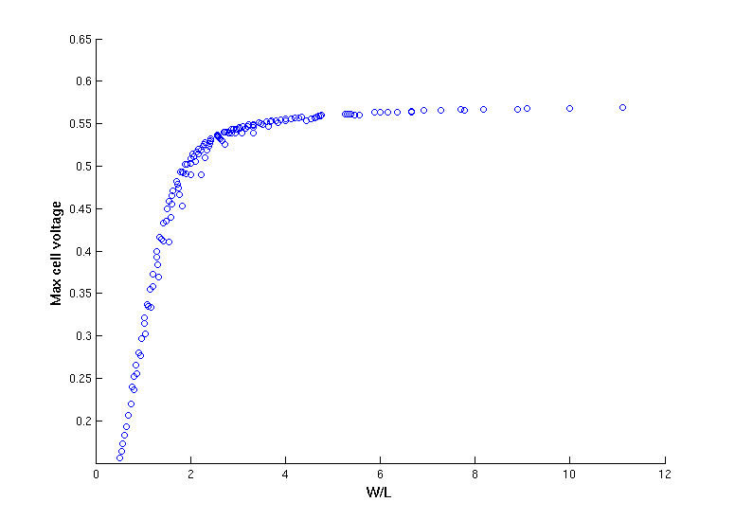
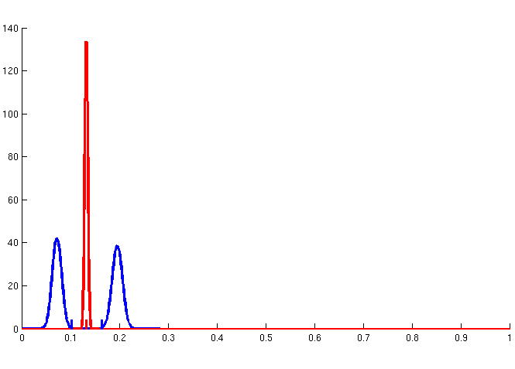
LOAD
Previous load is here
W = 300nm
L = 195nm
Suggest new load
W = 100nm
L = 195nm
Size x 4 for mismatch
→ 3σ_{Vdiff} = 29mV
→ Vcell max = 176mV (after mc)
(todo schrijf hoe berekend)

Slide 38
OUTLINE
ARICHTECTURE AND TIMING
TIMING
SENCE AMPLIFIERS
LOAD
PLANNING AND CONTENT TABLE
CONCLUSION : Conclusion and Future work

Slide 39
OUTLINE
ARCHITECTURE AND TIMING
TIMING
SENSE AMPLIFIERS
LOAD
PLANNING AND CONTENT TABLE
CONCLUSION : Conclusion and Future work

