Slide 1


Load Analysis
Alexander Standaert
Wouter Diels

Slide 2
OUTLINE
INPUTS : Load types, Design parameters and Simulation set up
OBJECTIVES : Linear sweep and Monte carlo
RESULTS LINEAR SWEEP
RESULTS MONTE CARLO
FINAL LOAD
CONCLUSION : Conclusion and Future work

Slide 3
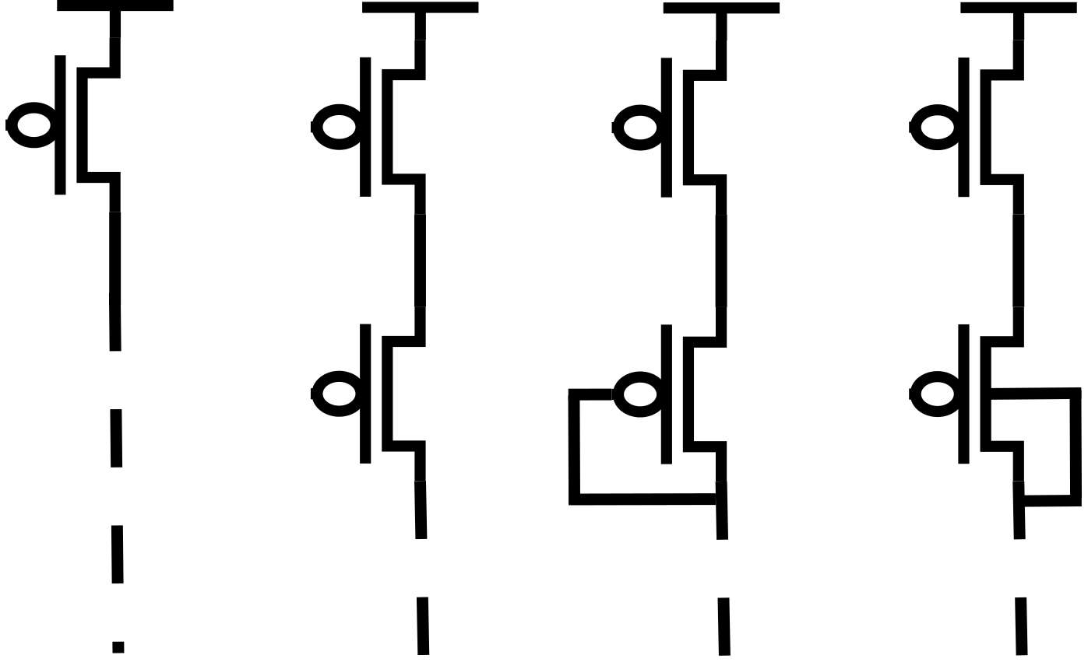
LOAD TYPES
Sel_load
Sel_load
Sel_load
Sel_load
Bias
Bulk
Switch Load
Bias Load
Diode Load
Bulk Load*
*(Ren et al., "A body-voltage-sensing-based short pulse reading circuit for spin-torque transfer RAMs (STT-RAMs) “, 2012)

Slide 4
LOAD TYPES
Sel_load
Sel_load
Sel_load
Sel_load
Bias
Bulk
Design parameters:
w_Switch
Switch Load
Bias Load
Diode Load
Bulk Load*
*(Ren et al., "A body-voltage-sensing-based short pulse reading circuit for spin-torque transfer RAMs (STT-RAMs) “, 2012)

Slide 5
LOAD TYPES
Sel_load
Sel_load
Sel_load
Sel_load
Bias
Bulk
Design parameters:
w_Switch
Design parameters:
w_Switch
w_Bias
V_Bias
Switch Load
Bias Load
Diode Load
Bulk Load*
*(Ren et al., "A body-voltage-sensing-based short pulse reading circuit for spin-torque transfer RAMs (STT-RAMs) “, 2012)

Slide 6
LOAD TYPES
Sel_load
Sel_load
Sel_load
Sel_load
Bias
Bulk
Design parameters:
w_Switch
Design parameters:
w_Switch
w_Bias
V_Bias
Design parameters:
w_Switch
w_Diode
Switch Load
Bias Load
Diode Load
Bulk Load*
*(Ren et al., "A body-voltage-sensing-based short pulse reading circuit for spin-torque transfer RAMs (STT-RAMs) “, 2012)

Slide 7
LOAD TYPES
Sel_load
Sel_load
Sel_load
Sel_load
Bias
Bulk
Design parameters:
w_Switch
Design parameters:
w_Switch
w_Bias
V_Bias
Design parameters:
w_Switch
w_Diode
Design parameters:
w_Switch
w_Bulk
Switch Load
Bias Load
Diode Load
Bulk Load*
*(Ren et al., "A body-voltage-sensing-based short pulse reading circuit for spin-torque transfer RAMs (STT-RAMs) “, 2012)

Slide 8
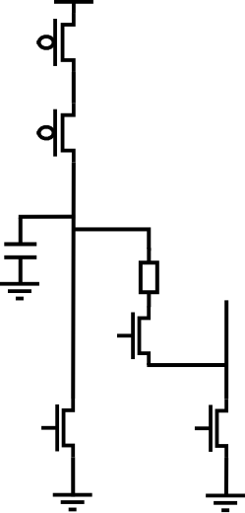
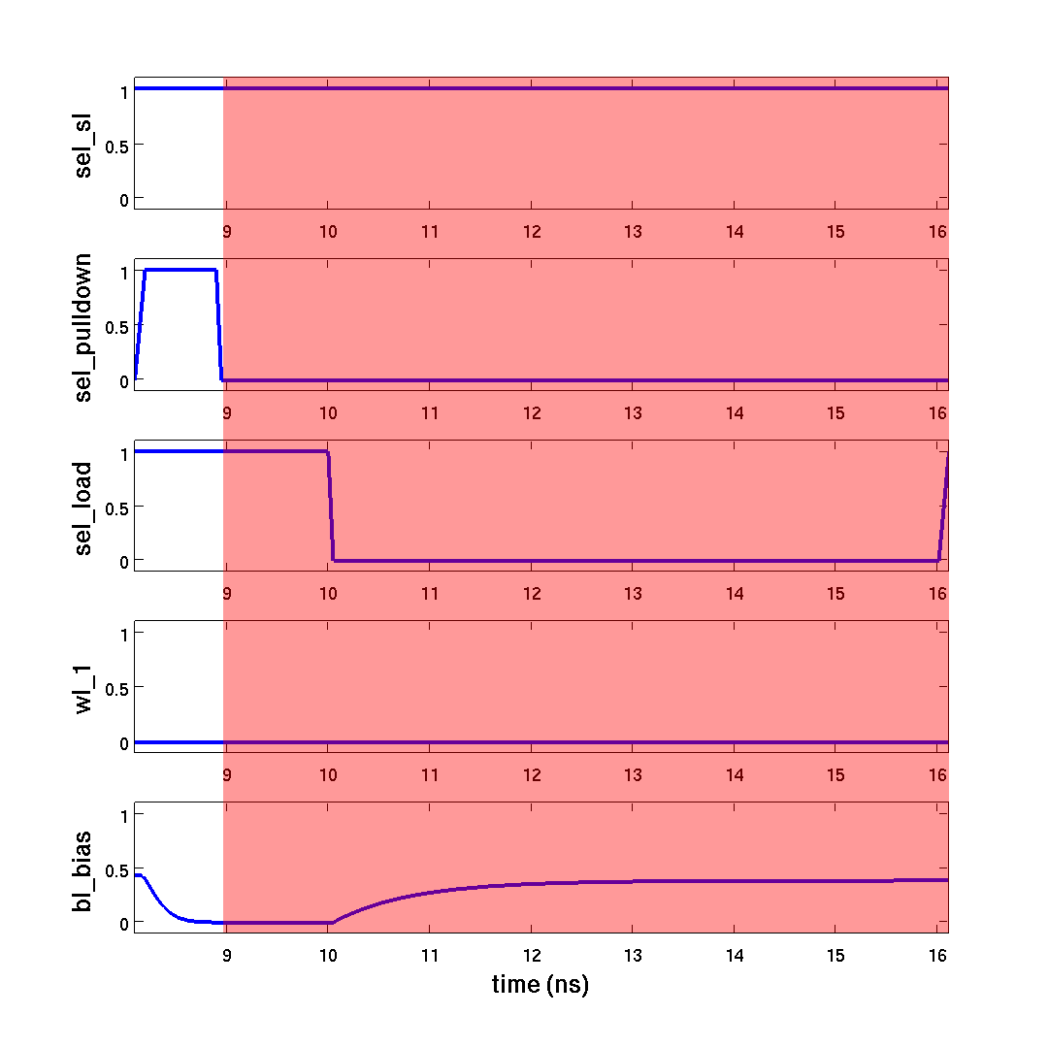
1V
SIMULATION SETUP
Sel_load
1) decharge
Bias
HRS = 30-35KΩ
LRS = 5-10KΩ
18fF
Memory cell
WL
Sel_pulldown
Sel_SL

Slide 9
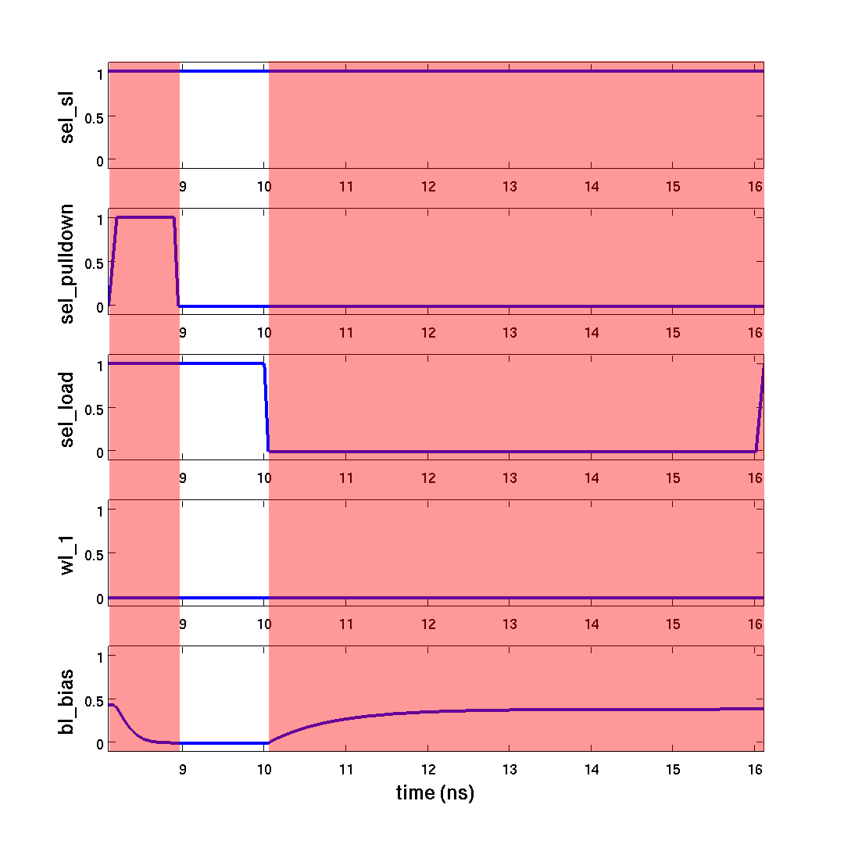
1V
SIMULATION SETUP
Sel_load
2) dead time
Bias
18fF
Memory cell
WL
Sel_pulldown
Sel_SL

Slide 10
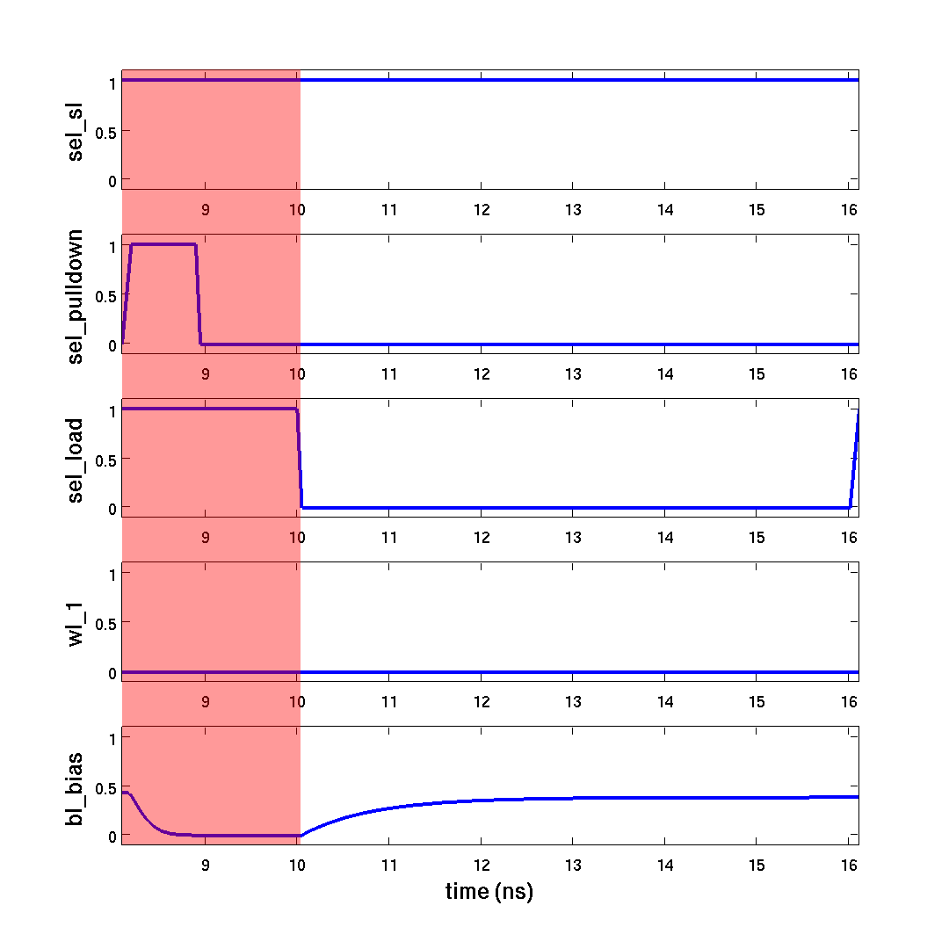
1V
SIMULATION SETUP
Sel_load
3) sense
Bias
V_BL
18fF
Memory cell
WL
Sel_pulldown
Sel_SL

Slide 11
OUTLINE
INPUTS : Load types, Design parameters and Simulation set up
OBJECTIVES : Linear sweep and Monte carlo
RESULTS LINEAR SWEEP
RESULTS MONTE CARLO
FINAL LOAD
CONCLUSION : Conclusion and Future work

Slide 12
OBJECTIVES
Bitline voltage difference: V_BL(HRS) – V_BL(LRS)
Bitline delay
Area
Voltage drop memory cell
Minimal Bitline voltage difference
Minimal Standard deviation Bitline voltage
Maximal Bitline delay
Robustness Temperature, Vss, ... variations
LINEAR SWEEP
MONTE CARLO

Slide 13
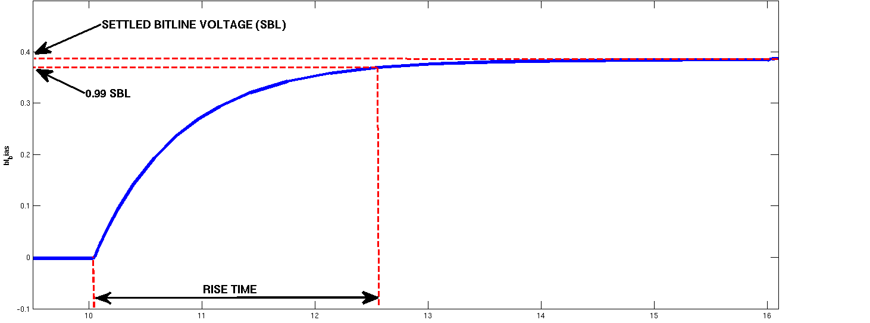
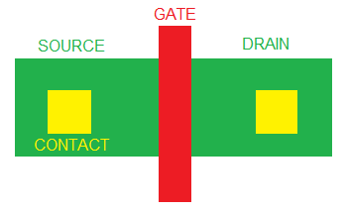
OBJECTIVES LINEAR SWEEP
Sel_load
Bias
V_BL
DELAY calculation
Voltage drop memory cell
AREA calculation
WL
W
Sel_pulldown
Sel_SL
L

Slide 14
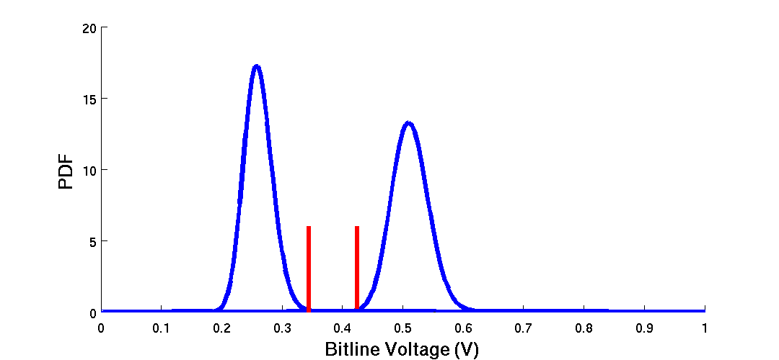
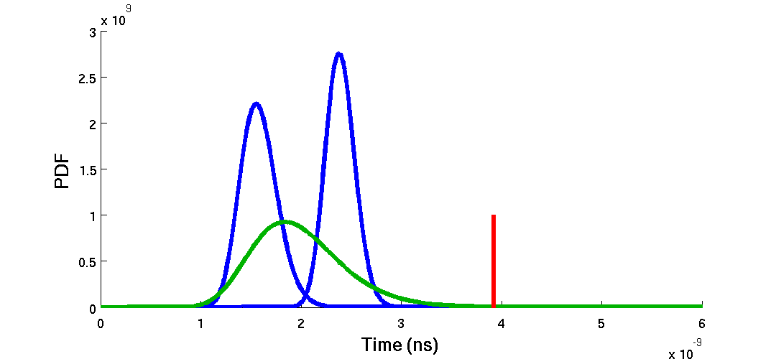
OBJECTIVES MONTE CARLO
MINIMUM BITLINE VOLTAGE DIFFERENCE
LRS
HRS
MINIMUM STANDARD DEVIATION BITLINE VOLTAGE
99.9 % population
HRS
LRS
LRS+HRS
MAXIMUM BITLINE DELAY

Slide 15
OUTLINE
INPUTS : Load types, Design parameters and Simulation set up
OBJECTIVES : Linear sweep and Monte carlo
RESULTS LINEAR SWEEP
RESULTS MONTE CARLO
FINAL LOAD
CONCLUSION : Conclusion and Future work

Slide 16
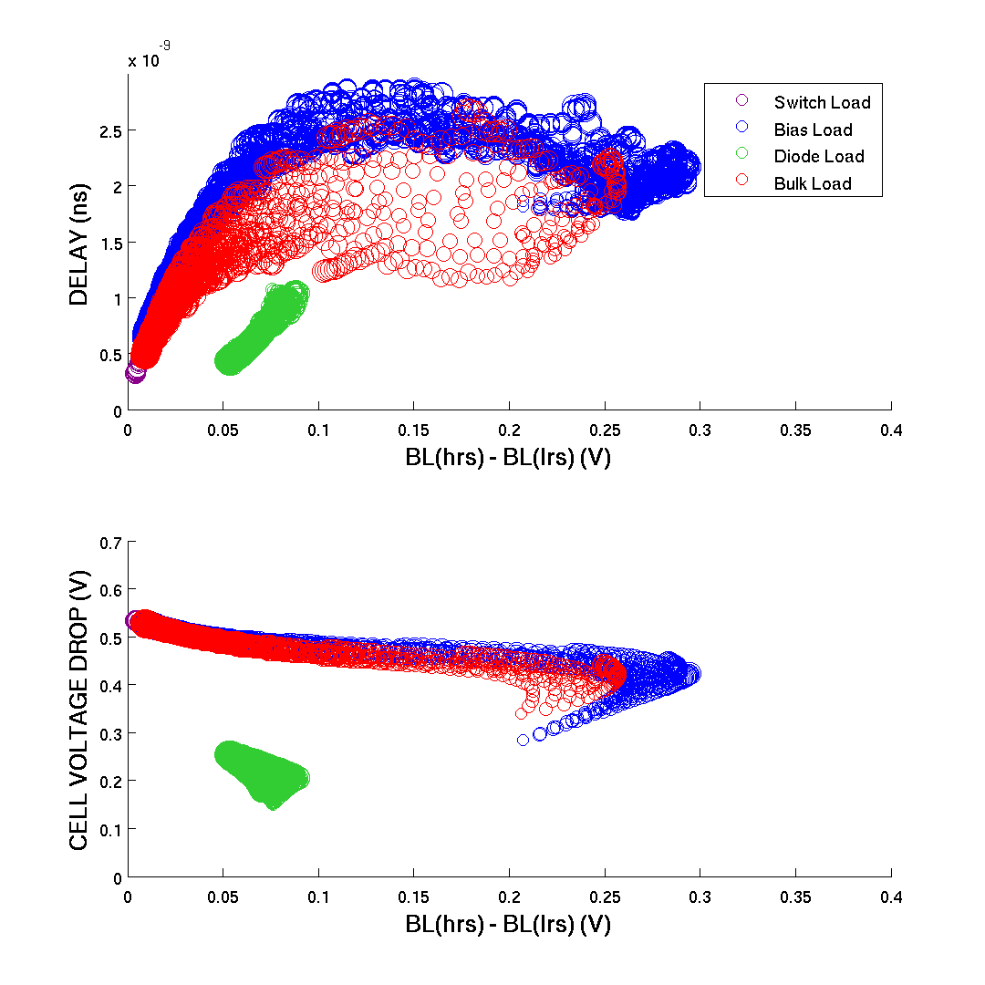
LINEAR SWEEP
21894 SOLUTIONS
SWEEP RANGE:
W_switch = 100-500nm
W_load = 100-500nm
V_bias = 0-0.4V

Slide 17
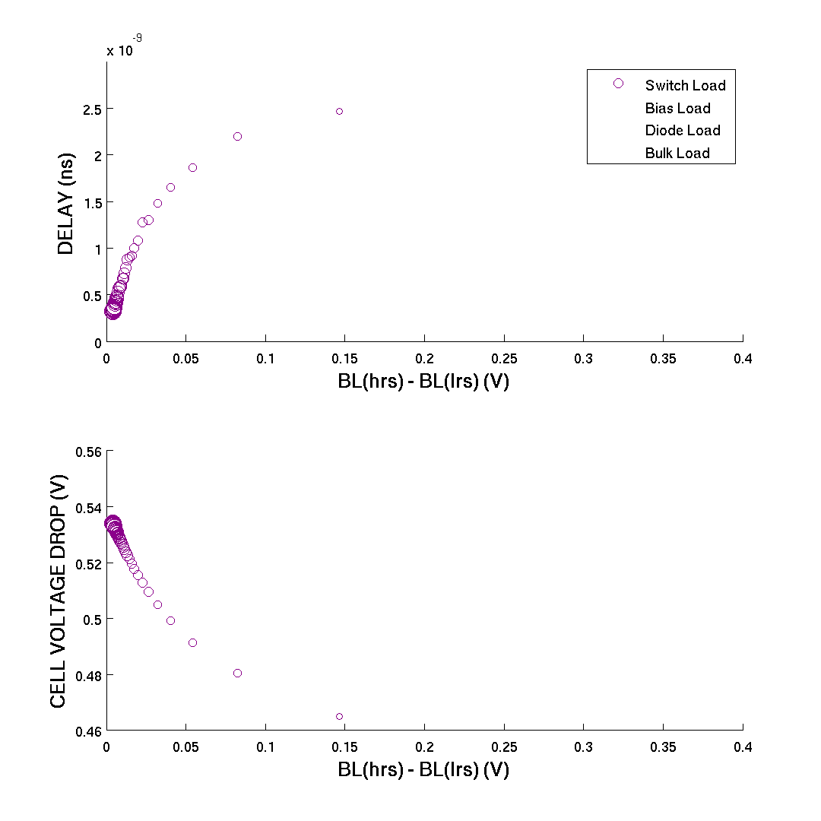

LINEAR SWEEP: SWITCH LOAD
W_switch 
Switch
W_switch 

Slide 18
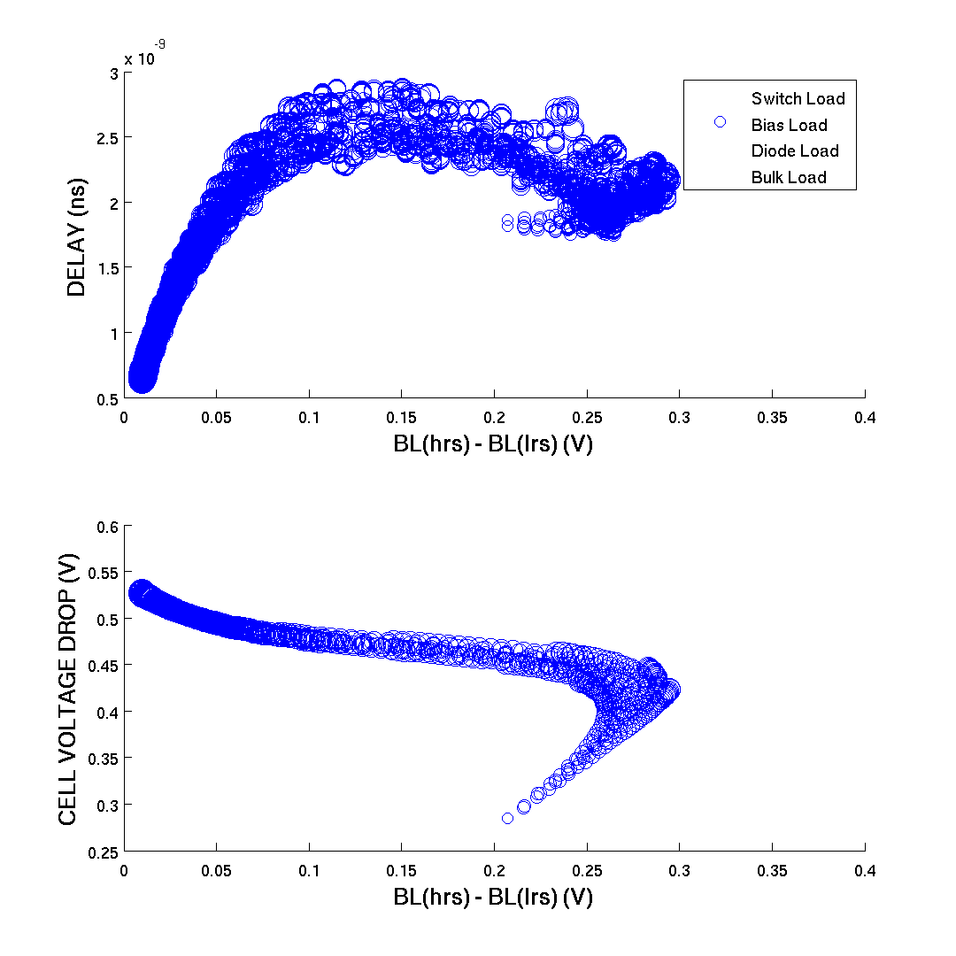
LINEAR SWEEP: BIAS LOAD
W_bias 
V_bias 
W_switch 
Switch
W_bias 
Bias
W_switch 
V_bias 

Slide 19
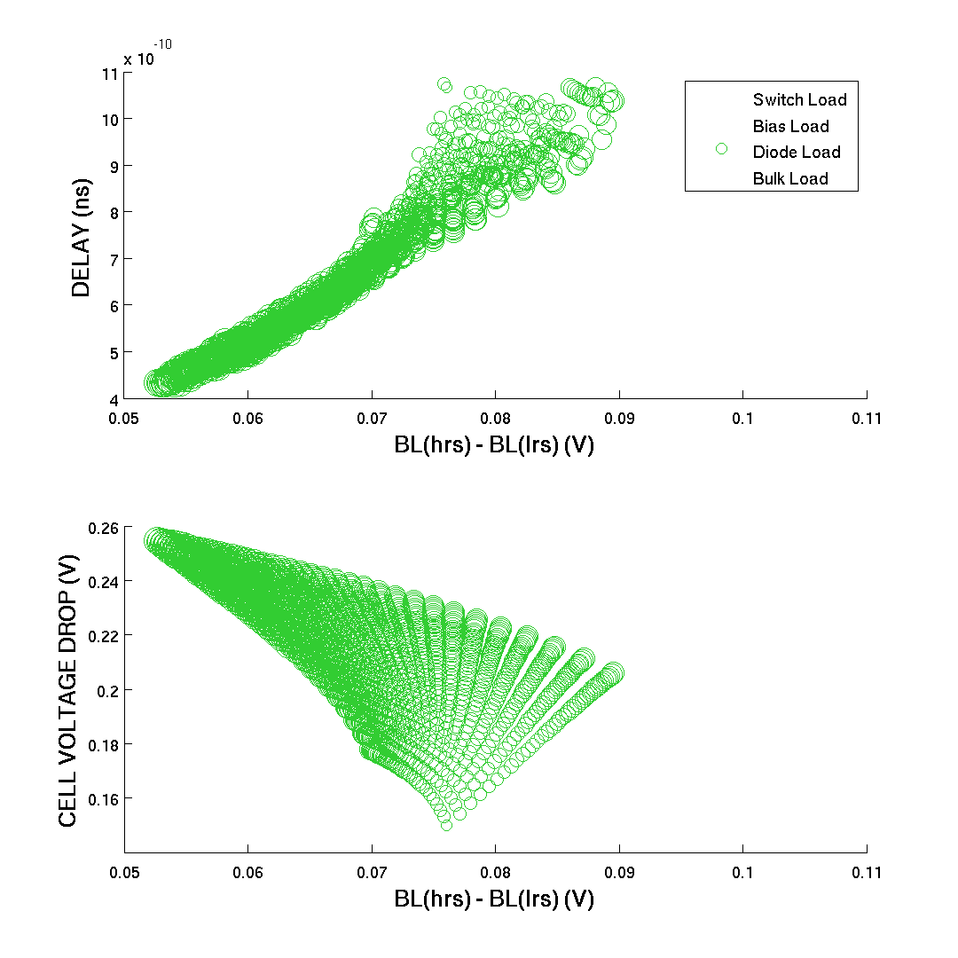
LINEAR SWEEP: DIODE LOAD
W_switch 
W_diode 
Switch
W_diode 
W_switch 
Diode

Slide 20
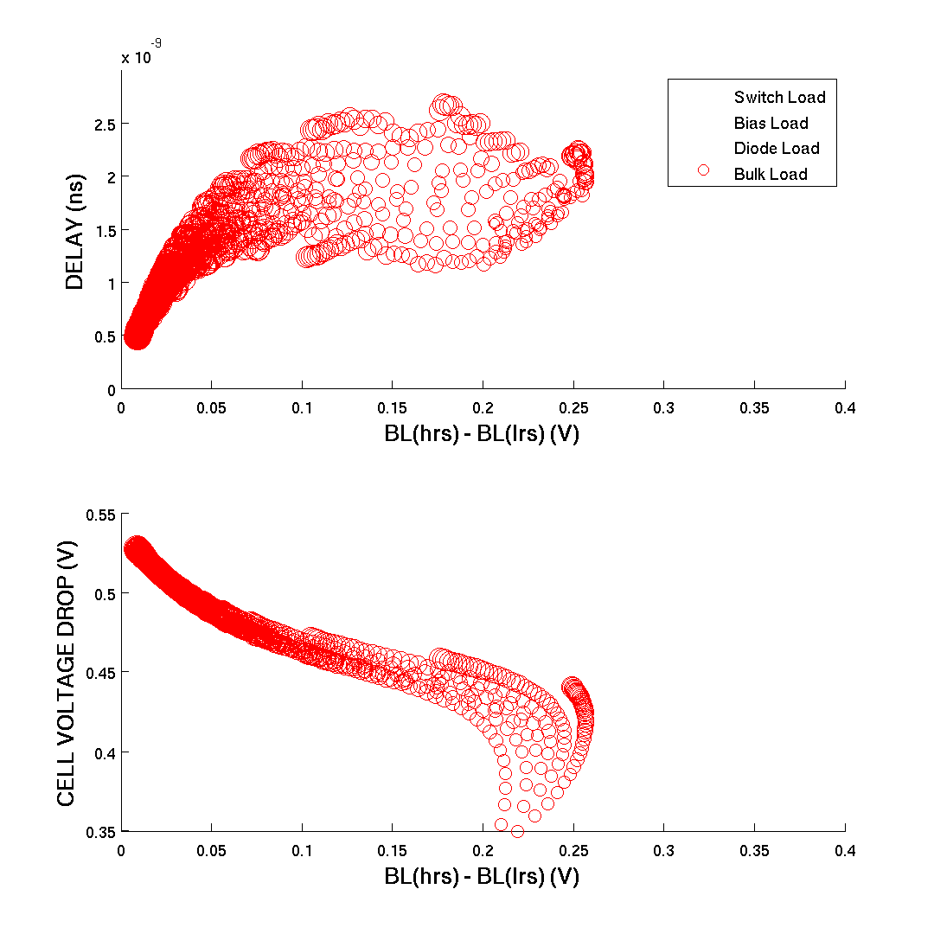
LINEAR SWEEP: BULK LOAD
W_switch 
W_bulk 
Switch
W_bulk 
W_switch 
Bulk

Slide 21
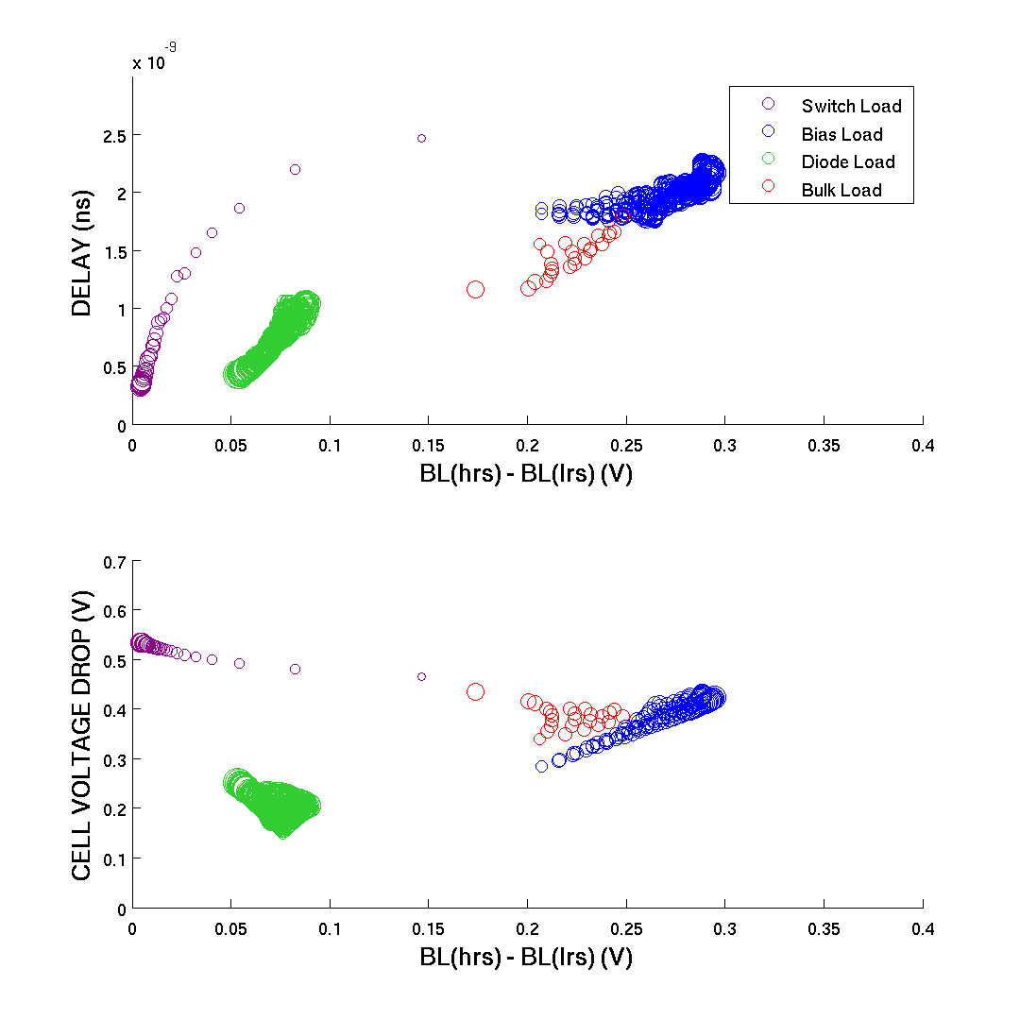
LINEAR SWEEP: PARETO
1681 SOLUTIONS
PARETO OBJECTIVES:
Area
Diff BL voltage
Settle Time
Voltage drop memory cell

Slide 22
OUTLINE
INPUTS : Load types, Design parameters and Simulation set up
OBJECTIVES : Linear sweep and Monte carlo
RESULTS LINEAR SWEEP
RESULTS MONTE CARLO
FINAL LOAD
CONCLUSION : Conclusion and Future work

Slide 23
OBJECTIVES MONTE CARLO
MINIMUM BITLINE VOLTAGE DIFFERENCE
LRS
HRS
MINIMUM STANDARD DEVIATION BITLINE VOLTAGE
99.9 % population
HRS
LRS
LRS+HRS
MAXIMUM BITLINE DELAY

Slide 24
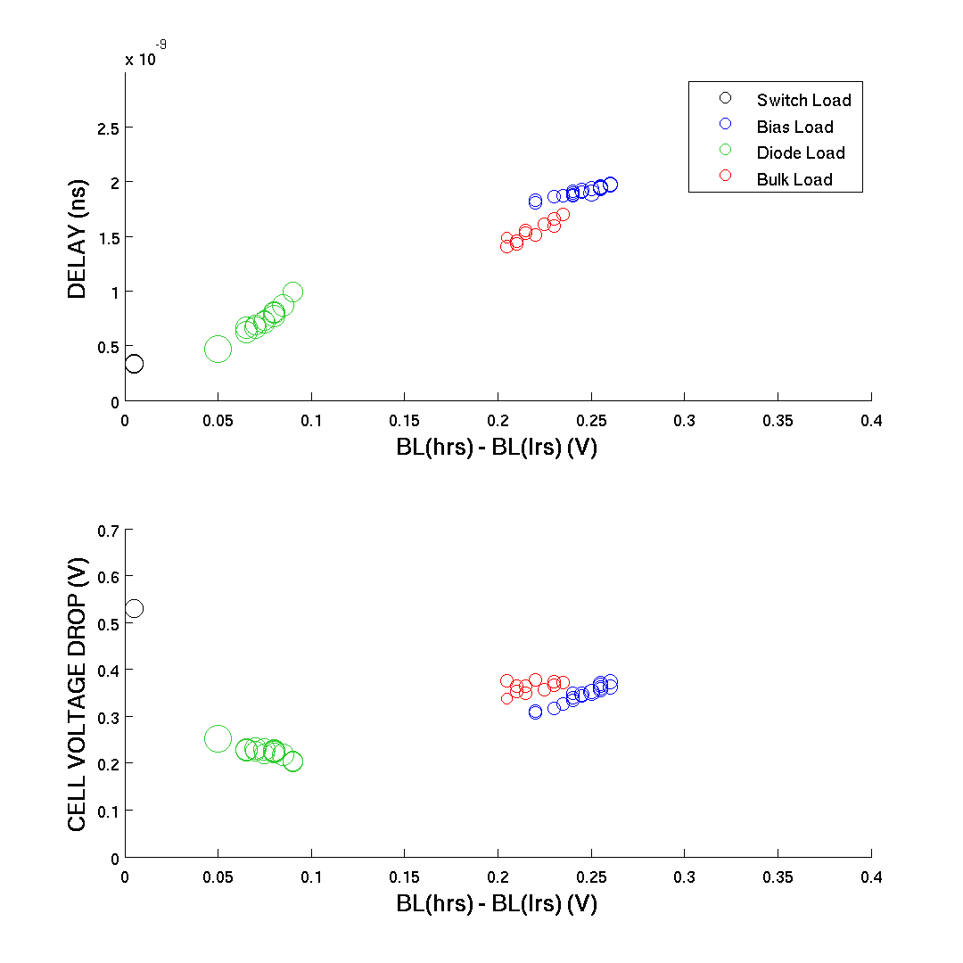
MONTE CARLO: PARETO
48 SOLUTIONS
PARETO OBJECTIVES:
600 mc iterations

Slide 25
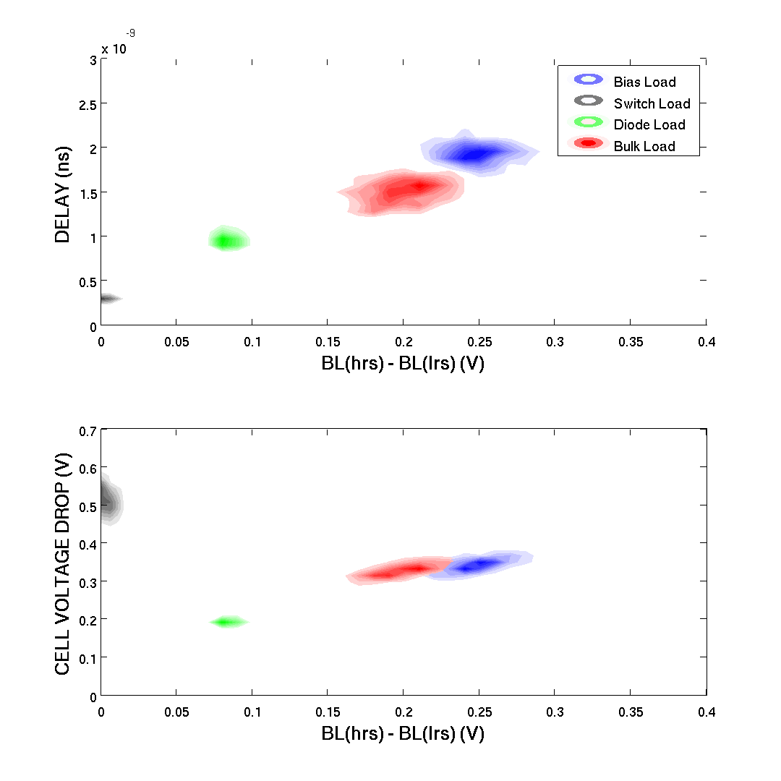

Slide 26
