Slide 1


Architecture Design
Alexander Standaert
Wouter Diels

Slide 2
OUTLINE
ARICHTECTURE AND TIMING
DECODERS
SENCE AMPLIFIERS
PLANNING AND CONTENT TABLE
CONCLUSION : Conclusion and Future work

Slide 3
TIMING (1)
LBen_0
SelLB_0
LBenbar_0
SelREF_0
RefEnable
LBen_1
SelLB_1
LBenbar_1
SelREF_1
BLencoded
BL decoder
WLencoded
WL decoder
Number of Bitlines
GBen
Start address
Start decoding
Constraints / Optimisation
T1 ≈ T2 : cell should be selected when the load is turned on, if not → dead time. (BL and WL decoder same size)
T1 ≈ T3 : if T1 > T3 ref is selected before mem → energy waste ( Design non optimal ref buffer)
GBen
LBen_0
SelLB_0
Lbenbar_1
SelREF_1
BL_0
T₁
WL_0
T₂
RefEnable
T₃

Slide 4
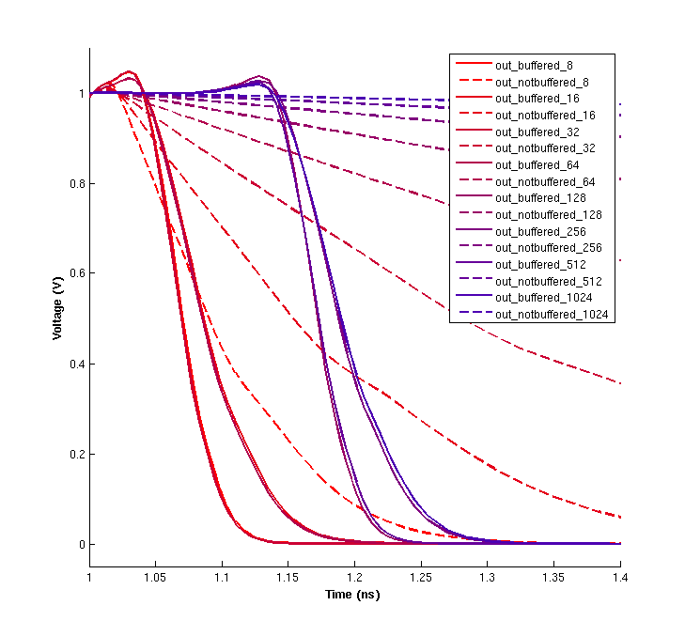









REFERENCE ARRAY: Buffers
RefEnable
Number of Bitlines
Buffer designed with logical effort
(stage effort = 4)

Slide 5
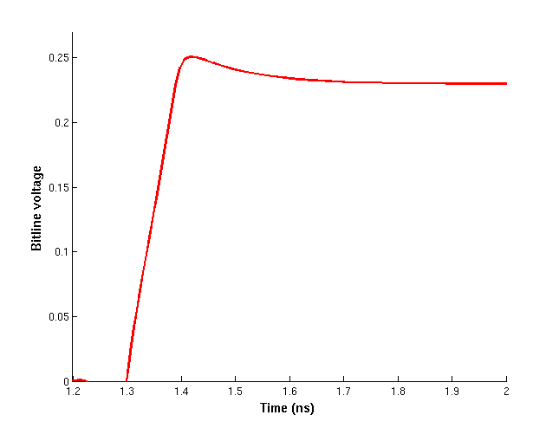
TIMING (2)
SelL
BL decoder
T5 is enabled
WL decoder
SelLbar
Memory cell connected to BL
Constraints / Optimisation
cell should be selected when load is turned on → T₃≈ T₄≈ T₅ .
T₃< T₄ because of inverter. T₅ is dependent of size of BL and WL decoders. When T₃ < T₄,T₅ the bitline is rising without cell selected
Start decoding
Bitline start rising
BL decoder
SelL
T₃
SelLbar
T₄
WL decoder
WL
T₅

Slide 6
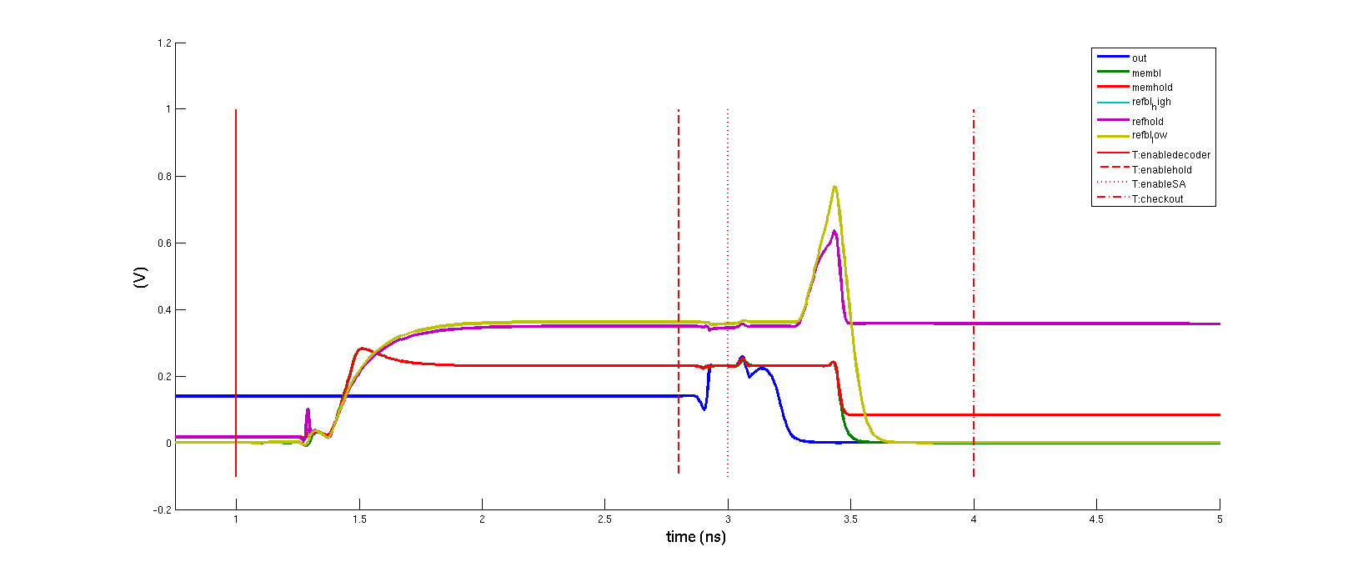
TIMING (3)
SelL
BL decoder
WL decoder
SelLbar
Memory cell disconnected to BL
Constraints / Optimisation
cell should be deselected when load is turned off → T₃≈ T₄≈ T₅ .
T₃< T₄ because of inverter. T₅ is dependent of size of BL and WL decoders. When T₃ > T₅ the bitline is rising without cell selected
Start decoding
Bitline start falling
BL decoder
SelL
T₃
SelLbar
T₄
WL decoder
WL
T₅

Slide 7
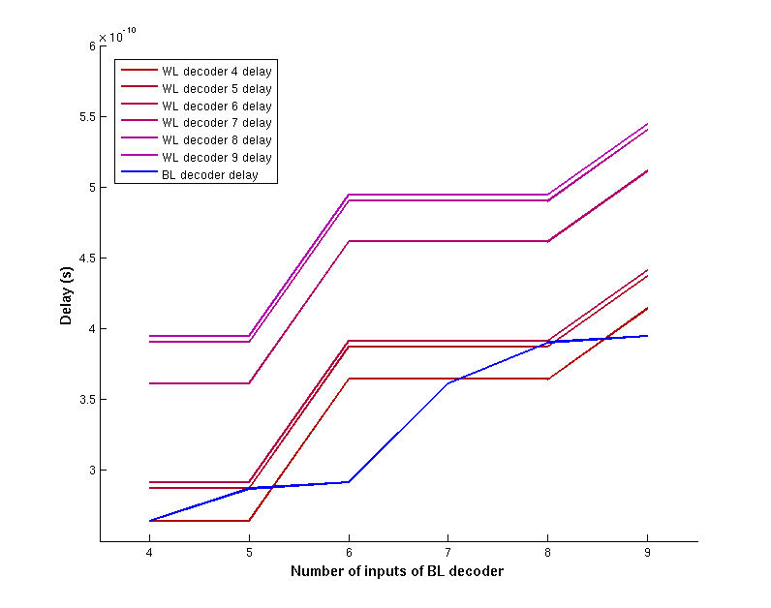
TIMING (4)
SelL
BL decoder
WL decoder
SelLbar
Memory cell disconnected to BL
Constraints / Optimisation
cell should be deselected when load is turned off → T₃≈ T₄≈ T₅ .
T₃< T₄ because of inverter. T₅ is dependent of size of BL and WL decoders. When T₃ > T₅ the bitline is rising without cell selected
Start decoding
Bitline start falling
BL decoder
SelL
T₃
SelLbar
T₄
WL decoder
WL
T₅

Slide 8
TIMING (5)
SelL
SelLbar
Memory cell disconnected to BL
Constraints / Optimisation
ref should be selected when load is turned on → T₆≈ T₇≈ T₈ .
T₆< T₇ because of inverter. T₈ is dependent of delay element (2 inverters)
Start decoding
Bitline start falling
RefEnable
SelL
T₆
SelLbar
T₇
WL
T₈

Slide 9
TIMING (6)
SelL
SelLbar
Memory cell disconnected to BL
Constraints / Optimisation
ref should be selected when load is turned off → T₉≈ T₁₀≈ T₁₁ .
T₉< T₁₀ because of inverter. T₁₁ is dependent of 2 inverters
Start decoding
Bitline start falling
RefEnable
SelL
T₉
SelLbar
T₁₀
WL
T₁₁

Slide 10
TIMING (7)
 | Affects | Implies
(1) | Speed | #WL ≈ #BL
(2) | Energy | /
(3) | Speed | #WL < #BL
(4) | Clean signals | #WL > #BL
(5) | Speed | T_{delay} < T_{nor +inv}
(6) | Clean signals | T_{delay} > T_{nor +inv}
Could try to extend ref delay to compensate energy wast in bitlines but time is to short
→ Don’t connect all the ref cells to bitline
ADDRESSING
Use not fully coded address (number of bits = 24??)
address_GB select_LB0 select_LB1 address_BL address_WL
Consider address bit voltage to come from ideal voltage source

Slide 11
ARCHITECTURE (1)
Find all possible solutions for #WL, #BL, #GB in the range 2³⁻⁹
That comply to the following constraints:
# cells = 4194304 (4MB)
# BL ≤ #WL
Simulate as follows:

Slide 12
OUTLINE
ARICHTECTURE AND TIMING
DECODERS
SENCE AMPLIFIERS
PLANNING AND CONTENT TABLE
CONCLUSION : Conclusion and Future work

Slide 13
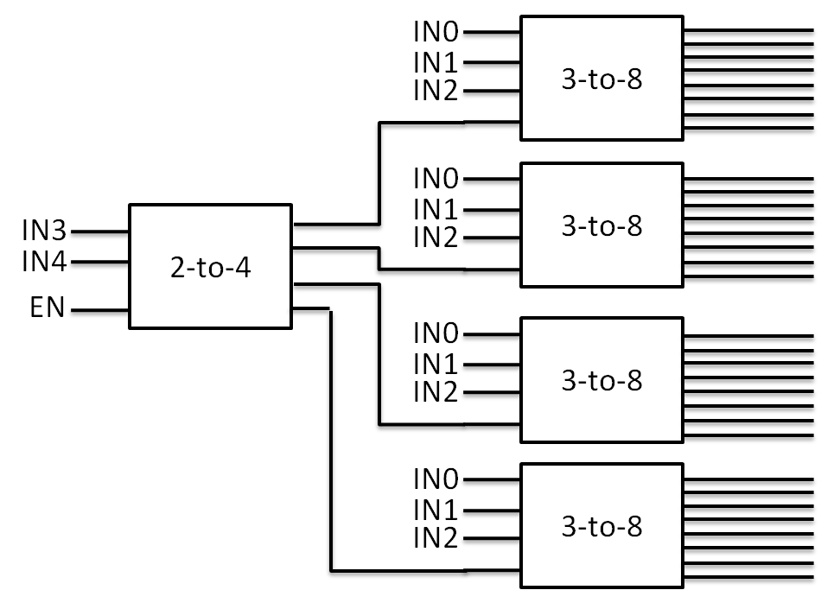
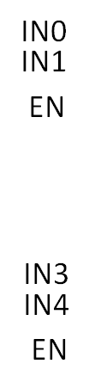
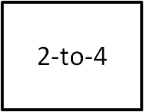
DECODERS (1)
Type 1
Type 2
Delay dependent of previous and current address
Prone to glitches
Delay more or less constant for each address
Delay and Energy are more robust against mismatch

Slide 14
DECODERS (2)
Replace by
Use as buffer and in bigger decoders add stages

Slide 15
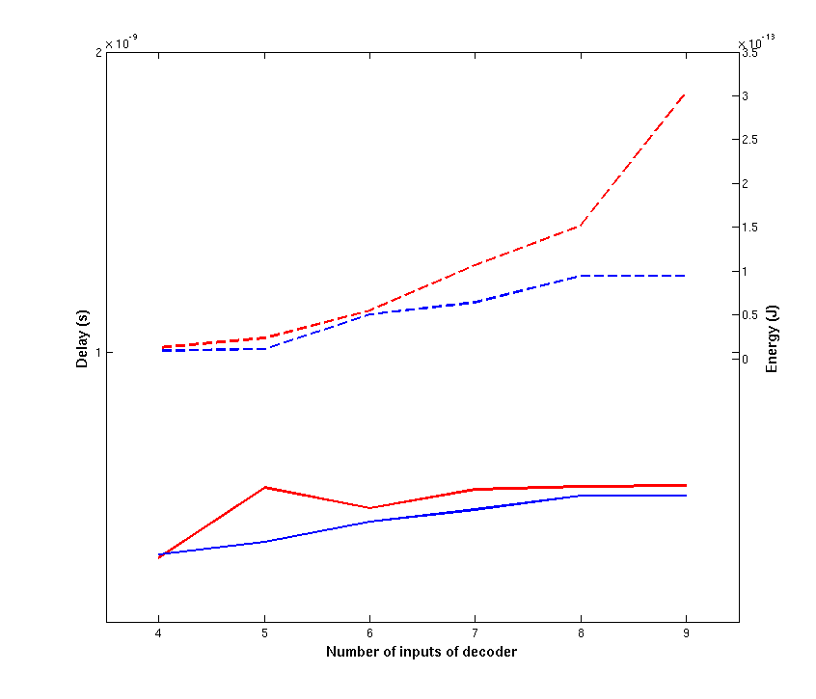

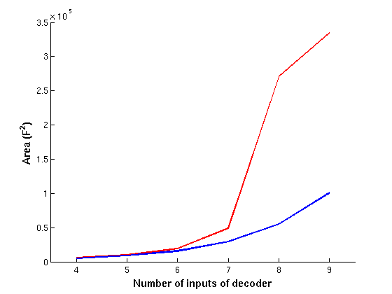
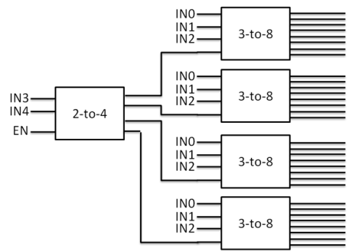
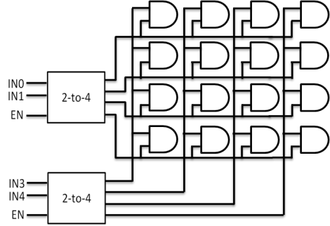
DECODERS (3)
←Worst case delay and energy at worst case delay
(≠ worst case energy !!!)
↓Total area (F² = min technology area)

Slide 16
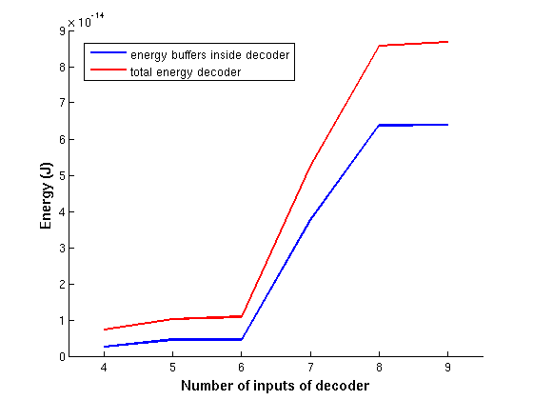
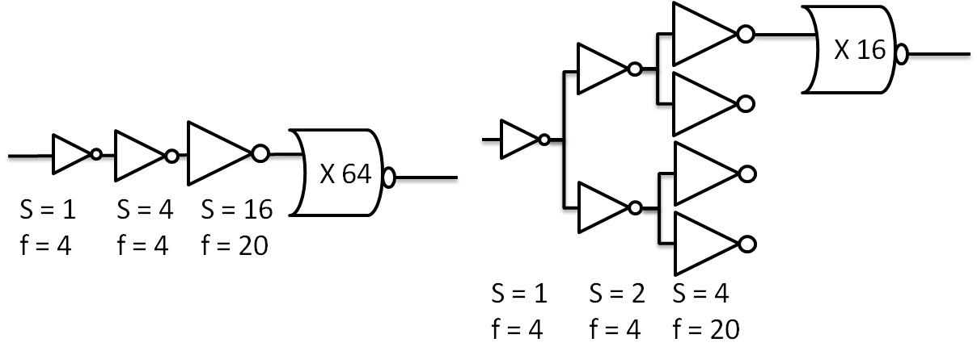
DECODERS (4)
Most energy go’s to buffers
Failed attempt to make buffers less energy consuming → E = C*V²
Total C stays the same in both configurations

Slide 17
OUTLINE
ARICHTECTURE AND TIMING
DECODERS
SENCE AMPLIFIERS
PLANNING AND CONTENT TABLE
CONCLUSION : Conclusion and Future work

Slide 18
OUTLINE
ARICHTECTURE AND TIMING
TIMING
SENCE AMPLIFIERS
PLANNING AND CONTENT TABLE
CONCLUSION : Conclusion and Future work

Slide 19
