Slide 1


Architecture Design
Alexander Standaert
Wouter Diels

Slide 2
OUTLINE
REFERENCE ARRAY
DECODERS + BUFFERS
VDD/SPEED TEST
CONDOR
ARCHITECTURE ANALYSIS
CONCLUSION : Conclusion and Future work

Slide 3
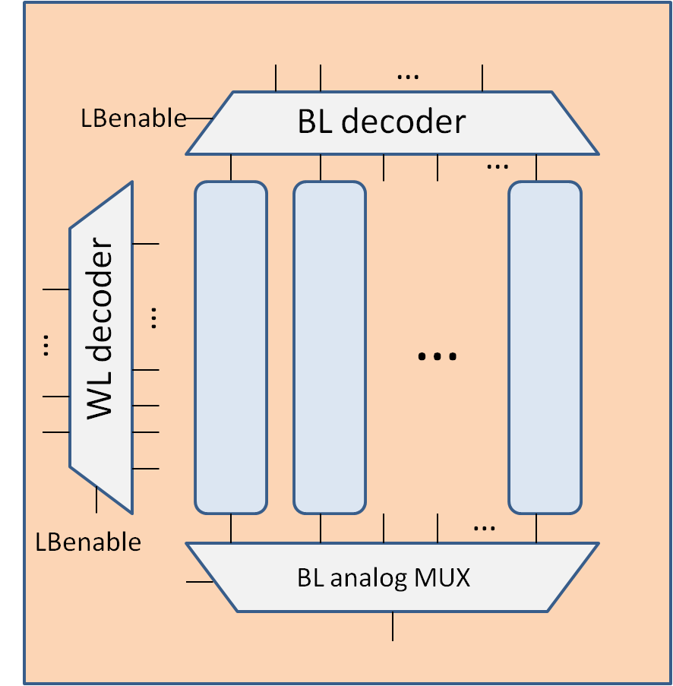
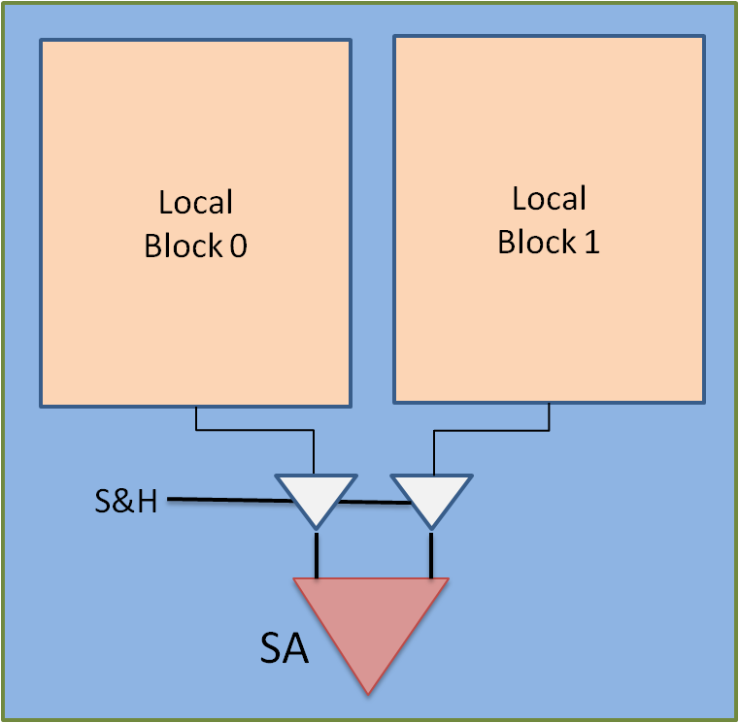
REFERENCE ARRAY
Reference now inside
Localblock:

Slide 4

REFERENCE ARRAY
LBEnable
VDD
GBenable
RefEnable
BL
BL decoder
WL
SL
BitLine MUX

Slide 5
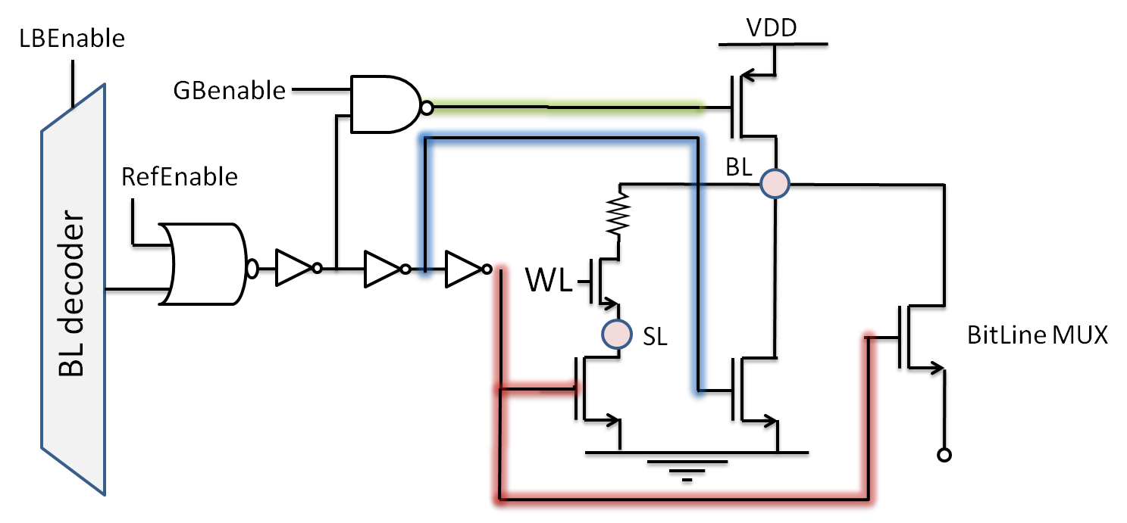
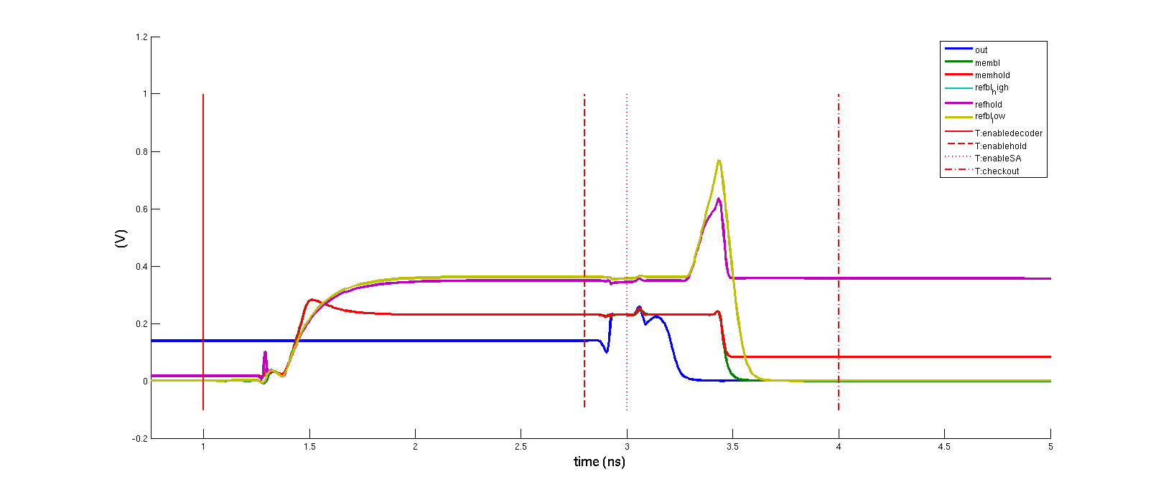
REFERENCE ARRAY
WL_ref = RefEnable
→ Load is still on when all the rest is of

Slide 6
REFERENCE ARRAY
BitLine Mux is turned off before the node is fully discharged.
Charge trapped is really small and doesn’t affect next read cycle

Slide 7
OUTLINE
REFERENCE ARRAY
DECODERS + BUFFERS
VDD/SPEED TEST
CONDOR
ARCHITECTURE ANALYSIS
CONCLUSION : Conclusion and Future work

Slide 8
Decoders
Netlist allows sizing every CMOS gate.
Based on cascading 2-to-4 decoders and
3-to-8 decoders
Enable
a0
a1
b0
Enable
a2
a0
a1
b1
a2
a0
b0
a1
b2
a2
a0
a1
b3
b1
a2
a0
a1
a2
b4
b2
a0
a1
a2
b5
a0
a0
a1
b6
b3
a2
a1
a0
a1
b7
a2

Slide 9
Decoders
Glitches because NOR-gated output
Solve by using NAND + Inverter Decoder topology, more area, worth it?
IN0 = IN1 = IN2
IN0
3-to-8
t
IN1
IN0 * IN1 * IN2 = A
IN2
IN0
t
3-to-8
Enable = B
IN1
IN3
2-to-4
IN2
IN4
t
A+B
EN
IN0
3-to-8
IN1
t
IN2
IN0
3-to-8
IN1
IN2

Slide 10
Vdd
Vdd_WRITE
BL Decoders
Data0
BL capacitance increases when more cells per BL
Delay increases too
Can’t decrease Pull-Up resistance because BL will be charged to VDD
Limited #WLpB
No sizing needed for BL decoders
Data1
BL
…
SL
Datax
Ref
Discharge
Select SL

Slide 11
WL Decoders: optimization
Sizing every CMOS block difficult:
Different paths towards output consisting of different amount of stages and logical efforts
Solution: Minimal decoder with sized inverter chain at output towards WL?
x-to-2^x
…
S1
S2
Sn-1
Sn

Slide 12
OUTLINE
REFERENCE ARRAY
DECODERS + BUFFERS
VDD/SPEED TEST
CONDOR
ARCHITECTURE ANALYSIS
CONCLUSION : Conclusion and Future work

Slide 13
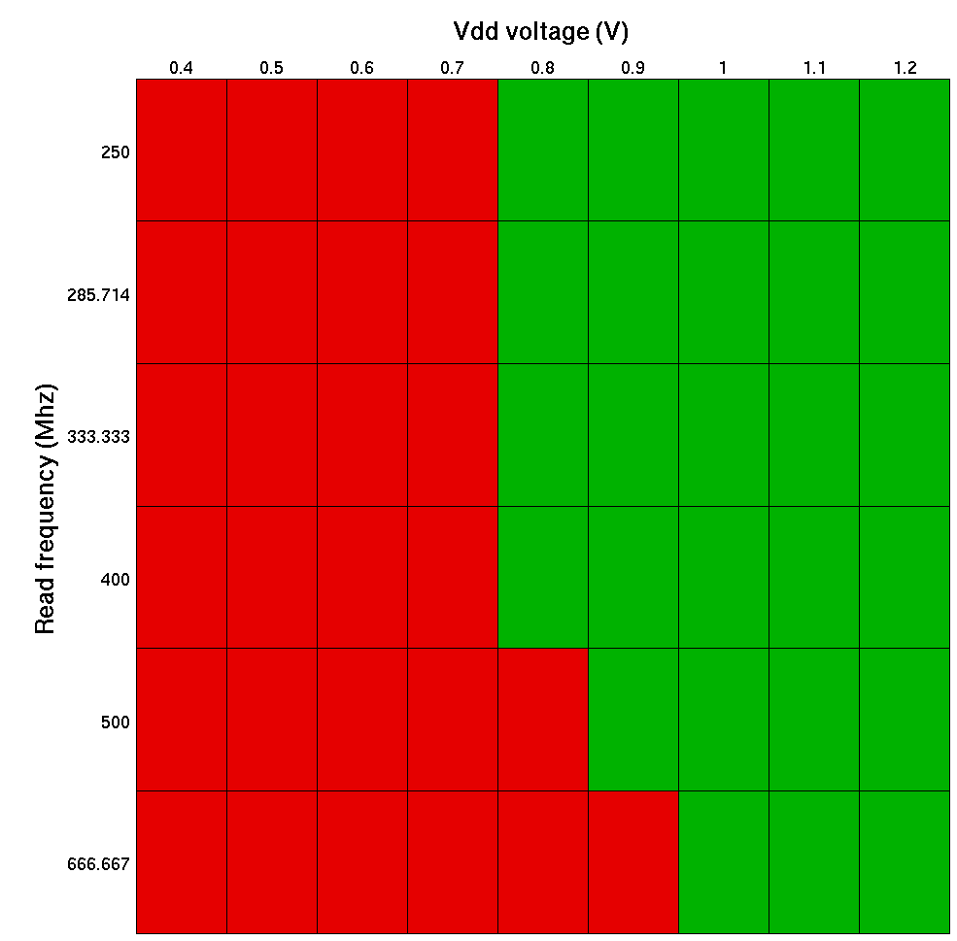
VDD/SPEED TEST
Reduce t_Saenable for different values of vdd till system fails.
t_checkout is cnt for now, but we should be able to decrease it to push speed limit futher
NOTE : no mismatch yet because SA is not yet sized !!!

Slide 14
OUTLINE
REFERENCE ARRAY
DECODERS + BUFFERS
VDD/SPEED TEST
CONDOR
ARCHITECTURE ANALYSIS
CONCLUSION : Conclusion and Future work

Slide 15

CONDOR
Grid computing system
Introduced at VISICS by Bert Deknuydt
Last week we got it working with Mat2Spice and Spectre
Documentation and new version Mat2Spice can be found on the wiki https://wiki.esat.kuleuven.be/visics/condor
It is currently looked into getting it installed in the pc rooms

Slide 16
OUTLINE
REFERENCE ARRAY
DECODERS + BUFFERS
VDD/SPEED TEST
CONDOR
ARCHITECTURE ANALYSIS
CONCLUSION : Conclusion and Future work

Slide 17
OUTLINE
REFERENCE ARRAY
DECODERS + BUFFERS
VDD/SPEED TEST
CONDOR
ARCHITECTURE ANALYSIS
CONCLUSION : Conclusion and Future work

Slide 18
Future work
Determine worst case decoder delay (MonteCarlo)
Research optimal architecture parameters Probably need to trim netlist to achieve acceptable simulation time
Inverter chain to buffer RefEnable (huge load to drive)
Optimize decoders? (and calculate decoder area)
Automate timing signals for Sense Amplifier

Slide 19
Main architecure
Vdd
Vdd_WRITE
CELL
Data0
WL
Data1
BL
…
SL
In this topology one sourceline and charge/discharge per bitline
Ideal?
Datax
BRANCH
Ref
Discharge
Select SL
#WLpB Data cells
1 Ref cell

Slide 20
Main architecure (cont.)
…
LBenable
BL decoder
…
Local Block
#BLpLB Branches
#BLpLB*#WLpB Data cells
#BLpLB Ref cells
WL decoder
…
…
…
LBenable
…
BL analog MUX

Slide 21
Global Block
Main architecure (cont.)
Local Block 0
Local Block 1
S&H
Sense Amplifier

Slide 22
Architecture parameters
# Global Blocks
# BitLines per Local Block
# WordLines per Branch
Total number of cells = 2*NoGB*NoBLpLB*NoWLpB

Slide 23
Decoders
Netlist allows sizing every CMOS gate.
Based on cascading 2-to-4 decoders and
3-to-8 decoders
Enable
a0
a1
b0
Enable
a2
a0
a1
b1
a2
a0
b0
a1
b2
a2
a0
a1
b3
b1
a2
a0
a1
a2
b4
b2
a0
a1
a2
b5
a0
a0
a1
b6
b3
a2
a1
a0
a1
b7
a2

Slide 24
Decoders
Glitches because NOR-gated output
Solve by using NAND + Inverter Decoder topology, more area, worth it?
IN0 = IN1 = IN2
IN0
3-to-8
t
IN1
IN0 * IN1 * IN2 = A
IN2
IN0
t
3-to-8
Enable = B
IN1
IN3
2-to-4
IN2
IN4
t
A+B
EN
IN0
3-to-8
IN1
t
IN2
IN0
3-to-8
IN1
IN2

Slide 25
Vdd
Vdd_WRITE
BL Decoders
Data0
BL capacitance increases when more cells per BL
Delay increases too
Can’t decrease Pull-Up resistance because BL will be charged to VDD
Limited #WLpB
No sizing needed for BL decoders
Data1
BL
…
SL
Datax
Ref
Discharge
Select SL

Slide 26
WL Decoders: optimization
Sizing every CMOS block difficult:
Different paths towards output consisting of different amount of stages and logical efforts
Solution: Minimal decoder with sized inverter chain at output towards WL?
x-to-2^x
…
S1
S2
Sn-1
Sn

Slide 27
Timing
Invertors as delay elements
Note: in case one Source Line Discharge per Local Block, Discharge gate connected to delayed LBEnable
LBEnable
VDD
Delayed GBenable
RefEnable
BL
BL decoder
WL
SL
BitLine MUX

Slide 28
Timing
RefEnable: AND-gated Gbenable + Lbenable
Delayed Gbenable: inverter chain
RefEnable connected to RefWL
GBenable
LB0
RefEnable0
LB0enable
GBenable
LB1
RefEnable1
LB1enable
GBenable
…
Delayed GBenable

Slide 29
Passgates
Just n-MOS (justified as long as Vsignal < 1V – Vt)
Low Vt!
Timing so only one charge injection occurs
BL0
BL1
BL2
BLx
LocalBlock0
…
LocalBlock1
Sel0
Sel1
Sel2
Selx
SelBL
SA S&H
SA S&H
t
SA In+
SA In-
LBEn
t
SAIn
t

Slide 30
Line Drivers
AND-gates
Passgates would leave nodes connected to digital circuits floated -> ill-advised
LB0en
GB0en
LB1en
GB01en
BL_Enc_xx
…
GB0xen

Slide 31
Future work
Determine worst case decoder delay (MonteCarlo)
Research optimal architecture parameters Probably need to trim netlist to achieve acceptable simulation time
Inverter chain to buffer RefEnable (huge load to drive)
Optimize decoders? (and calculate decoder area)
Automate timing signals for Sense Amplifier

