Slide 1


Architecture Design
Alexander Standaert
Wouter Diels

Slide 2
OUTLINE
DECODERS
REFERENCE TIMING
MEMORY CELL TIMING
CONCLUSION : Conclusion and Future work

Slide 3
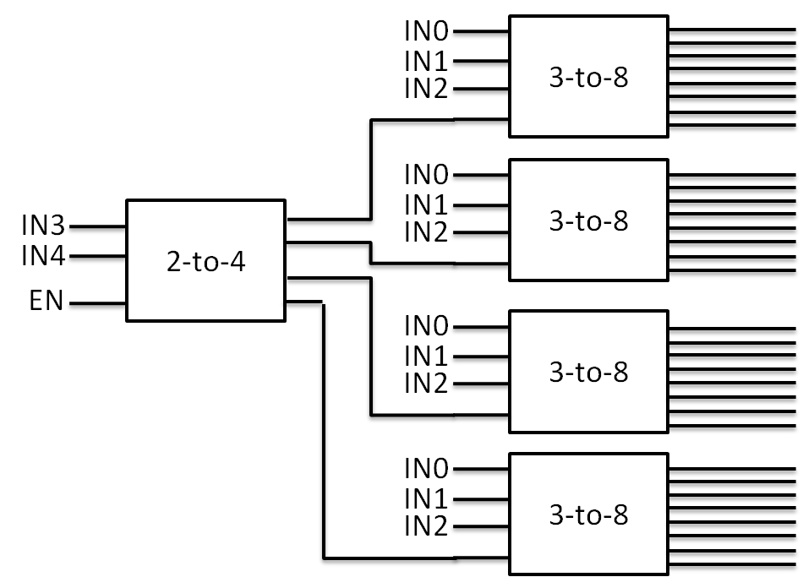
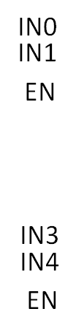
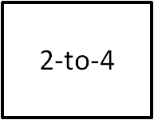
DECODERS (1)
Type 1
Type 2

Slide 4
DECODERS

Slide 5
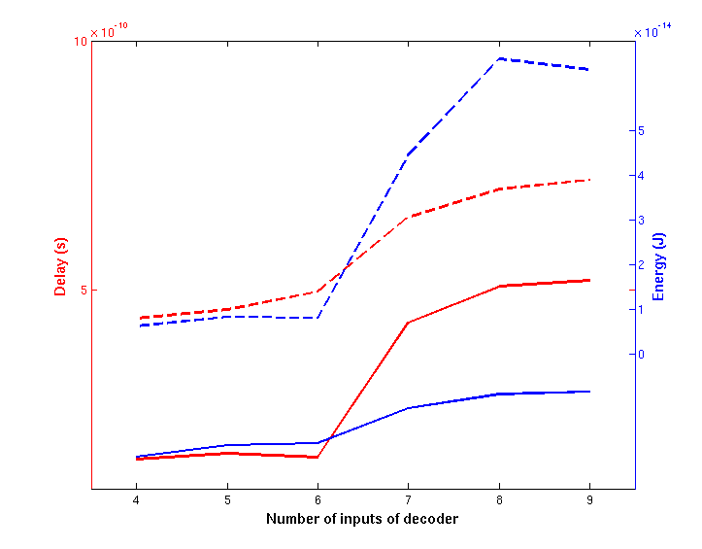

Timing: mem deselect dependency graph

Slide 6
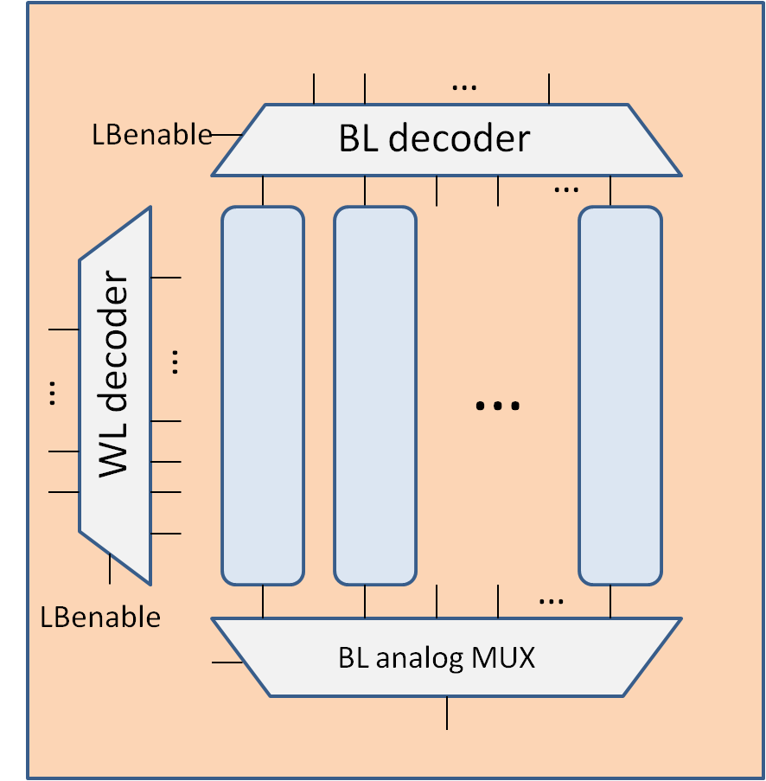
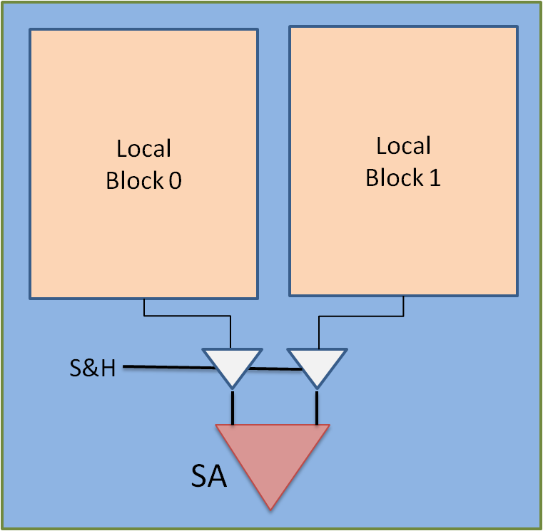
REFERENCE ARRAY
Reference now inside
Localblock:

Slide 7

REFERENCE ARRAY
LBEnable
VDD
GBenable
RefEnable
BL
BL decoder
WL
SL
BitLine MUX

Slide 8
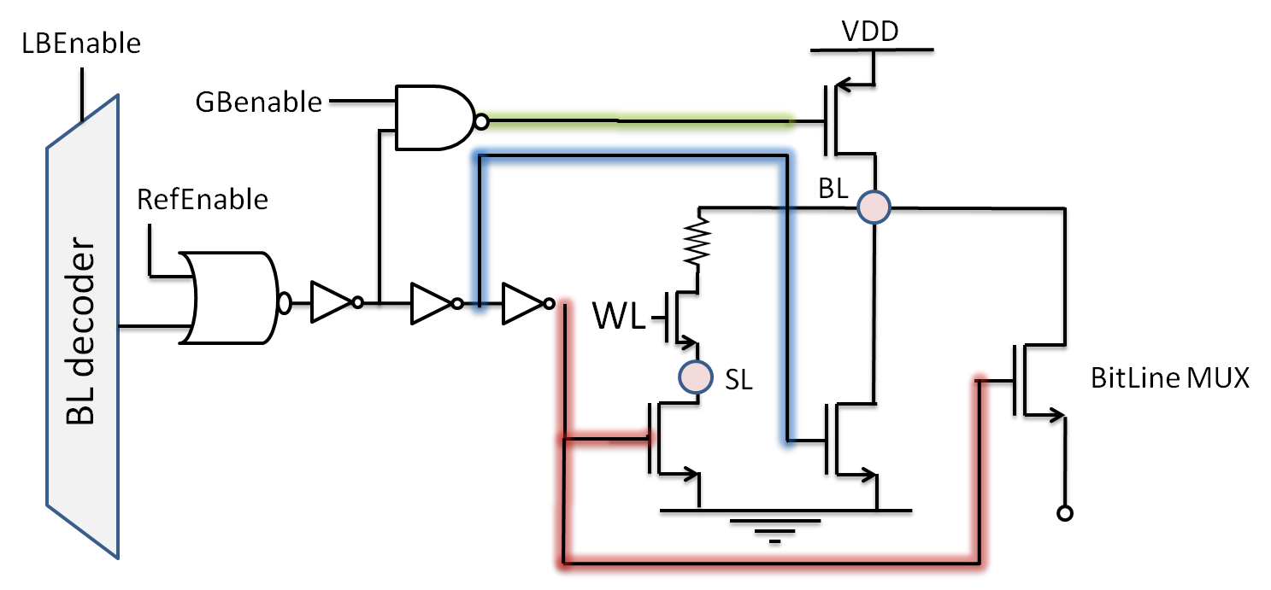
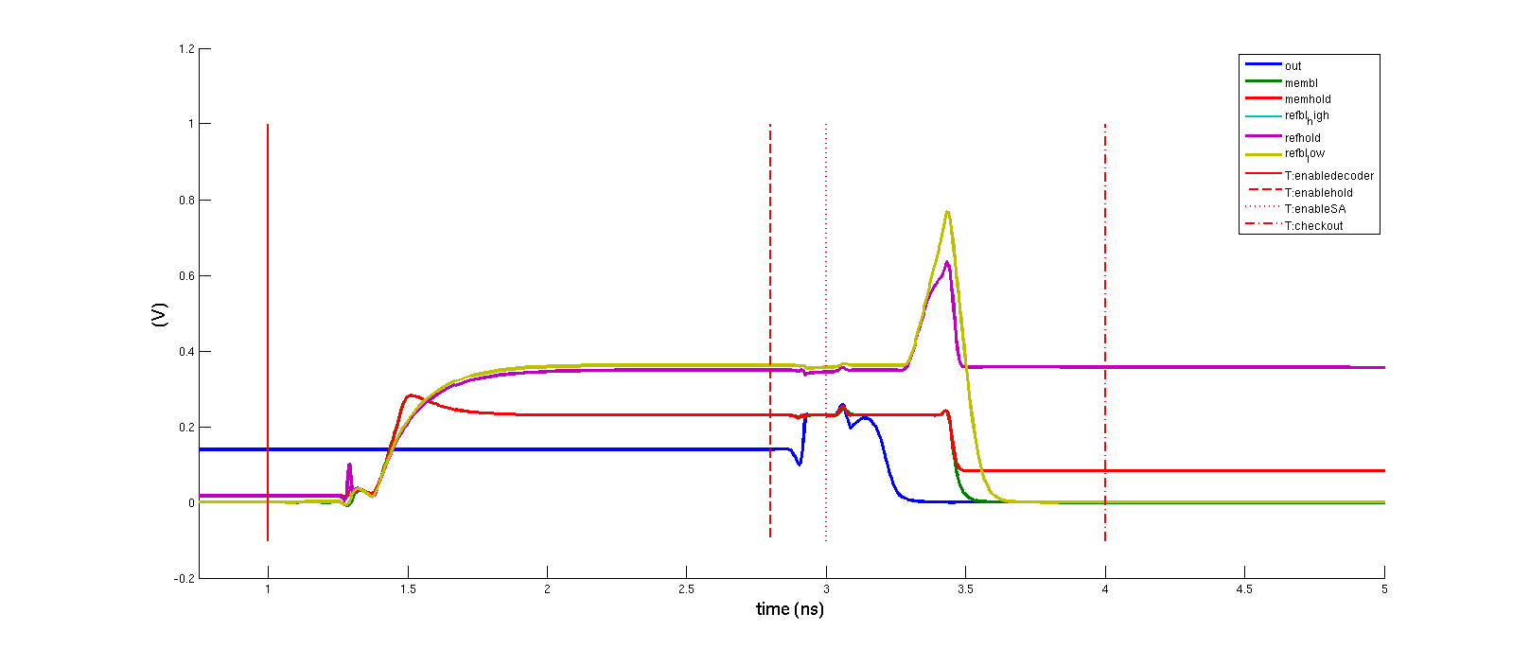
REFERENCE ARRAY
WL_ref = RefEnable
→ Load is still on when all the rest is of

Slide 9
REFERENCE ARRAY
BitLine Mux is turned off before the node is fully discharged.
Charge trapped is really small and doesn’t affect next read cycle

Slide 10









REFERENCE ARRAY: add delay to WL

Slide 11
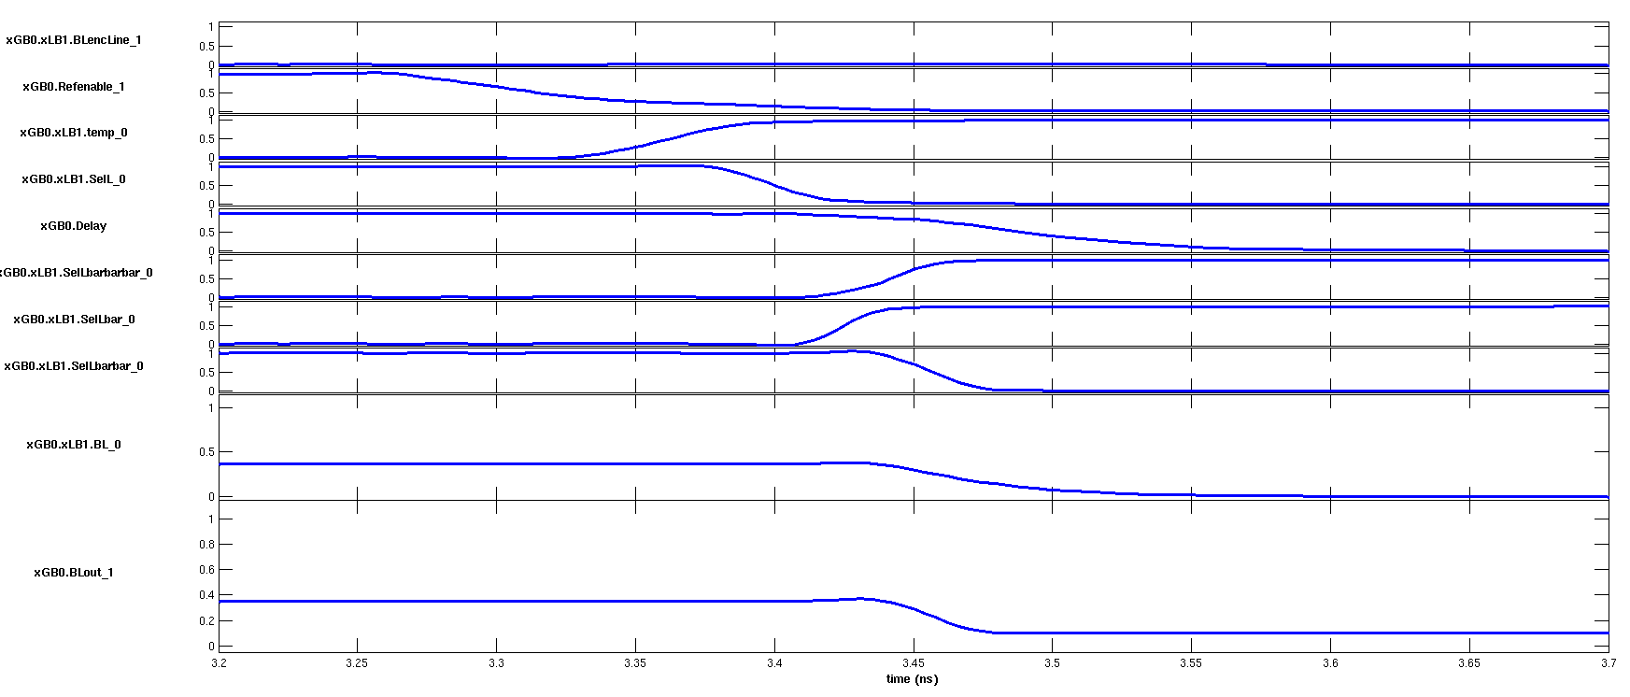
REFERENCE ARRAY: add delay to WL

Slide 12
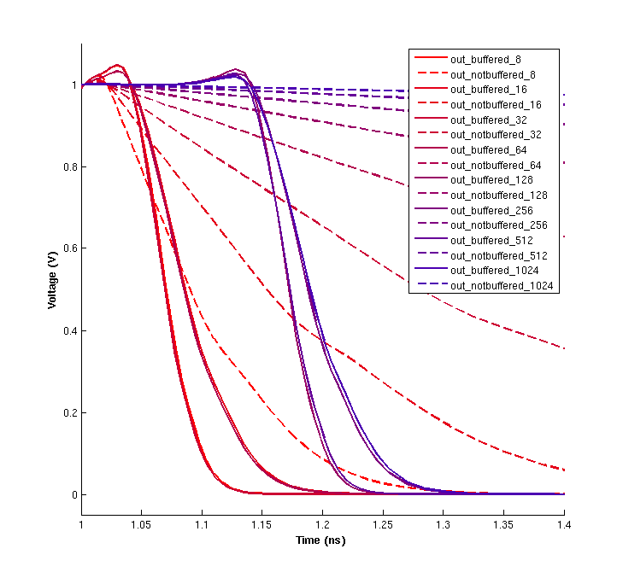



REFERENCE ARRAY: Buffers
RefEnable
Number of Bitlines
Buffer designed with logical effort
(stage effort = 4)

Slide 13
Timing: mem deselect dependency graph
Start deselecting
Load turned off
WL turned off
BLencLine
Temp
SelL
SelLbarbarbar
SelLbar
SelLbarbar
T₂
WL/WL buffered
T₁

