Slide 1


Load Analysis 2
Alexander Standaert
Wouter Diels

Slide 2
OUTLINE
RECAP LAST MEETING
TRIPLE LOAD
SINGLE LOAD
CONCLUSION

Slide 3
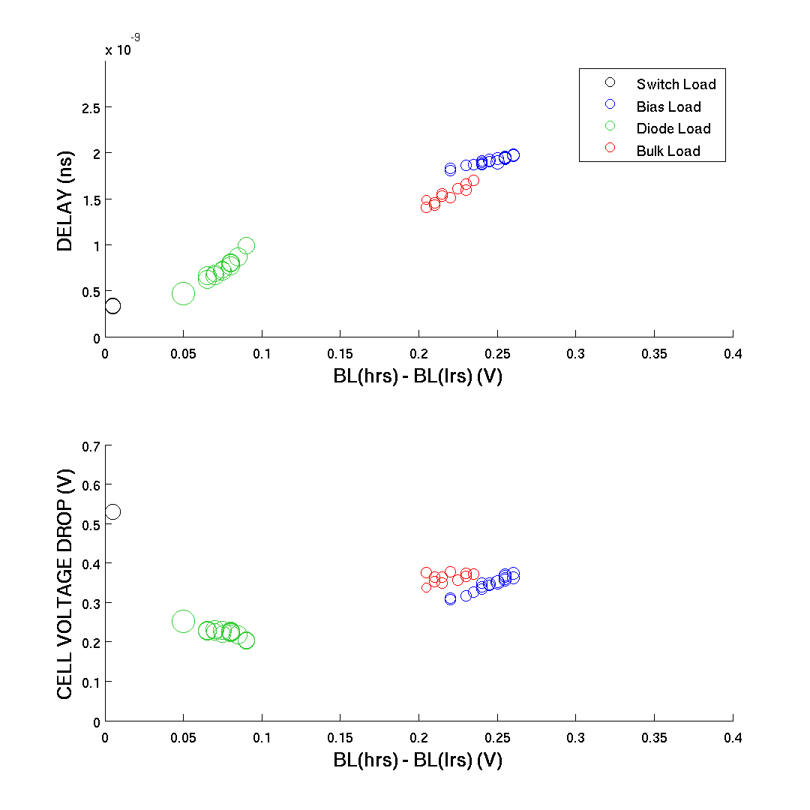
MONTE CARLO: PARETO
48 SOLUTIONS
CHOICE FINAL LOAD:
Type = bias
W_switch = 100nm
W_bias = 180nm
V_bias = 0V
600 mc iterations

Slide 4
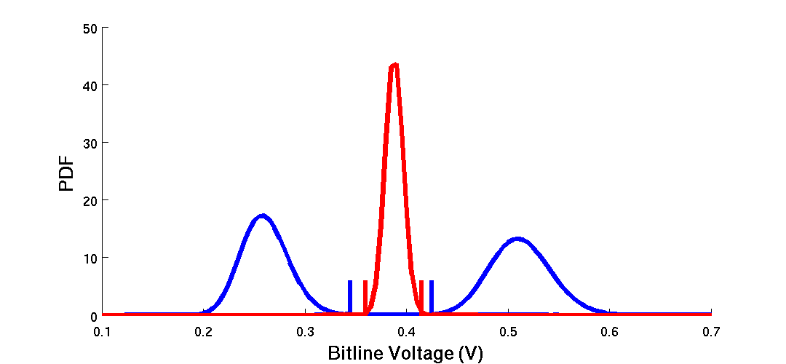
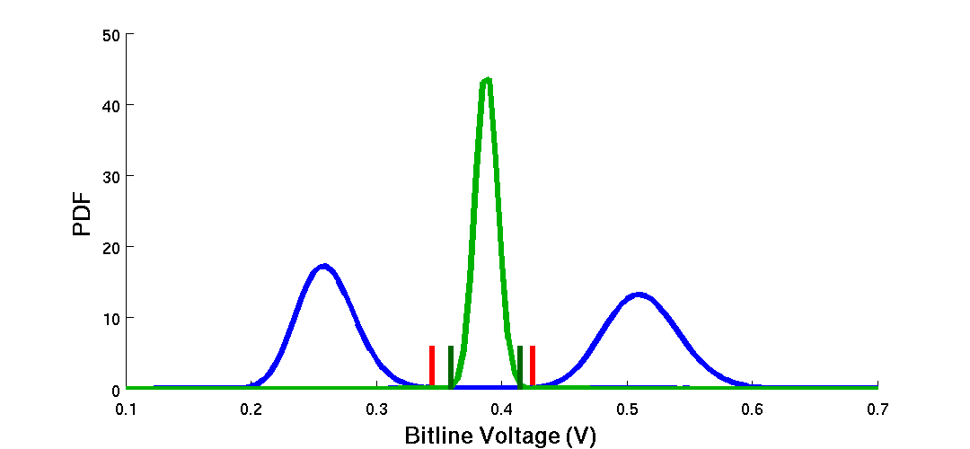
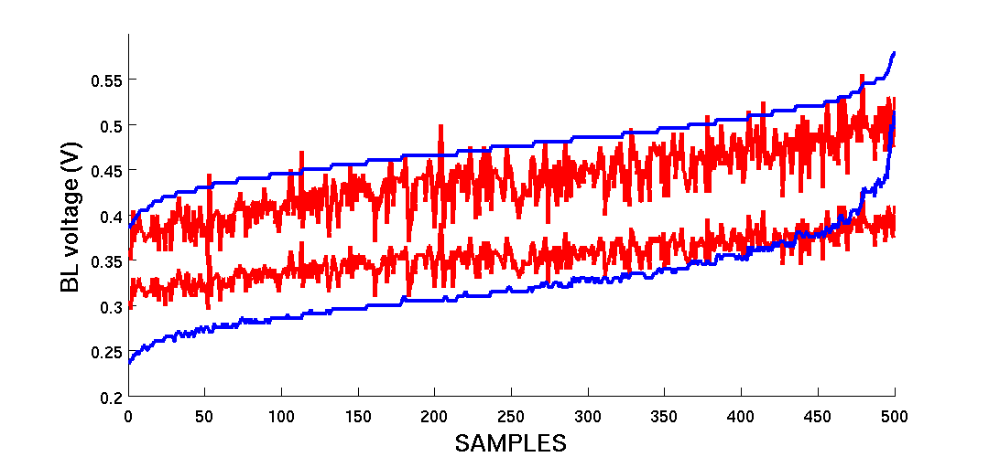
BIAS LOAD: BEST CASE SCENARIO
…
Why do the BL voltages react this way?

Slide 5
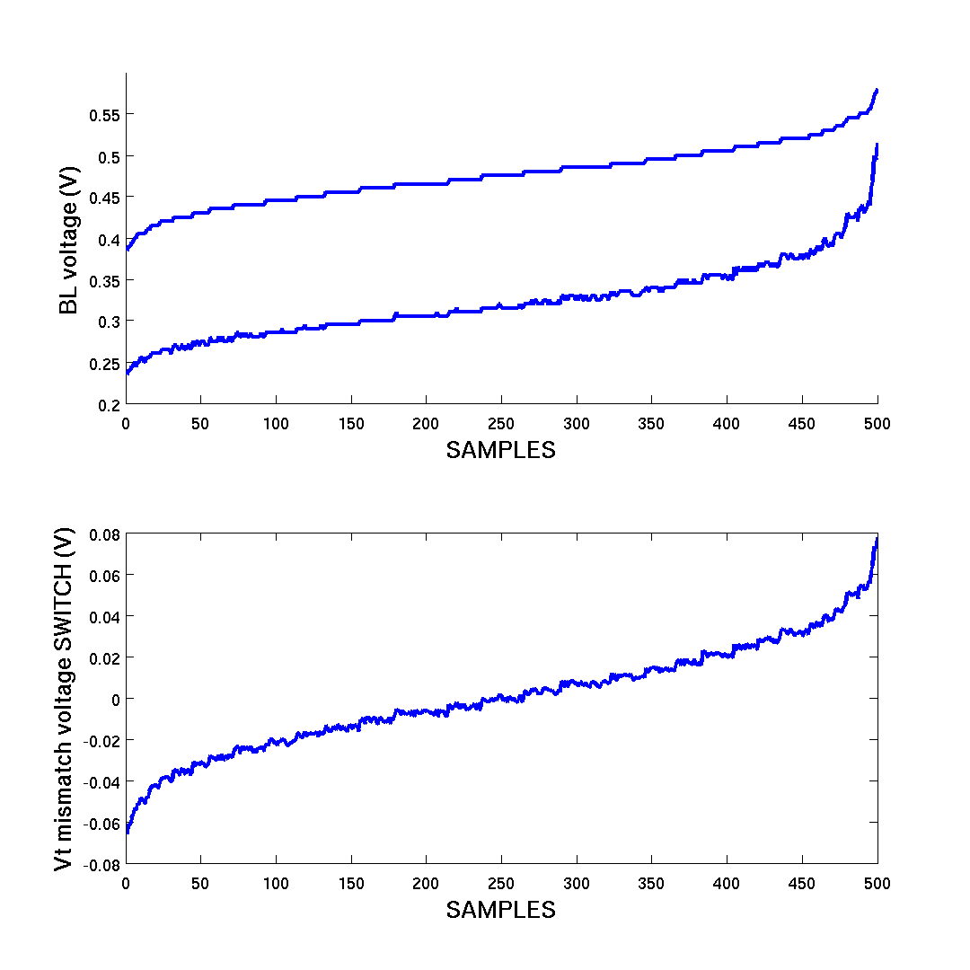
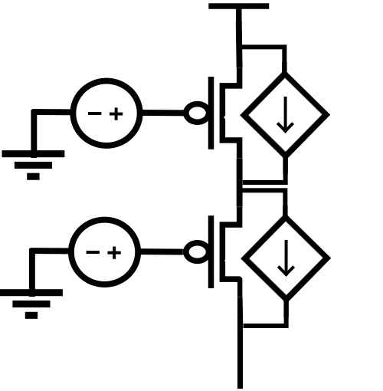
BIAS LOAD: BEST CASE SCENARIO
W = 100nm
W = 180nm

Slide 6
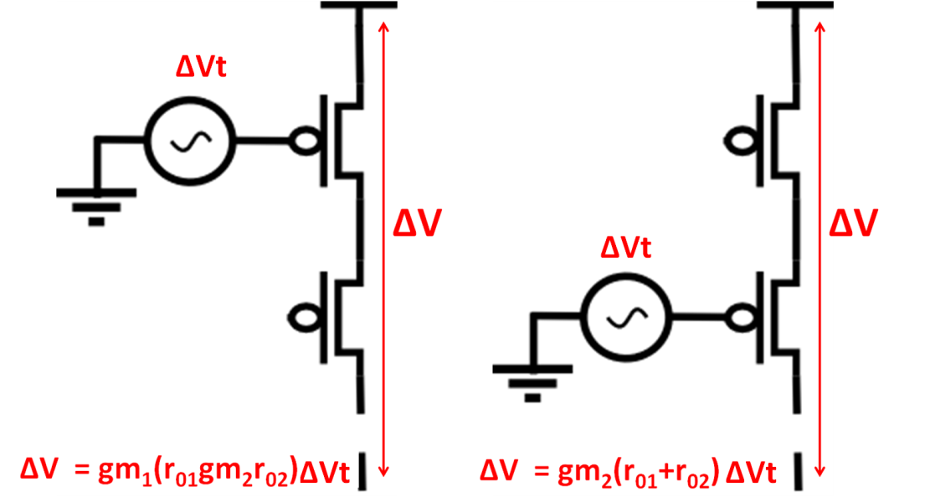
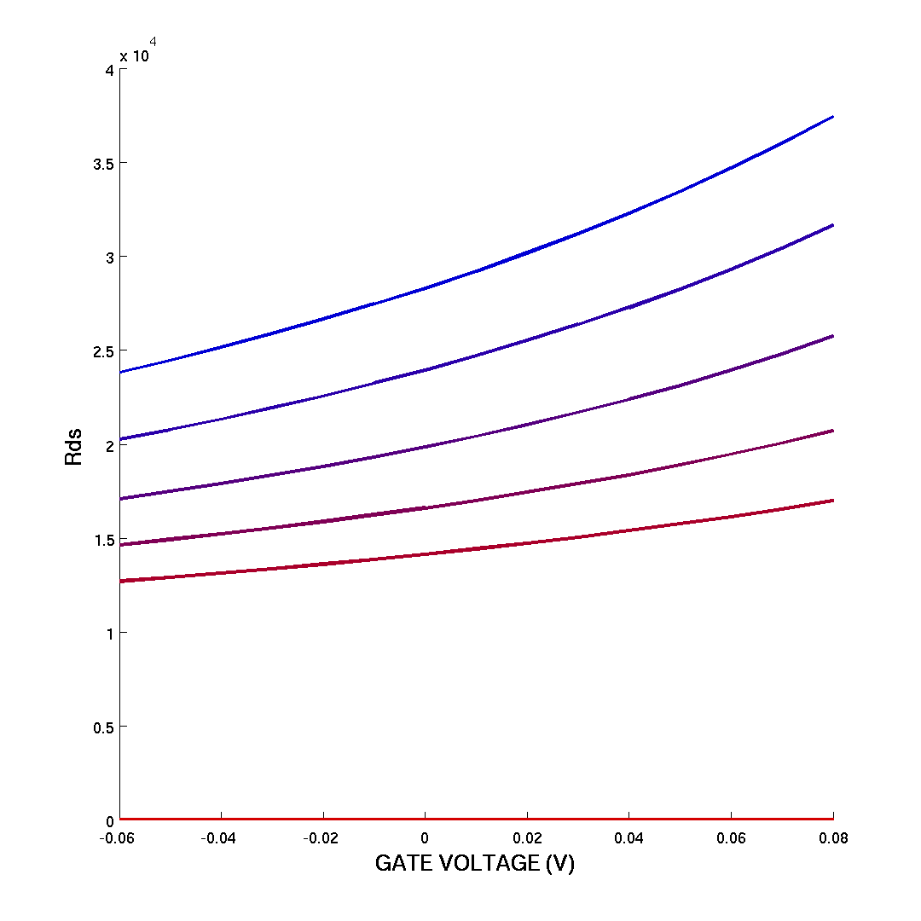
BIAS LOAD: BEST CASE SCENARIO
1 ) Cascode effect : explains why
mismatch switch is dominant
2) Increase ds resistance : explains
why V_bl(HRS)- V_bl(LRS)
becomes smaller at extreme
positive values of ∆Vt
1
1
2
2
R_load 
V_ds 

Slide 7
BIAS LOAD: BEST CASE SCENARIO
→Typo error
Cascode effect also not really valid because both transistors are in linear region

Slide 8
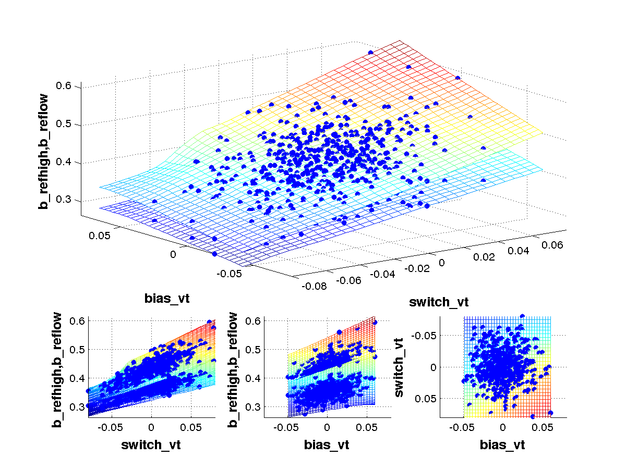
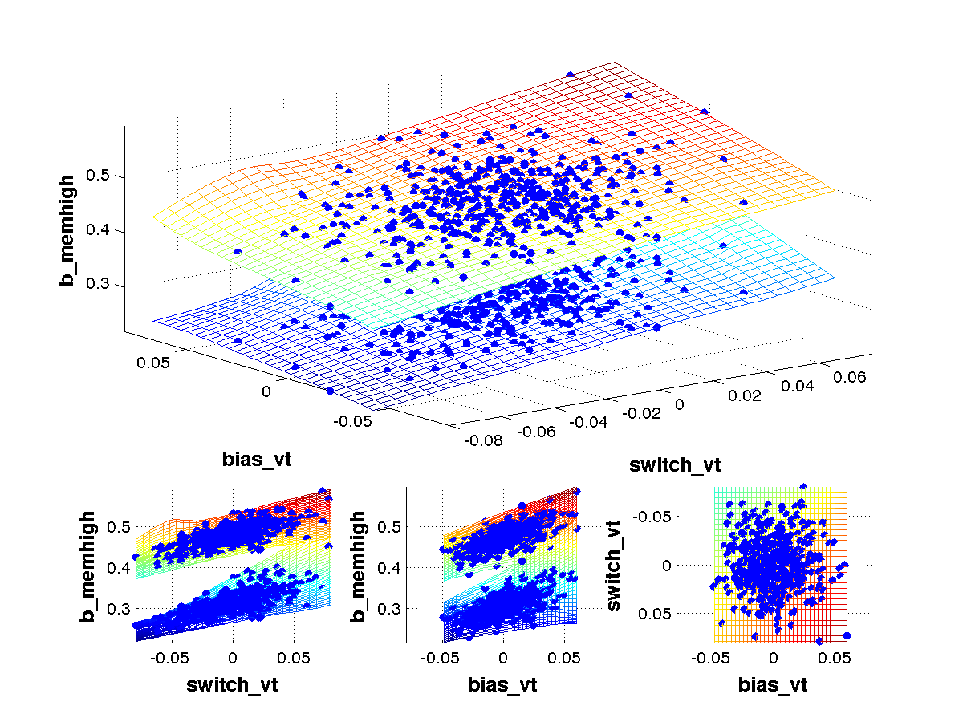
BIAS LOAD: BEST CASE SCENARIO
Corrected results → Both BL of reference and memory array react the same
→ Both transistor give equal mismatch problems

Slide 9
OUTLINE
RECAP LAST MEETING
TRIPLE LOAD
SINGLE LOAD
CONCLUSION

Slide 10
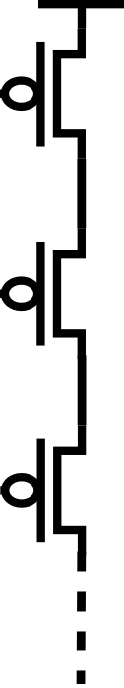
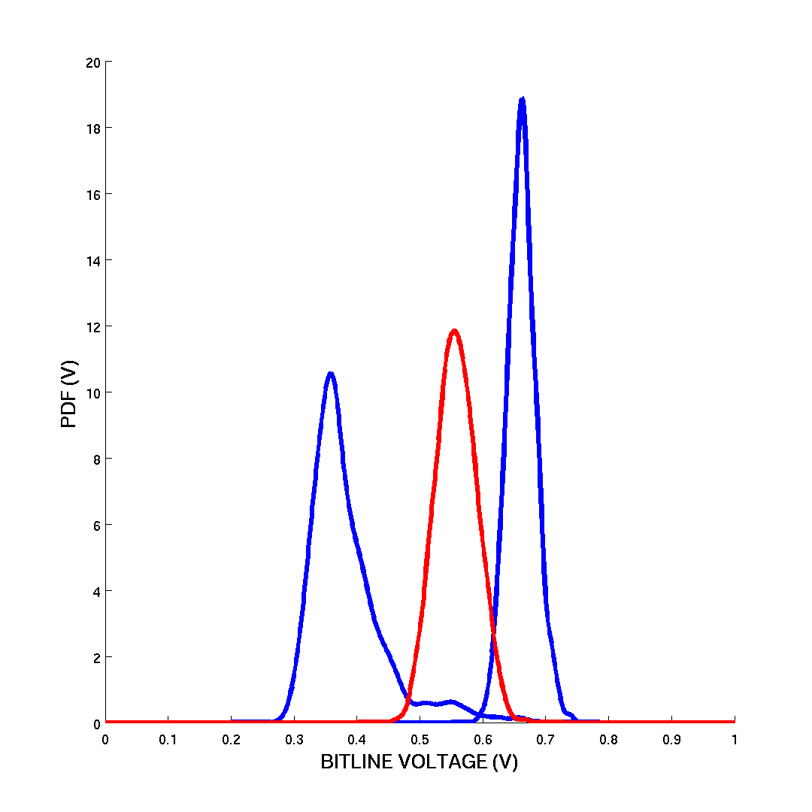
TRIPLE LOAD
W = 150nm
HRS: 0.87
LRS: 0.85
W = 300nm
HRS: 0.77
LRS: 0.74
W = 500nm
HRS: 0.67
LRS: 0.35

Slide 11
TRIPLE LOAD
W = 150nm
W = 300nm
W = 500nm
Vgs ≈ 0.3-0.4 with Vth ≈ 0.3-0.4
→ maybe in subthreshold

Slide 12
OUTLINE
RECAP LAST MEETING
TRIPLE LOAD
SINGLE LOAD
CONCLUSION

Slide 13

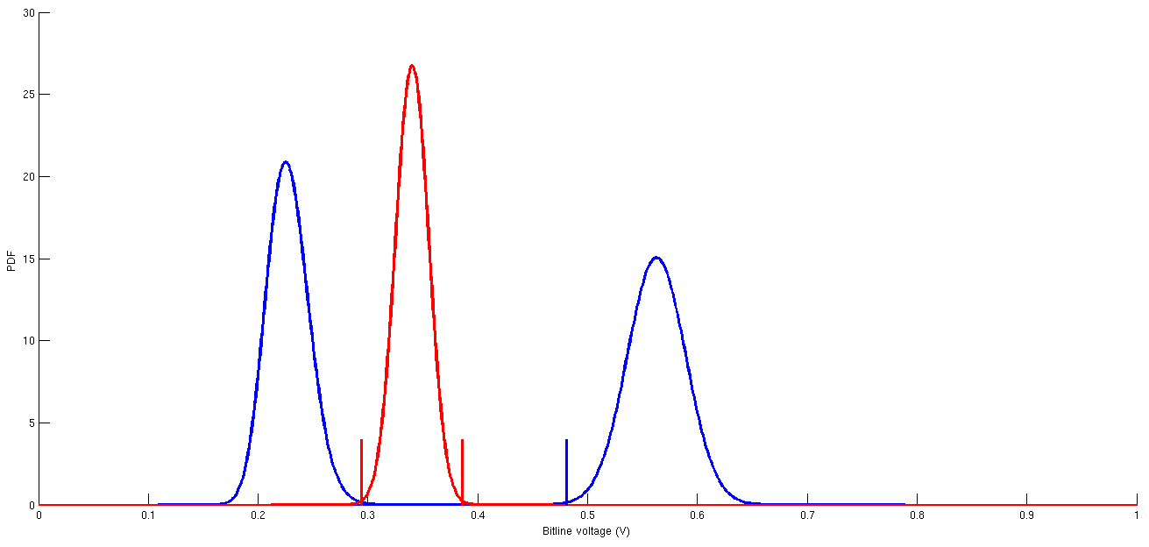
SINGLE LOAD
About 200mV margin and
Reference can easily be shifted to center
L = 195nm
W = 300nm
Reference consists out of 4cells

Slide 14
OUTLINE
RECAP LAST MEETING
TRIPLE LOAD
SINGLE LOAD
CONCLUSION

