Slide 1


Load Analysis
Alexander Standaert
Wouter Diels

Slide 2
OUTLINE
INPUTS : Load types, Design parameters and Simulation set up
OBJECTIVES : Linear sweep and Monte carlo
RESULTS LINEAR SWEEP
RESULTS MONTE CARLO
FINAL LOAD
CONCLUSION : Conclusion and Future work

Slide 3
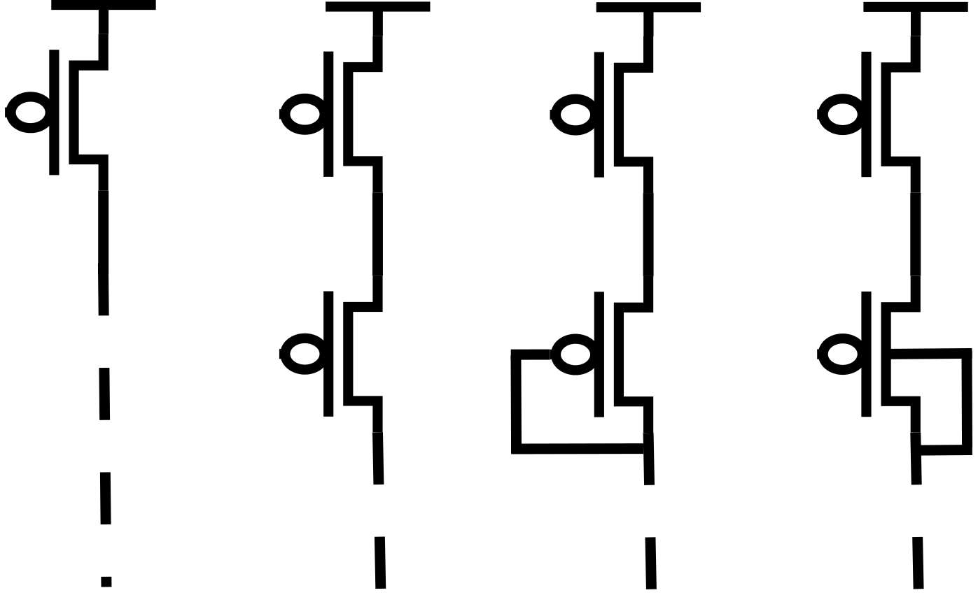
LOAD TYPES
Sel_load
Sel_load
Sel_load
Sel_load
Bias
Bulk
Switch Load
Bias Load
Diode Load
Bulk Load*
*(Ren et al., "A body-voltage-sensing-based short pulse reading circuit for spin-torque transfer RAMs (STT-RAMs) “, 2012)

Slide 4
LOAD TYPES
Sel_load
Sel_load
Sel_load
Sel_load
Bias
Bulk
Design parameters:
w_Switch
Switch Load
Bias Load
Diode Load
Bulk Load*
*(Ren et al., "A body-voltage-sensing-based short pulse reading circuit for spin-torque transfer RAMs (STT-RAMs) “, 2012)

Slide 5
LOAD TYPES
Sel_load
Sel_load
Sel_load
Sel_load
Bias
Bulk
Design parameters:
w_Switch
Design parameters:
w_Switch
w_Bias
V_Bias
Switch Load
Bias Load
Diode Load
Bulk Load*
*(Ren et al., "A body-voltage-sensing-based short pulse reading circuit for spin-torque transfer RAMs (STT-RAMs) “, 2012)

Slide 6
LOAD TYPES
Sel_load
Sel_load
Sel_load
Sel_load
Bias
Bulk
Design parameters:
w_Switch
Design parameters:
w_Switch
w_Bias
V_Bias
Design parameters:
w_Switch
w_Diode
Switch Load
Bias Load
Diode Load
Bulk Load*
*(Ren et al., "A body-voltage-sensing-based short pulse reading circuit for spin-torque transfer RAMs (STT-RAMs) “, 2012)

Slide 7
LOAD TYPES
Sel_load
Sel_load
Sel_load
Sel_load
Bias
Bulk
Design parameters:
w_Switch
Design parameters:
w_Switch
w_Bias
V_Bias
Design parameters:
w_Switch
w_Diode
Design parameters:
w_Switch
w_Bulk
Switch Load
Bias Load
Diode Load
Bulk Load*
*(Ren et al., "A body-voltage-sensing-based short pulse reading circuit for spin-torque transfer RAMs (STT-RAMs) “, 2012)

Slide 8
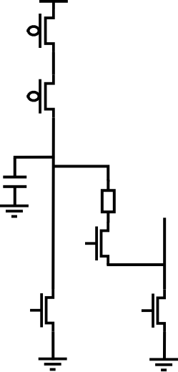
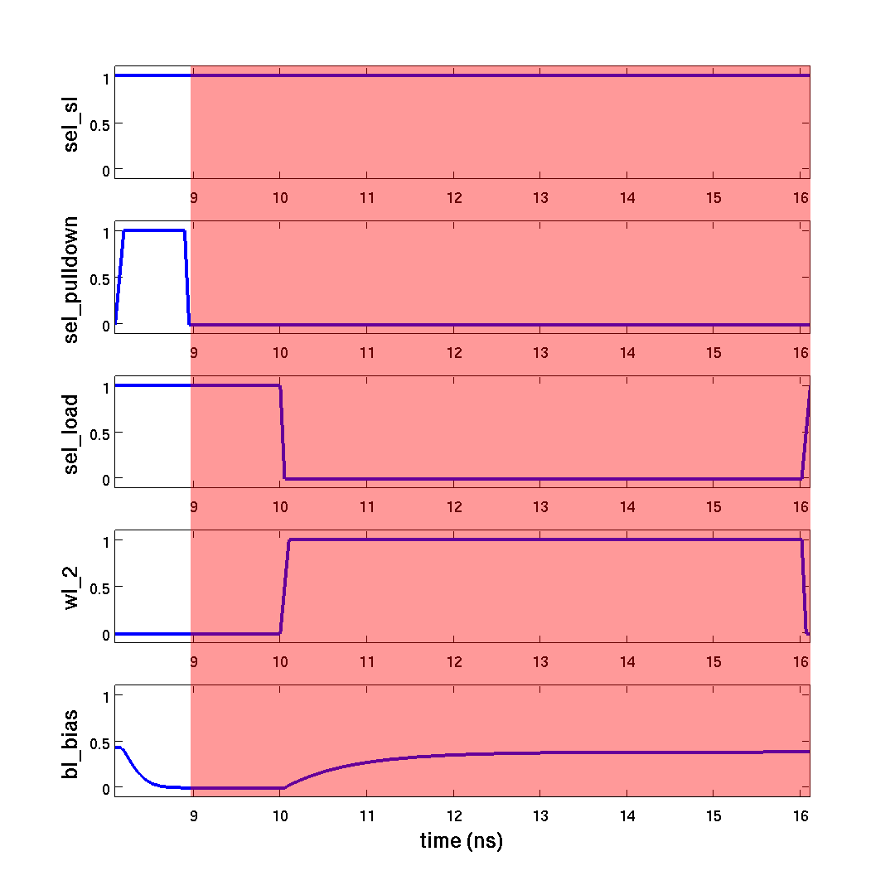
1V
SIMULATION SETUP
Sel_load
1) decharge
Bias
HRS = 30-35KΩ
LRS = 5-10KΩ
18fF
Memory cell
WL
Sel_pulldown
Sel_SL

Slide 9
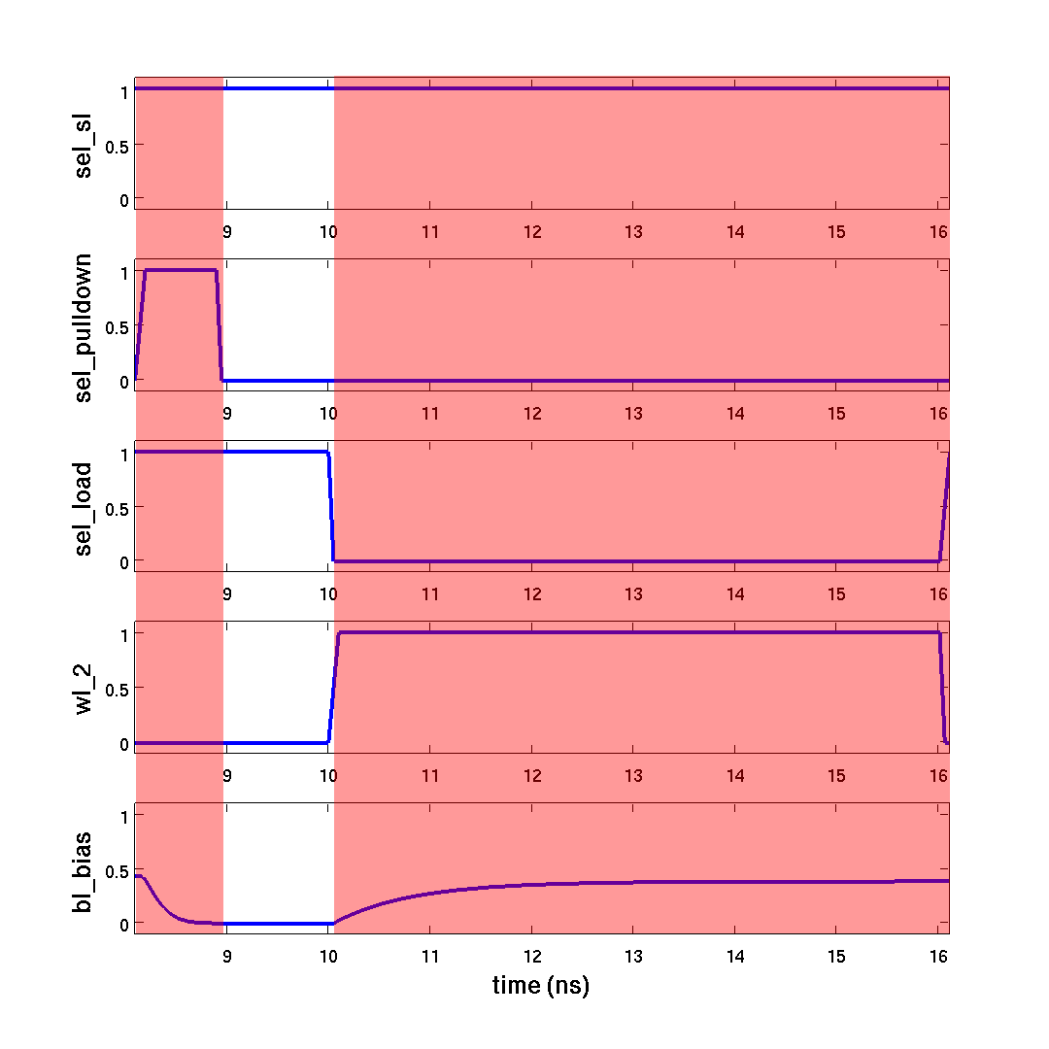
1V
SIMULATION SETUP
Sel_load
2) dead time
Bias
18fF
Memory cell
WL
Sel_pulldown
Sel_SL

Slide 10
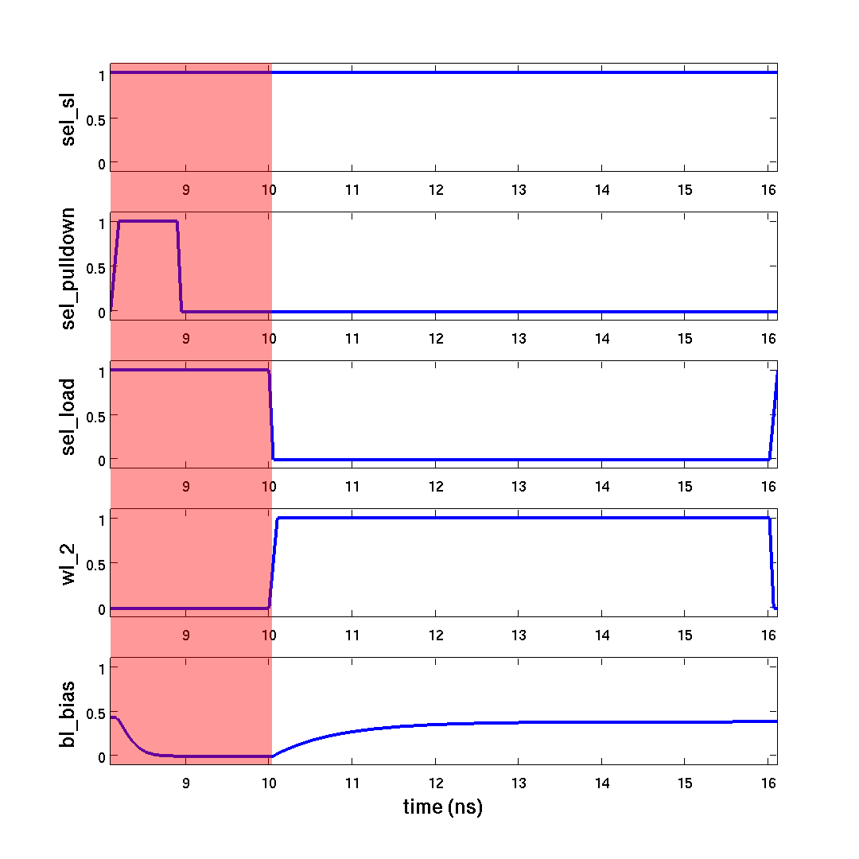
1V
SIMULATION SETUP
Sel_load
3) sense
Bias
V_BL
18fF
Memory cell
WL
Sel_pulldown
Sel_SL

Slide 11
OUTLINE
INPUTS : Load types, Design parameters and Simulation set up
OBJECTIVES : Linear sweep and Monte carlo
RESULTS LINEAR SWEEP
RESULTS MONTE CARLO
FINAL LOAD
CONCLUSION : Conclusion and Future work

Slide 12
OBJECTIVES
Bitline voltage difference: V_BL(HRS) – V_BL(LRS)
Bitline delay
Area
Voltage drop memory cell
Minimal Bitline voltage difference
Minimal Standard deviation Bitline voltage
Maximal Bitline delay
Robustness Temperature, Vss, ... variations
LINEAR SWEEP
MONTE CARLO

Slide 13
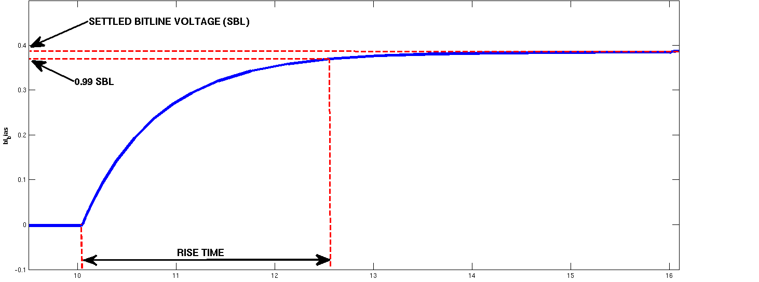
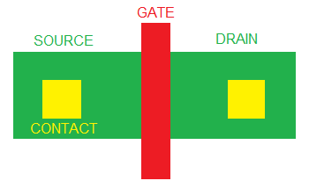
OBJECTIVES LINEAR SWEEP
Sel_load
Bias
V_BL
DELAY calculation
Voltage drop memory cell
AREA calculation
WL
W
Sel_pulldown
Sel_SL
L

Slide 14
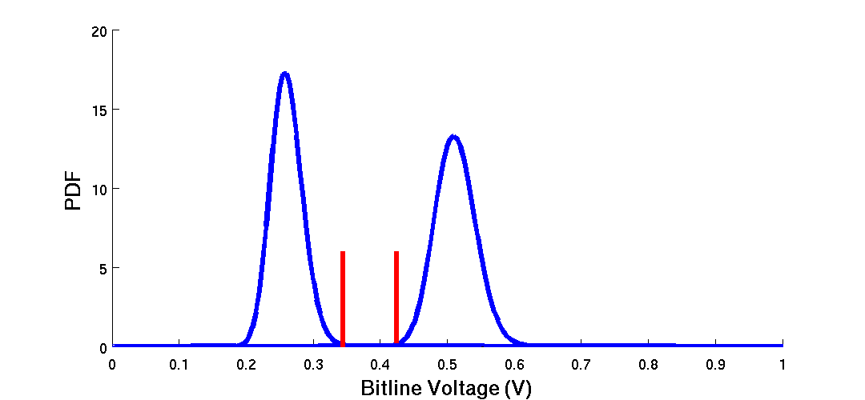
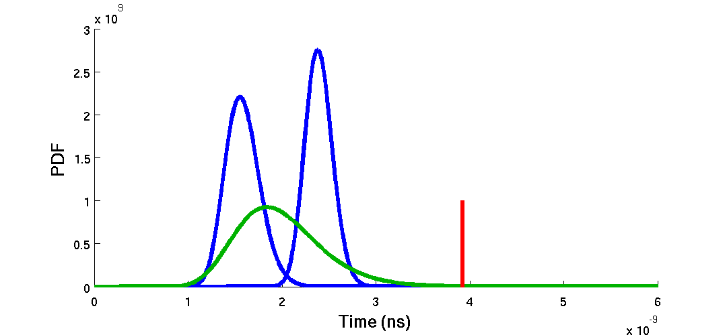
OBJECTIVES MONTE CARLO
MINIMUM BITLINE VOLTAGE DIFFERENCE
LRS
HRS
MINIMUM STANDARD DEVIATION BITLINE VOLTAGE
99.9 % population
HRS
LRS
LRS+HRS
MAXIMUM BITLINE DELAY

Slide 15
OUTLINE
INPUTS : Load types, Design parameters and Simulation set up
OBJECTIVES : Linear sweep and Monte carlo
RESULTS LINEAR SWEEP
RESULTS MONTE CARLO
FINAL LOAD
CONCLUSION : Conclusion and Future work

Slide 16
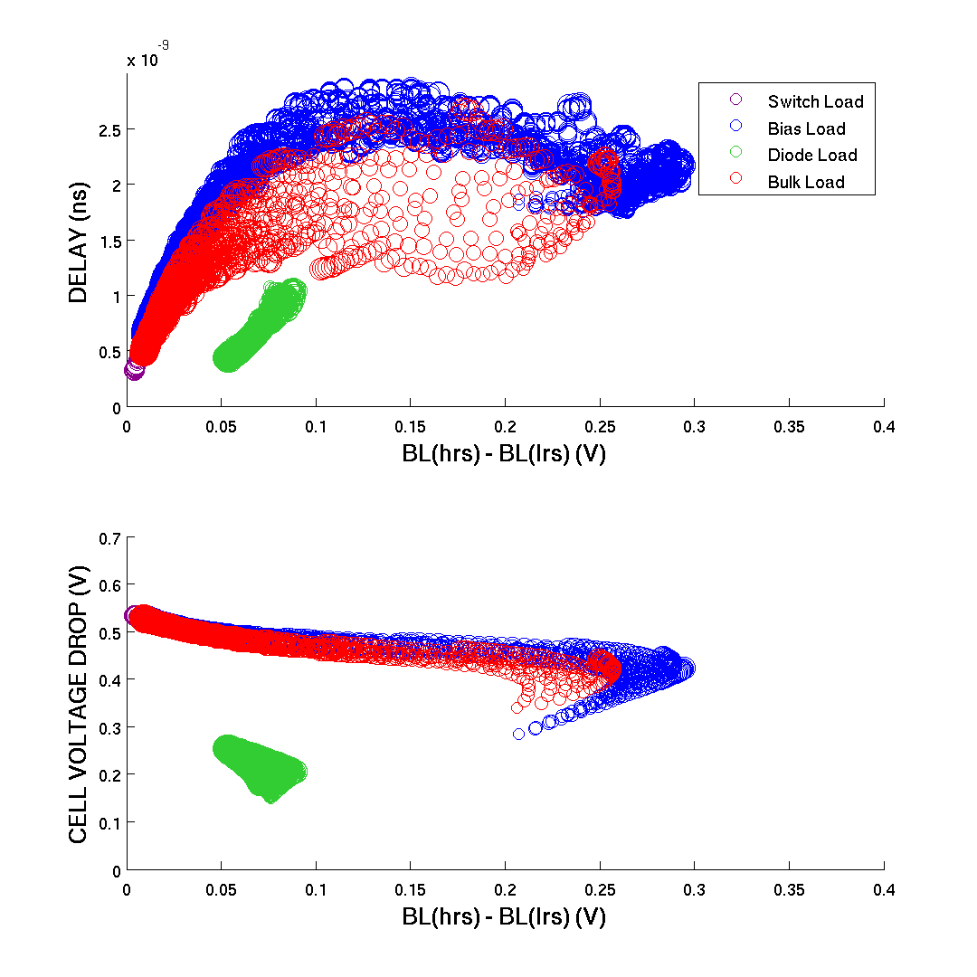
LINEAR SWEEP
21894 SOLUTIONS
SWEEP RANGE:
W_switch = 100-500nm
W_load = 100-500nm
V_bias = 0-0.4V

Slide 17
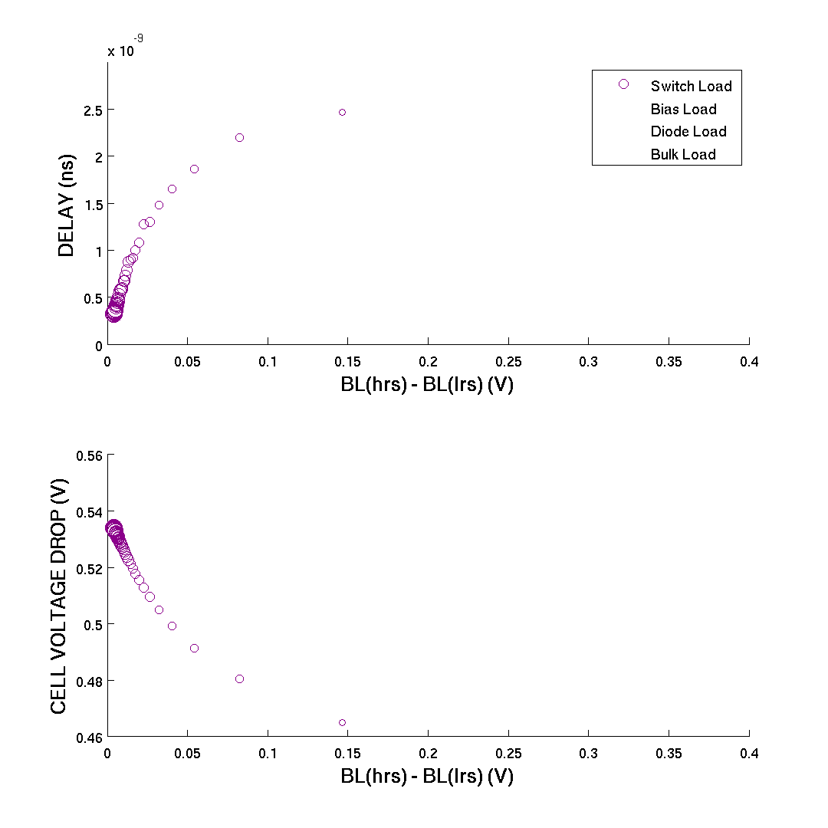

LINEAR SWEEP: SWITCH LOAD
W_switch 
Switch
W_switch 

Slide 18
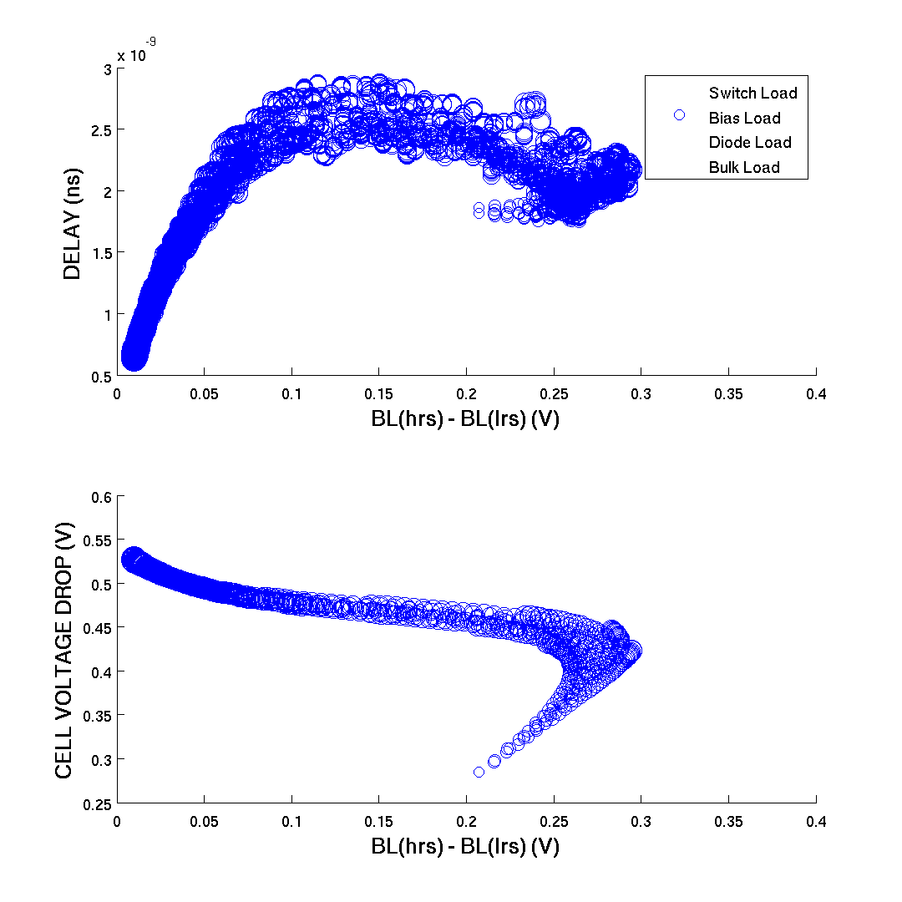
LINEAR SWEEP: BIAS LOAD
W_bias 
V_bias 
W_switch 
Switch
W_bias 
Bias
W_switch 
V_bias 

Slide 19
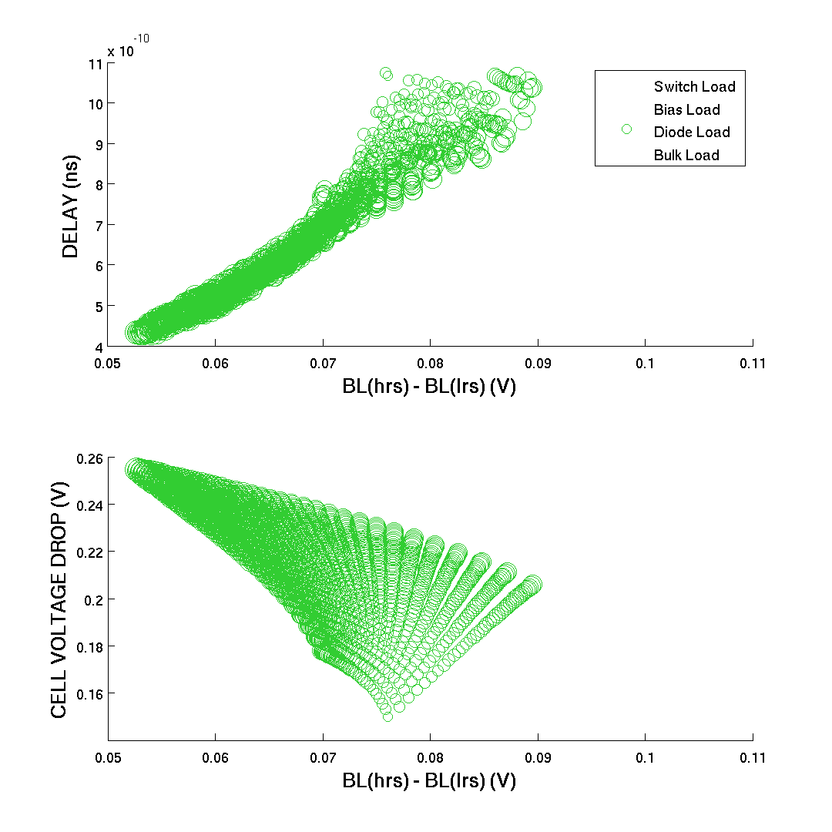
LINEAR SWEEP: DIODE LOAD
W_switch 
W_diode 
Switch
W_diode 
W_switch 
Diode

Slide 20
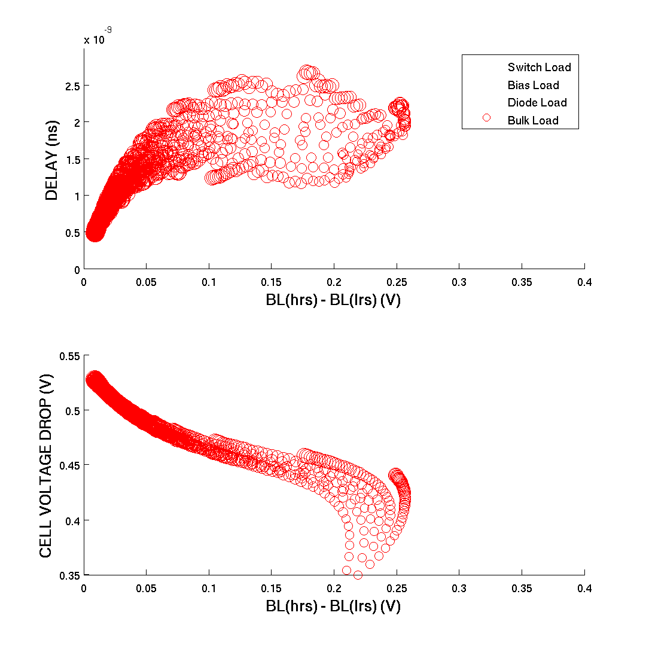
LINEAR SWEEP: BULK LOAD
W_switch 
W_bulk 
Switch
W_bulk 
W_switch 
Bulk

Slide 21
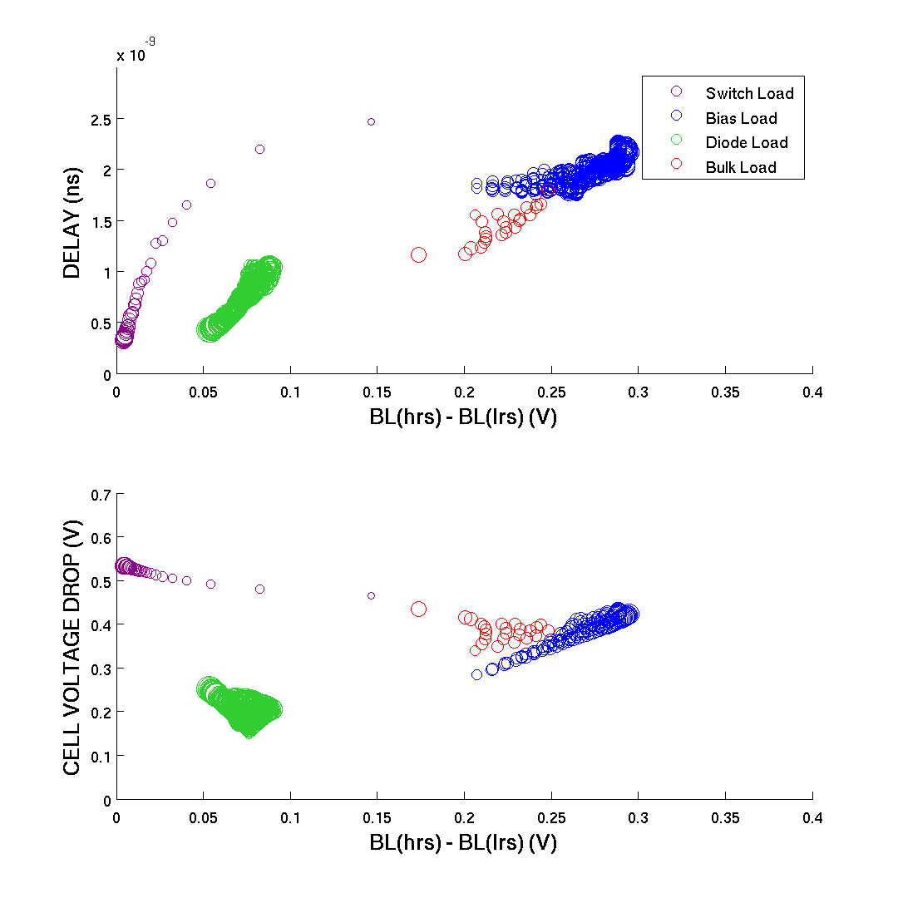
LINEAR SWEEP: PARETO
1681 SOLUTIONS
PARETO OBJECTIVES:
Area
Diff BL voltage
Settle Time
Voltage drop memory cell

Slide 22
OUTLINE
INPUTS : Load types, Design parameters and Simulation set up
OBJECTIVES : Linear sweep and Monte carlo
RESULTS LINEAR SWEEP
RESULTS MONTE CARLO
FINAL LOAD
CONCLUSION : Conclusion and Future work

Slide 23
OBJECTIVES MONTE CARLO
MINIMUM BITLINE VOLTAGE DIFFERENCE
LRS
HRS
MINIMUM STANDARD DEVIATION BITLINE VOLTAGE
99.9 % population
HRS
LRS
LRS+HRS
MAXIMUM BITLINE DELAY

Slide 24
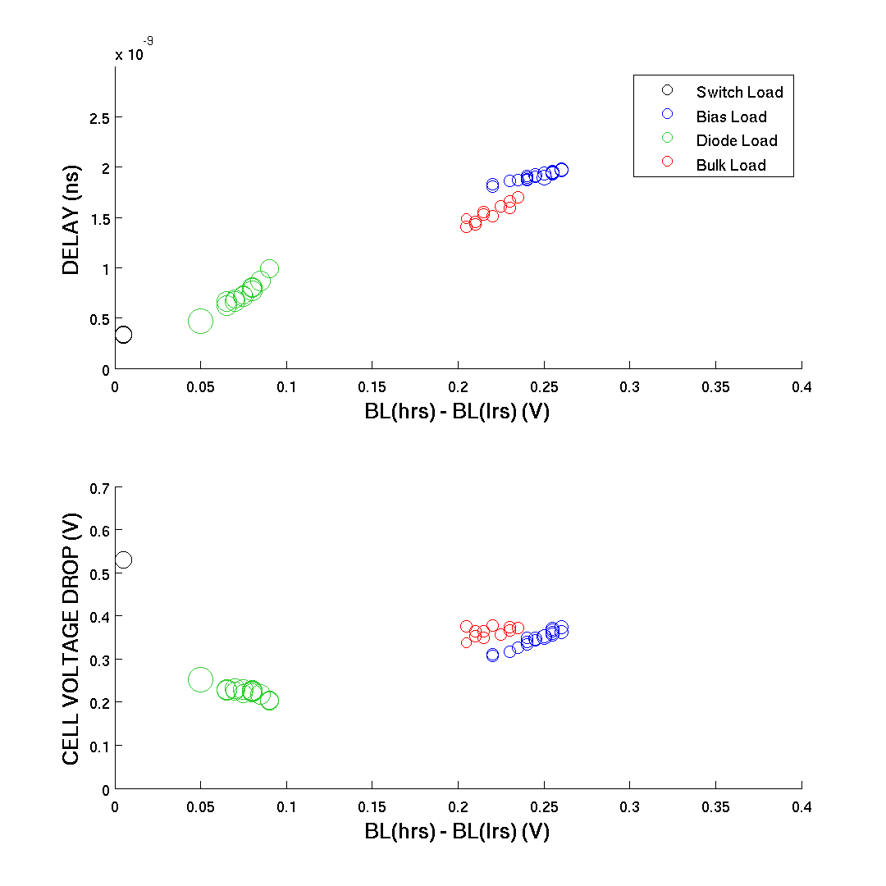
MONTE CARLO: PARETO
48 SOLUTIONS
A_Vt = 2.5 mV*um
A_I0 = 1.2
PARETO OBJECTIVES:
Minimal Bitline voltage difference
Minimal Standard deviation Bitline voltage
Maximal Bitline delay
600 mc iterations

Slide 25
MONTE CARLO: PARETO
48 SOLUTIONS
CHOICE FINAL LOAD:
Type = bias
W_switch = 100nm
W_bias = 180nm
V_bias = 0V
600 mc iterations

Slide 26
OUTLINE
INPUTS : Load types, Design parameters and Simulation set up
OBJECTIVES : Linear sweep and Monte carlo
RESULTS LINEAR SWEEP
RESULTS MONTE CARLO
FINAL LOAD
CONCLUSION : Conclusion and Future work

Slide 27
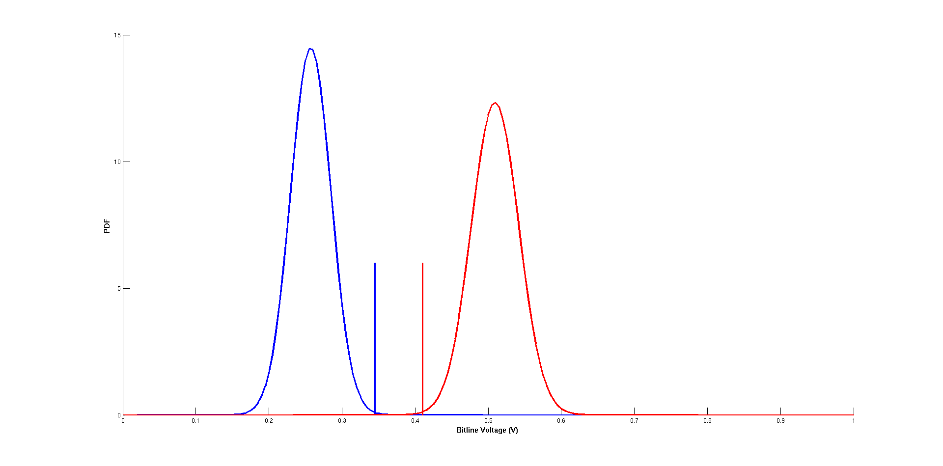
FINAL LOAD: WORST CASE SCENARIO
Everything has mismatch
LRS
CHOICE FINAL LOAD:
Type = bias
W_switch = 100nm
W_bias = 180nm
V_bias = 0V
HRS
CDF(LRS) > 99.9%
65mV
CDF(HRS) < 00.1%
A_Vt = 2.5 mV*um
A_I0 = 1.2

Slide 28
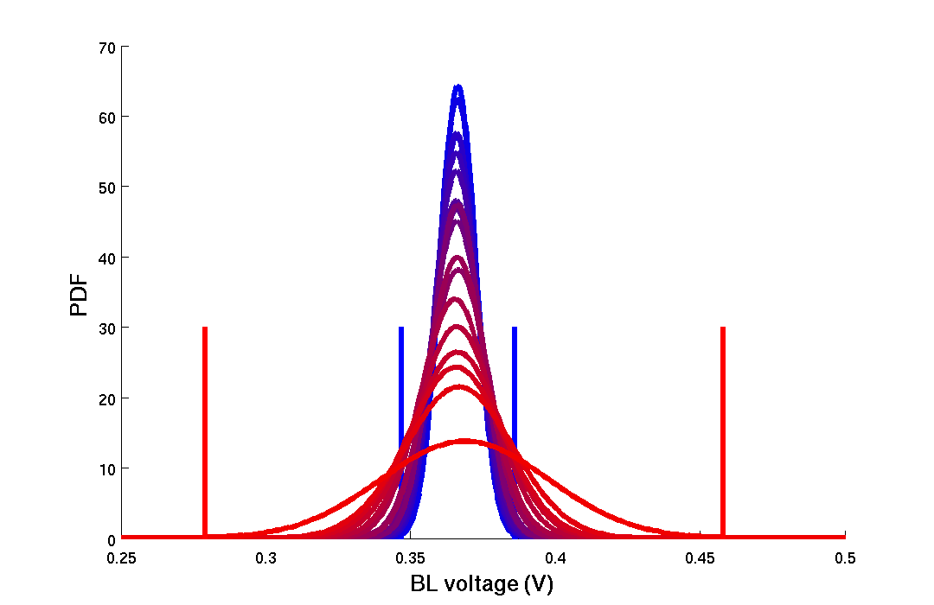
FINAL LOAD: WORST CASE SCENARIO
Everything has mismatch
39mV
180mV

Slide 29
FINAL LOAD: BEST CASE SCENARIO
Load of memory BL and reference BL are matched → Both loads have a mismatch but their mismatch is the same

Slide 30
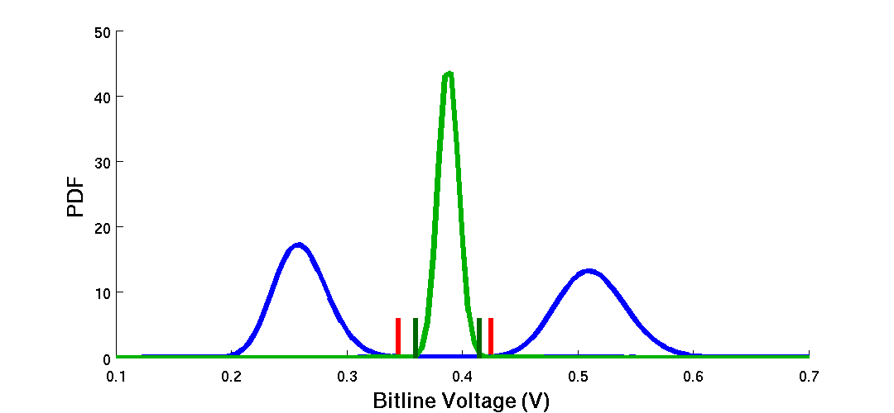
FINAL LOAD: BEST CASE SCENARIO
Load of memory BL and reference BL are matched → Both loads have a mismatch but their mismatch is the same = 100% correlation
…
PDF of BL voltage at mismatch instance 1 of loads
PDF of BL voltage at mismatch instance i of loads

Slide 31
FINAL LOAD: BEST CASE SCENARIO
Load of memory BL and reference BL are matched → Both loads have a mismatch but their mismatch is the same
…
Measure
CDF(BL_voltage HRS) < 0.1%
CDF(BL_voltage LRS) < 99.9%
CDF(BL_voltage REFERENCE) < 0.1%
CDF(BL_voltage REFERENCE) < 99.9%

Slide 32
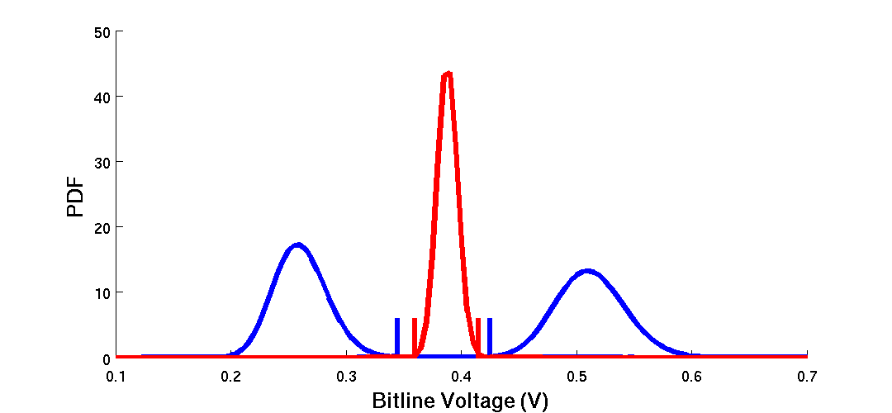
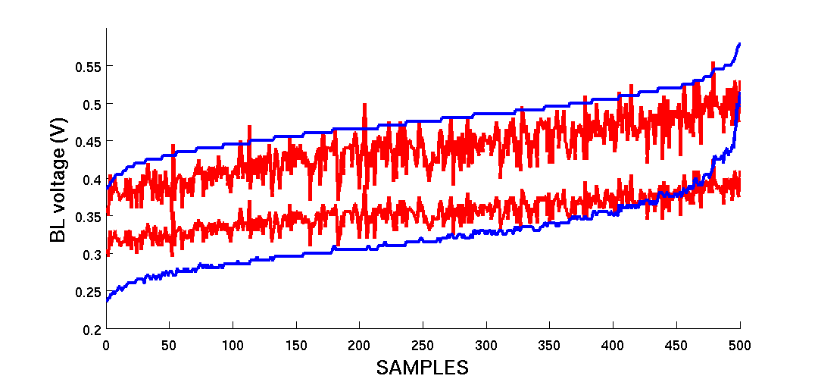
FINAL LOAD: BEST CASE SCENARIO
…
CDF(LRS) > 99.9%
CDF(HRS) < 00.1%

Slide 33
FINAL LOAD: BEST CASE SCENARIO
REF = 4 cells in parallel
…
CDF(REF) < 00.1%
CDF(REF) > 99.9%

Slide 34
FINAL LOAD: BEST CASE SCENARIO
…
Why do the BL voltages react this way?

Slide 35
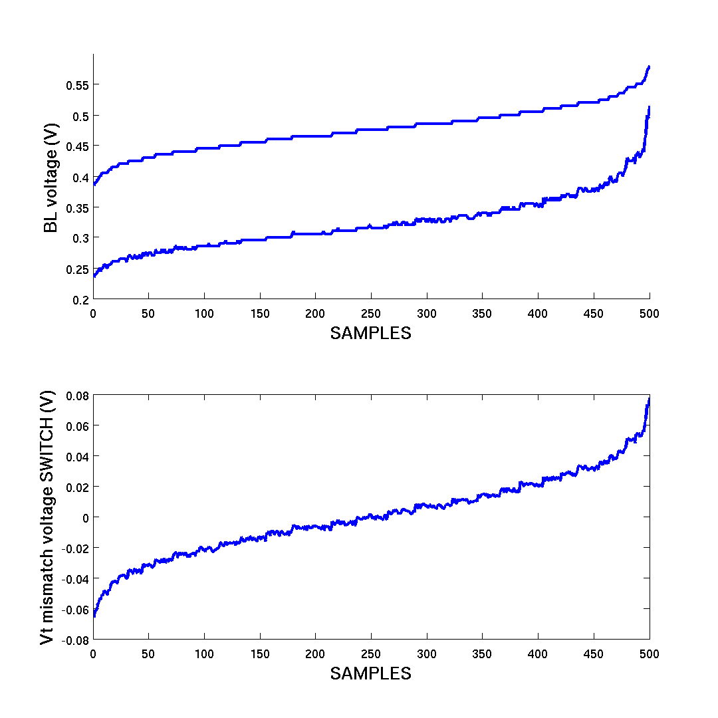
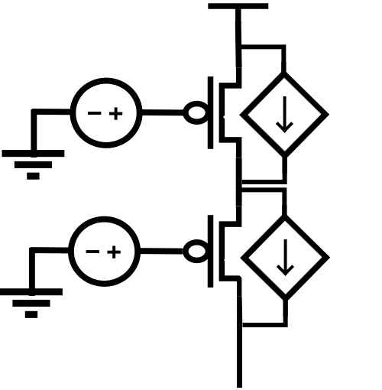
FINAL LOAD: BEST CASE SCENARIO
W = 100nm
W = 180nm

Slide 36
FINAL LOAD: BEST CASE SCENARIO
W = 100nm
W = 180nm
Why Dominant ?

Slide 37
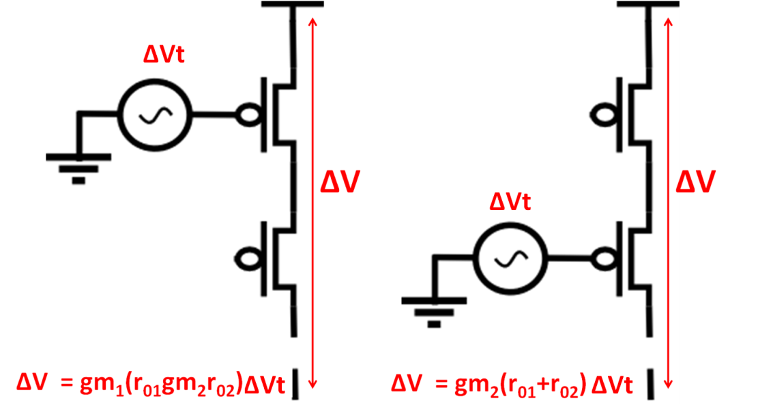
FINAL LOAD: BEST CASE SCENARIO
1 ) Cascode effect : explains why
mismatch switch is dominant

Slide 38
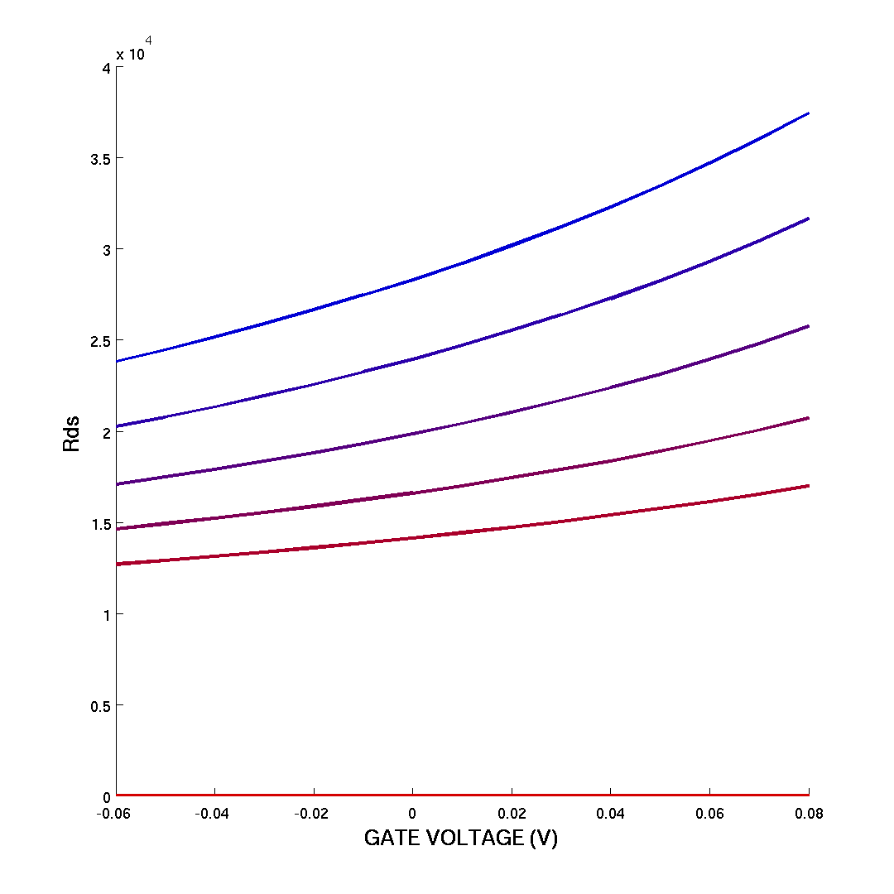
FINAL LOAD: BEST CASE SCENARIO
1 ) Cascode effect : explains why
mismatch switch is dominant
2) Increase ds resistance : explains
why V_bl(HRS)- V_bl(LRS)
becomes smaller at extreme
positive values of ∆Vt
1
1
2
2
R_load 
V_ds 

Slide 39
INTERMEZZO
Why no cascode effect with WL and Sel_SL transistors?
Sel_load
Bias
WL
Sel_pulldown
Sel_SL

Slide 40
OUTLINE
INPUTS : Load types, Design parameters and Simulation set up
OBJECTIVES : Linear sweep and Monte carlo
RESULTS LINEAR SWEEP
RESULTS MONTE CARLO
FINAL LOAD
CONCLUSION : Conclusion and Future work

Slide 41
FUTURE WORK

