Slide 1
MIPT-MIPS 2013 Basics of Pipelining
Alexander Titov
15.02.2014

Slide 2
Layers of Abstraction in Computes Science (CS)
Application
Algorithms
Programming Language
Operating System
Instruction Set Architecture
Topic of
this lecture
Microarchitecture
Gates/Register-Transfer Level (RTL)
Circuits
Physics

Slide 3
Refresher: MIPS Single-Cycle Implementation
4
0
Add
m
u
x
PC
Add
1
<< 2
PCSrc
RegWrite
MemWrite
MemToReg
Read
address
Instruction [31-0]
I [25-21]
Read
register 1
Read
data 1
Read
address
Read
data
ALU
1
I [20-16]
CondCode
m
u
x
Memory
Read
register 2
Result
Write
address
0
Read
data 2
0
0
Write
register
m
u
x
Write
data
I [15-11]
m
u
x
1
Memory
1
Write
data
ALUop
RegDst
Registers
ALUSrc
I [15-0]
Sign extend
Control
RegWrite
ALUSrc
RegDst
ALUop
PCSrc
CondCode
MemWrite
MemToReg

Slide 4
Is It Efficient?
For example, when registers are read the other hardware doesn’t do any useful work!
Can we fix that? – Yes, need to implement pipelined execution
4
4
0
0
m
u
x
Add
m
u
x
PC
Add
PC
Add
Add
1
1
<< 2
<< 2
PCSrc
PCSrc
MemToReg
RegWrite
MemWrite
MemToReg
RegWrite
MemWrite
I [25-21]
Read
address
Instruction [31-0]
I [25-21]
Read
address
Instruction [31-0]
Read
register 1
Read
data 1
Read
register 1
Read
data 1
Read
address
Read
data
Read
address
Read
data
ALU
ALU
1
1
m
u
x
Zero
m
u
x
I [20-16]
Zero
I [20-16]
Read
register 2
Read
register 2
Write
address
Memory
Write
address
Memory
Result
Result
0
Read
data 2
0
Read
data 2
0
0
m
u
x
0
m
u
x
0
Write
data
Write
register
Write
data
Write
register
Memory
m
u
x
Memory
I [15-11]
m
u
x
I [15-11]
1
1
ALUop
1
ALUop
1
Write
data
Write
data
Registers
Registers
ALUSrc
RegDst
ALUSrc
RegDst
I [15-0]
I [15-0]
Sign extend
Sign extend

Slide 5



What is pipelining?
The main idea: try to keep everyone busy with useful work
Pipelining is a general-purpose efficiency technique: it is not specific for processors
How to organize the pipeline?
Split the process into independent parts (stages)
Allow a stage starts execute the next workload event if the following stages are still processing the previous ones
There are a lot of example of pipelined execution in the real life
Assembly line (car, electronics, etc.)
Security control in an airport
Classical example using in CS is a laundry
wash
dry
iron
fold
60 min
80 min
30 min
30 min

Slide 6




Non-pipelined vs. Pipelined Laundry
Non-Pipelined
: throughput is one workload per 3h 20min (= 60 + 80 + 30 + 30)
workload #1
workload #2
workload #3
Pipelined
: throughput is one workload per 1h 20 min (the longest stage)
Pipeline “paradox”:
the processing speed of one workload is decreased,
but the total speed is increased
workload #1
busy
workload #2
workload #3
busy

Slide 7
From Laundry to Processor
It is hard to create hardware that will identify whether the next stage is busy and stop the pipeline if it is
The good alternative is making all stages the same length as the longest stage
cycle 0
cycle 1
cycle 2
cycle 3
cycle 4
cycle 5
workload #1
wait
wait
wait
workload #2
wait
wait
wait
workload #3
wait
wait
wait
It makes the pipeline control easier (the next stage is always ready)
It does not change the throughput: still one workload per 1h 20min
Why? Because the longest stage was not increased
Even if you add stages to pipeline, its throughput will not be changed until these stages are shorter than the longest one

Slide 8

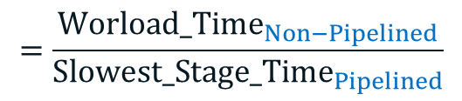
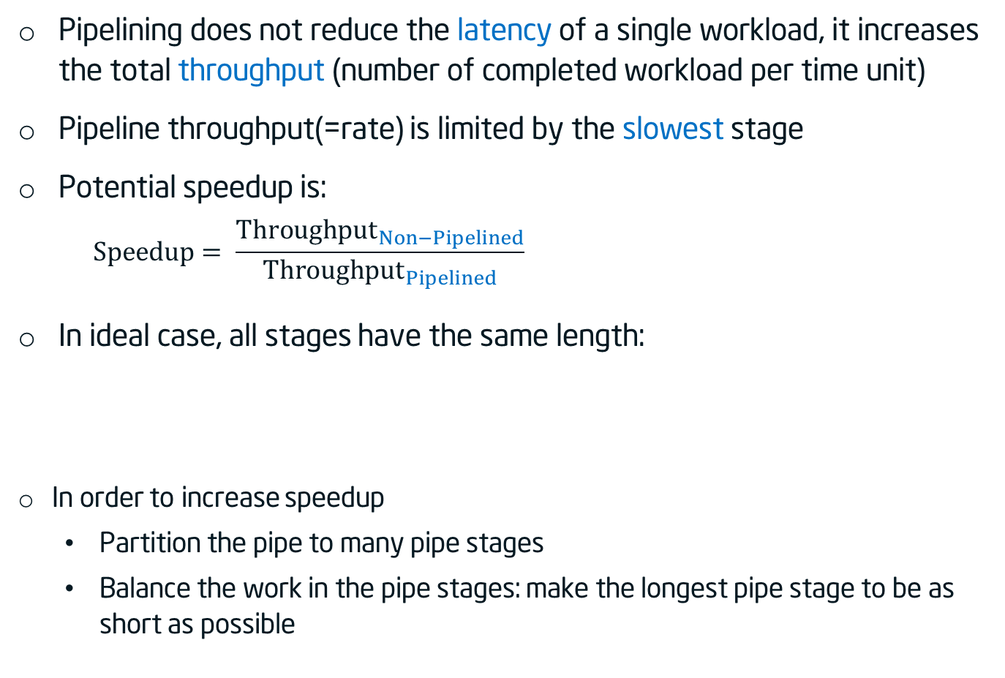
Pipeline speedup
Pipelining does not reduce the latency of a single workload, it increases the total throughput (number of completed workload per time unit)
Pipeline throughput(=rate) is limited by the slowest stage
Potential speedup is:
$$Speedup= \frac{{Throughput}_{Non−Pipelined}}{{Throughput}_{Pipelined}}$$
In ideal case, all stages have the same length:
In order to increase speedup
Partition the pipe to many pipe stages
Balance the work in the pipe stages: make the longest pipe stage to be as short as possible
$$=\frac{{Worload_Time}_{Non−Pipelined}}{{Slowest_Stage_Time}_{Pipelined}}$$
$$Speedup=\frac{{Worload_Time}_{Non−Pipelined}}{{Slowest_Stage_Time}_{Pipelined}}=Num_of_stages$$

Slide 9
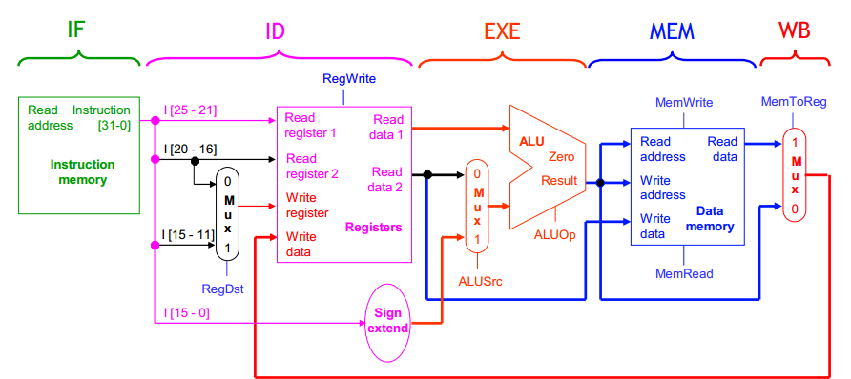
Stages in Classic MIPS Pipeline
The stages and their critical paths:
2 ns
1 ns
2 ns
2 ns
1 ns

Slide 10
Pipelined vs. Non-Pipelined MIPS
Program
execution
order
2
4
6
8
1
0
1
2
1
4
1
6
1
8
Time
lw R1, 100(R0)
Inst
Fetch
Reg
ALU
Data
Access
Reg
lw R2, 200(R0)
8 ns
Inst
Fetch
Reg
ALU
Data
Access
Reg
lw R3, 300(R0)
8 ns
Inst
Fetch
.
.
.
8 ns
Program
execution
order
2
4
6
8
1
0
1
2
1
4
Time
lw R1, 100(R0)
Inst
Fetch
Reg
ALU
Data
Access
Reg
lw R2, 200(R0)
2 ns
Inst
Fetch
Reg
ALU
Data
Access
Reg
lw R3, 300(R0)
2 ns
Inst
Fetch
Reg
ALU
Data
Access
Reg
2 ns
2 ns
2 ns
2 ns
2 ns

Slide 11
Pipelined CPU
Instruction
fetch
Instruction
Decode /
register fetch
Execute /
address
calculation
Memory
access
Write
back
0
PCSrc
m
u
x
1
IF/ID
ID/EX
EX/MEM
MEM/WB
Add
PC+4
4
result
RegWrite
Shift
left 2
Add
Branch
Instruction
Read
reg 1
MemWrite
PC
Address
Read
reg 2
Read
data 1
ALUSrc
lw
Register File
zero?
MemtoReg
Instruction
Write
reg
Read
data 2
0
result
Address
Read
Data
0
Instruction
Memory
m
u
x
ALU
m
u
x
Write
data
1
Data
Memory
1
Write
Data
[15-0]
16
Sign
extend
32
6
ALU
Control
MemRead
[20-16]
0
ALUOp
m
u
x
[15-11]
1
RegDst

Slide 12
Pipelined CPU with Control
Instruction
fetch
Instruction
Decode /
register fetch
Execute /
address
calculation
Memory
access
Write
back
ID/EX
WB
EX/MEM
0
Control
MEM
WB
PCSrc
MEM/WB
m
u
x
1
IF/ID
EXE
MEM
WB
Add
4
Add
result
RegWrite
Shift
left 2
Add
Branch
Instruction
Read
reg 1
MemWrite
PC
Address
Read
reg 2
Read
data 1
Register File
ALUSrc
Zero
MemtoReg
Instruction
Write
reg
Read
data 2
0
result
Address
Read
Data
0
Instruction
Memory
m
u
x
ALU
m
u
x
Write
data
1
Data
Memory
1
Write
Data
[15-0]
16
Sign
extend
32
6
ALU
Control
MemRead
[20-16]
0
ALUOp
[15-11]
m
u
x
1
RegDst

Slide 13
Pipelined execution: Load (cycle 1 – Fetch)
LW R1, (30)R2 ;
R1 ← Mem[R2+30]
PC
31
op
26
rs
21
rt
16
immediate
0
LW
2
1
30
0
PCSrc
m
u
x
1
IF/ID
ID/EX
EX/MEM
MEM/WB
Add
PC+4
4
result
RegWrite
Shift
left 2
Add
Branch
Instruction
Read
reg 1
MemWrite
PC
Address
Read
reg 2
Read
data 1
ALUSrc
lw
Register File
zero?
MemtoReg
Instruction
Write
reg
Read
data 2
0
result
Address
Read
Data
0
Instruction
Memory
m
u
x
ALU
m
u
x
Write
data
1
Data
Memory
1
Write
Data
[15-0]
16
Sign
extend
32
6
ALU
Control
MemRead
[20-16]
0
ALUOp
m
u
x
[15-11]
1
RegDst

Slide 14
Pipelined execution: Load (cycle 2 – Dec)
LW R1, (30)R2 ;
R1 ← Mem[R2+30]
PC
31
op
26
rs
21
rt
16
immediate
0
LW
2
1
30
0
PCSrc
m
u
x
1
IF/ID
ID/EX
EX/MEM
MEM/WB
Add
PC+4
4
result
RegWrite
Shift
left 2
Add
Branch
Instruction
Read
reg 1
[R2]
MemWrite
PC
Address
Read
reg 2
Read
data 1
ALUSrc
Register File
zero?
MemtoReg
Instruction
Write
reg
Read
data 2
0
result
Address
Read
Data
0
Instruction
Memory
m
u
x
ALU
m
u
x
Write
data
1
Data
Memory
1
Write
Data
[15-0]
16
Sign
extend
32
30
6
ALU
Control
MemRead
[20-16]
1
0
ALUOp
m
u
x
[15-11]
1
RegDst

Slide 15
Pipelined execution: Load (cycle 3 – EXE)
LW R1, (30)R2 ;
R1 ← Mem[R2+30]
PC
31
op
26
rs
21
rt
16
immediate
0
LW
2
1
30
0
PCSrc
m
u
x
1
IF/ID
ID/EX
EX/MEM
MEM/WB
Add
4
result
RegWrite
Shift
left 2
Add
Branch
Instruction
Read
reg 1
MemWrite
PC
Address
Read
reg 2
Read
data 1
ALUSrc
Register File
zero?
MemtoReg
Instruction
Write
reg
Read
data 2
0
result
[R2]+30
Address
Read
Data
0
Instruction
Memory
m
u
x
ALU
m
u
x
Write
data
1
Data
Memory
1
Write
Data
[15-0]
16
Sign
extend
32
6
ALU
Control
MemRead
[20-16]
0
ALUOp
m
u
x
1
[15-11]
1
RegDst

Slide 16
Pipelined execution: Load (cycle 4 – MEM)
LW R1, (30)R2 ;
R1 ← Mem[R2+30]
PC
31
op
26
rs
21
rt
16
immediate
0
LW
2
1
30
0
PCSrc
m
u
x
1
IF/ID
ID/EX
EX/MEM
MEM/WB
Add
4
result
RegWrite
Shift
left 2
Add
Branch
Instruction
Read
reg 1
MemWrite
PC
Address
Read
reg 2
Read
data 1
ALUSrc
Register File
zero?
MemtoReg
Instruction
Write
reg
Read
data 2
0
result
Address
Read
Data
DATA
0
Instruction
Memory
m
u
x
ALU
m
u
x
Write
data
1
Data
Memory
1
Write
Data
[15-0]
16
Sign
extend
32
6
ALU
Control
MemRead
[20-16]
0
ALUOp
m
u
x
1
[15-11]
1
RegDst

Slide 17
Pipelined execution: Load (cycle 5 – WB)
LW R1, (30)R2 ;
R1 ← Mem[R2+30]
PC
31
op
26
rs
21
rt
16
immediate
0
LW
2
1
30
0
PCSrc
m
u
x
1
IF/ID
ID/EX
EX/MEM
MEM/WB
Add
4
result
RegWrite
Shift
left 2
Add
Branch
Instruction
Read
reg 1
MemWrite
PC
Address
Read
reg 2
Read
data 1
ALUSrc
Register File
zero?
MemtoReg
Instruction
1
Write
reg
Read
data 2
0
result
Address
Read
Data
0
Instruction
Memory
m
u
x
ALU
m
u
x
DATA
Write
data
1
Data
Memory
1
Write
Data
[15-0]
16
Sign
extend
32
6
ALU
Control
MemRead
[20-16]
0
ALUOp
m
u
x
[15-11]
1
RegDst

Slide 18
Pipelined execution: cycle 1
0
PCSrc
m
u
x
1
IF/ID
ID/EX
EX/MEM
MEM/WB
Add
4
4
result
RegWrite
Shift
left 2
Add
Branch
4
Instruction
Read
reg 1
MemWrite
PC
Address
Read
reg 2
Read
data 1
ALUSrc
lw
Register File
zero?
MemtoReg
Instruction
Write
reg
Read
data 2
0
result
Address
Read
Data
0
Instruction
Memory
m
u
x
ALU
m
u
x
Write
data
1
Data
Memory
1
Write
Data
[15-0]
16
Sign
extend
32
6
ALU
Control
MemRead
[20-16]
0
ALUOp
m
u
x
PC
[15-11]
1
RegDst
0 lw R10,9(R1)
4 sub R11,R2,R3
8 and R12,R4,R5 12 or R13,R6,R7

Slide 19
Pipelined execution: cycle 2
0
PCSrc
m
u
x
1
IF/ID
ID/EX
EX/MEM
MEM/WB
Add
8
4
4
result
RegWrite
Shift
left 2
Add
Branch
8
Instruction
Read
reg 1
[R1]
MemWrite
PC
Address
Read
reg 2
Read
data 1
ALUSrc
sub
Register File
zero?
MemtoReg
Instruction
Write
reg
Read
data 2
0
result
Address
Read
Data
0
Instruction
Memory
m
u
x
ALU
m
u
x
Write
data
1
Data
Memory
1
Write
Data
[15-0]
16
Sign
extend
32
9
6
ALU
Control
MemRead
[20-16]
R10
0
m
u
x
ALUOp
PC
[15-11]
1
RegDst
0 lw R10,9(R1)
4 sub R11,R2,R3
8 and R12,R4,R5 12 or R13,R6,R7

Slide 20
Pipelined execution: cycle 3
0
PCSrc
m
u
x
1
IF/ID
ID/EX
EX/MEM
MEM/WB
Add
12
8
4
result
RegWrite
Shift
left 2
Add
Branch
12
Instruction
Read
reg 1
[R2]
MemWrite
PC
Address
Read
reg 2
Read
data 1
ALUSrc
and
Register File
[R3]
zero?
MemtoReg
Instruction
Write
reg
Read
data 2
0
result
[R1]+9
Address
Read
Data
0
Instruction
Memory
m
u
x
ALU
m
u
x
Write
data
1
Data
Memory
1
Write
Data
[15-0]
16
Sign
extend
32
6
ALU
Control
MemRead
[20-16]
0
ALUOp
R10
R11
m
u
x
PC
[15-11]
1
RegDst
0 lw R10,9(R1)
4 sub R11,R2,R3
8 and R12,R4,R5 12 or R13,R6,R7

Slide 21
Pipelined execution: cycle 4
0
PCSrc
m
u
x
1
IF/ID
ID/EX
EX/MEM
MEM/WB
Add
16
12
4
result
RegWrite
Shift
left 2
Add
Branch
16
Instruction
Read
reg 1
[R4]
MemWrite
PC
Address
Read
reg 2
Read
data 1
ALUSrc
or
Register File
[R5]
zero?
MemtoReg
Instruction
Write
reg
Read
data 2
0
[R3]-[R2]
Read
Data
Mem([R1]+9)
m
u
x
ALU
result
Address
0
Instruction
Memory
Write
data
m
u
x
1
Write
Data
Data
Memory
1
[15-0]
16
Sign
extend
32
6
ALU
Control
MemRead
[20-16]
0
ALUOp
R11
R10
R12
m
u
x
PC
[15-11]
1
RegDst
0 lw R10,9(R1)
4 sub R11,R2,R3
8 and R12,R4,R5 12 or R13,R6,R7

Slide 22
Pipeline hazards: Data Hazard

Slide 23
Data Hazard
Problem with starting next instruction before the previous ones are finished
Dependencies that “go backward in time” are data hazards
Time (clock cycles)
1
2
3
4
5
6
7
8
9
Program
execution
order
Value of R2
10
10
10
10
10 / -20
-20
-20
-20
-20
sub R2, R1, R3
and R12,R2, R5
or R13,R6, R2
add R14,R2, R2
sw R15,100(R2)
R
e
g
I
M
R
e
g
D
M
I
M
R
e
g
D
M
R
e
g
I
M
R
e
g
D
M
R
e
g
I
M
R
e
g
D
M
R
e
g
I
M
R
e
g
D
M
R
e
g

Slide 24
Data Hazard: HW Solution 1 - Add Stalls
Have the hardware detect hazard and add stalls if needed
Time (clock cycles)
1
2
3
4
5
6
7
8
9
Program
execution
order
Value of R2
10
10
10
10
10 / -20
-20
-20
-20
-20
sub R2, R1, R3
stall
stall
stall
and R12,R2, R5
or R13,R6, R2
add R14,R2, R2
sw R15,100(R2)
R
e
g
I
M
R
e
g
D
M
I
M
bubble
bubble
bubble
bubble
I
M
bubble
bubble
bubble
bubble
I
M
bubble
bubble
bubble
bubble
I
M
R
e
g
D
M
R
e
g
I
M
R
e
g
D
M
R
e
g
I
M
R
e
g
D
M
R
e
g
I
M
R
e
g
D
M
R
e
g
Problem: this also slows us down!

Slide 25
Data Hazard: HW Solution 2 - Forwarding
Don’t wait for results to be written into the register file, use it as soon as it is calculated
Time (clock cycles)
1
2
3
4
5
6
7
8
9
Program
execution
order
Value of R2
10
10
10
10
10 / -20
-20
-20
-20
-20
sub R2, R1, R3
and R12,R2, R5
or R13,R6, R2
add R14,R2, R2
sw R15,100(R2)
R
e
g
I
M
R
e
g
D
M
I
M
R
e
g
D
M
R
e
g
I
M
R
e
g
D
M
R
e
g
I
M
R
e
g
D
M
R
e
g
I
M
R
e
g
D
M
R
e
g

Slide 26
Forwarding Hardware
IF/ID
ID/EX
EX/MEM
MEM/WB
WB
Control
M
WB
EX
M
WB
EX/MEM.RegWrite
0
m
u
x
A
1
MEM/WB.RegWrite
Instruction
Register
File
2
PC
Instruction
Memory
ALU
Data
Memory
1
0
m
u
x
m
u
x
B
0
1
2
IF/ID.Rs
Rs
IF/ID.Rt
Rt
IF/ID.Rt
Rt
0
EX/MEM.Rd
IF/ID.Rd
Rd
m
u
x
1
Forwarding
Unit
MEM/WB.Rd

Slide 27
Forwarding Control
EXE Hazard:
if (EX/MEM.RegWrite and (EX/MEM.WriteReg == ID/EX.ReadReg1)) then ALUSelA = 1
if (EX/MEM.RegWrite and (EX/MEM.WriteReg == ID/EX.ReadReg2)) then ALUSelB = 1
MEM Hazard:
if (MEM/WB.RegWrite and (ALUSelA != 1) and
(MEM/WB.WriteReg == ID/EX.ReadReg1))
then ALUSelA = 2
if (MEM/WB.RegWrite and (ALUSelB != 1) and
(MEM/WB.WriteReg == ID/EX.ReadReg2))
then ALUSelB = 2

Slide 28
Forwarding Hardware Example: bypassing from EXE to Src1 and from WB to Src2
IF/ID
ID/EX
EX/MEM
MEM/WB
WB
Control
M
WB
EX
M
WB
[R10]
0
sub
lw
1
m
u
x
Instruction
Register
File
and
2
PC
Instruction
Memory
ALU
[R2]-[R3]
Data
Memory
1
[R11]
m
u
x
Data from
memory
address
[R1]+9
0
1
m
u
x
0
10
2
IF/ID.Rs
Rs
IF/ID.Rt
11
Rt
IF/ID.Rt
Rt
0
10
EX/MEM.Rd
11
IF/ID.Rd
12
Rd
m
u
x
1
Forwarding
Unit
lw R11,9(R1)
MEM/WB.Rd
sub R10,R2, R3
and R12,R10,R11

Slide 29
Can't always forward
Load word can still causes a hazard:
an instruction follows a load instruction and reads the same register that is written by the load.
Program
execution
order
Time (clock cycles)
1
2
3
4
5
6
7
8
9
lw R2, 30(R1)
and R12,R2, R5
or R13,R6, R2
add R14,R2, R2
sw R15,100(R2)
R
e
g
I
M
D
M
R
e
g
I
M
R
e
g
Need it here!
D
M
R
e
g
I
M
R
e
g
D
M
R
e
g
I
M
R
e
g
D
M
R
e
g
I
M
R
e
g
D
M
R
e
g
A hazard detection unit has to “stall” the instruction following the load

Slide 30
Stalling
De-assert the write enable to ID/EXE
The dependent instruction (and) stays another cycle in IF/EXE
De-assert the write enable to the IF/ID latch, and to the PC
Freeze pipeline stages preceding the stalled instruction
Issue a NOP into the EXE/MEM latch (instead of the stalled inst.)
Allow the stalling instruction (lw) to move on
Time (clock cycles)
1
2
3
4
5
6
7
8
9
Program
execution
order
lw R2, 30(R1)
and R12,R2, R5
or R13,R6, R2
add R14,R2, R2
sw R15,100(R2)
R
e
g
D
M
R
e
g
I
M
I
M
R
e
g
R
e
g
D
M
R
e
g
I
M
I
M
R
e
g
D
M
R
e
g
bubble
I
M
R
e
g
D
M
R
e
g
I
M
R
e
g
D
M
R
e
g

Slide 31
Hazard Detection (Stall) Logic
if (ID/EX.RegWrite and (ID/EX.opcode == lw) and
( (ID/EX.WriteReg == IF/ID.ReadReg1) or
(ID/EX.WriteReg == IF/ID.ReadReg2) )
then stall

Slide 32
Forwarding + Hazard Detection Unit
Hazard
Detection
Unit
ID/EX.MemRead
IF/ID
ID/EX
EX/MEM
MEM/WB
WB
PC Write
IF/ID Write
Control
0
M
WB
m
u
x
0
1
EX
M
WB
0
1
m
u
x
Instruction
Register
File
2
PC
Instruction
Memory
ALU
Data
Memory
1
0
m
u
x
1
m
u
x
0
2
IF/ID.Rs
Rs
IF/ID.Rt
Rt
IF/ID.Rt
Rt
0
EX/MEM.Rd
IF/ID.Rd
Rd
m
u
x
1
Forwarding
Unit
MEM/WB.Rd
ID/EX.Rt

Slide 33
Software Scheduling to Avoid Load Hazards
Example: code for (assume all variables are in memory):
a = b + c;
d = e – f;
Slow code
LW Rb,b
LW Rc,c
Stall ADD Ra,Rb,Rc
SW a,Ra
LW Re,e
LW Rf,f
Stall SUB Rd,Re,Rf
SW d,Rd
Instruction order can be changed as long as the correctness is kept
LW Rb,b
LW Rc,c
LW Re,e
ADD Ra,Rb,Rc
LW Rf,f
SW a,Ra
SUB Rd,Re,Rf
SW d,Rd

Slide 34
Acknowledgments
These slides contain material developed and copyright by:
Lihu Rappoport (MAMAS/Intel), 234267, L2
Luis Ceze (UW), CS378, L10, L11, L12

Slide 35
Thank You Q/A

