Slide 1
Caches and Memory Hierarchy
Pavel Kryukov
03/01/2014

Slide 2
Classic components of a computer
Computer
control
memory
output
datapath
processor
input

Slide 3
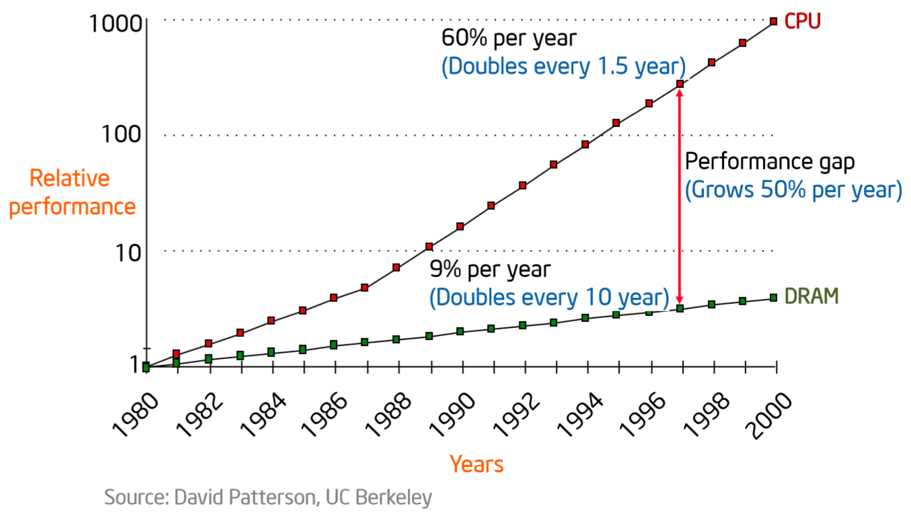
CPU-Memory Performance Gap

Slide 4
The city example (spatial locality)
Factory
Your shop
Shop store
Large storehouse
Storehouse
The delay is decreased, but the cost is increased

Slide 5
The bookshelf example (temporal locality)
Your bookshelf
Places for books
fast
slow
City Library
Your table

Slide 6
Full associative cache
Cache
data
00101
10001
10000
10010
01100
01000
01001
00000
address
Main memory
data
10010
01001
01000
10000
00000
01100
00101
10001
address

Slide 7
A full associative cache scheme
31 30 29 . . . . . . . . . . . . 12 11 10 9 8 . . . . . . 3 2 1 0
Address
Physical address tag
Byte offset
30
2
V
Data
Tag
Data
Tag
V
Tag
Data
Tag
Data
V
V
32
=
=
=
=
multiplexor
OR
32
Hit
Data

Slide 8
Direct mapped cache
111
110
101
100
011
010
001
000
index
Index length = log2(number of cache block)
Cache capacity is 8 = 2³ , therefore the index takes 3 bites
Cache
data
Main memory
data
10101
10001
01101
01001
00101
00001
address

Slide 9
Direct mapped cache scheme
31 30 29 . . . . . . . . . . . . 12 11 10 9 8 . . . . . . 3 2 1 0
Address
Physical address tag
Cache index
Byte offset
20
10
2
Index
Valid
Tag
Data
0
1
2
…
…
1022
1023
Cache hit
=
32
Data

Slide 10
Partial associativity
Index length = log2(number of cache block/number of ways)
Direct mapped cache
2-way set-associative
Fully associative cache
data
index
set
data
index
set
1
2
3
4
set
111
110
101
100
011
010
001
000
11
11
10
10
01
01
00
00
1
8
7
6
5
index
Not used
4
3
2
1
data
The miss rate is decreased, but hit time, size, power are increased

Slide 11
A four-way set-associative cache
31 30 29 . . . . . . . . . . . . 12 11 10 9 8 . . . . . . 3 2 1 0
Address
Physical address tag
Cache index
Byte offset
22
8
2
Tag
Data
Index
Tag
Data
V
V
Tag
Data
Tag
Data
V
V
0
1
2
…
…
254
255
32
=
=
=
=
multiplexor
OR
32
Hit
Data

Slide 12
Associativity and bookshelf
Direct bookshelf
A-B | C-D | E-F | G-H | I-J | … | … | … | … | Y-Z
Only one place for a book
Two-way set-associative bookshelf
A-D |  | E-F |  | … |  | … |  | W-Z
Only two place for a book
Full associative bookshelf
Any place are available for a book

Slide 13
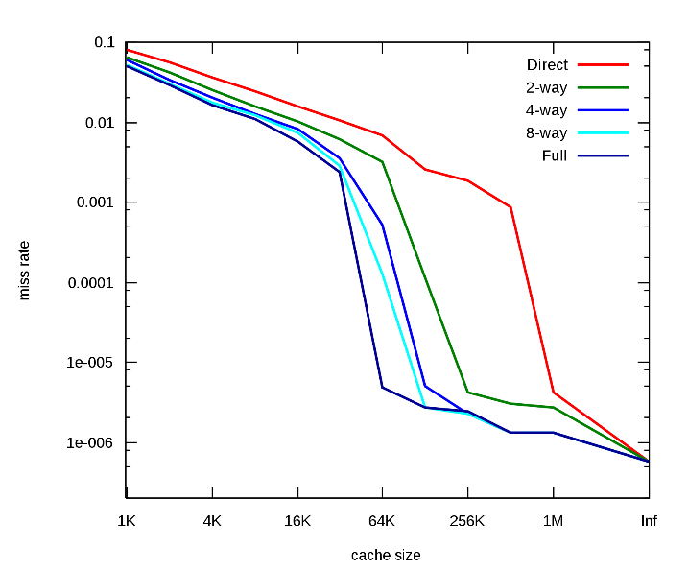
Miss rate diagram
Capacity misses
Conflict
Compulsory
Compulsory misses. They are caused by the first reference to the data.
Capacity misses (due to cache capacity limitation only)
Conflict misses:
Mapping misses (cache is not fully associative)
Replacement misses (the replacement policy is not ideal)

Slide 14
Cache Replacement
Direct map
A new block is mapped to a single line in the cache
Old line is evicted (re-written to memory if needed)
N-way set associative cache
Choose a victim from all ways in the appropriate set
Replacement algorithms
Optimal replacement algorithm
FIFO – First In First Out
Random
LRU – Least Recently used
LRU is the best
but not that much better even than random

Slide 15
Writes handling
There is no write into the instruction cache.
In the most of modern systems the cache block is larger than store data, thus only the part of the cache block is updated.
Hit/miss logic is very similar to one in cache read.
Write request
Locate block using index
No
Is tag equal?
Yes
Write miss
Load block from the next level of hierarchy into the cache
Write hit
Write the data into the cache block

Slide 16
Memory Update Policy on Writes
Write back
“Store” operations that hit the cache write only to the cache
Main memory is not accessed in case of write hit
Line is marked as modified or dirty
Modified cache line written to memory only when it is evicted
Saves memory accesses when a line is updated many times
On eviction, the entire line must be written to memory
There is no indication which bytes within the line were modified
Write through
Stores that hit the cache write both to cache and to memory
Need to write only the bytes that were changed (not entire line)
The ratio between reads and write is ~ 4:1
While writing to memory, the processor goes on reading from cache
No need to evict blocks from the cache (never dirty)
Use write buffers so that don’t wait for lower level memory

Slide 17
Write-through vs write-back
The key advantages of write-back:
Individual words can be written by the processor at the rate that the cache, rather then the main memory, can accept them.
Multiple writes within a block require only one write to the lower level in the hierarchy.
Ones of write-through:
Evictions of a block from the cache are simpler and cheaper because they never require a block to be written back to the lower level of the memory hierarchy.
Write-through is easier to implement than write-back

Slide 18
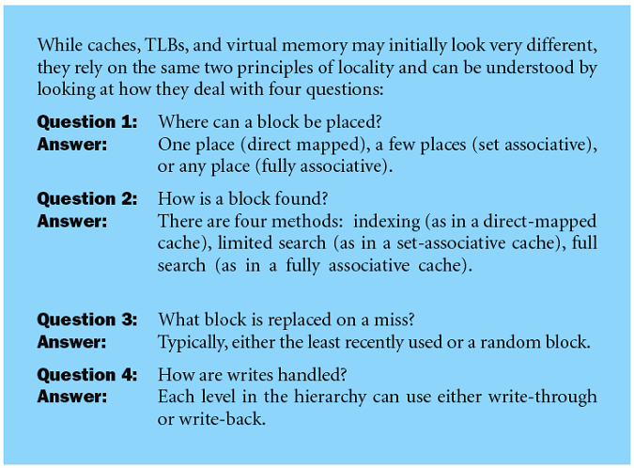
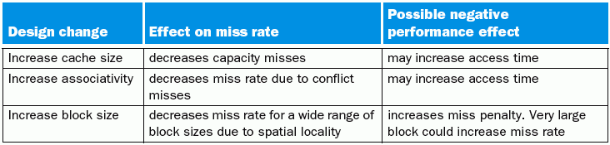
Small summary

Slide 19
Improving Cache Performance
Rates:
Miss Rate = Misses / total CPU request
Hit Rate = Hits / total CPU request = 1 – Miss Rate
Goal: reduce the Average Memory Access Time (AMAT):
AMAT = Hit Rate * Hit Time + Miss Rate * Miss Penalty
But HitRate ≈ 0.9, HitTime ≈ 10 clk, MissRate ≈ 0.1, MissPenalty ≈ 200 clk, then
AMAT ≈ Hit Time + Miss Rate * Miss Penalty
Approaches:
Reduce Hit Time
Reduce Miss Penalty
Reduce Miss Rate
Notes:
There may be conflicting goals
Keep track of clock cycle time, area, and power consumption
Hit Time =
(ALU to Cache Transfer)
+ (Hit/Miss check)
Memory
+ (Cache to ALU)
ALU
Cache
Hit!

Slide 20
Improving Cache Performance
Rates:
Miss Rate = Misses / total CPU request
Hit Rate = Hits / total CPU request = 1 – Miss Rate
Goal: reduce the Average Memory Access Time (AMAT):
AMAT = Hit Rate * Hit Time + Miss Rate * Miss Penalty
But HitRate ≈ 0.9, HitTime ≈ 10 clk, MissRate ≈ 0.1, MissPenalty ≈ 200 clk, then
AMAT ≈ Hit Time + Miss Rate * Miss Penalty
Approaches:
Reduce Hit Time
Reduce Miss Penalty
Reduce Miss Rate
Notes:
There may be conflicting goals
Keep track of clock cycle time, area, and power consumption
Miss Penalty =
(ALU to Cache Transfer)
+ (Hit/Miss check)
+ (Cache to Memory)
+ (Memory Search)
+ (Memory to Cache)
Memory
+ (Cache to ALU)
ALU
Cache
Miss!

Slide 21
Tuning Basic Cache Parameters: Size, Associativity, Block width
Size:
Must be large enough to fit working set (temporal locality)
If too big, then hit time degrades
Associativity:
Need large to avoid conflicts, but 4-8 way is as good as FA (full associative)
If too big, then hit time degrades
Block:
Need large to exploit spatial locality & reduce tag overhead
If too large => cache has few blocks => higher miss rate & miss penalty
Hit rate
≈4
Size
Associatively
Block width

Slide 22
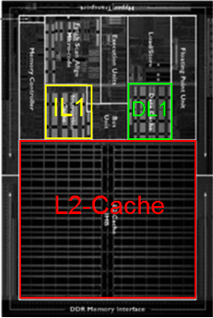
Multilevel caches
AMD Opteron
Motivation:
Optimize each cache for different constraints
Exploit cost/capacity trade-offs at different levels
L1 caches
Optimized for fast access time (1-3 CPU cycles)
8KB-64KB, DM to 4-way SA
L2 caches
Optimized for low miss rate (off-chip latency high)
256KB-4MB, 4- to 16-way SA
L3 caches
Optimized for low miss rate (DRAM latency high)
Multi-MB, highly associative
Processor
L1-instr
L1-data
L2-cache
L3-cache

Slide 23
2-level Cache Performance Equations
L1 AMAT = HitTimeL1 + MissRateL1 * MissPenaltyL1
MissLatencyL1 is low, so optimize HitTimeL1
MissPenaltyL1 = HitTimeL2 + MissRateL2 * MissPenaltyL2
MissLatencyL2 is high, so optimize MissRateL2
MissPenaltyL2 = DRAMaccessTime + (BlockSize/Bandwidth)
If DRAM time high or bandwidth high, use larger block size
L2 miss rate:
Global: L2 misses / total CPU references
Local: L2 misses / CPU references that miss in L1
The equation above assumes local miss rate
HitTimeL2
DRAM
DRAMaccessTime is time to find block in DRAM
HitTimeL1
L2-Cache
BlockSize/Bandwidth
ALU
L1-Cache
Bandwidth – how many bytes can be transacted from DRAM per cycle

Slide 24
Improvement of AMAT for 2-level system

Slide 25
Reduce Cache Hit Time
Techniques we have seen so far (most interesting for L1)
Smaller capacity
Smaller associativity
Additional techniques
Wide cache interfaces
Pseudo-associativity
Techniques that increase cache bandwidth (number of concurrent accesses)
Pipelined caches
Multi-ported caches
Multi-banked caches

Slide 26
Reduce Miss Rate
Techniques we have already seen before
Larger caches
Reduces capacity misses
Higher associativity
Reduces conflict misses
Larger block sizes
Reduces cold misses
Additional techniques
Skew associative caches
Victim caches

Slide 27
Victim Cache
Small FA cache for blocks recently evicted from L1
Accessed on a miss in parallel or before the lower level
Typical size: 4 to 16 blocks (fast)
Benefits
Captures common conflicts due to low associativity or ineffective replacement policy
Avoids lower level access
Notes
Helps the most with small or low-associativity caches
Helps more with large blocks
Cache
Victim
Cache
Lower level

Slide 28
Reducing Miss Penalty
Techniques we have already seen before:
Multi-level caches
Additional techniques
Sub-blocks
Critical word first
Write buffers
Non-blocking caches

Slide 29
Sub-blocks
Idea: break cache line into sub-blocks with separate valid bits
But the still share a single tag
Low miss latency for loads:
Fetch required subblock only
Low latency for stores:
Do not fetch the cache line on the miss
Write only the sub-block produced, the rest are invalid
If there is temporal locality in writes, this can save many refills

Slide 30
Write buffers
CPU/Cache L1
Cache L1/Cache L2
stores
Write buffers allow for a large number of optimizations
Write through caches
Stores don’t have to wait for lower level latency
Stall store only when buffer is full
Write back caches
Fetch new block before writing back evicted block
CPUs and caches in general
Allow younger loads to bypass older stores

