Slide 1
Layers of Computer Science, ISA and uArch
Alexander Titov
10/12/2013

Slide 2
What is Computer Architecture?
Computer architecture is the design of the abstraction layers that allow us to implement information processing applications efficiently using available manufacturing technologies.
Application
Issue: the gap is too large to cross it over in one step
Decision: create many layers with standardized interfaces
Physics

Slide 3
Layers of Abstraction
Compressing pictures, text editing, music/video encoding, games, etc.
Fractal compression,
Entropy encoding,
Quick sort, etc.
Application
Algorithms
Programming Language
Representation of algorithms on Java, C++, Python, etc.
Representation of programs in machine commands, definition of main structures and mechanisms: MIPS, x86, ARM, POWER, Itanium, etc.
Operating System
Execution under control of OS: Unix, Windows
Instruction Set Architecture
Microarchitecture
High-level structure of hardware: caches, buses, registers, etc.
Gates/Register-Transfer Level (RTL)
Detailed representation of hardware: floor plan, wires, etc.
Circuits
Structure of base elements and transistors
Physics
Diffusion of electrons, structure of semiconductors, etc.

Slide 4
Layers of Abstraction
Application
Application
Algorithms
Algorithms
Software (SW)
Programming Language
Programming Language
Operating System
Operating System
Interface between HW and SW
Instruction Set Architecture
Instruction Set Architecture
Microarchitecture
Microarchitecture
Gates/Register-Transfer Level (RTL)
Gates/Register-Transfer Level (RTL)
Hardware (HW)
Circuits
Circuits
Physics
Physics

Slide 5
ISA and uArch
Instruction Set Architecture (ISA) is a precise definition of computer instructions, features and mechanism (procedures, interrupt/exception handler, etc.) and also some structures (registers, memory, etc.)
It can be thought as an agreement between a programmer and an engineer:
It’s all programmer needs to program machine.
It’s all hardware designer needs to design machine.
Microarchitecture (uArch, implementation) is an organization and features of Hardware that executes instructions and support features defined in the ISA.

Slide 6
ISA and uArch
What a typical ISA defines
Data Formats. (Integer, Floating Point, Vector/Packed)
Instructions. (Operations, encoding, etc.)
Registers and Memory Organization.
Interrupts, exceptions, and traps.
Implementation-Dependent Features. (Memory control, custom features.)
What a typical uArch defines (not included into ISA)
Memory hierarchy organization (caches, buses, etc.)
Pipeline (forwarding, branch prediction, etc.)
Out-of-order executions … and many others.
they change the state
the programmer-visible state

Slide 7
Example of ISA and their uArches: MIPS
An example of a RISC processor.
Designed for easy programming and implementation.
Short and simple, but fast instructions → programs are larger than others, but run faster.
The main aim was to take advantages of pipelined execution
Pipeline was not specified in ISA, but ISA developers tried to simplify its implementation in uArch.
Implementations:
The first one is R2000 (1986)
Later: R3000A (PlayStation), R4000 (PSP), R5900 (PlayStation 2), etc.
Currently it is widely used in embedded systems.
One moment MIPS seemed to be overcome Intel IA-32, but it didn’t happen because Intel’s uArch was significantly better and could compensate the drawback of IA-32.
One moment MIPS seemed to be overcome Intel IA-32,, but it didn’t happen because Intel’s uArch was significantly better and could compensate the drawback of IA-32.

Slide 8
Data Formats
In the memory all including data and program code is presented as binary numbers:
Data representation:
Sizes: 8-b Bytes, 16-b Half words, 32-b words and 64-b double words (not used in our project)
Formats: signed/unsigned integer, signed/unsigned floating point (not used in our project)
0000 0010 | 0011 0010 | 0100 0000 | 0010 0000
=
=
0x2012620
add $t0, $s1, $s2

Slide 9

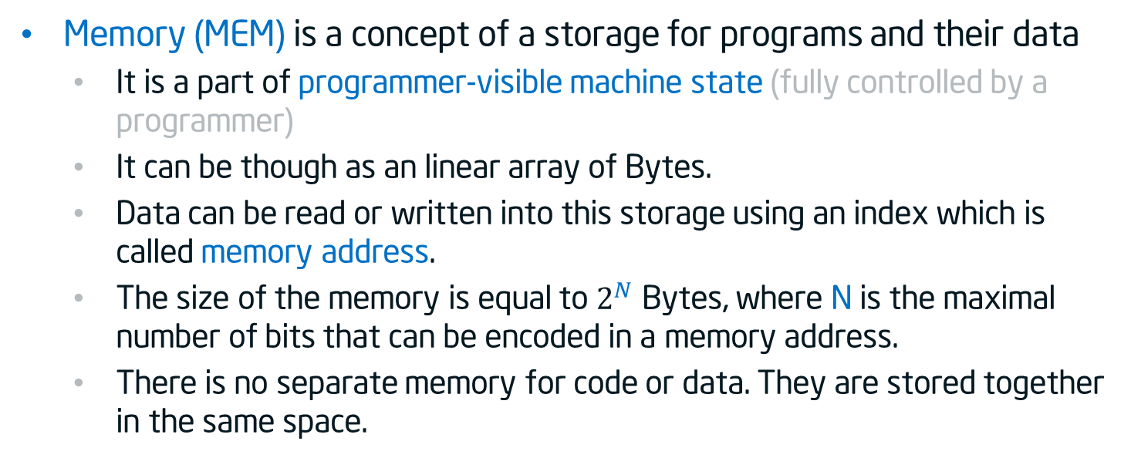


Memory addressing
Memory (MEM) is a concept of a storage for programs and their data
It is a part of programmer-visible machine state (fully controlled by a programmer)
It can be though as an linear array of Bytes.
Data can be read or written into this storage using an index which is called memory address.
The size of the memory is equal to $2^{N}$ Bytes, where N is the maximal number of bits that can be encoded in a memory address.
There is no separate memory for code or data. They are stored together in the same space.
0
1
2
$$2^{N−2}$$
$$2^{N−1}$$
$$2^{N}$$
…
00100100
…
…
…
…
…
8 bits = 1 Byte

Slide 10
Big and Little Endian
Historically numbers are being written from the right to the left (the most significant digit is on the right):
However, we used to enumerate elements in an array (and most other things) from the left to the right:
The question: if we put an value of two bytes (e.g. 256) at the beginning of the array where the most significant byte will be? In element 0 or element 1?
Decimal 537 = 7*${\text{10}}^{0}$ + 3*${\text{10}}^{1}$ + 5*${\text{10}}^{2}$
Decimal 537 = 7*${\text{10}}^{0}$ + 3*${\text{10}}^{1}$ + 5*${\text{10}}^{2}$
Binary 1101 = 1*${\text{2}}^{0}$ + 0*${\text{2}}^{1}$ + 1*${\text{2}}^{2}$ + 1*${\text{2}}^{3}$
Binary 1101 = 1*${\text{2}}^{0}$ + 0*${\text{2}}^{1}$ + 1*${\text{2}}^{2}$ + 1*${\text{2}}^{3}$
0
1
2
$$2^{N−2}$$
$$2^{N−1}$$
$$2^{N}$$
…
…
…
…
…
…
…

Slide 11
Big and Little Endian
The answer: it depends on the ending which is defined in the ISA.
Most significant byte
Least significant byte
Decimal 256 = Binary 0000 0001 | 0000 0000
Decimal 256 = Binary 0000 0001 | 0000 0000
Decimal 256 = Binary 0000 0001 | 0000 0000
15
8
7
0
Bib Endian
Little Endian
0
1
2
0
1
2
00000001
00000000
00000000
10000000
15
8
0
7
7
0
8
15
The ISA of our host machines in the lab (x86) and MIPS ISA that we will simulate both assume Little Endian

Slide 12
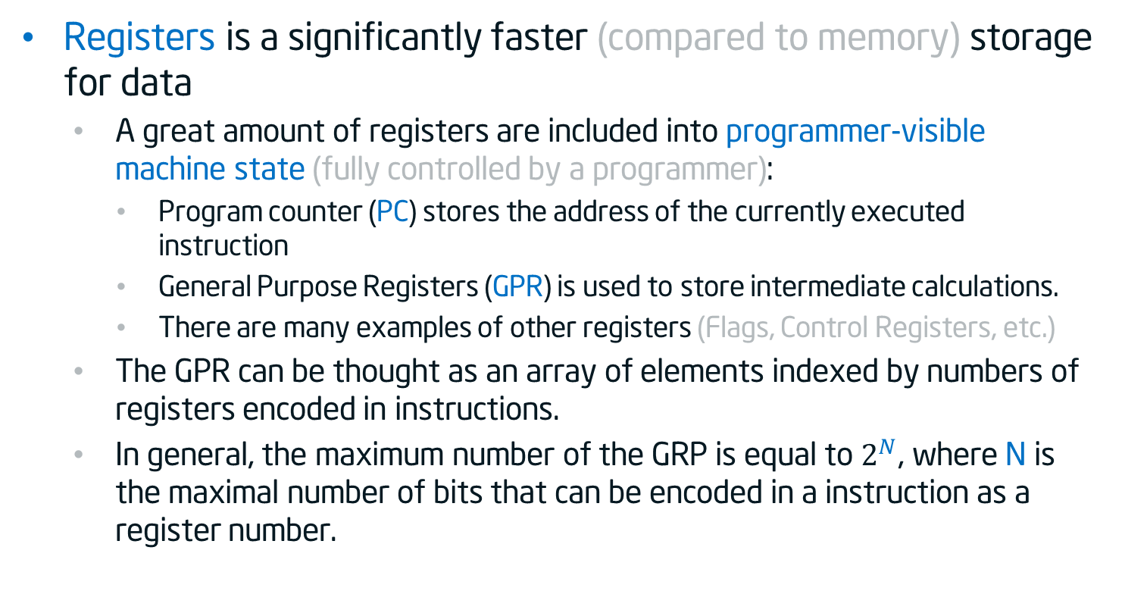
Registers
Registers is a significantly faster (compared to memory) storage for data
A great amount of registers are included into programmer-visible machine state (fully controlled by a programmer):
Program counter (PC) stores the address of the currently executed instruction
General Purpose Registers (GPR) is used to store intermediate calculations.
There are many examples of other registers (Flags, Control Registers, etc.)
The GPR can be thought as an array of elements indexed by numbers of registers encoded in instructions.
In general, the maximum number of the GRP is equal to $2^{N}$, where N is the maximal number of bits that can be encoded in a instruction as a register number.

Slide 13
Operations
Common types:
Set a register to constant value or value of other register (move operation).
Loads (memory → register ) & stores (register ← memory)
Read and write data from hardware devices (I/O) – not used in our project
Arithmetic and Logic:
+, -, *, /, =. . .
And, Or, Xor, Not
Compare two values of registers
Control flow (taking decision: loops, if-else)
branch to another location (set new value into PC)
conditionally branch (if (condition) then PC new value)
save current location and jump to new location (Procedure call)

Slide 14
MIPS Integer Arithmetic instruction format (R-type)
opcode
rs
rt
rd
shamt
funct
6 bits
5 bits
5 bits
5 bits
5 bits
6 bits
All MIPS instruction (not only R-Type) has fixed length of 4 Bytes
MIPS arithmetic instructions work only with registers.
The filed description:
opcode denotes of the operation that is performed by this instruction
rs stores register number of for the first source operand
rt stores register number of for the second source operand
rd stores register number where the result (destination operand) will be put
shamt – used in shift instructions
funct is a function code. It can slightly change the behavior of the operation encoded in opcode.

Slide 15
MIPS Integer Arithmetic instruction format (R-type)
opcode
rs
rt
rd
shamt
funct
6 bits
5 bits
5 bits
5 bits
5 bits
6 bits
Example: encoding of
add $t0, $s1, $s2
add
$s1
$s2
$t0
signed
opcode
rs
rt
rd
shamt
funct
000000| 10001 | 10010 | 01000 | 00000 | 100000
Due to Little Endian in the memory the bits of this instructions are “mirrored”:
Start address of the instruction
IP
IP+1
IP+2
IP+3
…
00000100
00000010
01001100
01000000
…
funct
shamt
rd
rt
rs
opcode
0
6
11
16
21
26
31

Slide 16
Instruction Execution Cycle
Fetch Instruction by PC
Download instruction from the memory using value stored in the program counter (PC) register as an address.
Read registers
Read values of registers which are pointed by the instruction as their source operands.
Process Calculations
Execute an action encoded in the instruction (e.g. addition, subtraction, address calculation, etc.).
Read/Write
Memory
Write the result of the calculation into the memory or read the value using the address calculated on the previous step.
Write registers
Write the result of the calculation or the value read on the previous step into the memory.
Update PC
Update the program counter to the next instruction:
PC = PC + InstructionLength
Or it is a taken branch then:
PC = PC + InstructionLength + BranchOffset

Slide 17
Acknowledgements
These slides contain material developed and copyright by:
Krste Asanovic (MIT/UCB), CS152-L1
David M. Koppelman (LSU), EE4720-L1

Slide 18
Thank You

