Slide 1
MIPT-MIPS 2013 Sequential logic. Critical paths.
Pavel Kryukov
02.11.2013

Slide 2
Layers of Abstraction in Computes Science (CS)
Application
Algorithms
Programming Language
Operating System
Instruction Set Architecture
Microarchitecture
Gates/Register-Transfer Level (RTL)
More about logical circuits
Topics of
this lecture
Circuits
Less about physics, wires and transistors…
Physics

Slide 3
Combinational and sequential logic
If the output of a function is completely defined by the current input then the function is called combinational.
Ft = F(xt, yt, zt)
F = F(xt, yt, zt, Ft-1)
combinational
sequential
Combinational logic (scheme) is an implementation of a combinational function.
But how is sequential logic made?

Slide 4
SR Flip-Flop
S | R | Q(t) | Q(t+1)
0 | 0 | 0 | 0
0 | 0 | 1 | 1
0 | 1 | 0 | 0
0 | 1 | 1 | 0
1 | 0 | 0 | 1
1 | 0 | 1 | 1
1 | 1 | 0 | 0
1 | 1 | 1 | 0
set
!Q
no change
resets to 0
sets to 1
Q
reset
forbidden!
x
!x
0
x
0
1

Slide 5
SR unbalanced situation
1
0
0
0
0
0
1
0
Where will ‘1’ appear first?

Slide 6
D Flip-Flop
D | E | Q(t) | Q(t+1)
0 | 0 | 0 | 0
1 | 0 | 0 | 0
0 | 0 | 1 | 1
1 | 0 | 1 | 1
0 | 1 | 0 | 0
1 | 1 | 0 | 1
0 | 1 | 1 | 0
1 | 1 | 1 | 1
data
S
!Q
no change
R
Q
enable
returns D
How can we use this device?
We can make a memory array!

Slide 7
Memory array
address (M bits)
address
M
…
Write enable
Memory
Memory
N
N
input data
…
…
(N bits)
input data
output data
output data
Can store 2^{M} lines of data
Each line is N bits long
So, every line can contain number from 0 to 2^{N}−1
Is used for register file of CPU

Slide 8
Critical paths

Slide 9
What is a critical path of scheme?
Critical path is the slowest logic path in the circuit
Reliable result of whole logic path can not be ready until critical path is passed by signal

Slide 10
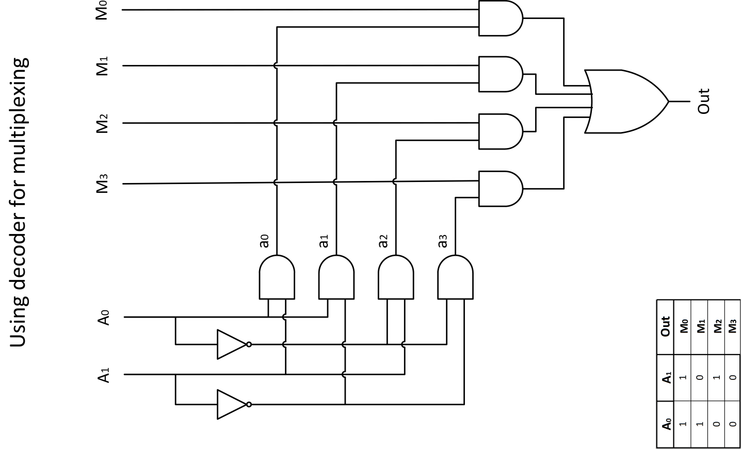
Example of critical path finding: Multiplexer

Slide 11
Example of critical path finding: 2-bit adder

Slide 12
Thank You

