Slide 1
MIPT-MIPS 2013 Sequential logic
Alexander Titov
09.11.2013

Slide 2
Layers of Abstraction in Computes Science (CS)
Application
Algorithms
Programming Language
Operating System
Instruction Set Architecture
Microarchitecture
Topics of
this lecture
Gates/Register-Transfer Level (RTL)
Circuits
Physics

Slide 3
Refresher: Combinational vs. Sequential Circtuis
If the output of a function is completely defined by the current input then the function is called combinational:
Qt = F(xt, yt, zt, …)
Combinational circuit (scheme) is an implementation of a combinational function
A lot of things can be implemented using combinational circuits
Just a few examples that we already know: summator, decoder, multiplexer
But, combinational circuits have a significant limitation:
But, combinational circuits have a significant limitation: they cannot remember any information

Slide 4
Refresher: Sequential Circuits
Sequential circuits are able to store information
If the output of a function depends not only on the current input, but on the previous state, then the function is called sequential
Qt = F(xt, yt, zt, …, Qt-1)
Qt = F(xt, yt, zt, …, Qt-1)
F(xt-1, yt-1, zt-1, …, Qt-2))
F(xt-2, yt-2, zt-2, …, Qt-3)))
Sequential circuit is an implementation of a sequential function
Their main advantage is ability to remember the previous state
Any circuit with memory is a sequential circuits

Slide 5
Refresher: SR Flip-Flop
set
!Q
S | R | Qt-1 | Qt
0 | 0 | Q | Q
0 | 1 | Q | 0
1 | 0 | Q | 1
1 | 1 | Q | 0
S
!Q
S | R | Qt-1 | Qt
0 | 0 | 0 | 0
0 | 0 | 1 | 1
0 | 1 | 0 | 0
0 | 1 | 1 | 0
1 | 0 | 0 | 1
1 | 0 | 1 | 1
1 | 1 | 0 | 0
1 | 1 | 1 | 0
R
Q
Q
reset
S
1
0
The output will be determined by the fastest signal
R
1
0
Q
1
But, which signal will be really faster will depend on many factors (e.g., temperature).
?
0
!Q
1
?
0

Slide 6
Refresher: D Flip-Flop
Data
S
!Q
D
Q
D | e | Qt-1 | Qt
D | 0 | Q | Q
0 | 1 | Q | 0
1 | 1 | Q | 1
R
Q
e
enable
Don’t have prohibited states
Store one bit of information
Can be used as building block for creating static memory arrays

Slide 7
Single port 2^MxN Memory Array
address
M
Write enable
Memory
Array
N
N
input data
output data

Slide 8
Single port 4x1 Memory Array
address
2
Write enable
Memory
Array
1
1
input data
output data

Slide 9
Single port 4x1 Memory Array

Slide 10
Single port 4x2 Memory Array

Slide 11
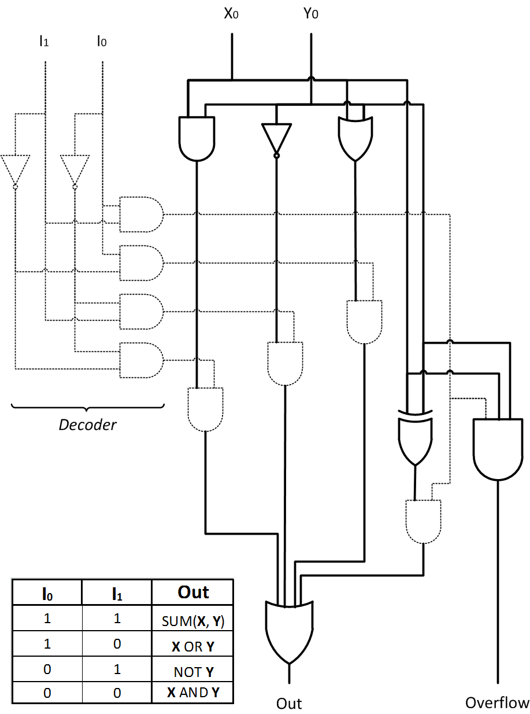
Arithmetic Logic Unit

Slide 12
MIPS ALU with Register File

Slide 13
Thank You Q/A

