Slide 1
Memory Hierarchy (part II)
Alexander Titov
21 March 2015

Slide 2
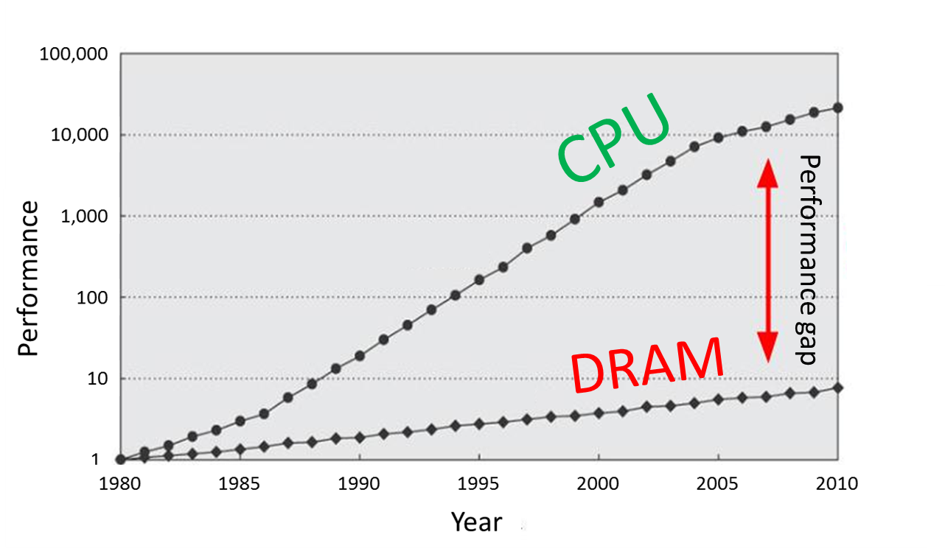
Refresher: Memory Hierarchy
Main memory is large, but too slow
Luckily, there are temporal and spatial locality in our workloads
Memory hierarchy provides visibility that memory is usually fast
L3
Cache
Main Memory
L1
L2
CPU
smallest, but fastest
slowest, but largest

Slide 3
Refresher: Caches
Three types of caches
Fully Associative: no conflict, but slow and complex HW
Direct MAP: fast and simple HW, but many conflicts
Multi-Way: something in between (more ways → closer to fully associative)
Example: 32KB, 8 ways, 64B line
To estimate performance use average access time
AMAT = Hit Rate * Hit Time + Miss Rate * Miss Penalty
address
64 | 11 |  | 5 | 0
Tag | Set |  | Offset
→
way size = 32KB / 8 = 4KB
# of sets = 4KB / 64B = 64

Slide 4
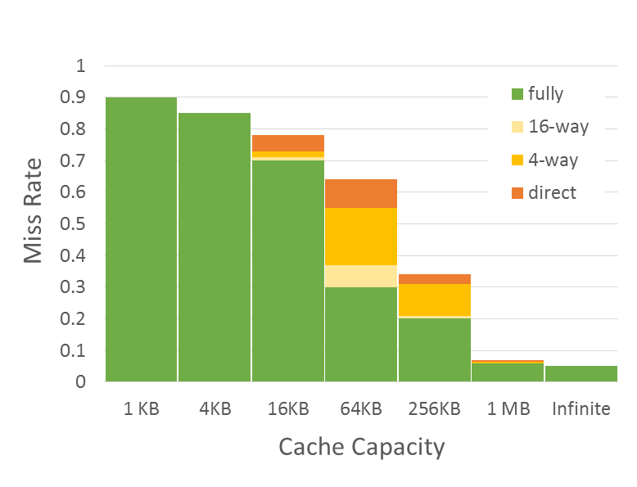
Three Types of Cache Misses (3-C)
Compulsory misses
Those that occurs even in a infinite cache
First access to data
So-called cold misses
Capacity misses
Those that occurs in an fully associative cache
Workset is larger than the cache size
Miss Rate = F(Cache Capacity, Associativity)
Conflict
Compulsory
Capacity
Conflict misses
Difference between fully associate and direct mapped cache
The size of the cache is enough, but the problem is in line mapping to sets

Slide 5
Cache Line Replacement
When miss occurs need to free space in a cache for a new line
Direct mapped cache
A new line is mapped to a single entry → evict old line from the entry
N-way set associative cache
Choose a victim from all ways in the appropriate set, but how?
FIFO (First In First Out) replacement
Easy to implement in HW, but can violate temporal locality
LRU (Least Recently Used) replacement
Evict the most unused line (was not accessed longer than other)
Good temporal locality, but complex HW → use simplified pseudo-LRU

Slide 6
Write Handling
Memory writes (store instructions) also need to update a cache
If update only memory, the old data can be read from the cache later
There two main approached of write handling
WriteTrough: always update both memory and cache
WriteBack: update only cache, update memory at line eviction
Event | WriteTrough | WriteBack
Write hits cache | Update memory and cache | Update only cache (make line “dirty”)
Write misses cache | Option 1: Upload missing line into cache, update memory and cache Option 2: Update only memory | Upload missing line into cache, update only cache (make the line “dirty)
A line is evicted | Do nothing | If the line is “dirty” write it back into memory
Event | WriteTrough | WriteBack

Slide 7
Small Summary
How is a block found?
Indexing → direct mapped
Limited search → set associative
Full search → full associative
Where can a block placed?
One place → direct mapped
A few places → set associative
Any place → full associative
What line is replaced on a miss?
FIFO
LRU
Pseudo-LRU
How are writes handled?
WriteThrough
WriteBack

Slide 8
Multi-Level Caches
L1 cache: AMAT ≈ HitTimeL1 + MissRateL1 * MissPenaltyL1
L2 reduces L1 miss penalty – saves access to memory
Now, on L1 miss we access L2, but not memory
MissPenaltyL1 ≈ HitTimeL2 + MissRateL2 * MissPenaltyL2
L2 Cache is larger (better HitRate), but has higher latency
Example:

Slide 9
Prefetching
Prefetching – predict future memory accesses
Instruction Prefetching
On a cache miss, prefetch sequential cache line
Data Prefetching
Next sequential: on a cache miss, prefetch sequential cache line
Stride: remember the repetitive step of a load and prefetch data in advance
General direction: even if there is no fixed stride can understand general direction and prefetch along it
Software Prefetching: special prefetching instructions
Prefetch Limitations
Prefetching relies on extra memory bandwidth
Too aggressive / inaccurate prefetching slows down demand fetches

Slide 10
Code Optimization: Merging Arrays
Merge arrays into an array of compound elements
Before: two sequential arrays
int val[SIZE];
int key[SIZE];
After: One array of structures
struct merge {
int val;
int key;
} merged_array[SIZE];
Reduce conflicts between val and key
Improves spatial locality

Slide 11
Code Optimization: Loop Fusion
Combine loops that have same looping and work with the same memory
Assume each element is 8 bytes, 32KB cache, 64 B/line
for (i = 0; i < 10240; i++)
a[i] = 1 / a[i];
…
for (i = 0; i < 10240; i++)
sum = sum + a[i];
Fuse the loops
for (i = 0; i < 10240; i++) {
a[i] = 1 / a[i];
sum = sum + a[i];
}
Improves temporal locality

Slide 12
Code Optimization: Loop Interchange
Change loops nesting to access data in order stored in memory
Two dimensional array in memory:
x[0][0] x[0][1] … x[0][99] x[1][0] x[1][1] …
Before:
for (j = 0; j < 100; j++)
for (i = 0; i < 5000; i++)
x[i][j] = 2 * x[i][j];
Improves spatial locality
Sequential accesses instead of striding through memory every 100 words
After:
for (j = 0; j < 100; j++)
for (i = 0; i < 5000; i++)
for (j = 0; j < 100; j++)
x[i][j] = 2 * x[i][j];
for (i = 0; i < 5000; i++)
x[i][j] = 2 * x[i][j];

Slide 13
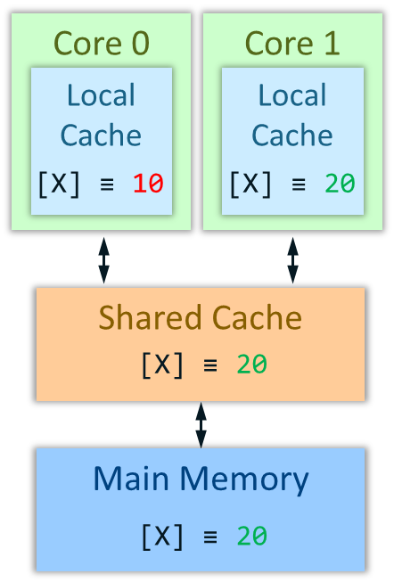
Memory Coherence in Multi-Core/Processor System
Problem: one core modifies data that another core has in its local cache
Example:
Memory system must be coherent
Cores should see memory identically
Cores should see the latest state of memory
Core 0
Core 1
Local
Cache
Local
Cache
Memory: Mem[X] ≡ 10
Core 0: a = Mem[X] # a = 10
Core 1: Mem[X] = 20
Core 0: b = Mem[X] # b = 10
[X] ≡ 10
[X] ≡ 20
miss
hit
Shared Cache
20
Error: read the old value from the local cache
[X] ≡ 10
miss
Main Memory
20
[X] ≡ 10

Slide 14
Coherence protocol: MESI
Coherency protocols describe how to handle writes and reads in a multi-core system in order to maintain memory coherence
The most famous one is MESI
Define the four possible state of a cache line
Describe transactions from one state to another (next foils)
 | Is the line valid? | Do others have this line? | Has it been modified?
Invalid | NO | NA | NA
Shared | YES | YES | NO
Exclusive | YES | NO | NO
Modified | YES | NO | YES
There is no state when a line is modified and contained by multiple cores

Slide 15
MESI Operating Example
Memory: Mem[X] ≡ 25
Core 0: a = Mem[X] # a = 25
Core 0: Mem[X] ≡ 35
Core 1: b = Mem[X] # b = 35
Snoop [X]
Core 0 writeback [X]
Core 1: Mem[X] ≡ 45
Request ownership for [X]
Core 0 invalidate [X]
Core 0
Core 1
Local
Cache
Local
Cache
[X] ≡ 25
[X] ≡ 35
[X]
[X]
35
[X]
45
S
35
I
E
M
S
M
Shared Cache
[X] ≡ 25
35
(1, 0)
(1, 1)
(0, 1)
Main Memory
[X] ≡ 25
[X] ≡ 25

Slide 16
MESI State Diagram
SN or RO
R and S
R or SN
I
RO
S
RO
SN
RO
R and !S
SN
W
W
E
M
R – read
W – write
S – line shared
!S – line not shared
W
R
R or W
SN – snoop
RO – request ownership

Slide 17
The End

