Slide 1
Out-Of-Order Execution (part II)
Alexander Titov
4 April 2015

Slide 2
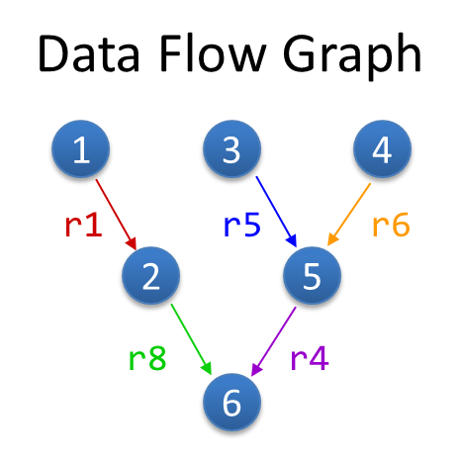
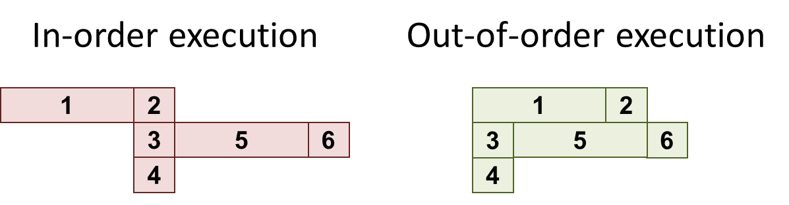
Refresher: OOO Exe
Superscalar – wide pipeline (4-5 in modern CPU)
Out-of-order – execute according real dependencies (“data flow”) rather than program order
Advantages:
Exploit parallelism beyond adjacent instructions
Hide long latencies (e.g., cache misses)
Compatibility: need to maintain visibility of in-order execution
Precise exceptions, memory model, etc.

Slide 3
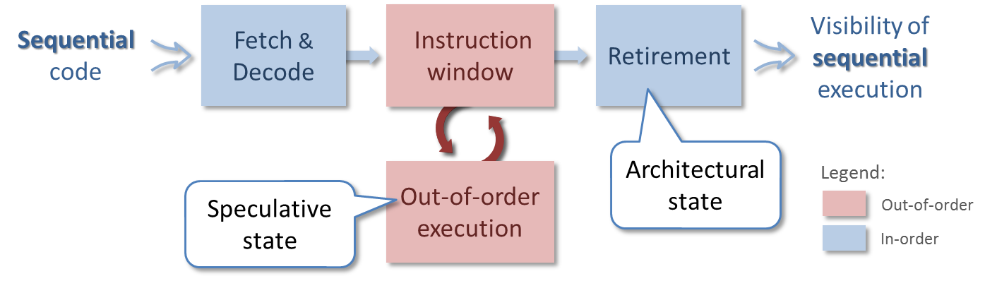
Refresher: HW Instruction Window
Two states are supported: speculative and architectural
Instruction window (ROB) keeps all in-flight instructions and allows reconstruction of the original order at retirement
The large window the better performance
Limitations:
False dependencies -> rename registers
Branches -> accurate dynamic prediction
Complex HW (so far we did not talk about that)

Slide 4
Why Is ROB Complex?
Allocation
Retirement
from decoder
Rename Registers
Check
Dependencies
ROB
ARF
Write data
Out-of-order execution
Memory
Scheduler
PRF
EXE
The two complex searches though all ROB entries
At allocation (once per each instruction): to identify producers of the instruction sources
At scheduling (every cycle): to identify ready instructions and send them to execution
The larger ROB the longer search and large HW structures
Prevents from doing ROB really large -> loose potential performance

Slide 5
Scheduler Queue
Allocation
Retirement
from decoder
Rename Registers
Check
Dependencies
ROB
ARF
Write data
Out-of-order execution
Memory
Scheduler
PRF
EXE
It is enough to check only not completed instructions
Their number is usually significantly less than ROB size (20-30%)
Decision:
Create a smaller queue for not completed instructions only (scheduling queue or reservation stations)

Slide 6
Scheduler Queue
Allocation
ROB
Retirement
from decoder
Rename Registers
Check
Dependencies
ARF
Write data
Out-of-order execution
SQ
Scheduler
Memory
PRF
EXE
It is enough to check only not completed instructions
Their number is usually significantly less than ROB size (20-30%)
Decision:
Create a smaller queue for not completed instructions only (scheduling queue or reservation stations)
All checks (allocation and scheduling) are performed on it
Use RON only for order reconstruction at retirement

Slide 7
SQ Operation Example
Example:
(1) r1 ← …
(2) r2 ← …
(3) … ← r1 + r2
Free entries
1
5
3
At allocation of (3):
Search for Src1 producer
Found in entry 1
Mark dependency
Search for Src2 producer
Found in entry 5
Mark dependency
At least one is found -> not ready
Dependency Matrix
Producers
0 | 1 | 2 | 3 | 4 | 5 | … | N
 | Dst | Src 1 | Src 2
0
1
2
3
4
5
…
N
Ready?
r1
…
…
…
r1
r2
1
1
false
r2
…
…

Slide 8
SQ Operation Example
Example:
(1) r1 ← …
(2) r2 ← …
(3) … ← r1 + r2
Free entries
At completion of (1,2):
Reset dependency to all consumers
For each entry check its readiness
Dependency Matrix
Producers
0 | 1 | 2 | 3 | 4 | 5 | … | N
 | Dst | Src 1 | Src 2
0
1
2
3
4
5
…
N
Ready?
r1
…
…
…
r1
r2
1
1
false
true
r2
…
…

Slide 9
Memory Dependencies
OOO Scheduler can track dependency through registers, but not through memory
(1) Mem[r1] ← …
…
(6) … ← Mem[r1]
Unlike register dependencies, memory dependency cannot be known at allocation
(1) Mem[r2] ← …
…
(6) … ← Mem[r3]
Decision: load should wait until all the previous stores write into the memory (cache)
It works, but it is too slow (stores write after retirement)
If instruction(6) will executes before (1) lit will read a wrong value from memory
Registers r2 and r3 can have the same values

Slide 10
Store Forwarding
Faster decision: load waits only if there is some older store with not calculated address
If addresses of all the previous stores are known and there is not intersection with them, then load can be executed
In case of intersection, the load is waiting until the data of the store is ready and take it directly from the store

Slide 11
End of Part I

