Slide 1
Virtual Memory
Alexander Titov
18 April 2015

Slide 2
Memory managing
Initially, resources was managed manually by SW developer
One program (= process) occupied the whole machine recourses
There was no “external” programs with unknown code/requirements
Modern requirements
Multi-tasking → not effective to give all resources to one process
Many SW → cannot plan their co-existents anymore
How multiple process share the memory?
What happens if a process tries to access memory of another process?
What happens if processes need more memory and there is no free one?
What happens if a new process is spawned?
address 0
address N
Process A
Process B
Process C

Slide 3
Virtual Memory (primary)
Virtual Memory (VM) is an approach that enables flexible, secure memory management
Provides isolation between processes
Processes can concurrently run on a single machine
VM prevents them from illegal accessing the memory of one another
Allows convenient sharing of memory for communication when required
Provides illusion of large memory for each process
VM size can be bigger than physical memory size
VM decouples program from real size (can differ across machines)
Provides illusion of contiguous memory
Programmers need not worry about where data is placed exactly

Slide 4
Virtual Memory (secondary)
Allows for memory dynamic growth
Can add memory to processes at runtime as needed
Allows for memory overcommitment
Sum of VM spaces (across all processes) can be >> physical space
Memory often one of the most costly parts in the system

Slide 5
Virtual and Physical Address Space
Virtual address space
Space used by the programmer (part of program visible state)
Perfect abstraction = contiguous and completely belongs to the process
Physical address space
The real physical memory (e.g., DRAM) available in the computer
Not known by the programmer (completely hidden by OS/HW)
How to map virtual space to physical one?

Slide 6
Basic Idea of VM
Split both virtual and physical spaces into fixed size blocks called pages (commonly 4KB)
Not need to place the whole virtual space into the computer → only pages used by the process
Virtual Space
Pages can be in physical memory or disk
Memory acts as a cache for the secondary storage (disk)
Process can use more pages that can be stored by physical memory
Each process can access only their pages
#page
0
1
2
3
4
5
6
…
…
91
92
93
…
…
Physical Space
#page
2
91
4
5
Disc
#page
6
93

Slide 7
Page Table
To perform translation of virtual address into physical one, the special structure called Page Table (PT) is used
It contains the flowing information for each page:
Whether the page is in memory or on the disc
Physical address of the page (if it is in memory)
Was its data modified? → need for evictions
Access rights (readonly, read-write, etc.) → security
Each process has its own PT
HW can use PT to translate addresses (= hit the table)
But, all complex tasks (initialization, misses, evictions, etc.) are performed by OS

Slide 8
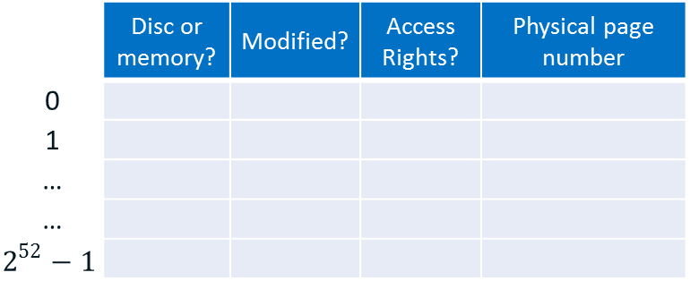
Translation
Virtual Address
63 | 11 | 0
Virtual Page Number | Page Offset
Page Table
 | Disc or memory? | Modified? | Access Rights? | Physical page number
0
1
…
…
$$2^{52}−1$$
31 | 11 | 0
Physical Page Number | Page Offset
Physical Address

Slide 9
TLB (translation lookaside buffer)
The PT is too huge to be in HW → it is stored in memory
There are multiple methods to compact it
Each translation requires several memory access
Needed for every load or store → too many!
Virtual Address
TLB caches recently used PT entries
speed up translation
typically 64 to 256 entries
usually 2 to 8 way associative
TLB access time is faster than L1 cache access time
TLB Access
Access
Page Table
No
TLB Hit ?
Yes
Physical
Addresses

Slide 10
PT, TLB and Cache
Virtual Address
Access
TLB
Access
Cache
Access
Page Table
In Memory
L2 Cache
Hit ?
No
L1 Cache
Hit ?
L2 Cache
Hit ?
No
TLB
Hit ?
No
No
Access
Memory
Yes
Yes
Physical
Addresses
Data

Slide 11
The End

