Slide 1
Digital Combinational Circuits
Titov Alexander
4 October 2014

Slide 2
Layers of Abstraction in Computes Science (CS)
Application
Algorithms
Programming Language
Operating System
Instruction Set Architecture
Microarchitecture
Gates/Register-Transfer Level (RTL)
More about logical circuits
Topics of
this lecture
Circuits
Less about physics, wires and transistors…
Physics

Slide 3
Physical Abstraction
Real physical circuits deal with physical properties, such as voltages and currents
Digital circuits use the abstractions of 0 and 1 to represent the presence or absence of these physical properties (signals) rather than a continuous range
voltage
It could not be a stable state: should not occur in the circuit except during transitions from one state to he other
5 V
Logic 1
3.5 V
Weak 1
undefined
1.5 V
Weak 0
Logic 0
0 V

Slide 4
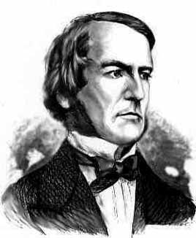
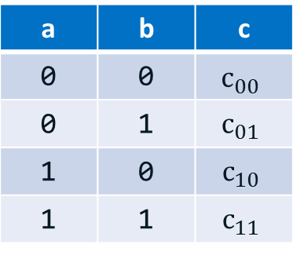
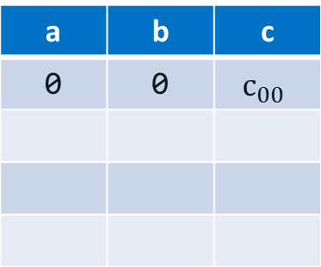
Boolean Algebra
Boolean Algebra (BA) works with object that can take only two values (true and false, or 1 and 0)
Such object is called a Boolean object (term bit of information is used in CS)
BA defines operations on Boolean objects → Boolean operations and functions
It is convenient to represent these operations and functions via truth tables:
George Boole
(1815 – 1864)
English mathematician, philosopher and logician
a | b | c
0 | 0
a | b | c
a | b | c
0 | 0 | $$c_{00}$$
a | b | c
0 | 0 | $$c_{00}$$
0 | 1 | $$c_{01}$$
1 | 0 | $$c_{10}$$
1 | 1 | $$c_{11}$$
a
c = F(a,b)
c
b
Boolean function
Truth table

Slide 5
Main Boolean operations
inversion (NOT)
The simplest Boolean operation is …
AND (or Boolean multiplication)
AND is often used as a logical key:
x | !x
0 | 1
1 | 0
x
!x
x
x | y | x*y
0 | 0
0 | 1
1 | 0
1 | 1
x*y
0
y
0
0
1
x | y | x*y
0 (closed) | y | 0
1 (open) | y | y

Slide 6
Main Boolean operations
OR (or Boolean addition)
x | y | x+y
0 | 0
0 | 1
1 | 0
1 | 1
0
x
x+y
1
y
1
1
XOR (or exclusive OR, or addition by module 1)
x | y | x ⊕ y
0 | 0
0 | 1
1 | 0
1 | 1
0
x
x + y
= x*!y + !x*y
1
y
1
0

Slide 7
Main axioms
There about ten axioms that can be used to create new or to simplify existed functions
Axiom | AND form | OR form
Identity law | 1*x = x | 0 + x = x
Idempotent law | x*x = x | x + x = x
Inverse law | !x*x = 0 | !x + x = 1
Commutative law | x*y = y*x | x + y = y + x
Associative law | (x*y)*z = x*(y*z) | (x + y) + z = x + (y + z)
Distributive law | x*y + z = (x + z)(y + z) | (x + y)*z = x*z + y*z
De Morgan's laws | !(x*y) = !x + !y | !(x + y) = !x * !y
n(n(x) + y) + n(n(x) + n(y)) = x
… and a lot of other useful equations:
(Huntington equation)

Slide 8
Boolean functions
Boolean operations can be combined into functions
F(x, y, z) = x + !y*z
x
x + !y*z
x | y | z | F
0 | 0 | 0
0 | 0 | 1
0 | 1 | 0
0 | 1 | 1
1 | … | … | 1
y
0
z
1
0
0

Slide 9
Examples of reduction
F = (!x * !y * !z) + (!x * y * z) + (x * !y * !z) + (x * y * !z) =
= (!x * !y * !z) + (!x * y * z) + (x * !z) * (!y + y) =
= (!x * !y * !z) + (!x * y * z) + (x * !z) =
= !x * (!y * !z + y * z) + (x * !z) =
= !x * (!y ⊕ z) + (x * !z).
= (!x + x) * (!y * !z) + (!x * y * z) + (x * y * !z) =
= (!y * !z) + y * (!x * z + x * !x) =
= (!y * !z) + y * (x ⊕ z) =
= !(y + z) + y * (x ⊕ z).

Slide 10
Canonical disjunctive normal form (CDNF)
CDNF is an algorithm of reconstructing a Boolean function from its truth table
Take lines with ‘1’ only
Conjunct all variables in line with correct sign
Make disjunction on expressions
x | y | z | F
0 | 0 | 0 | 1
0 | 0 | 1 | 0
0 | 1 | 0 | 0
0 | 1 | 1 | 1
1 | 0 | 0 | 1
1 | 0 | 1 | 0
1 | 1 | 0 | 1
1 | 1 | 1 | 0
!x * !y * !z
F = (!x * !y * !z) + (!x * y * z) + (x * !y * !z) + (x * y * !z)
!x * y * z
x * !y * !z
x * y * !z

Slide 11
Canonical conjunctive normal form (CCNF)
CCNF is an algorithm of reconstructing a Boolean function from its truth table
Take lines with ‘0’ only
Make disjunction on all variables in line with correct sign
Conjunct expressions
x | y | z | F
0 | 0 | 0 | 1
0 | 0 | 1 | 0
0 | 1 | 0 | 0
0 | 1 | 1 | 1
1 | 0 | 0 | 1
1 | 0 | 1 | 0
1 | 1 | 0 | 1
1 | 1 | 1 | 0
x + y + !z
x + !y + z
F = (x + y + !z)(x + !y + z)(!x + y + !z)(!x + !y + !z)
!x + y + !z
!x + !y + !z

Slide 12
Combinational Circuits
If the output of a function is completely defined by the current input then the function is called combinational :
Qt = F(xt, yt, zt, …)
Combinational circuit (scheme) is an implementation of a combinational function
A lot of things can be implemented using combinational circuits
Just a few examples that will be presented soon: summator, decoder, multiplexer

Slide 13
Half adder scheme
It is an adder, but it is not a full adder, because it does not have input carry
It is an adder, but it is not a full adder, because it does not have input carry
x
x | y | s | c
0 | 0
0 | 1
1 | 0
1 | 1
s
y
x
half +
sum
0
0
1
0
y
carry
1
0
0
1
c
Calculations:
Sum =
= !x * y + x * !y =
= x ⊕ y
Carry = x * y

Slide 14
Full adder scheme
xn | yn | cn-1 | sn | cn
0 | 0 | 0
0 | 1 | 0
1 | 0 | 0
1 | 1 | 0
cn-1
0
0
1
0
half +
1
0
xn
half +
sn
0
1
0 | 0 | 1
0 | 1 | 1
1 | 0 | 1
1 | 1 | 1
1
0
yn
0
1
0
1
1
1
c
Cn
x
+
sum
It is called a full adder
y
carry

Slide 15
Wide adder
cn-1
xn
+
sn
yn
cn
xn+1
+
sn+1
yn+1
cn+1

Slide 16
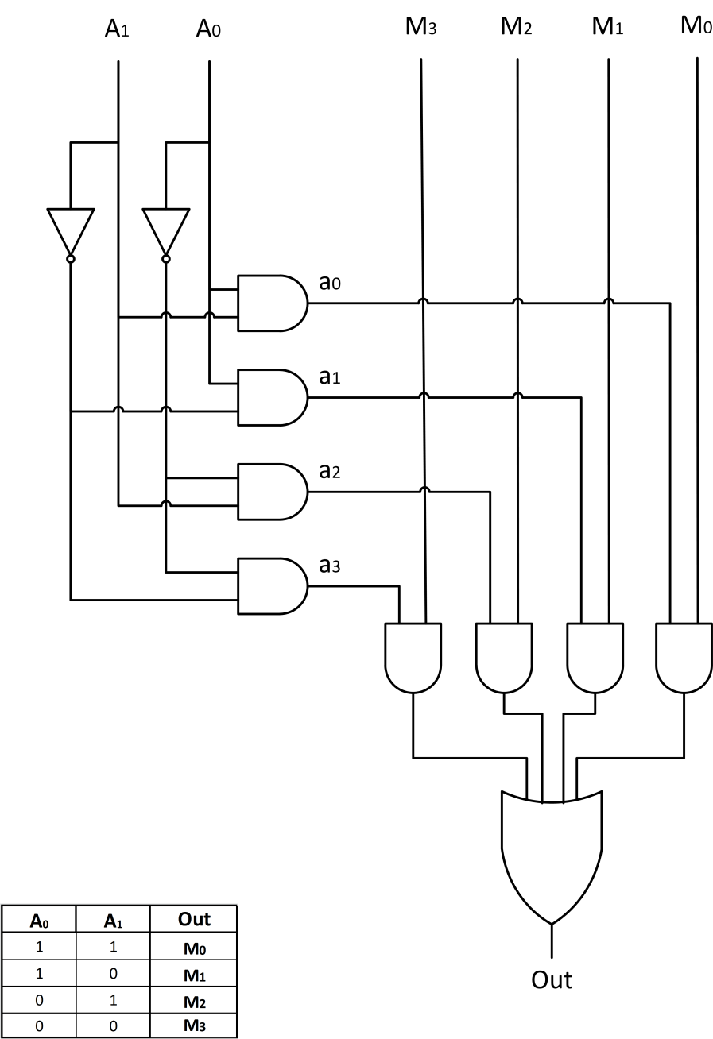
Multiplexer

Slide 17
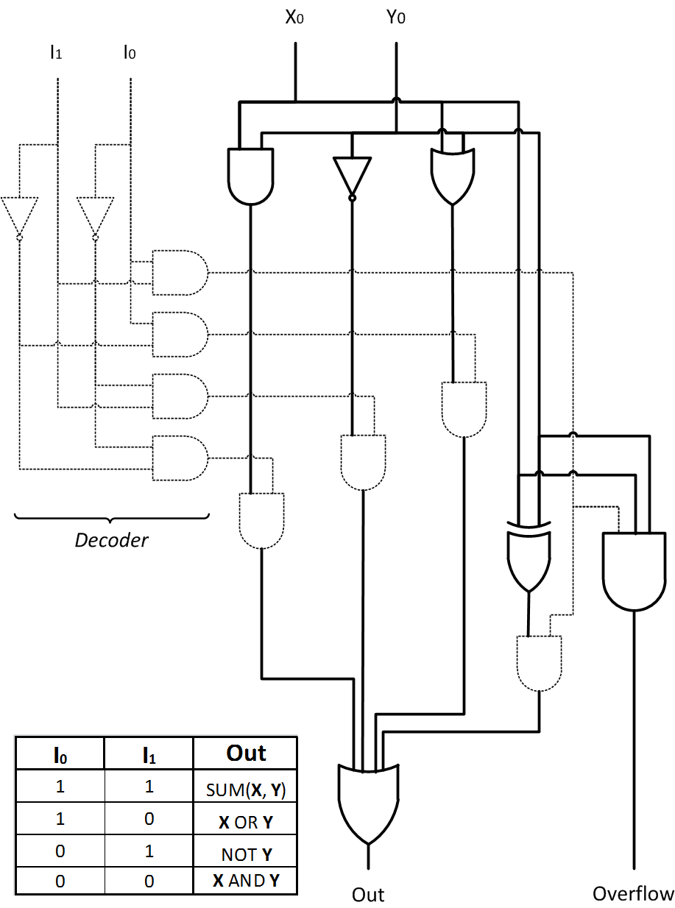
Arithmetic Logic Unit

Slide 18
Thank You

