Slide 1
Basics of MIPS ISA
Pavel Kryukov
8 November 2014

Slide 2
Layers of Abstraction in Computes Science (CS)
Application
Algorithms
Programming Language
Operating System
Instruction Set Architecture
Topic of
this lecture
Microarchitecture
Gates/Register-Transfer Level (RTL)
Circuits
Physics

Slide 3
What is ISA
Instruction Set Architecture (ISA) is a precise definition of computer instructions, features and mechanism (procedures, interrupt/exception handler, etc.) and also some structures (registers, memory, etc.)
It can be thought as an agreement between a programmer and an engineer:
It’s all programmer needs to program machine.
It’s all hardware designer needs to design machine.
What a typical ISA defines
Data Formats. (Integer, Floating Point, Vector/Packed)
Instructions. (Operations, encoding, etc.)
Registers and Memory Organization.
Interrupts, exceptions, and traps, other features.

Slide 4
Example of ISA and their uArches: MIPS
An example of a RISC processor.
Designed for easy programming and implementation.
Short and simple, but fast instructions → programs are larger than others, but run faster.
The main aim was to take advantages of pipelined execution
Pipeline was not specified in ISA, but ISA developers tried to simplify its implementation in uArch.
Implementations:
The first one is R2000 (1986)
Later: R3000A (PlayStation), R4000 (PSP), R5900 (PlayStation 2), etc.
Currently it is widely used in embedded systems.
One moment MIPS seemed to be overcome Intel IA-32, but it didn’t happen because Intel’s uArch was significantly better and could compensate the drawback of IA-32.
One moment MIPS seemed to be overcome Intel IA-32,, but it didn’t happen because Intel’s uArch was significantly better and could compensate the drawback of IA-32.

Slide 5
MIPS: Register-To-Register, Three Address
MIPS is a register-to-register, or load/store, architecture
The destination and sources must all be registers
Special instructions, which we’ll see soon, are needed to access main memory
MIPS uses three-address instructions for data manipulation
Each ALU instruction contains a destination and two sources
For example, an addition instruction (a = b + c) has the form:
operation
operands
add a, b, c
source 2
destination
source 1

Slide 6
MIPS Registers

Slide 7
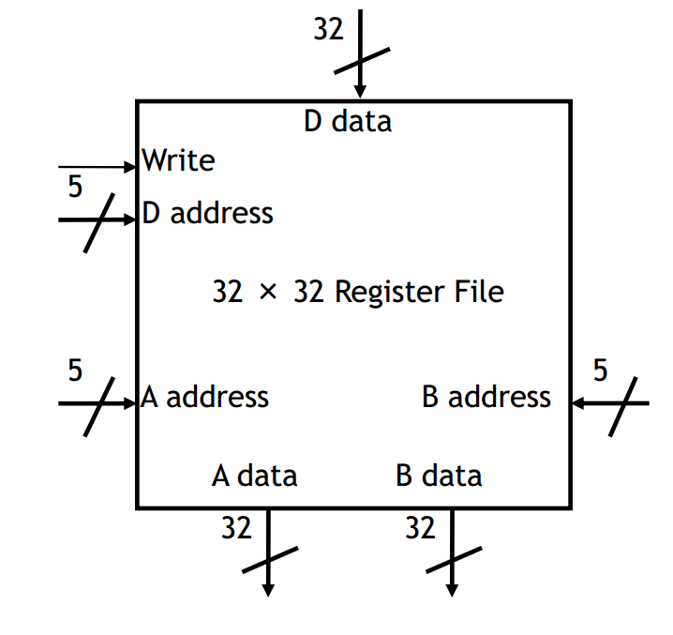
MIPS Register File
MIPS processors have 32 registers, each of which holds a 32-bit value
Register addresses are 5 bits long
The data inputs and outputs are 32-bits wide
More registers might seem better, but there is a limit to the goodness
The more register the larger decoders, multiplexers, etc. → larger circuits delays
Instruction length is affected, as need more space to encode register numbers

Slide 8
MIPS Register Names
MIPS register names begin with a $. There are two naming conventions:
By number:
$0 $1 $2 … $31
By (mostly) two-character names, such as:
$a0-$a3 $s0-$s7 $t0-$t9 $sp $ra
Number | Name
$0 | $zero
$1 | $at
$2, $3 | $v0, $v1
$4 - $7 | $a0 - $a3
$8 - $15 | $t0 - $t7
$15 - $23 | $s0 - $s7
$24, $25 | $t8, $t9
$26, $27 | $k0, $k1
$28 | $gp
$29 | $sp
$30 | $fp
$31 | $ra
Why so many different registers?
Not all of them are general purpose registers (GPR)
There are a lot of special purposes: procedure mechanism, exception/interrupt handling, etc.
In our project mostly GRPs are used: $t and $s
Detailed description of each register can be seen by this link

Slide 9
MIPS Instructions

Slide 10
R-type Format
Register-to-register (three register operands) arithmetic instructions use the R-type format:
This format includes six different fields:
op is an operation code that selects a specific action (also defines the format)
rs and rt are the first and second source registers
rd is the destination register
shamt is only used for shift instructions
func is used together with op to select an arithmetic instruction
Example:
op
rs
rt
rd
shamt
funct
6 bits
5 bits
5 bits
5 bits
5 bits
6 bits
add
$s1
$s2
$t0
signed
opcode
rs
rt
rd
shamt
funct
000000| 10001 | 10010 | 01000 | 00000 | 100000

Slide 11
Immediate Operands
R-type instructions take data from registers. How does it occur there?
From the memory (on the next foils)
From immediate
MIPS allows to specify a immediate value (signed constant), for the second source instead of a register, i.e. instead of rt
For example: addi $t0, $t1, 4 # $t0 = $t1 + 4
rt field is too small to preset real constants
5 bits → values from [-16; 15]
Cannot use R-type format to encode such instructions → need a new format

Slide 12
I-type Format for ALU Instructions
ALU instructions with immediate (two register operands) use the I-type format:
For uniformity, op, rs and rt are in the same positions as in the R-type format
This format includes four different fields:
rs is a source register (first operand)
rt is a destination register
imm is a signed value of the second operand
The immediate can range from -32,768 to +32,767
But that’s not always enough → need to write to a register by halves
op
rs
rt
imm
6 bits
5 bits
5 bits
16 bits

Slide 13
I-type Format for Loads/Stores
I-type format is also used for memory operations (load/store) as they are usually have constant memory displacement:
This format includes four different fields:
rs is a source register, the base of an address for loads and stores
rt is a source register for stores, but a destination register for loads
offset is used as an increment to the base to get the address
Examples
for( int i=0; i < L; i++)
{
int v1 = array[i].v1;
int v2 = array[i].v2;
…
}
op
rs
rt
offset
6 bits
5 bits
5 bits
16 bits
lw $t1, 0x0004($t2) # Read 4B into $t1 from Mem[ Reg[ $t2] + 0004]
sw $t1, 0x0004($t2) # Write 4B from $t1 into Mem[ Reg[ $t2] + 0004]

Slide 14
I-type Format for Branches
I-type format is also used for branches.
The target address is calculated as the end address of the branch (PC+4) plus the displacement encoded in the instruction
This format includes four different fields:
rs and rt are the first and second source registers
offset is specified in terms of words instead of bytes:
target PC = ( PC + 4) + offset << 2
The branch condition is calculated depending on opcode and source values:
For example, beq write the target address into PC only if its source operands are equal
beq $t1, $t2, L
add $s1, $s0, $0
add $t3, $t1, $t1
L:
add $v1, $v0, $v0
op
rs
rt
offset in words
6 bits
5 bits
5 bits
16 bits

Slide 15
J-type format
J-type format is used for instructions that do not access any specified register. They are usually unconditional branches (jumps)
Unlike I-type branches, the offset is not added, but change the least bits of PC:
target PC = ( PC & 0xf0000000 ) | offset << 2
op
offset in words
6 bits
26 bits

Slide 16
MIPS ALU with Register File

Slide 17
A2: MIPS Disassembler

Slide 18
What is disassembler
Although formatted 4-bytes opcodes are compact and fully readable by processor, for programmer it is very complicated.
People use assembler language — a language with translates understandable and standardized statement.
Every statement can be converted to 4-byte instruction — it is called assembling.
Vice versa, every 4-byte instruction can be converted to statement of assembler language — disassembling.
Disassembling is useful during development of any simulator, architectual or micro-architectual, functional or performance.

Slide 19
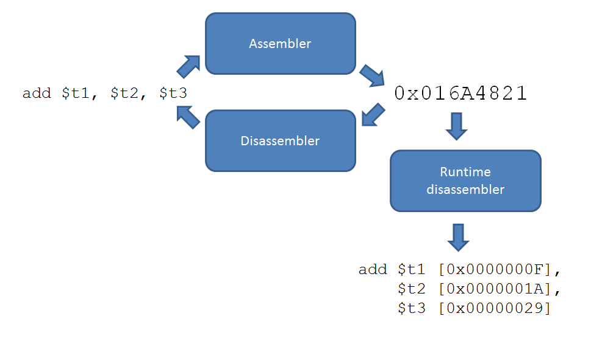
Static and runtime disassembler
We are going to start from static disassembler
It can be simply reused to make a runtime disassembler

Slide 20
C-style union
To handle with complicated bit structures, C-style unions can be used
A union is a special data type available in C that enables you to store different data types in the same memory location
union { struct { unsigned imm:16; unsigned t:5; unsigned s:5; unsigned opcode:6; } asI; struct { // ... } asR; struct { // ... } asJ; uint32 raw; } bytes;

Slide 21
ISA table
To store ISA information we suggest you to use static array. There is example of this array below.
struct ISAEntry { const char* name; uint8 opcode; uint8 func; FuncInstr::FormatType format; FuncInstr::Type type; // ... }; static const ISAEntry[] isaTable;
const FuncInstr::ISAEntry[] FuncInstr::isaTable = { // name opcode func format type { "add ", 0x0, 0x20, FuncInstr::FORMAT_R, FuncInstr::ADD /*...*/ }, // more instructions ... };
Because there are not so many instructions, you may find instruction via iterative search

Slide 22
More information and deadlines
Disassembled program will be loaded from memory model (A1)
You have to check-out to your new branch our version of A1 even if your implementation is fully correct
Link with additional useful materials and list of instructions you have to support will be sent to you tomorrow
Deadline is 7 Dec
On any questions about A2, please contact Pavel Kryukov

Slide 23
Test announcement
The next class (15 Nov) is test
The tests will include questions based on the material of the 2­­­−5th lectures
There will be no question on semiconductors, n/p-doping and transistor structure!
In addition, there will be questions on C++. Knowledge of 1 and 2 chapters of Schildt manual is welcome

Slide 24
Thank You

