Slide 1
Finite State Machines Part 1
Alexander Titov

Slide 2
Recap: Sequential Logic
Store the current state of the circuit
Memory Device
Next state
Synchronization
Current state
allows to update the state
Combinational Logic
Output
Input

Slide 3
Design of Simple Counter
5-state counter repeats 5 numbers in a sequence
The numbers are 000, 010, 011, 101, 110
How to implement it? From what to start?
Step 1: State transition diagram
Step 2: State transition table
Present state
Next state
C | B | A
0 | 0 | 0
0 | 0 | 1
0 | 1 | 0
0 | 1 | 1
1 | 0 | 0
1 | 0 | 1
1 | 1 | 0
1 | 1 | 1
C+ | B+ | A+
0 | 1 | 0
x | x | x
0 | 1 | 1
1 | 0 | 1
x | x | x
1 | 1 | 0
0 | 0 | 0
x | x | x
000
110
010
101
011
Fig.: State Diagram
Fig.: State Transition Table

Slide 4
Design of Simple Counter (cont.)
Present state
Next state
Counter design procedure
Step 1: State transition diagram
Step 2: State transition table
Step 3: Next-state functions
C | B | A
0 | 0 | 0
0 | 0 | 1
0 | 1 | 0
0 | 1 | 1
1 | 0 | 0
1 | 0 | 1
1 | 1 | 0
1 | 1 | 1
C+ | B+ | A+
0 | 1 | 0
x | x | x
0 | 1 | 1
1 | 0 | 1
x | x | x
1 | 1 | 0
0 | 0 | 0
x | x | x
BC
C+
 | 00 | 10 | 11 | 01
0 | 0 | 0 | 0 | x
1 | x | 1 | x | 1
A
→ C+ = A
Fig.: State Transition Table
B+
BC
A+
BC
 | 00 | 10 | 11 | 01
0 | 1 | 1 | 0 | x
1 | x | 0 | x | 1
 | 00 | 10 | 11 | 01
0 | 0 | 1 | 0 | x
1 | x | 1 | x | 0
A
→ B+ = !A!C +!B
A
→ A+ = B!C

Slide 5
Design of Simple Counter (cont.)
Counter design procedure
Step 1: State transition diagram
Step 2: State transition table
Step 3: Next-state functions
Step 4: Schematic
C+ = A
B+ = !A!C +!B
A+ = B!C
Fig.: Next-state functions
A
C
B
A
D
Q
D
Q
D
Q
B
!B
!C
A
!C
Fig.: 5-state counter schematic

Slide 6
Self-starting counters
Is our design robust?
What if the counter jumps to 111 state (e.g., due to noise disturbance)?
Invalid states should transition to valid ones
Assures startup
Assures bit-error tolerance
Design your counters to be self-starting
Draw all states in the state diagram
Fill in the entire state-transition table
May limit your ability to exploit don't cares
Choose startup transitions that minimize the logic
Is such loop possible?
If yes → stuck in invalid states
001
111
000
110
100
010
101
011

Slide 7
Make 5-state Counter Self-Starting
Next state
Present state
C | B | A
0 | 0 | 0
0 | 0 | 1
0 | 1 | 0
0 | 1 | 1
1 | 0 | 0
1 | 0 | 1
1 | 1 | 0
1 | 1 | 1
C+ | B+ | A+
0 | 1 | 0
1 | 1 | 0
0 | 1 | 1
1 | 0 | 1
0 | 1 | 0
1 | 1 | 0
0 | 0 | 0
1 | 0 | 0
BC
C+
 | 00 | 10 | 11 | 01
0 | 0 | 0 | 0 | x
1 | x | 1 | x | 1
A
0
→ C+ = A
→ OK
1
1
B+
BC
 | 00 | 10 | 11 | 01
0 | 1 | 1 | 0 | x
1 | x | 0 | x | 1
A
1
→ B+ = !A!C +!B
→ OK
Fig.: State Transition Table
1
0
BC
000
110
001
A+
 | 00 | 10 | 11 | 01
0 | 0 | 1 | 0 | x
1 | x | 1 | x | 0
A
0
→ A+ = B!C
→ OK
101
111
100
010
0
0
011
Fig.: State Diagram

Slide 8
FSM is more than counters
FSM: A system that visits a finite number of logically distinct states
Counters are simple FSMs
Outputs and states are identical
Visit states in a fixed sequence independent on inputs
FSMs are typically more complex than counters
Outputs can depend on current state and on inputs
State sequencing depends on current state and on inputs

Slide 9
FSM Design
Counter design procedure
Step 1: State transition diagram
Step 2: State transition table
Step 3: Next-state functions
Step 4: Schematic
FSM design procedure
Step 1: State transition diagram
Step 2: State transition table
Step 3: State minimization
Step 4: State encoding
Step 5: Next-state functions
Step 6: Schematic

Slide 10
Two Methods for FSM Minimization
Row matching
Easier to do by hand
Misses minimization opportunities
Implication table
Guaranteed to find the most reduced FSM
More complicated algorithm
← next lecture

Slide 11
Example: sequence analyzer
Conditions:
Scheme has one input and one output
Output 1 if the previous three inputs are 011 or 110
Intput/output trace example:
Let’s create the state diagram
Sequence Analyzer FSM
Sequence
Match
1
1
in | 0 | 0 | 1 | 0 | 1 | 1 | 1 | 0 | 1 | 1 | 1 | 0 | …
out | 0 | 0 | 0 | 0 | 0 | 1 | 0 | 0 | 0 | 0 | 0 | 1 | …

Slide 12
Sequence Analyzer: straightforward diagram
X
[0]
0
1
0
[0]
1
[0]
0
1
0
1
00
[0]
01
[0]
10
[0]
11
[0]
0
1
0
1
0
1
0
1
000
[0]
001
[0]
010
[0]
011
[1]
100
[0]
101
[0]
110
[1]
111
[0]
1
0
0
1
0
1
0
1
0
1
0
1
0
1
0
1

Slide 13
Transition Table Minimization: step 1
Input Sequence | Present State | Next State |  | Output
 |  | In=0 | In=1
Reset | S_{x} | S₀ | S₁ | 0
0 | S₀ | S₀₀ | S₀₁ | 0
1 | S₁ | S₁₀ | S₁₁ | 0
00 | S₀₀ | S₀₀₀ | S₀₀₁ | 0
01 | S₀₁ | S₀₁₀ | S₀₁₁ | 0
10 | S₁₀ | S₁₀₀ | S₁₀₁ | 0
11 | S₁₁ | S₁₁₀ | S₁₁₁ | 0
000 | S₀₀₀ | S₀ | S₁ | 0
001 | S₀₀₁ | S₀ | S₁ | 0
010 | S₀₁₀ | S₀ | S₁ | 0
011 | S₀₁₁ | S₀ | S₁ | 1
100 | S₁₀₀ | S₀ | S₁ | 0
101 | S₁₀₁ | S₀ | S₁ | 0
110 | S₁₁₀ | S₀ | S₁ | 1
111 | S₁₁₁ | S₀ | S₁ | 0

Slide 14
Transition Table Minimization: step 2
Input Sequence | Present State | Next State |  | Output
 |  | In=0 | In=1
0 | S₀ | S₀₀ | S₀₁ | 0
1 | S₁ | S₁₀ | S₁₁ | 0
00 | S₀₀ | S_{no} | S_{no} | 0
01 | S₀₁ | S_{no} | S_{yes} | 0
10 | S₁₀ | S_{no} | S_{no} | 0
11 | S₁₁ | S_{yes} | S_{no} | 0
Not 011/110 or Reset | S_{no} | S₀ | S₁ | 0
011/110 | S_{yes} | S₀ | S₁ | 1

Slide 15
Minimized FSM
No more rows to match
Input Sequence | Present State | Next State |  | Output
 |  | In=0 | In=1
0 | S₀ | S_{no} | S₀₁ | 0
1 | S₁ | S_{no} | S₁₁ | 0
00/10 | S_{no} | S_{start} | S_{start} | 0
01 | S₀₁ | S_{start} | S_{yes} | 0
11 | S₁₁ | S_{yes} | S_{start} | 0
Not 011/110 or Reset | S_{start} | S₀ | S₁ | 0
011/110 | S_{yes} | S₀ | S₁ | 1
start
[0]
0
1
0
[0]
1
[0]
1
0
1
0
01
[0]
no
[0]
11
[0]
0
1
0
0
1
1
Fig.: State Transition Table
1
yes
[1]
0
Fig.: State Diagram

Slide 16
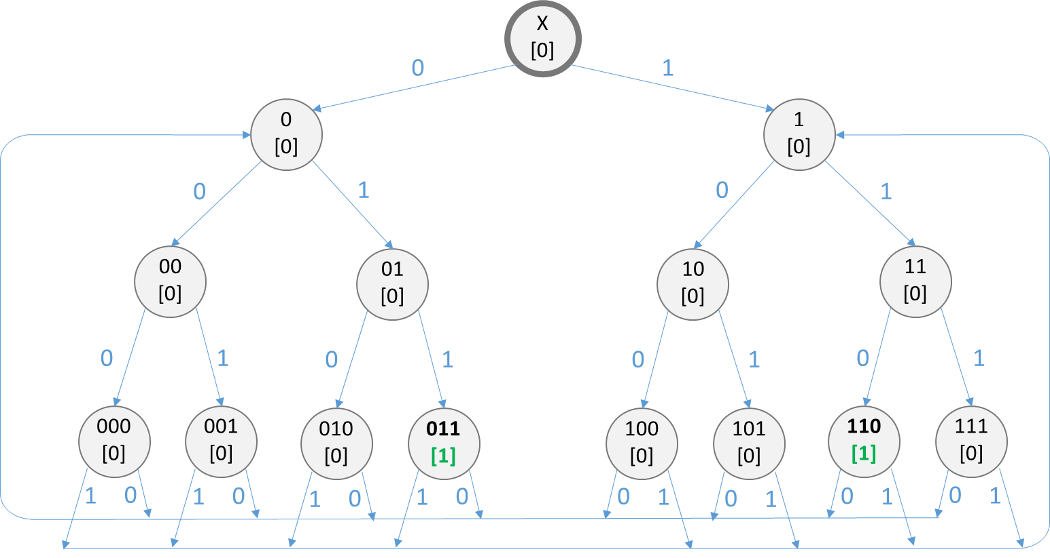
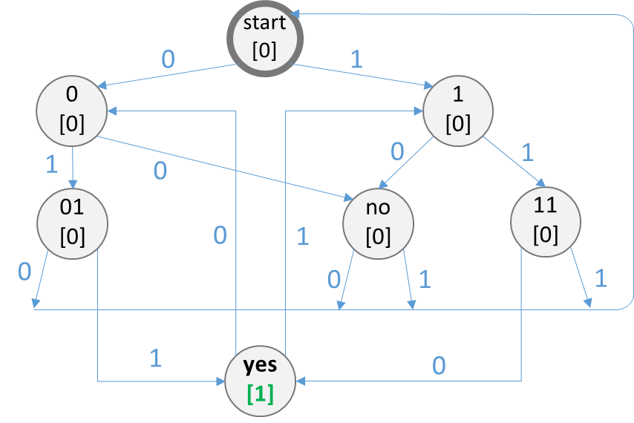
Minimized vs. Initial FSM
Fig.: Minimized State Diagram
Fig.: Initial State Diagram
Minimization allows using less elements (gates, latches)
Faster FSM as has shorter critical path
Smaller power/area

Slide 17
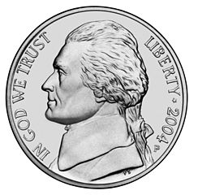
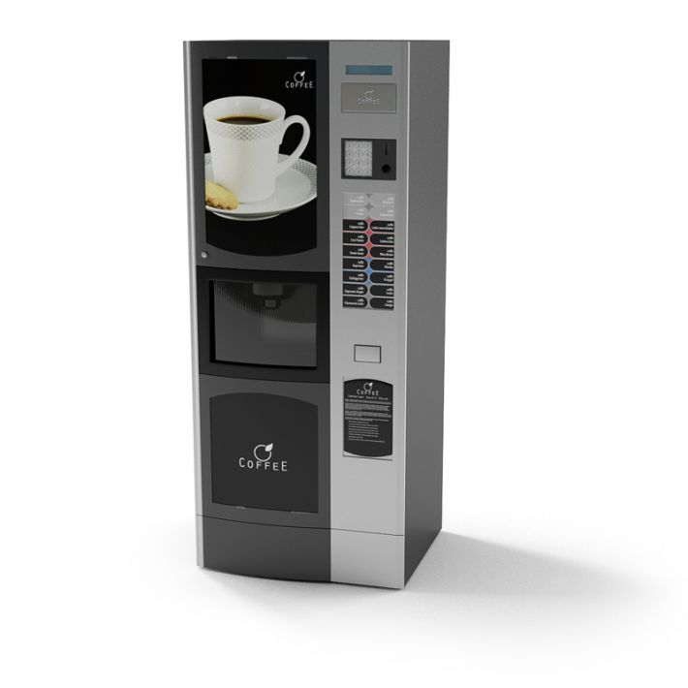

Real-life Example: Vending Coffee Machine
Conditions:
15₵ for a cup of coffee
Take only 5₵ and 10₵ coins
Do no provide any change
Reset
Receive 5₵
F
Coin Sensor
Vending Machine FSM
Make a coffee
Start
T
Receive 10₵
Clock

Slide 18
FSM design procedure
Step 1: State transition diagram
Step 2: State transition table
Step 3: State minimization
Step 4: State encoding
Step 5: Next-state functions
Step 6: Schematic

Slide 19
Vending Machine FSM: step 1 and 2
Current state | F | T | Nest state | Start
S0 | 0 | 0 | S0 | 0
 | 0 | 1 | S1 | 0
 | 1 | 0 | S2 | 0
 | 1 | 1 | x | x
S1 | 0 | 0 | S1 | 0
 | 0 | 1 | S4 | 0
 | 1 | 0 | S3 | 0
 | 1 | 1 | x | x
S2 | 0 | 0 | S2 | 0
 | 0 | 1 | S6 | 0
 | 1 | 0 | S5 | 0
 | 1 | 1 | x | x
S3 | 0 | 0 | S3 | 0
 | 0 | 1 | S8 | 0
 | 1 | 0 | S7 | 0
 | 1 | 1 | x | x
S4/S5/S6/S7/S8 | x | x | S0 | 1
From S4, S5, S6, S7, S8
S0
!F and !T
F
T
!F and !T
S1
S2
!F and !T
F
T
F
T
!F and !T
S3
S4
[start]
S5
[start]
S6
[start]
F
T
S7
[start]
S8
[start]
S0
S0
S0
S0
S0

Slide 20
Vending Machine FSM: step 3
Current state | F | T | Nest state | Start
S0 | 0 | 0 | S0 | 0
 | 0 | 1 | S1 | 0
 | 1 | 0 | S2 | 0
 | 1 | 1 | x | x
S1 | 0 | 0 | S1 | 0
 | 0 | 1 | S4 | 0
 | 1 | 0 | S3 | 0
 | 1 | 1 | x | x
S2 | 0 | 0 | S2 | 0
 | 0 | 1 | S6 | 0
 | 1 | 0 | S5 | 0
 | 1 | 1 | x | x
S3 | 0 | 0 | S3 | 0
 | 0 | 1 | S8 | 0
 | 1 | 0 | S7 | 0
 | 1 | 1 | x | x
S4/S5/S6/S7/S8 | x | x | S0 | 1
Current state | F | T | Nest state | Start
S0 | 0 | 0 | S0 | 0
 | 0 | 1 | S1 | 0
 | 1 | 0 | S2 | 0
 | 1 | 1 | x | x
S1 | 0 | 0 | S1 | 0
 | 0 | 1 | S4 | 0
 | 1 | 0 | S3 | 0
 | 1 | 1 | x | x
S2 | 0 | 0 | S2 | 0
 | 0 | 1 | S4 | 0
 | 1 | 0 | S4 | 0
 | 1 | 1 | x | x
S3 | 0 | 0 | S3 | 0
 | 0 | 1 | S4 | 0
 | 1 | 0 | S4 | 0
 | 1 | 1 | x | x
S4’ | x | x | S0 | 1
Current state | F | T | Nest state | Start
S0 | 0 | 0 | S0 | 0
 | 0 | 1 | S1 | 0
 | 1 | 0 | S2 | 0
 | 1 | 1 | x | x
S1 | 0 | 0 | S1 | 0
 | 0 | 1 | S4 | 0
 | 1 | 0 | S3 | 0
 | 1 | 1 | x | x
S2’ | 0 | 0 | S2’ | 0
 | 0 | 1 | S4 | 0
 | 1 | 0 | S4 | 0
 | 1 | 1 | x | x
S4’ | x | x | S0 | 1

Slide 21
Vending Machine FSM: step 3
Current state | F | T | Nest state | Start
S0 | 0 | 0 | S0 | 0
 | 0 | 1 | S1 | 0
 | 1 | 0 | S2 | 0
 | 1 | 1 | x | x
S1 | 0 | 0 | S1 | 0
 | 0 | 1 | S4 | 0
 | 1 | 0 | S3 | 0
 | 1 | 1 | x | x
S2 | 0 | 0 | S2 | 0
 | 0 | 1 | S6 | 0
 | 1 | 0 | S5 | 0
 | 1 | 1 | x | x
S3 | 0 | 0 | S3 | 0
 | 0 | 1 | S8 | 0
 | 1 | 0 | S7 | 0
 | 1 | 1 | x | x
S4/S5/S6/S7/S8 | x | x | S0 | 1
Current state | F | T | Nest state | Start
S0 | 0 | 0 | S0 | 0
 | 0 | 1 | S1 | 0
 | 1 | 0 | S2 | 0
 | 1 | 1 | x | x
S1 | 0 | 0 | S1 | 0
 | 0 | 1 | S4 | 0
 | 1 | 0 | S3 | 0
 | 1 | 1 | x | x
S2 | 0 | 0 | S2 | 0
 | 0 | 1 | S4 | 0
 | 1 | 0 | S4 | 0
 | 1 | 1 | x | x
S3 | 0 | 0 | S3 | 0
 | 0 | 1 | S4 | 0
 | 1 | 0 | S4 | 0
 | 1 | 1 | x | x
S4’ | x | x | S0 | 1
Current state | F | T | Nest state | Start
S0 | 0 | 0 | S0 | 0
 | 0 | 1 | S1 | 0
 | 1 | 0 | S2 | 0
 | 1 | 1 | x | x
S1 | 0 | 0 | S1 | 0
 | 0 | 1 | S4 | 0
 | 1 | 0 | S3 | 0
 | 1 | 1 | x | x
S2’ | 0 | 0 | S2’ | 0
 | 0 | 1 | S4 | 0
 | 1 | 0 | S4 | 0
 | 1 | 1 | x | x
S4’ | x | x | S0 | 1

Slide 22
Minimized FSM
Current state | F | T | Nest state | Start
S0 | 0 | 0 | S0 | 0
 | 0 | 1 | S1 | 0
 | 1 | 0 | S2 | 0
 | 1 | 1 | x | x
S1 | 0 | 0 | S1 | 0
 | 0 | 1 | S4 | 0
 | 1 | 0 | S3 | 0
 | 1 | 1 | x | x
S2’ | 0 | 0 | S2’ | 0
 | 0 | 1 | S4 | 0
 | 1 | 0 | S4 | 0
 | 1 | 1 | x | x
S4’ | x | x | S0 | 1
!F and !T
S0
[0]
F
!F and !T
S1
[0]
F
X
!F and !T
S2’
[1]
T
F or T
S3’
[1]

Slide 23
Minimized FSM
Current state | 5₵ | 10₵ | Nest state | Start
0₵ | 0 | 0 | 0₵ | 0
 | 0 | 1 | 5₵ | 0
 | 1 | 0 | 10₵ | 0
 | 1 | 1 | x | x
5₵ | 0 | 0 | 5₵ | 0
 | 0 | 1 | 10₵ | 0
 | 1 | 0 | ≥15₵ | 0
 | 1 | 1 | x | x
10₵ | 0 | 0 | 10₵ | 0
 | 0 | 1 | ≥15₵ | 0
 | 1 | 0 | ≥15₵ | 0
 | 1 | 1 | x | x
≥15₵ | x | x | 0₵ | 1
Nothing paid
0₵
5₵
Nothing paid
5₵
5₵
always
Nothing paid
10₵
10₵
5₵ or 10₵
≥15₵
Make coffee

Slide 24
Step 4, 5 and 6
Do the rest steps on your own!

Slide 25
Backup

