Slide 1
Boolean Algebra and Combinational Circuits
Alexander Titov

Slide 2
Topics of The Lecture
Boolean Algebra
math apparatus for Digital Circuits
Combinational Circuits
Circuits without memory: their output is defined by the given input only
Examples: all arithmetic (adder, multiplier, etc.), decoder, multiplexer and much more
Register-Transfer Level (RTL)
Gates
Circuits
Devices (Transistors)
Physics
Fig.: Position in the layers of abstraction

Slide 3

Digital Abstraction
To design an electrical circuit we need to deal with real physical properties
In the abstraction of Digital circuits we reduce all physical properties to 0 and 1 states
$$∇∙D=ρ$$
$$∇∙B=0$$
$$∇×E=−\frac{∂B}{∂t}$$
$$∇×H=j+\frac{∂D}{∂t}$$
X
→ complicated for large systems
Fig.: Maxwell’s equations
voltage
Supply voltage
1.2
Logic 1
Logic 1
1.0
Weak 1
It cannot be a stable state: should not occur in the circuit except during transitions from one state to the other
undefined
Weak 0
Logic 0
0.2
Ground
Logic 0
0.0

Slide 4
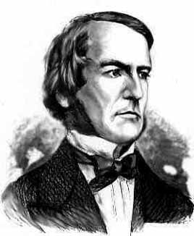
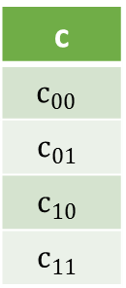
Boolean Algebra
Boolean Algebra works with objects that can have only two states (true and false, or 1 and 0)
Such object is called a Boolean object (term bit of information is used in CS)
Boolean Algebra defines operations on Boolean objects → Boolean operations and functions
It is convenient to represent these operations and functions via truth tables:
George Boole
(1815 – 1864)
English mathematician, philosopher and logician
a | b
0 | 0
0 | 1
1 | 0
1 | 1
c
$$c_{00}$$
$$c_{01}$$
$$c_{10}$$
$$c_{11}$$
a
c = F(a,b)
c
b
Fig.: Boolean function
Fig.: Truth table

Slide 5
Main Operations
inversion (NOT)
The simplest Boolean operation is …
x
0
1
! x
1
0
x
!x
AND (or Boolean multiplication)
x | y
0 | 0
0 | 1
1 | 0
1 | 1
x * y
x
0
x * y
y
0
0
1

Slide 6
Main Operations (2)
OR (Boolean addition)
x | y
0 | 0
0 | 1
1 | 0
1 | 1
x + y
0
x
x + y
1
y
1
1
XOR (exclusive OR, addition by module 1)
x
x | y
0 | 0
0 | 1
1 | 0
1 | 1
x ⊕ y
x + y = !x*y + x*!y
0
y
1
1
0

Slide 7
Boolean Functions
Boolean operation can be combined into functions
F(x, y, z) = x + !y*z
x
x + !y*z
y
x | y | z
0 | 0 | 0
0 | 0 | 1
0 | 1 | 0
0 | 1 | 1
1 | 0 | 0
… | … | …
F
z
0
1
0
0
1
…

Slide 8
Main axioms/laws
Axiom | AND form | OR form
Null law | 0*x = 0 | 1 + x = 1
Distributive law | x*y + z = (x + z)(y + z) | (x + y)*z = x*z + y*z
Associative law | (x*y)*z = x*(y*z) | (x + y) + z = x + (y + z)
Commutative law | x*y = y*x | x + y = y + x
Inverse law | !x*x = 0 | !x + x = 1
Idempotent law | x*x = x | x + x = x
De Morgan's laws | !(xy) = !x + !y | !(x + y) = !x * !y
Identity law | 1*x = x | 0 + x = x

Slide 9
Main axioms/laws
Axiom | AND form | OR form
Null law | 0*x = 0 | 1 + x = 1
Identity law | 1*x = x | 0 + x = x
AND and OR can be used as a logical key
x | y
0 | y
1 | y
x * y
0 (closed)
y (open)
x | y
0 | y
1 | y
x + y
y (open)
1 (closed)
Useful to reconstruct a function from the given truth table

Slide 10
Canonical disjunctive normal form (CNDF)
CDNF is an algorithm of reconstructing a function from its truth table
Take lines with 1’s in the output only
Conjunct (ANDing) all variables in each line with a correct sign
Make disjunction (ORing) on the expressions
→ Hint: use CNFG if there are less 1’s than 0’s
x | y | z
0 | 0 | 0
0 | 0 | 1
0 | 1 | 0
0 | 1 | 1
1 | 0 | 0
1 | 0 | 1
1 | 1 | 0
1 | 1 | 1
F
1
0
0
1
1
0
1
0
By construction, this expression gives 1 only for these values of the arguments and 0 for all the others
!x !y !z
!x y z
F = (!x !y !z) + (!x y z) + (x !y !z) + (x y !z)
x !y !z
x y !z
Due to ORing 0’s in other terms do not prevent 1 from propagating to the output

Slide 11
Canonical conjunctive normal form (CCDF)
CCNF is an algorithm of reconstructing a function from its truth table
Take lines with 0’s in the output only
Make disjunction (ORing) of all variables in line with correct sign
Make conjunction (ANDing) on the expressions
→ Hint: use CCFG if there are less 0’s than 1’s
x | y | z
0 | 0 | 0
0 | 0 | 1
0 | 1 | 0
0 | 1 | 1
1 | 0 | 0
1 | 0 | 1
1 | 1 | 0
1 | 1 | 1
F
1
0
0
1
1
0
1
0
By construction, this expression gives 0 only for these values of the arguments and 1 for all the others
x + y + !z
x + !y + z
Due to ANDing 1’s in other terms do not prevent 0 from propagating to the output
F = (x + y + !z)(x + !y + z)(!x + y + !z) (!x + !y + !z)
!x + y + !z
!x + !y + !z

Slide 12
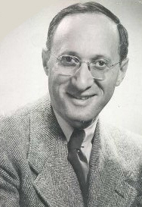
Karnaugh Map
Karnaugh maps help to facilitate a simplification process of Boolean functions
 | A | B | C | D
0 | 0 | 0 | 0 | 0
1 | 0 | 0 | 0 | 1
2 | 0 | 0 | 1 | 0
3 | 0 | 0 | 1 | 1
4 | 0 | 1 | 0 | 0
5 | 0 | 1 | 0 | 1
6 | 0 | 1 | 1 | 0
7 | 0 | 1 | 1 | 1
8 | 1 | 0 | 0 | 0
9 | 1 | 0 | 0 | 1
10 | 1 | 0 | 1 | 0
11 | 1 | 0 | 1 | 1
12 | 1 | 1 | 0 | 0
13 | 1 | 1 | 0 | 1
14 | 1 | 1 | 1 | 0
15 | 1 | 1 | 1 | 1
F
1
1
0
0
0
0
1
0
1
1
1
1
0
0
1
0
Row and columns are ordered in Gray Code: adjacent values differ only by a single bit.
There are no borders. Rectangles can cross them to form larger rectangles.
Maurice Karnaugh
(1924)
American physicist and mathematician
A B
 | 0 | 0 | 1 | 1
 | 0 | 0 | 1 | 1
 | 0 | 0 | 0 | 1
 | 0 | 1 | 1 | 1
00
01
11
10
00
1
0
0
1
01
1
0
0
1
C D
F =
B C !D
+ A !B
+ !B !C
11
0
0
0
1
10
0
1
1
1
Fig.: Karnaugh map
Algorithm:
Cover all ones by minimal number of rectangles
Length of each side of the rectangles must be power of two (1, 2, 4 and so on)
Each rectangle must be as large as possible
Each rectangle is a term in CDNF, but without variables that change their values inside the rectangle

Slide 13
Combinational Circuits
If the output of a function is completely defined by the current input then the function is called combinational:
Q = F(x, y, z, …)
Combinational circuit (scheme) is an implementation of a combinational function
Such circuit does not depend on its previous output
Has no state
Cannot remember data

Slide 14
Comparator
x ⊕ y = !x y + x !y
x | y
0 | 0
0 | 1
1 | 0
1 | 1
x ⊕ y
0
1
1
0
Two binary numbers are equal if their bits are equal
Comparator returns true if numbers are equal
Fig.: XOR truth table
Q = !x0 !x1 !y0 !y1 + x0 !x1 y0 !y1 + !x0 x1 !y0 y1 +
x0 x1 y0 y1
= !x0 !y0 (!x1 !y1 + x1 y1) + x0 y0 (x1 y1 + !x1 !y1)
= (!x0 !y0 + x0 y0) (!x1 !y1 + x1 y1)
= !(x0 !y0 + !x0 y0) * !(x1 !y1 + !x1 y1)
= !(x0 ⊕ y0) * !(x1 ⊕ y1)
x0 | x1 | y0 | y1
0 | 0 | 0 | 0
0 | 1 | 0 | 1
1 | 0 | 1 | 0
1 | 1 | 1 | 1
… | … | … | …
Q
1
1
1
1
0
= !(x0 ⊕ y0) * !(x1 ⊕ y1)
x0
y0
Q
x1
Fig.: 2-bit digits comparator truth table
y1

Slide 15
Multiplexor
Multiplexor (mux) transfers one of the data input to the output according to the control input
x | y | c
1 | 0 | 0
0 | 1 | 1
1 | 1 | 0
1 | 1 | 1
… | … | …
M
1
1
1
1
0
M = x !y !c + !x y c + x y !c + x y c
= x !c (!y + y) + y c (!x + x)
= x !c + y c
x
Q
y
x
c
c
M
Fig.: mux truth table
Fig.: mux notation
y
Fig.: mux circuit

Slide 16
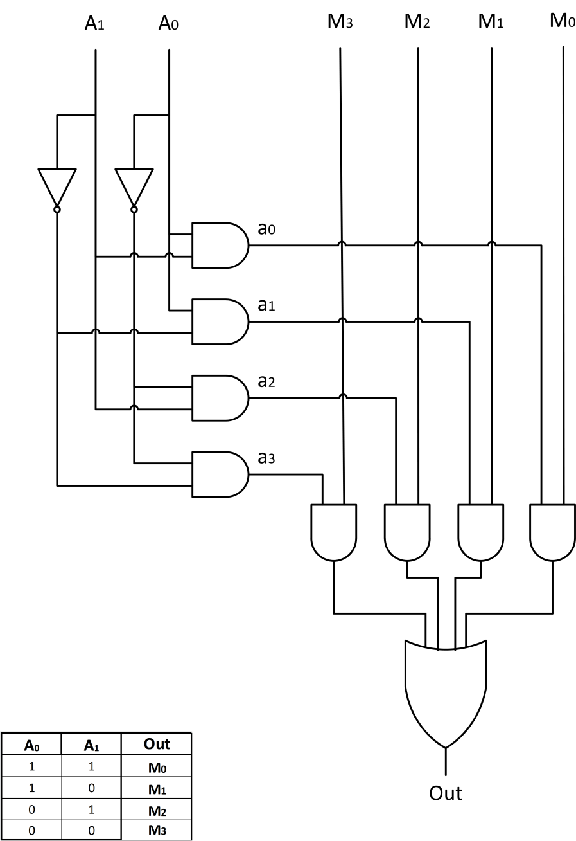
4-input Multiplexor
A0
A1
D0
D1
D2
D3
A0 | A1
0 | 0
0 | 1
1 | 0
1 | 1
M
D0
D1
D2
D3
d3
d2
Fig.: 4-in-1 mux truth table
d1
d0
A0 | A1
0 | 0
1 | 0
0 | 1
1 | 1
d0 | d1 | d2 | d3
1 | 0 | 0 | 0
0 | 1 | 0 | 0
0 | 0 | 1 | 0
0 | 0 | 0 | 1
Fig.: decoder truth table
M

Slide 17
Half Bit Adder
Half
x | y
0 | 0
0 | 1
1 | 0
1 | 1
sum
carry
x
HBA
sum
sum
x
0
0
y
H
1
0
y
carry
1
0
0
1
Fig.: bit adder notation
Fig.: bit adder truth table
carry
Fig.: bit adder circuit
However, it is a half bit adder (HBA) as an input carry is not accounted
The multi-digit adder cannot be build based on it

Slide 18
Full Adder
cn-1
cn-1
HBA
xn
HBA
sn
xn
FBA
yn
sn
yn
cn
xn+1
FBA
sn+1
Cn
c
yn+1
cn+1
x
FBA
sum
y
carry

Slide 19
Questions?

