Slide 1
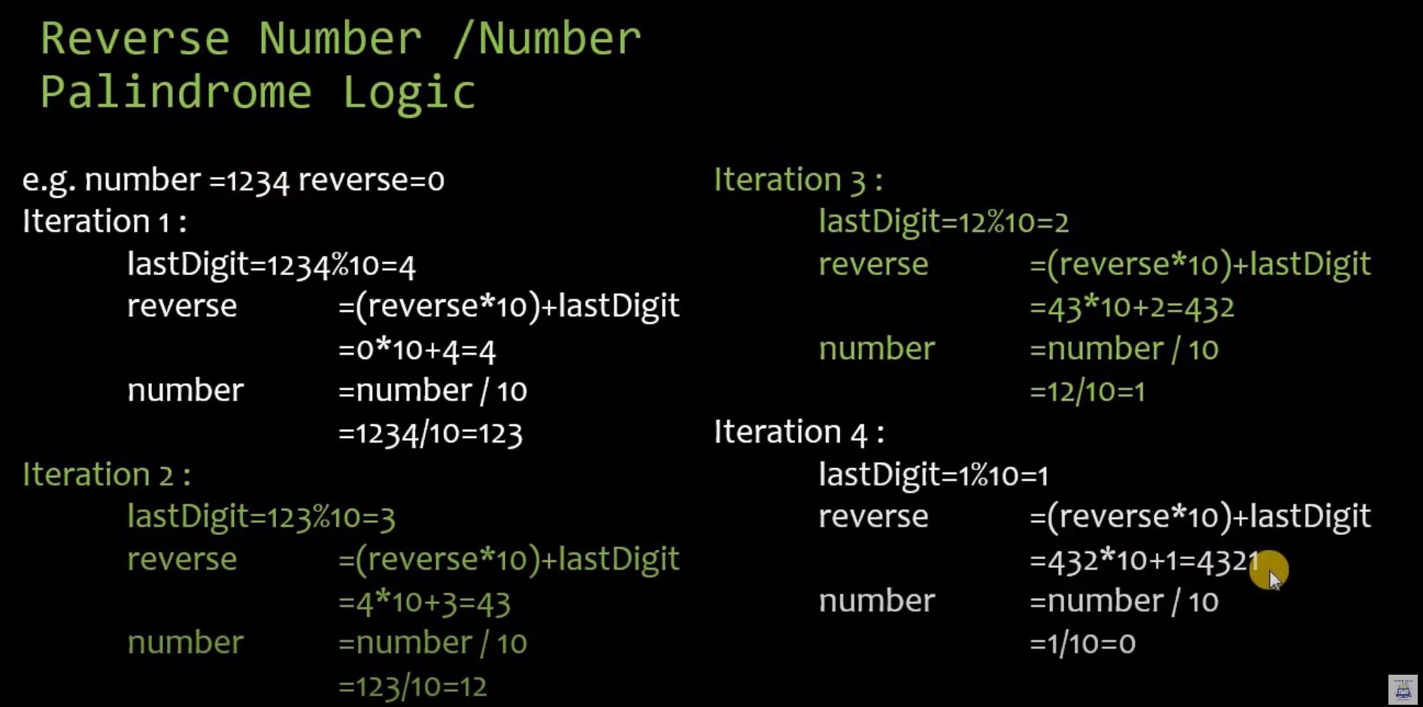

Slide 3
read -p "Enter any number:" number
reverse=0
while [ $number -ne 0 ]
do
n=`expr $number % 10`
reverse=$((($reverse * 10) + $n))
number=`expr $number / 10`
done
echo "Reverse: $reverse"

Slide 4
echo enter n
read n
num=0
while [ $n -gt 0 ]
do
num=$(expr $num \* 10)
k=$(expr $n % 10)
num=$(expr $num + $k)
n=$(expr $n / 10)
done
echo number is $num

