Slide 1
What is SSH command?

Slide 2
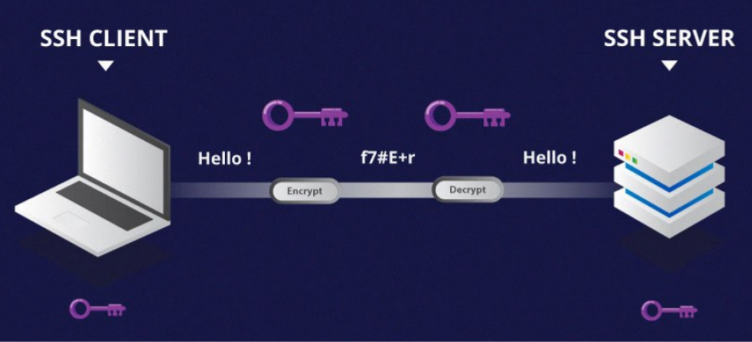
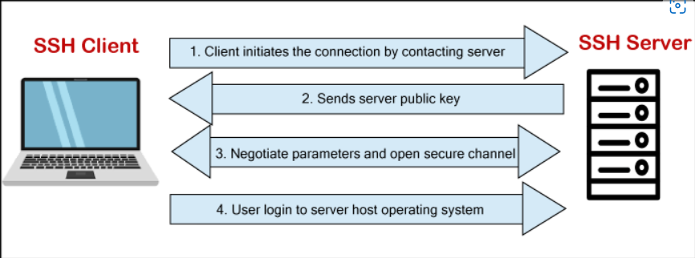
The ssh command provides a secure encrypted connection between two hosts over an insecure network. This connection can also be used for terminal access, file transfers, and for tunneling other applications.

Slide 3
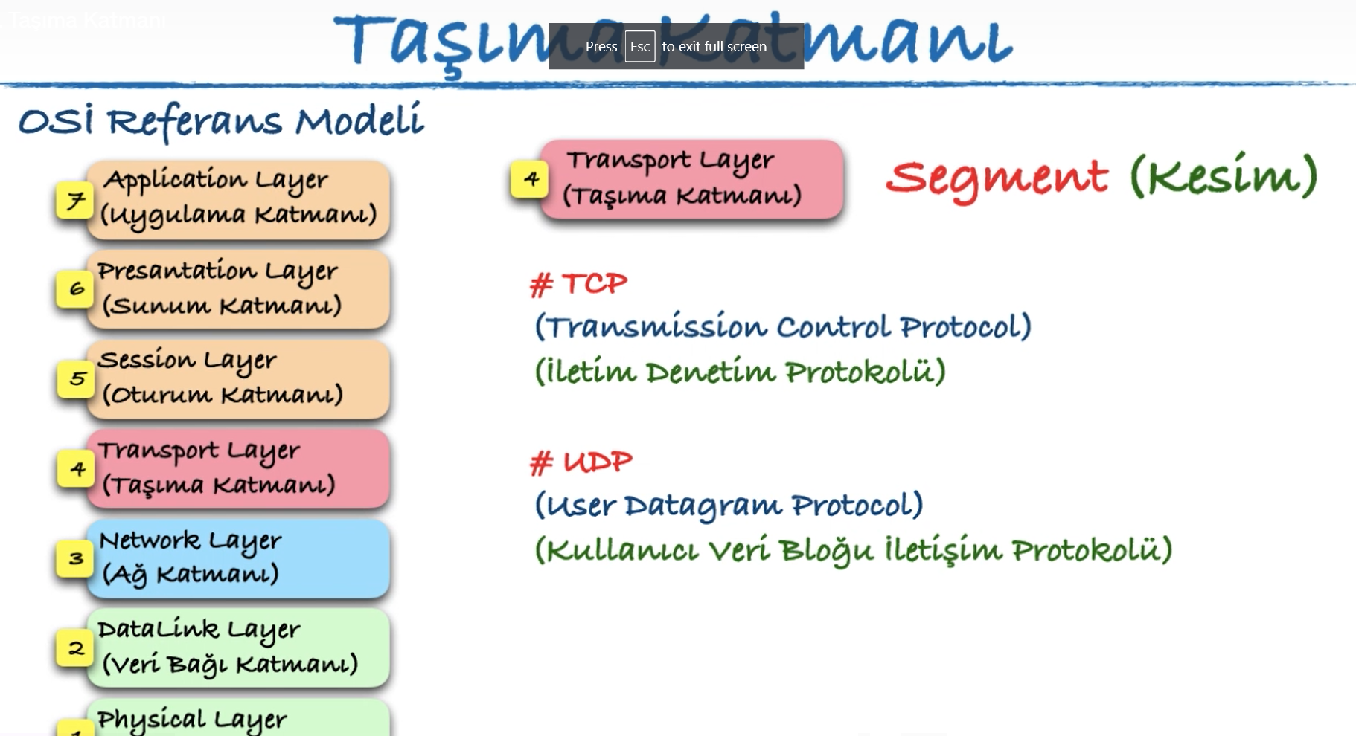
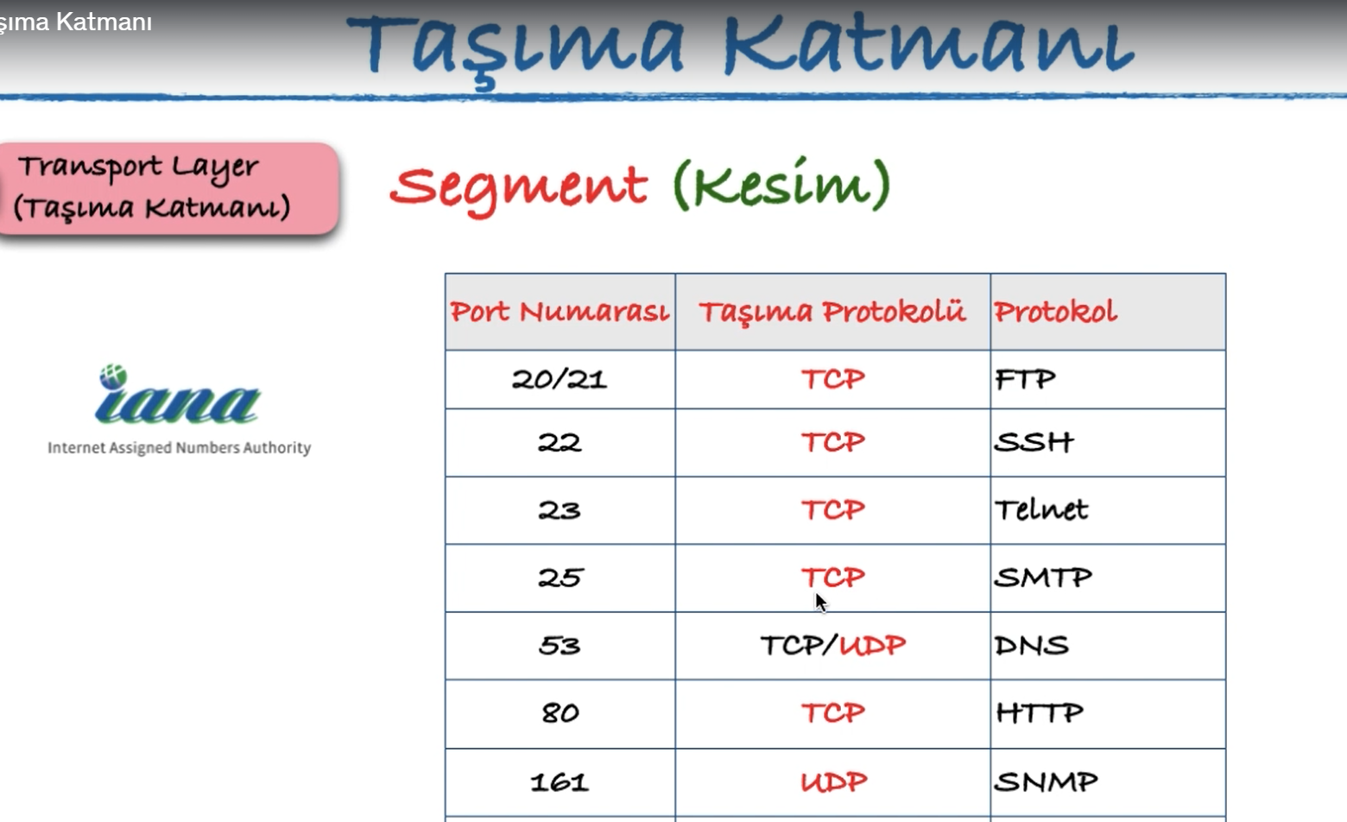

Slide 4
SSH tarafından kullanılan 3 farklı şifreleme teknolojisi bulunur:
Simetrik şifreleme
(Simetrik şifrelemede bir mesajın hem şifrelenmesi ve şifresinin çözülmesi için hem client hem de host tarafından aynı gizli anahtar kullanılır.)
Asimetrik şifreleme
(Simetrik şifrelemeden farklı olarak, asimetrik şifreleme yöntemi şifreleme ve şifreyi çözme işlemleri için iki farklı anahtar kullanır. Bu iki anahtar public key ve private key olarak bilinir.)
Hashing
(Secure Shell Bağlantılarında tek yönlü hashing de kullanılan şifreleme yöntemlerinden biridir. Bu yöntemle şifrelenen mesajları diğerlerinden farklı kılan özellik, mesajların asla çözülmesi gerekmemesidir.)

Slide 5
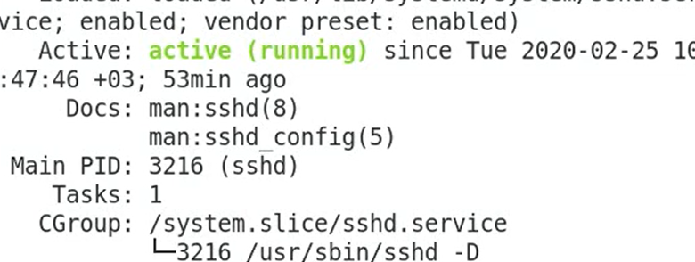
For windows ssh connection use PuTTY
sudo systemctl restart sshd
sudo system status sshd
ssh <username>@ipaddress

Slide 6
scp -i "C:\Users\99650\Desktop\firstkey.pem" -r Project-101/ ec2-user@52.23.232.204:/home/ec2-user

Slide 7
1. What are the different phases in DevOps?
Plan: Initially, there should be a plan for the type of application that needs to be developed. Getting a rough picture of the development process is always a good idea.
Code: The application is coded as per the end-user requirements.
Build: Build the application by integrating various codes formed in the previous steps.
Test: This is the most crucial step of the application development. Test the application and rebuild, if necessary.
Integrate: Multiple codes from different programmers are integrated into one.
Deploy: Code is deployed into a cloud environment for further usage. It is ensured that any new changes do not affect the functioning of a high traffic website.
Operate: Operations are performed on the code if required. Monitor - Application performance is monitored. Changes are made to meet the end-user requirements.

Slide 8
2. Explain the concept behind Infrastructure as Code (IaC).
Infrastructure as Code (IaC) is a process for managing and operating data servers, storage systems, system configurations, and network infrastructure.
In traditional configuration management practices, each minute configuration change required manual action by system administrators and the IT support team. But with IaC, all the configuration details are managed and stored in a standardized file system, wherein the system automatically manages infrastructure changes and deals with system configurations.
Therefore, we do not require most of the manual effort since everything is managed and automated by following the IaC approach. Tools such as Terraform or Ansible can be used to implement IaC approach.

Slide 9
3. How Terraform works?
Terraform produce an execution plan delineate, what it will do to reach the desired state, and then executes it to build the described infrastructure. As the configuration changes, Terraform is able to determine what changed and create incremental execution plans which can be applied.

Slide 10
4. What is difference between virtualization and containerization?
Containers provide an isolated environment for running the application. The entire user space is explicitly dedicated to the application. Any changes made inside the container is never reflected on the host or even other containers running on the same host. Containers are an abstraction of the application layer. Each container is a different application.
Whereas in Virtualization, hypervisors provide an entire virtual machine to the guest(including Kernal). Virtual machines are an abstraction of the hardware layer. Each VM is a physical machine.

Slide 11
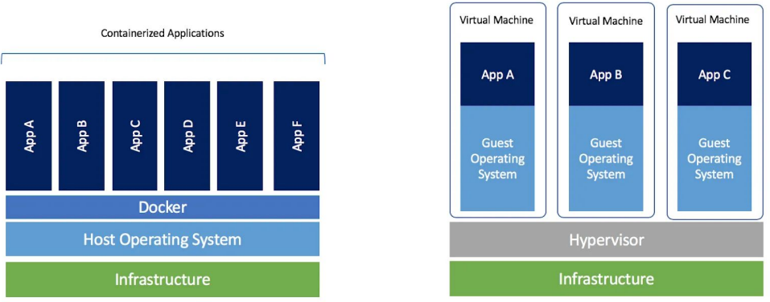

Slide 12
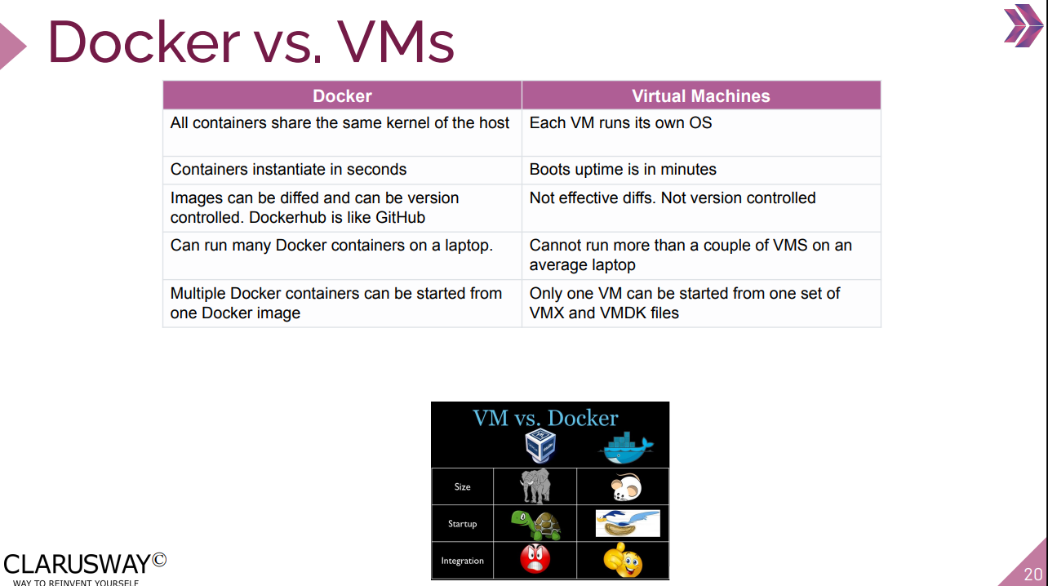

Slide 13
5. What are Docker Images?
Docker image is the source of Docker container. In other words, Docker images are used to create containers. When a user runs a Docker image, an instance of a container is created. These docker images can be deployed to any Docker environment.

