Slide 1
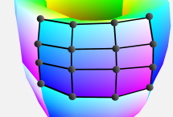













Proxy Ray
Computation
Spline Generation & Transformation
1
2
3
Clustering
Rendering
Spline Representation
Model Data
Splines
Arclength Parametrization
Transform (c)
$$r_{y}$$
$$r_{x}$$
$$x_{n}$$
Grid
$$x_{0}$$
$$r_{z}$$
Metric
Lookup (c) and ($θ$) for sample
Overshoot
Transformation
$$r_{z}$$
$$z$$
$$y$$
Proxy Rays
$$r_{y}$$
$$θ$$
Centroids (c) & Angles ($θ$)
$$r_{x}$$
Depth Peeling
Ray Marching
$$x$$
Preprocessing

