Slide 1

CATEGORIES OF DESIGN PATTERNS
Creational Design Patterns
Structural Design Patterns
Behavioral Design Patterns
Conclusion
Additional Resources

Slide 2
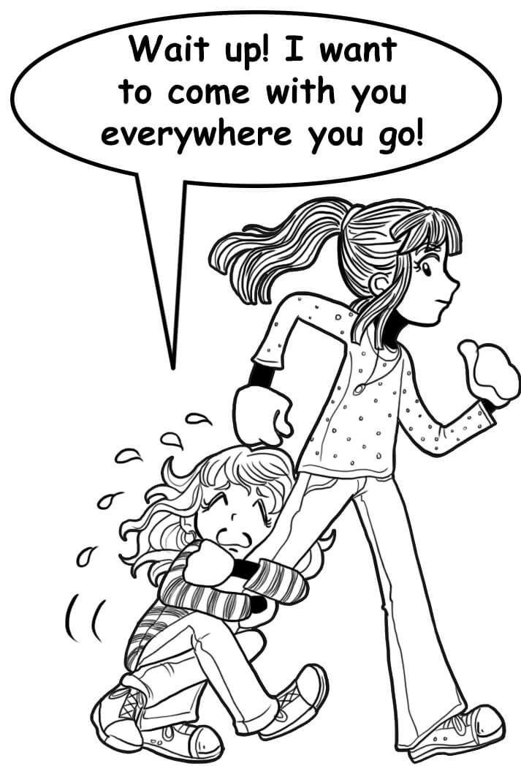

Creational Design Patterns
Notes:
Let's talk about the cool kids on the block - the creational design patterns. Now, I know what you're thinking: "Creational design patterns? That sounds about as fun as listening a elevator music". But let me tell you, these patterns are like the Willy Wonkas of the software engineering world.
Let me break it down for you. Creational design patterns are like the cool parents of programming. They're all about creating new objects and making sure everything is in its right place. It's like building your very own family of Lego people, complete with their own names and personalities.

Slide 3
🔍 Examples
💬 Singleton design pattern is like having a clingy best friend who never lets you hang out with anyone else.
🏭 Factory Method design pattern is like having your own personal assembly line for creating new objects.
🏢 Composite pattern. This is like having a Lego set that can build an entire city.
🍴 Abstract Factory design pattern is like being the head chef of a fancy restaurant.
Notes:
The Singleton design pattern is like having a clingy best friend who never lets you hang out with anyone else. This pattern ensures that there's only one instance of a particular object, so you don't have to worry about accidentally creating duplicates. It's like having a personal assistant who knows you so well that they finish your sentences.
The Factory Method design pattern is like having your own personal assembly line for creating new objects. This pattern defines an interface for creating objects, but lets the subclasses decide which class to instantiate. It's like having your own factory where you can customize each product to your heart's content.
And the last one, the Abstract Factory design pattern is like being the head chef of a fancy restaurant. This pattern lets you create families of related objects without specifying their concrete classes. It's like creating an entire menu of dishes, complete with all the ingredients and recipes.
So there you have it, folks. Creational design patterns are like the cool parents who let you build your own Lego family, and with patterns like Singleton, Factory Method, and Abstract Factory, you'll feel like you've got your own personal assistant, a factory of customization, and a fancy restaurant menu of code. So let's go forth and create some awesome objects!

Slide 4
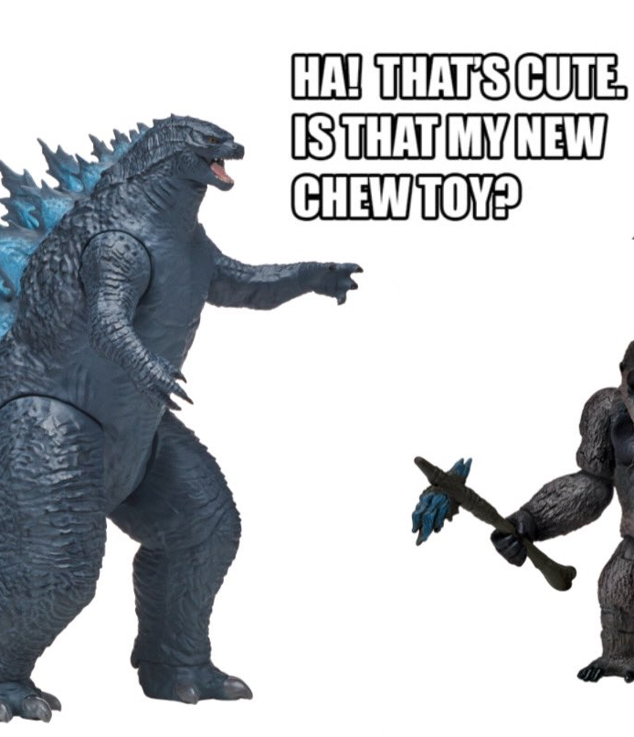

Sturctural Desıgn patterns
Notes:
Ladies and gentlemen, let's talk about structural design patterns. I know, I know, it sounds about as exciting as waiting for the phone to ring.
, but stick with me here.
Think of structural design patterns like a really sturdy Lego castle. You know, the kind that can withstand the wrath of your little sibling's Godzilla toy. These patterns are all about building a solid foundation and making sure that everything fits together just right.

Slide 5
🔍 Examples
🔌 Adapter pattern. This is like having a universal translator for your code.
🌉 Bridge pattern. This is like having a really fancy suspension bridge for your code
🏙️ Composite pattern. This is like having a Lego set that can build an entire city.
🧑‍💼 Facade pattern, which is like having a personal assistant for your code
🧱 Flyweight pattern. This is like having a really efficient Lego storage system
Notes:
First up, we've got the Adapter pattern. This is like having a universal translator for your code. The Adapter pattern lets you take two incompatible interfaces and make them work together seamlessly. It's like making sure that your French Legos can play nice with your German Legos.
Next, we've got the Bridge pattern. This is like having a really fancy suspension bridge for your code. The Bridge pattern lets you decouple an abstraction from its implementation, making it easier to modify and extend. It's like having a really flexible foundation for your Lego castle that can adapt to changes in terrain.
And then there's the Composite pattern. This is like having a Lego set that can build an entire city. The Composite pattern lets you treat individual objects and groups of objects in the same way, making it easier to work with complex hierarchies. It's like having a bunch of Lego blocks that can be combined to make a castle, a city, or even a giant robot.
But wait, there's more! We've also got the Facade pattern, which is like having a personal assistant for your code. The Facade pattern provides a simplified interface to a complex subsystem, making it easier to use and understand. It's like having a butler who takes care of all the behind-the-scenes work for you.
And last but not least, we've got the Flyweight pattern. This is like having a really efficient Lego storage system. The Flyweight pattern lets you share objects to reduce memory usage, making your code more efficient and faster. It's like having a really organized Lego storage bin that can hold all your Legos without taking up too much space.
So, there you have it. Adapter, Bridge, Composite, Facade, and Flyweight are just a few examples of the many structural design patterns out there. And who doesn't love a universal translator, a fancy bridge, a Lego city, a personal assistant, and an efficient storage system? So go forth and use those design patterns to build your sturdy, adaptable Lego castles of code.

Slide 6


Behavioral Design Patterns
Notes:
Alright, folks, let's talk about behavioral design patterns. I know, I know, you're thinking "Behavioral? That sounds like something my therapist would talk about." But don't worry, I promise this will be more fun than a therapy session.
So, think of behavioral design patterns like a group of friends trying to plan a road trip. You've got your organized friend who plans out every detail, your spontaneous friend who's always up for anything, and your indecisive friend who can't make up their mind.

Slide 7
🔍 Examples
🔍 Observer pattern is like the organized friend who always keeps everyone updated on what's going on
🤝 Chain of Responsibility pattern, which is like . You pass a problem from one friend to the next until someone finally takes responsibility for it.
👑 Command pattern is like your bossy friend who always tells everyone what to do.
😒 State pattern is like your moody friend who's always changing their mind.
💼 Strategy pattern, which is like having a bunch of different friends with different skills.
Notes:
The Observer pattern is like the organized friend who always keeps everyone updated on what's going on. They're like the group chat that you can't leave because you'll miss all the important updates.
Then there's the Chain of Responsibility pattern, which is like . You pass a problem from one friend to the next until someone finally takes responsibility for it. It's like, "Not it!" "Not it!" "Not it!" "Ugh, fine, I'll do it."
The Command pattern is like your bossy friend who always tells everyone what to do. "You drive, you pick the music, you stop for snacks." But hey, sometimes it's good to have someone take charge.
The State pattern is like your moody friend who's always changing their mind. One minute they're excited about the trip, the next minute they're ready to go home. The State pattern lets an object change its behavior when its internal state changes.
And finally, we have the Strategy pattern, which is like having a bunch of different friends with different skills. You can call on the friend with the best sense of direction for navigating, the friend who knows all the best restaurants for food recommendations, and the friend who's great at finding the best photo spots for Instagram. The Strategy pattern lets you choose the best algorithm for a particular task.
So, there you have it. Behavioral design patterns are like planning a road trip with your friends. You've got your organized friend, your spontaneous friend, your bossy friend, your moody friend, and your friend with different skills. And just like planning a road trip, using behavioral design patterns can make your code more flexible and adaptable.

Slide 8



Conclusıon
Notes:
Alright, folks, we've covered a lot of ground today talking about design patterns. It's been a wild ride, hasn't it? We compared design patterns to everything from Legos to nosy neighbors. But now, it's time to wrap things up and draw some conclusions.
So, what have we learned today? Well, we've learned that design patterns are like the secret sauce of software development. They're the special ingredients that make your code extra delicious. And just like a chef carefully chooses which ingredients to use in their dish, you should carefully choose which design patterns to use in your code.
We've also learned that design patterns come in three flavors: creational, structural, and behavioral. Creational design patterns are like the proud parents, structural design patterns are like the architects, and behavioral design patterns are like the therapists of the design pattern world.
But most importantly, we've learned that using design patterns can make your code more robust, more flexible, and more maintainable. It's like having a superhero costume for your code, ready to tackle any challenge that comes its way.
So, go forth and use those design patterns to make your code the hero it was always meant to be. And remember, just like a good chef, always use the right ingredients in the right amounts to get that perfect flavor.

Slide 9
Additional Resources
Design Patterns: Elements of Reusable Object-Oriented Software: This is the classic book on design patterns, written by the "Gang of Four" (Erich Gamma, Richard Helm, Ralph Johnson, and John Vlissides). It's a must-read for any software engineer interested in design patterns. Link: https://www.amazon.com/Design-Patterns-Elements-Reusable-Object-Oriented/dp/0201633612
Head First Design Patterns: This is a fun and engaging book on design patterns, with a focus on practical examples and real-world applications. It's a great resource for those who prefer a more visual and interactive approach to learning. Link: https://www.amazon.com/Head-First-Design-Patterns-Brain-Friendly/dp/0596007124
Refactoring Guru: This website provides a comprehensive overview of design patterns, with examples in various programming languages. It's a great resource for those who prefer online tutorials and visual aids. Link: https://refactoring.guru/design-patterns
Design Patterns in Python: This is a GitHub repository that provides examples of various design patterns in Python. It's a great resource for those who prefer to learn by doing and exploring code examples. Link: https://github.com/faif/python-patterns
Design Patterns Game: This is a fun and interactive way to learn about design patterns. It's a game that challenges you to identify design patterns in code examples, with points and rewards for correct answers. Link: https://gameful.design/games/5980e0c28adad20400c960b5

