Slide 1
Introduction
What are Design Patterns? 🤔
Categories of Design Patterns 📂 Examples of Design Patterns 💡 Benefits of Using Design Patterns 🎉 How to Choose the Right Design Pattern 🤔 Anti-patterns 😱 Conclusion and Next Steps 🚀

Slide 2
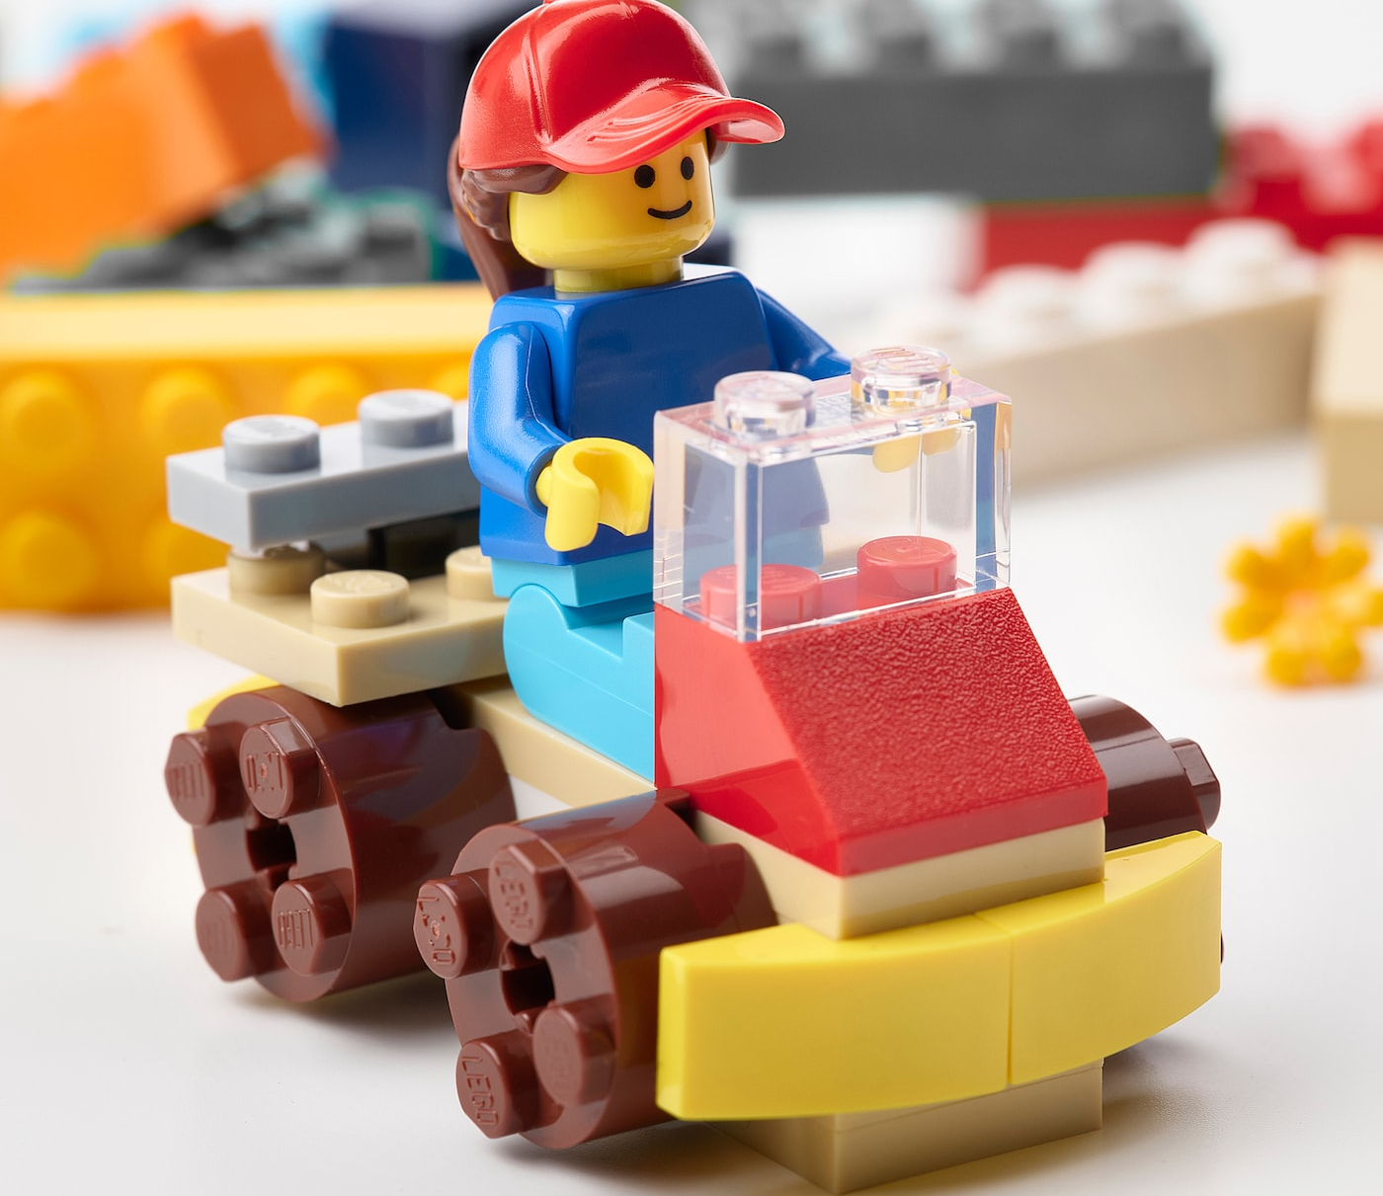
What are Design Patterns? 🤔
🧱 Design patterns are a way of putting together different programming concepts to create a more complex solution.
🚀 Design patterns give you a set of instructions to follow and help you build something awesome.
🔨 There are different types of design patterns, including creational, structural, and behavioral design patterns, that you can use depending on the problem you're trying to solve.
Notes:
"Alright, let's talk about the big question: what the heck are design patterns? Well, let me break it down for you with an analogy that I think we can all relate to: Legos.
Yes, Legos. You know those colorful little bricks that you used to play with as a kid (or maybe still do, no judgment here)? Well, think of design patterns like Legos. Just like how you can take individual Lego blocks and put them together to create something bigger and more complex, design patterns are a way of putting together different programming concepts to create a more complex solution.
Let's say you want to build a cool spaceship out of Legos. You start with a base, and then you add wings, thrusters, and all kinds of other cool stuff. But here's the thing: you can't just throw all the pieces together and hope for the best. You need to follow a set of instructions that tell you which pieces to use and how to put them together. That's exactly what design patterns do for your code. They give you a set of instructions, a blueprint to follow, to help you build something awesome.
And just like how Legos come in different shapes and sizes, there are different types of design patterns that you can use depending on the problem you're trying to solve. Creational design patterns are like the basic Lego blocks, giving you a foundation to build on. Structural design patterns are like the connectors and joints that hold everything together. And behavioral design patterns are like the specialized pieces that give your creation unique functionality.
So, there you have it. Design patterns are like Legos, a way of putting together different programming concepts to create something bigger and more complex. And who doesn't love Legos? So go forth and build something awesome with your newfound design pattern knowledge!"

Slide 3
Categories of Design Patterns
🏰 Structural design patterns focus on building a solid foundation and making sure that everything fits together just right.
👪 Creational design patterns are all about creating new objects and giving you the foundation to build your own unique objects and customize them to your heart's content.
🧑‍🤝‍🧑 Behavioral design patterns are about how objects interact with each other and making sure that everyone plays nicely together.
🔨 Design patterns give your code structure, support, and flexibility to make it easier to add new features and modify existing ones.
Notes:
"Alright, folks, it's time to dive into the three categories of design patterns: creational, structural, and behavioral. Now, I know what you're thinking: 'Wow, those categories sound about as exciting as watching paint dry.' But trust me, this stuff is actually pretty cool (well, as cool as software engineering can get).
First up, we've got creational design patterns. These are like the proud parents of the design pattern world. They're all about creating new objects and making sure that everything is in its right place. It's like building a family of Lego people, complete with their own names and personalities. Creational design patterns give you the foundation you need to build your own unique objects and customize them to your heart's content.
Next, we've got structural design patterns. These are like the architects of the design pattern world. They're all about building a solid foundation and making sure that everything fits together just right. It's like building a massive Lego castle that's so sturdy, you could stand on it. Structural design patterns give your code structure and support, making it easier to add new features and modify existing ones.
And last but not least, we've got behavioral design patterns. These are like the therapists of the design pattern world. They're all about how objects interact with each other and making sure that everyone plays nicely together. It's like a group therapy session for your code. Behavioral design patterns help you manage complex interactions between objects and make your code more flexible and adaptable.
So, there you have it. Creational, structural, and behavioral design patterns are like proud parents, architects, and therapists of the design pattern world. They give you the foundation you need to build your own unique objects, the structure to support them, and the therapy to make sure they get along. And who doesn't love a good family, castle, and therapy session? So go forth and use those design patterns, my friends!"

Slide 4
Examples of Design Patterns 💡
🧑‍🤝‍🧑 The Singleton pattern ensures there's only one instance of a particular object, preventing accidental duplicates.
🎩 The Decorator pattern lets you add new functionality to an existing object without modifying its structure, like putting a fancy hat on top of a boring outfit to make it stylish.
🏭 The Factory Method pattern lets subclasses decide which class to instantiate, creating a personal assembly line for creating new objects.
👀 The Observer pattern lets you define a one-to-many dependency between objects so that changes to one object update all its dependents automatically, like having nosy neighbors who always know what's going on in your life.
🎒 The Strategy pattern lets you define a family of algorithms, encapsulate each one, and make them interchangeable, like having a Swiss Army Knife for your code.
Notes:
"Okay folks, let's get down to the nitty-gritty and talk about some examples of design patterns. I know, I know, this sounds about as exciting as watching paint dry (or worse, watching your code compile). But trust me, there are some pretty cool examples out there.
First up, we've got the Singleton design pattern. This is like having a really overprotective best friend who never lets you hang out with anyone else. The Singleton pattern ensures that there's only one instance of a particular object, so you don't have to worry about accidentally creating duplicates.
Next, we've got the Decorator design pattern. This is like putting a fancy hat on top of a boring outfit to make it look more stylish. The Decorator pattern lets you add new functionality to an existing object without modifying its structure. It's like magic, but for code.
And then there's the Factory Method design pattern. This is like having your own personal assembly line for creating new objects. The Factory Method pattern defines an interface for creating objects, but lets the subclasses decide which class to instantiate. It's like having a factory where you can customize each product to your heart's content.
But wait, there's more! We've also got the Observer pattern, which is like having a bunch of nosy neighbors who always know what's going on in your life. The Observer pattern lets you define a one-to-many dependency between objects, so when one object changes state, all of its dependents are notified and updated automatically.
And last but not least, we've got the Strategy pattern. This is like having a whole bag of tricks up your sleeve, ready to handle any situation. The Strategy pattern lets you define a family of algorithms, encapsulate each one, and make them interchangeable. It's like having a Swiss Army Knife for your code.
So, there you have it. Singleton, Decorator, Factory Method, Observer, and Strategy are just a few examples of the many design patterns out there. And who doesn't love having a fancy best friend, a magic hat, a personal assembly line, nosy neighbors, and a bag of tricks? So go forth and use those design patterns, my friends!"

Slide 5
Benefits of Using Design Patterns 🎉
🚀 Improved code quality: using design patterns can help you write more maintainable, readable, and extensible code, which means fewer bugs and happier developers.
🔄 Code reusability: design patterns can help you write code that's reusable across different projects, which means less time spent reinventing the wheel and more time spent building cool stuff.
🤝 Improved team communication: design patterns provide a common language and framework for your team to work with, which means fewer misunderstandings and more high-fives all around.
Notes:
Alright folks, let's talk about why you should care about using design patterns. I know, I know, it sounds about as exciting as watching paint dry (or worse, sitting in a meeting that could have been an email). But trust me, there are some pretty cool benefits to using design patterns.
First off, we've got improved code quality. This is like having a personal trainer for your code, making sure it's always in tip-top shape. Design patterns can help you write more maintainable, readable, and extensible code, which means fewer bugs and happier developers (and nobody wants grumpy developers, am I right?).
Next, we've got code reusability. This is like having a Swiss Army Knife for your code, with all the tools you need right at your fingertips. Design patterns can help you write code that's reusable across different projects, which means less time spent reinventing the wheel and more time spent building cool stuff.
And then there's code flexibility. This is like having a yoga instructor for your code, making sure it's always ready to bend and stretch to meet new requirements. Design patterns can help you write code that's more adaptable to changes in the future, which means less headaches and fewer late nights spent refactoring.
But wait, there's more! We've also got improved team communication. This is like having a really awesome game plan for your team, with everyone working together towards a common goal. Design patterns provide a common language and framework for your team to work with, which means fewer misunderstandings and more high-fives all around.
And last but not least, we've got improved job prospects. This is like having a golden ticket to the chocolate factory of software engineering. Design patterns are a fundamental concept in software engineering, and knowing how to use them can make you stand out in a sea of job candidates.
So, there you have it. Improved code quality, code reusability, code flexibility, improved team communication, and improved job prospects are just a few of the benefits of using design patterns. And who doesn't love happy developers, a Swiss Army Knife for their code, a yoga instructor for their code, an awesome game plan for their team, and a golden ticket to the chocolate factory of software engineering? So go forth and use those design patterns

Slide 6
How to Choose the Right Design Pattern 🤔
🍕 Understand the problem: ask yourself what problem you're trying to solve, and choose a design pattern that fits the problem. Each design pattern is like a different pizza topping, and you need to pick the right one for the job.
📈 Think about scalability: choose a design pattern that's not too rigid or too complex, but scalable to accommodate growth and modifications in your code.
🔧 Consider performance: choose a design pattern that's efficient and doesn't slow down your code. You want to avoid angry users and ensure that your code performs well.
Notes:
Alright folks, let's talk about the age-old question: how do you choose the right design pattern for your code? I know, I know, it sounds about as exciting as watching grass grow (or worse, listening to elevator music). But trust me, there are some pretty cool tips and tricks for choosing the right design pattern.
First up, you gotta ask yourself: what problem am I trying to solve? This is like trying to figure out what kind of pizza to order (which is always an important decision, let's be real). Each design pattern is like a different kind of pizza topping, and you need to pick the right one for the job. Are you trying to create a new object? Use a creational pattern. Are you trying to add new functionality to an existing object? Use a structural pattern. Are you trying to manage interactions between objects? Use a behavioral pattern.
Next, you gotta think about scalability. This is like trying to plan a party without knowing how many people are gonna show up. You don't want to use a design pattern that's too rigid and inflexible, or you'll end up with a mess when your code starts growing. On the other hand, you don't want to use a design pattern that's too complex and over-engineered, or you'll end up with a headache when you try to modify it.
And then there's reusability. This is like trying to convince your friend to let you borrow their awesome shirt. You want to use a design pattern that's reusable across different projects and scenarios, so you don't have to keep reinventing the wheel every time you start a new project. Plus, who doesn't love a good hand-me-down (especially if it's a cool design pattern)?
But wait, there's more! We've also got complexity. This is like trying to figure out how to play a new board game (which, let's be honest, can be pretty confusing). You don't want to use a design pattern that's too complex and difficult to understand, or you'll end up with a bunch of developers scratching their heads and wondering what the heck is going on.
And last but not least, there's performance. This is like trying to run a marathon in flip-flops (not recommended, by the way). You want to use a design pattern that's efficient and doesn't slow down your code, otherwise you'll end up with a bunch of angry users (and nobody wants angry users).
So, there you have it. When choosing the right design pattern, you gotta think about the problem you're trying to solve, scalability, reusability, complexity, and performance. And who doesn't love pizza toppings, party planning, hand-me-downs, board games, and marathon running? So go forth and choose those design patterns

Slide 7
Anti-patterns 😱
🍝 Watch out for Spaghetti Code: this anti-pattern occurs when your code is so tangled and convoluted that you can't even figure out what's going on. It's like a big mess of code noodles that nobody wants to eat.
🦸 Beware of the God Object: this anti-pattern happens when you have a single object that has way too much responsibility and functionality. It's like a superhero who's so powerful that nobody else even gets a chance to save the day.
🔢 Avoid Magic Numbers: this anti-pattern happens when you hard-code values into your code instead of using constants or variables. It's like trying to play a game without knowing the rules.
Notes:
Alright folks, it's time to talk about the dark side of design patterns: anti-patterns. I know, I know, it sounds about as scary as watching a horror movie alone in the dark (or worse, working with legacy code). But trust me, there are some pretty cool examples of anti-patterns out there.
First up, we've got the Spaghetti Code anti-pattern. This is like trying to untangle a bunch of noodles without a fork (which, let's be honest, is pretty challenging). The Spaghetti Code anti-pattern happens when your code is so tangled and convoluted that you can't even figure out what's going on. It's like a big mess of code noodles that nobody wants to eat.
Next, we've got the God Object anti-pattern. This is like having a single superhero who can do everything, and nobody else even gets a chance to shine. The God Object anti-pattern happens when you have a single object that has way too much responsibility and functionality. It's like a superhero who's so powerful that nobody else even gets a chance to save the day.
And then there's the Magic Number anti-pattern. This is like playing a game of Simon Says without knowing what Simon says. The Magic Number anti-pattern happens when you hard-code values into your code instead of using constants or variables. It's like trying to play a game without knowing the rules.
But wait, there's more! We've also got the Golden Hammer anti-pattern. This is like trying to fix every problem with a single tool, no matter how inappropriate it is (like using a hammer to fix a computer). The Golden Hammer anti-pattern happens when you use the same solution for every problem, even if it's not the best solution. It's like trying to fix every problem with a single tool, no matter how inappropriate it is (like using a hammer to fix a computer).
And last but not least, we've got the Copy-Paste anti-pattern. This is like trying to make a cake by copying and pasting random ingredients from different recipes. The Copy-Paste anti-pattern happens when you copy and paste code instead of creating reusable functions or classes. It's like trying to make a cake by copying and pasting random ingredients from different recipes (which, let's be honest, probably won't end well).
So, there you have it. Spaghetti Code, God Object, Magic Number, Golden Hammer, and Copy-Paste are just a few examples of the many anti-patterns out there. And who doesn't love code noodles, superhero showdowns, games of Simon Says, inappropriate tools, and cake disasters? So go forth and avoid those anti-patterns,

Slide 8
Conclusion and Next Steps 🚀
Benefits of using design patterns: happy developers and golden tickets to the chocolate factory of software engineering 🍫🎫😃
Resources to help you learn more about design patterns: books, blogs, videos, and courses 📚💻🎥
Reminder to use design patterns wisely and appropriately, and to have fun with them 🤔💡😄
Notes:
Well folks, we've covered a lot of ground today. We've talked about what design patterns are (and how they're like our best friends), the benefits of using them (like happy developers and golden tickets to the chocolate factory of software engineering), the different categories of design patterns (like proud parents, architects, and therapists), and even the dark side of anti-patterns (like code noodles and superhero showdowns gone wrong).
So, what's next? Well, first of all, give yourselves a round of applause for sticking with me through all of this (and hopefully laughing at some of my terrible jokes). Second, it's time to start using those design patterns! Whether you're working on a new project or trying to refactor some old code, design patterns are a powerful tool in your arsenal.
But wait, there's more! If you're looking to dive deeper into the world of design patterns, there are plenty of resources out there to help you. There are books, blogs, videos, and even courses like this. So go forth and keep learning, my friends!
And last but not least, remember that design patterns are just one tool in your toolkit. They're not a magic solution that will solve all your problems (unlike duct tape, which is a magic solution that will solve all your problems). So use them wisely, use them appropriately, and above all, have fun with them.
So, there you have it. We've covered a lot of ground today, and hopefully, you've learned something new (or at least gotten a few chuckles). So go forth and design those patterns

