Slide 1
Reproducible Research and Literate Statistical Programming (with knitr)
Roger D. Peng, PhD
Department of Biostatistics
Johns Hopkins Bloomberg School of Public Health
University of Minnesota
April 2013

Slide 2
Replication
The ultimate standard for strengthening scientific evidence is replication of findings and conducting studies with independent
Investigators
Data
Analytical methods
Laboratories
Instruments
Replication is particularly important in studies that can impact broad policy or regulatory decisions

Slide 3
What’s Wrong with Replication?
Some studies cannot be replicated
No time, opportunistic
No money
Unique
Reproducible Research: Make analytic data and code available so that others may reproduce findings

Slide 4
How Can We Bridge the Gap?
Replication
?
Nothing

Slide 5
How Can We Bridge the Gap?
Replication
Reproduciblity
Nothing

Slide 6
Why Do We Need Reproducible Research Now?
New technologies increasing data collection throughput; data are more complex and extremely high dimensional
Existing databases can be merged into new “megadatabases”
Computing power is greatly increased, allowing more sophisticated analyses
For every field “X” there is a field “Computational X”

Slide 7
Example: Reproducible Air Pollution and Health Research
Estimating small (but important) health effects in the presence of much stronger signals
Results inform substantial policy decisions, affect many stakeholders
EPA regulations can cost billions of dollars
Complex statistical methods are needed and subjected to intense scrutiny

Slide 8
Research Pipeline
Article
Reader

Slide 9
Research Pipeline
Author
Presentation code
Processing code
Analytic code
Figures
Measured Data
Analytic Data
Computational Results
Tables
Article
Numerical Summaries
Text
Reader

Slide 10

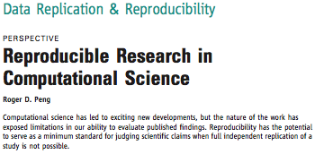
Recent Developments in Reproducible Research

Slide 11
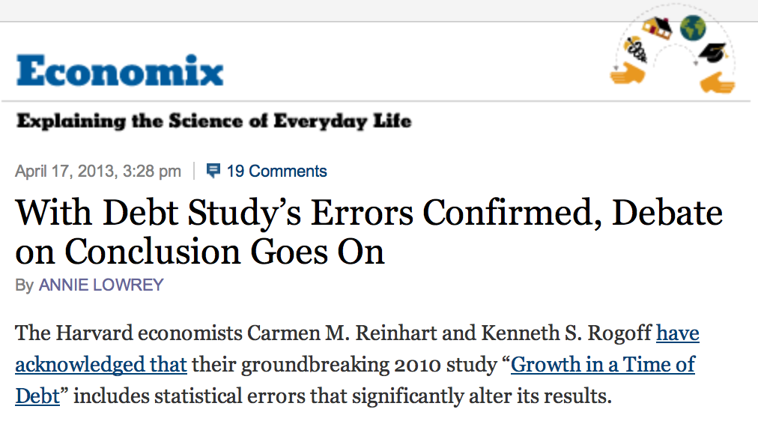
Recent Developments in Reproducible Research

Slide 12

Recent Developments in Reproducible Research
The Duke Saga
http://goo.gl/hijaN

Slide 13
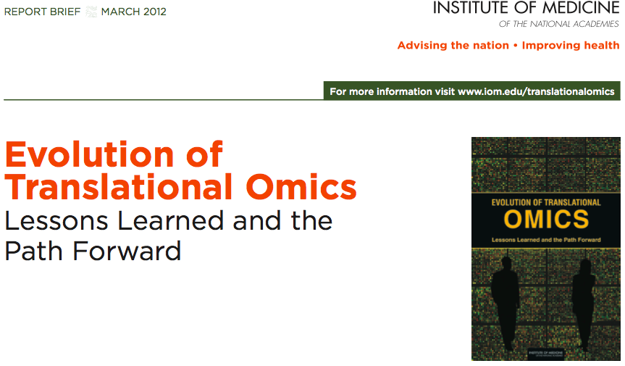
Recent Developments in Reproducible Research
http://goo.gl/ZllJa

Slide 14
The IOM Report
In the Discovery/Test Validation stage of omics-based tests:
Data/metadata used to develop test should be made publicly available
The computer code and fully specified computational procedures used for development of the candidate omics-based test should be made sustainably available
“Ideally, the computer code that is released will encompass all of the steps of computational analysis, including all data preprocessing steps, that have been described in this chapter. All aspects of the analysis need to be transparently reported.”

Slide 15
When Can Research be Reproducible?
Analytic data are available
Analytic code are available
Standard means of distribution
Documentation of code and data

Slide 16
Literate (Statistical) Programming
An article is a stream of text and code
Analysis code is divided into text and code “chunks”
Each code chunk loads data and computes results
Presentation code formats results (tables, figures, etc.)
Article text explains what is going on
Literate programs can be weaved to produce human-readable documents and tangled to produce machine-readable documents

Slide 17
Literate (Statistical) Programming
Literate programming is a general concept that requires
A documentation language (human readable)
A programming language (machine readable)
Sweave uses L^{A}T_{E}X and R as the documentation and programming languages
Sweave was developed by Friedrich Leisch (member of the R Core) and is maintained by R core
Main web site: http://www.statistik.lmu.de/ ̃leisch/Sweave

Slide 18
Sweave Limitations
Sweave has many limitations
Focused primarily on LaTeX, a difficult to learn markup language used only by weirdos
Lacks features like caching, multiple plots per chunk, mixing programming languages and many other technical items
Not frequently updated or very actively developed

Slide 19
Literate (Statistical) Programming
knitr is an alternative (more recent) package
Brings together many features added on to Sweave to address limitations
knitr uses R as the programming language (although others are allowed) and variety of documentation languages
LaTeX, Markdown, HTML
knitr was developed by Yihui Xie (graduate student in statistics at Iowa State)
See http://yihui.name/knitr/

Slide 20
What is LSP good for?
Manuals
Short/medium-length technical documents
Tutorials
Reports (esp. if generated periodically)
Data preprocessing documents/summaries

Slide 21
What is LSP NOT good for?
Long research articles
Complex time-consuming computations (i.e. long MCMC, optimizations)
Documents that require precise formatting
Books (although can be done with use of other tools)

Slide 22
Using knitr
Toolchain
Text editor
R
knitr package (from CRAN via install.packages)
An appropriate document viewer (PDF viewer, web browser)
pandoc (optional)
Easiest to use RStudio where knitr (and Sweave) are already integrated

Slide 23
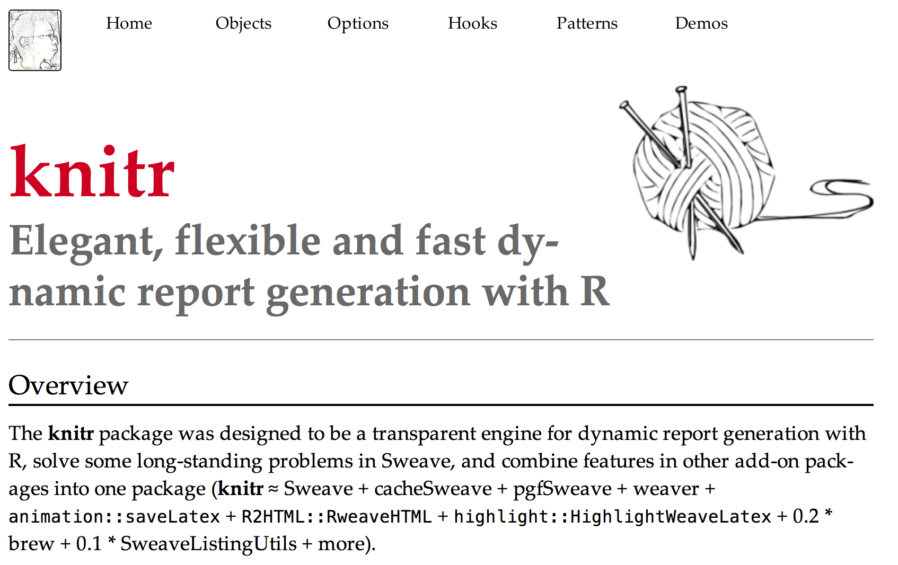
knitr
http://yihui.name/knitr

Slide 24
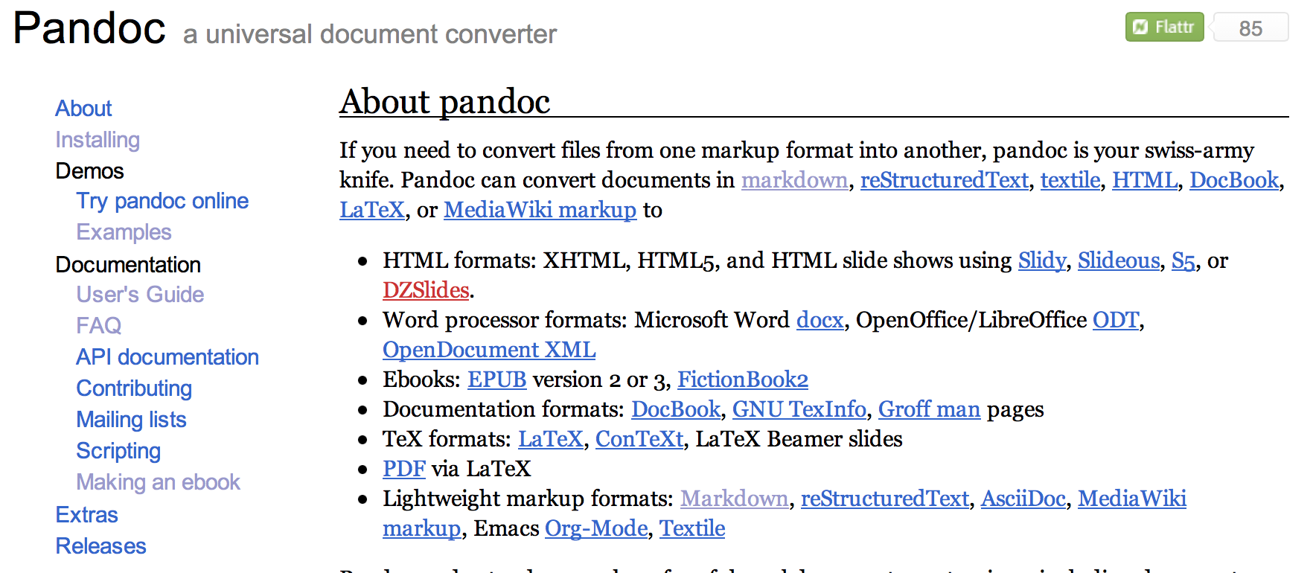
Pandoc
http://johnmacfarlane.net/pandoc/

Slide 25
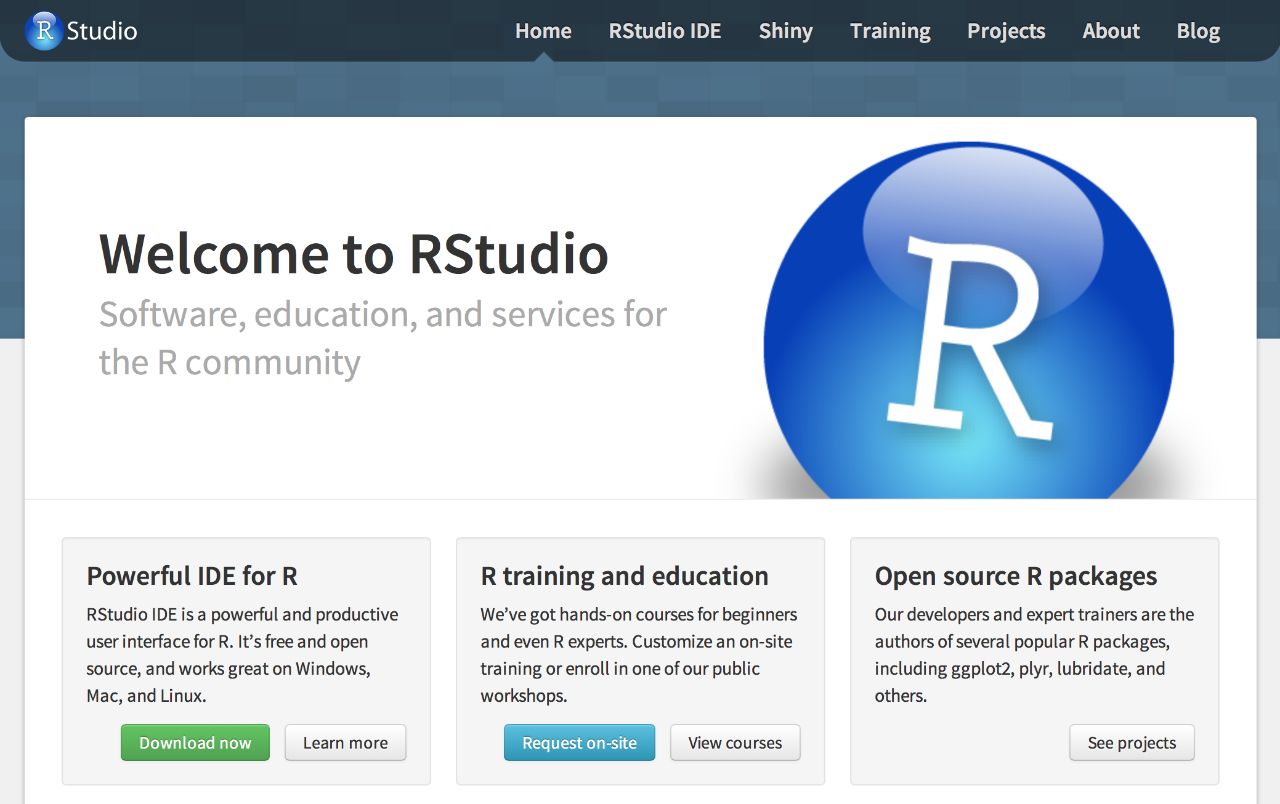
RStudio
http://www.rstudio.com

Slide 26
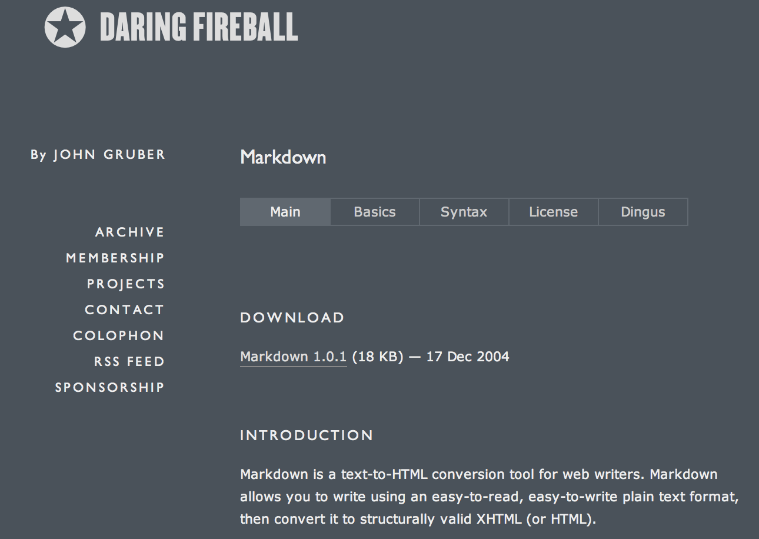
Markdown
http://daringfireball.net/projects/markdown/

Slide 27
Markdown
A simpler version of “markup” languages
Written in simple text format
Has minimal formatting indicators
Tools support converting it to many other formats (pandoc)

Slide 28
Markdown
# indicates a first-level header
## second-level header
### third-level header
Indentation can be used to create an ordered (with numbers) or unordered (with non-numbers) list

Slide 29
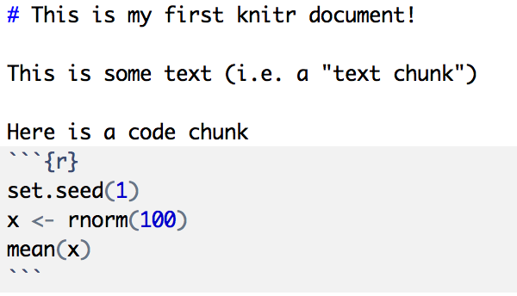
Your First R Markdown Document

Slide 30
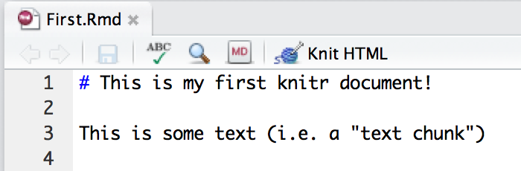
Processing R Markdown

Slide 31
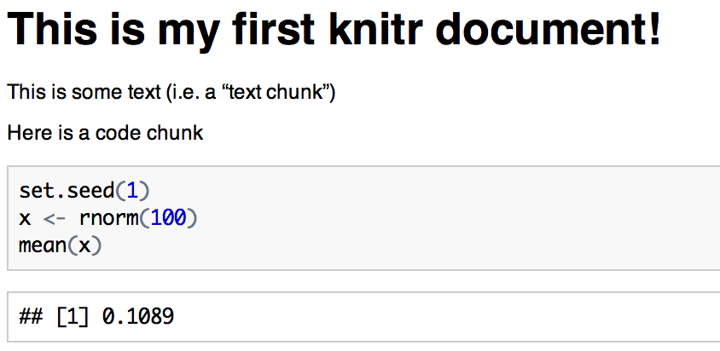
Resulting HTML Document

Slide 32
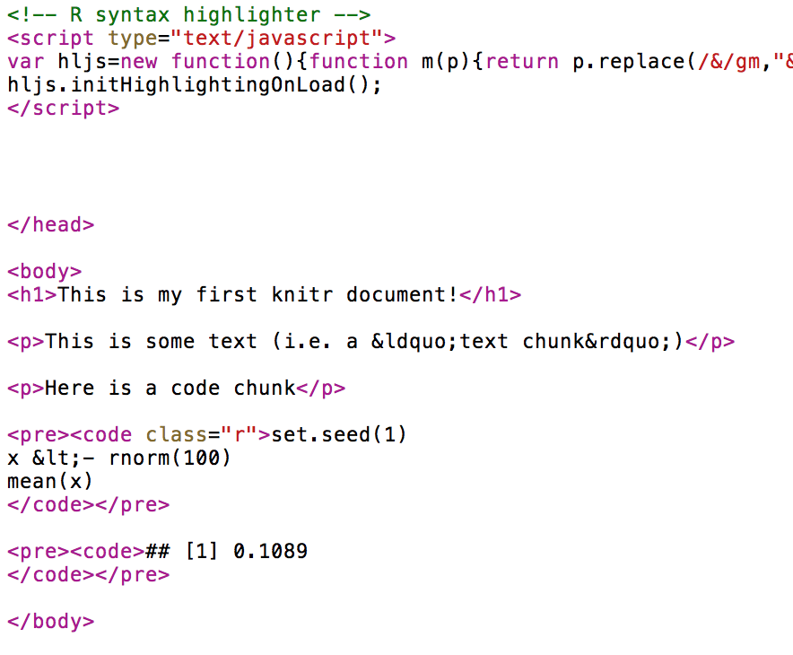
Under the Hood

Slide 33
A Few Notes
Code chunks begin with ```{r} on a line by itself and end with ``` on a line by itself
All R code goes in between
Code chunks can have names, which is useful when making plots
By default, code in a code chunk will be echoed, as will the result of the computation (if there is anything to print)

Slide 34
Processing R Markdown Documents
The order is
First.Rmd (written by you!)
First.md (created by knitr)
First.html (created by knitr)
The .md file (and the .html file) are not things we care about and should not be edited
Always edit the .Rmd file

Slide 35
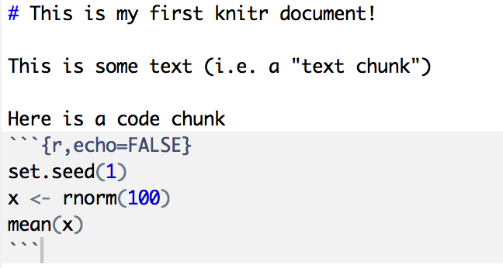
Chunk Options

Slide 36
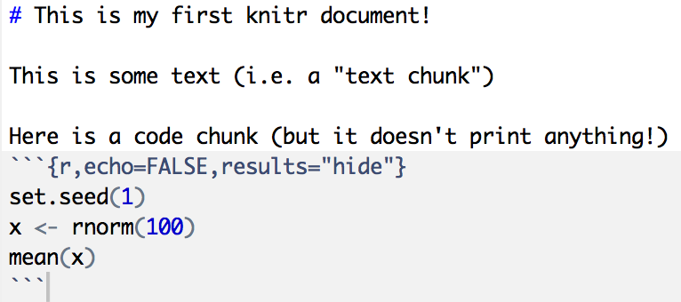
Chunk Options

Slide 37

Chunk Options

Slide 38
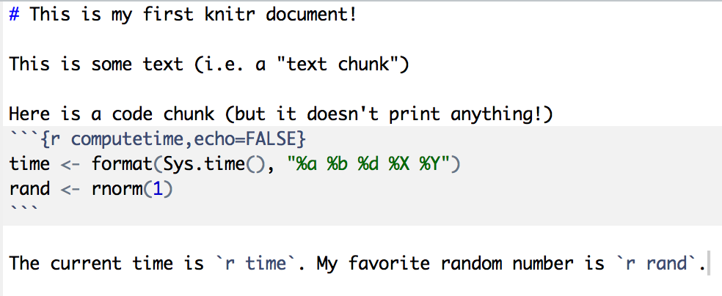
Inline Computation
(NOTE: Look at ?strptime for a list of all the date/time format codes.)

Slide 39
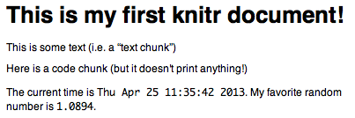
Inline Computation

Slide 40
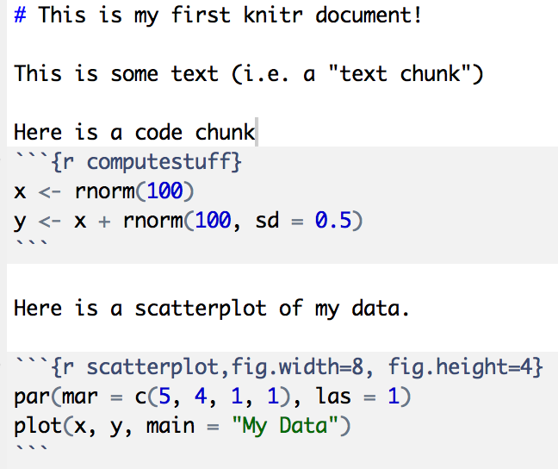
Graphics

Slide 41
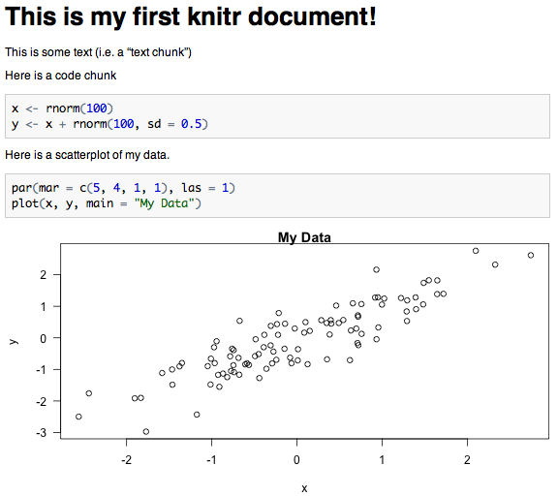
Graphics

Slide 42
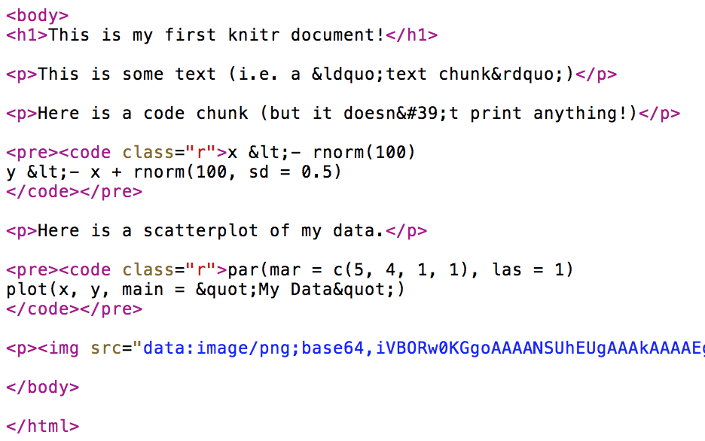
Graphics: What knitr Produces

Slide 43
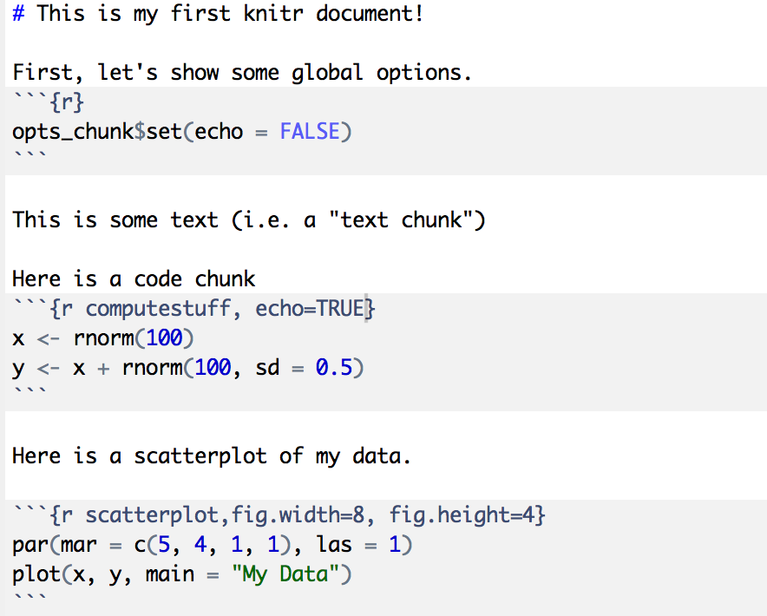
Setting Global Options

Slide 44
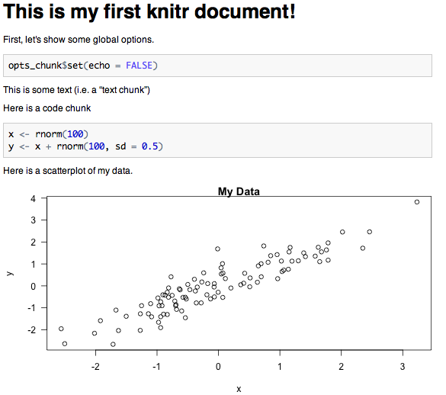
Setting Global Options

Slide 45
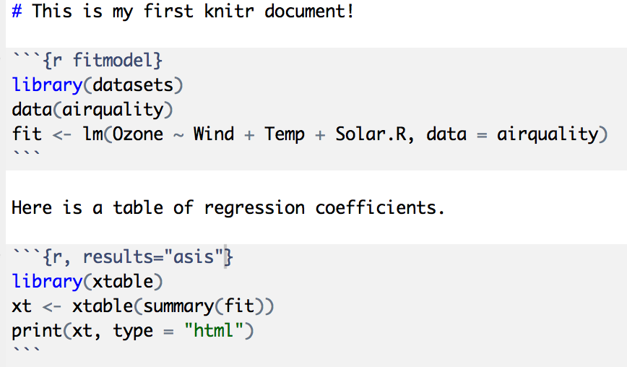
Making Tables with xtable
Very important!

Slide 46
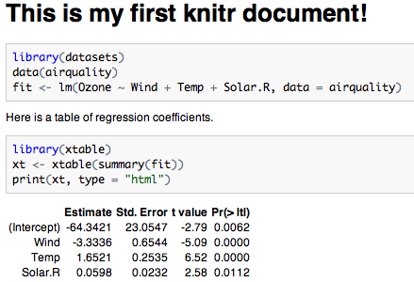
Making Tables with xtable

Slide 47
Caching Long Computations
Important for long documents with complex computations
Set ‘cache = TRUE’ in chunk option to cache results
Code has to be run once; results are then stored in a key-value database
On subsequent runs, results are loaded from database rather than execute code
If code changes, results are re-run
Dependencies can be specified via ‘dependson’

Slide 48
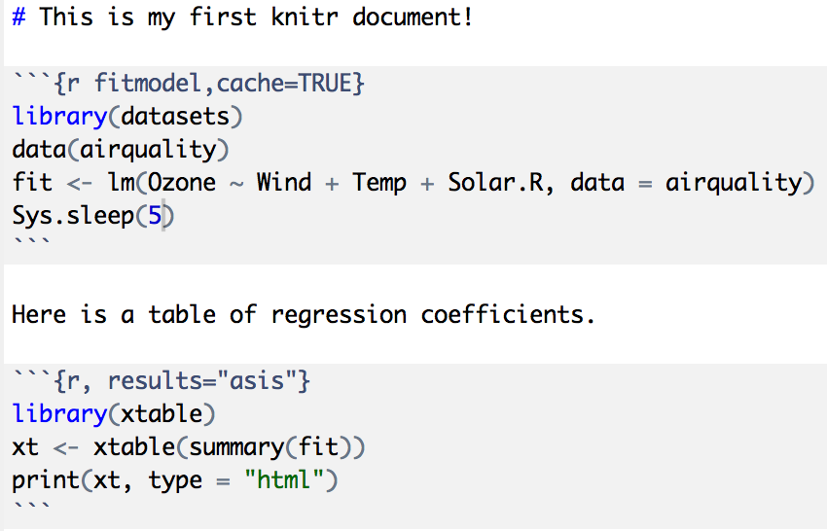
Caching Long Computations

Slide 49
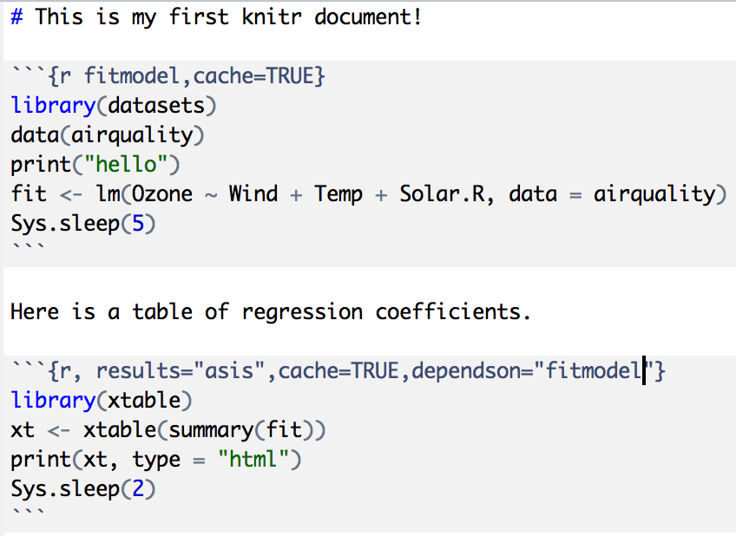
Caching Long Computations

Slide 50
Summary of Basic Options
Controlling Output
results: “markup”, “asis”, “hide”
echo: TRUE, FALSE
eval: TRUE, FALSE
Figures
fig.width: width of plot (passed to graphics dev)
fig.height: height of plot
fig.path: directory to put figures (“figure/”)

Slide 51
Reproducibility: The Bigger Picture
Reproducibility is not just about using individual tools
Need a “reproducible workflow” that incorporates a number of other tools/practices
Version control: git, svn, cvs (!)
Software versioning, regression/unit testing

Slide 52
Thank you!

