Slide 1

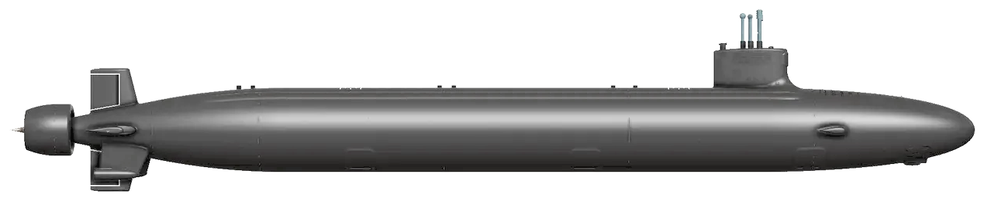
FINAL PRESENTATION
ECHO
Adventure
Building a 10-minute shipyard decision game with AI.
Notes:
Open with the project name and the scope: a short decision game created with AI-assisted development.
[Sources]
- /Users/matthew/echo_adventure/instructions.md
- /Users/matthew/echo_adventure/echo_adventure/ui/assets/logos/echo-logo-full.png
- /Users/matthew/echo_adventure/echo_adventure/ui/assets/virginia-submarine-cutout.png
[/Sources]

Slide 2
A 10-minute game built to prove one point
PROJECT INTRO
An Oregon Trail-style choose-your-own-adventure built around daily shipyard decisions. Complete every job as quickly as possible—and see whether you can keep pace with ECHO.
20
DAILY
~10
jobs to complete
shipyard decisions
minutes per run
2
Notes:
Introduce the core loop: daily choices affect 20 jobs, and the short play time keeps the comparison with ECHO immediate.
[Sources]
- /Users/matthew/echo_adventure/instructions.md
- /Users/matthew/echo_adventure/README.md
[/Sources]

Slide 3
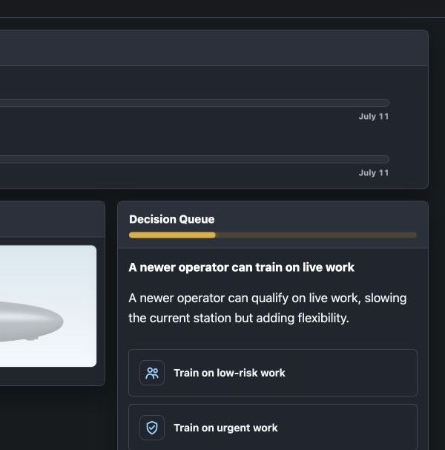
LIVE DEMO
Make the daily calls.
Try to keep pace with ECHO.
3
Notes:
Switch to the live game here. Show one daily decision, the 20-job submarine assembly, and the player-versus-ECHO progress bars.
[Sources]
- /Users/matthew/echo_adventure/instructions.md
- /private/tmp/echo-final-deck.ndK8s3/app-decision.png
[/Sources]

Slide 4
Three AI tools played three different roles
ChatGPT Prompt refinement and decision generation
Codex app Actual development
Gemini Logo generation
4
Notes:
Keep this distinction practical: ChatGPT helped shape prompts and content, Codex was the integrated development environment, and Gemini supplied the logo.
[Sources]
- /Users/matthew/echo_adventure/instructions.md
[/Sources]

Slide 5
ChatGPT carried the coding workflow; Gemini filled the image gap
CHATGPT VS. GEMINI
For our workflow, ChatGPT was stronger for coding, prompt refinement, and codebase scanning.
We did not meaningfully test Gemini for coding because we used the integrated Codex app.
CHATGPT
GEMINI
Code generation
Prompt refinement
Bug and error scanning
Image generation
Logo creation
Limited coding comparison
5
Notes:
Frame this as our team's experience, not a universal benchmark. The important caveat is that Gemini did not receive the same integrated coding test.
[Sources]
- /Users/matthew/echo_adventure/instructions.md
[/Sources]

Slide 6
The project progressed through repeated, overlapping rebuilds
Milestone | Milestone | Milestone | Milestone | Milestone
01 CREATE
02 DECISIONS
03 UI
04 GAMEPLAY WEB
05 CURRENT APP
Initial project creation
Grand decision overhaul
UI revamp
Gameplay web rework
UI revamp, again
The middle three repeated and ran concurrently
6
Notes:
The first and last stages are clear bookends. Between them, decisions, UI, and the gameplay web were rebuilt multiple times and often at the same time.
[Sources]
- /Users/matthew/echo_adventure/instructions.md
- /Users/matthew/echo_adventure repository git history through 2026-07-28
[/Sources]

Slide 7
Vibe coding shifts the work from implementation to oversight
MANUAL VS. VIBE CODING
Both approaches trade time for different kinds of work.
The estimate below is intentionally left open for teammate feedback.
MANUAL
VIBE CODING
More programming knowledge required
Implementation is deliberate
Teammate estimate: __________
High-level understanding can be enough
One month, a little work each day
More review and debugging work
7
Notes:
Ask the teammate for their manual-development estimate before presenting this comparison. Do not invent the number.
[Sources]
- /Users/matthew/echo_adventure/instructions.md
[/Sources]

Slide 8
The biggest lessons were specificity and testing
TESTING
AI-built software—especially UI work—needs extensive testing.
PROMPTS
Prompts must be as specific as possible.
8
Notes:
Emphasize that vague prompts and light testing created rework. The quality of the output depended on the specificity of the request and the rigor of the review.
[Sources]
- /Users/matthew/echo_adventure/instructions.md
[/Sources]

Slide 9
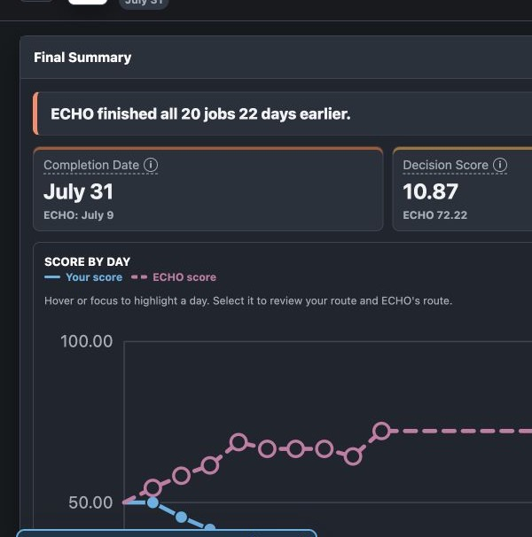
AI accelerated development.
Humans still own the result.
Production-grade work still needs human judgment.
AI dependence can limit codebase understanding.
Development time and debugging time trade places.
Best fit: smaller development work and questions.
9
Notes:
Close on the tradeoff: AI made a month of small daily development sessions productive, but production quality still depended on human understanding, testing, and judgment.
[Sources]
- /Users/matthew/echo_adventure/instructions.md
- /private/tmp/echo-final-deck.ndK8s3/app-final.png
- /Users/matthew/echo_adventure/README.md
[/Sources]

